Slide 1
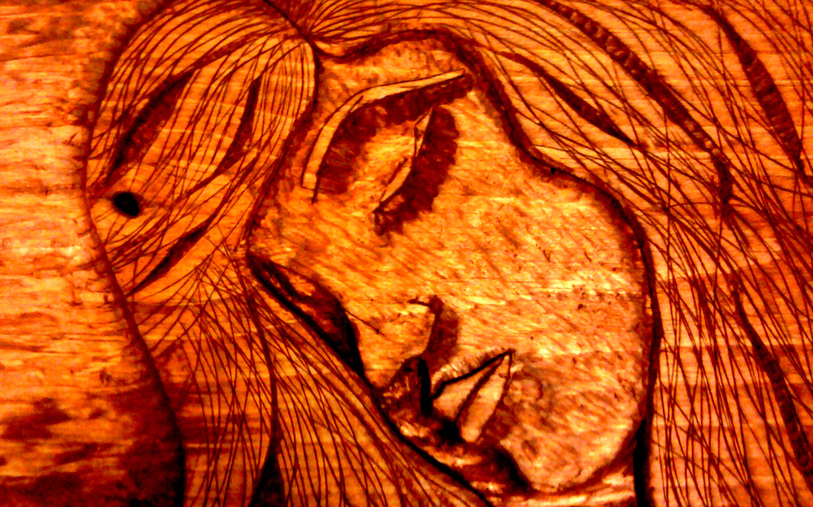
Relief
Woodcarving
Art Intermediate

Slide 2
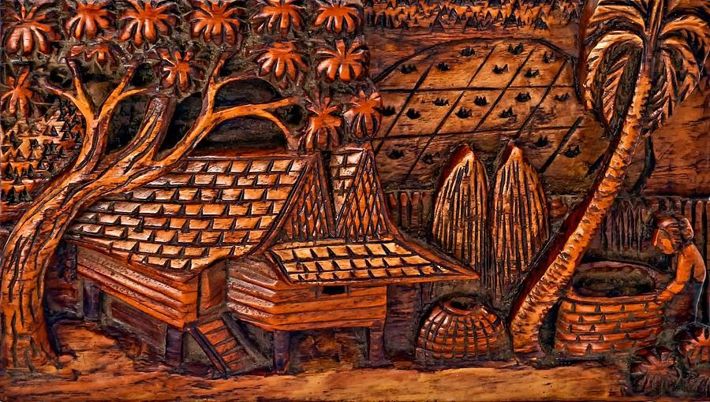
Relief- sculpture that is flat on the back

Slide 3
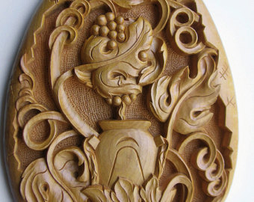
Intricate carving

Slide 4
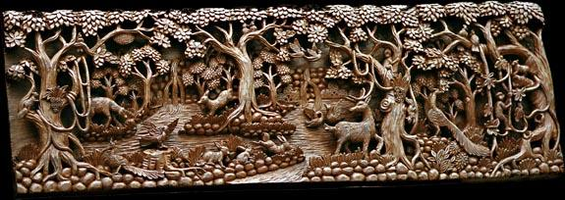
Extremely intricate carving

Slide 5
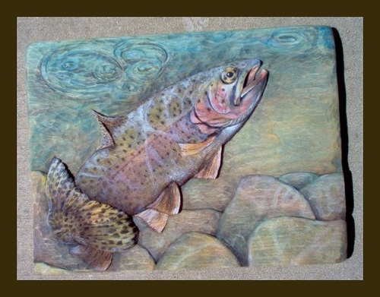
carved and painted

Slide 6
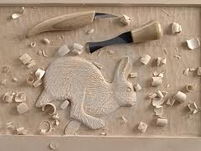
Tools

Slide 7
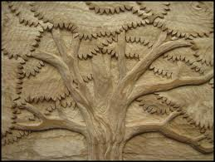
simple and clean- tool marks blend in as appropriate textures

Slide 8
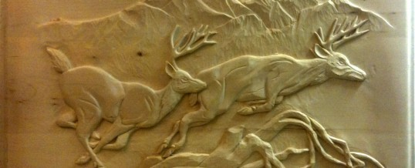
animals and organic shapes work best for first time carvings

Slide 9
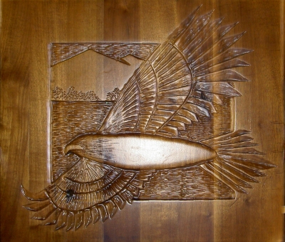

Slide 10
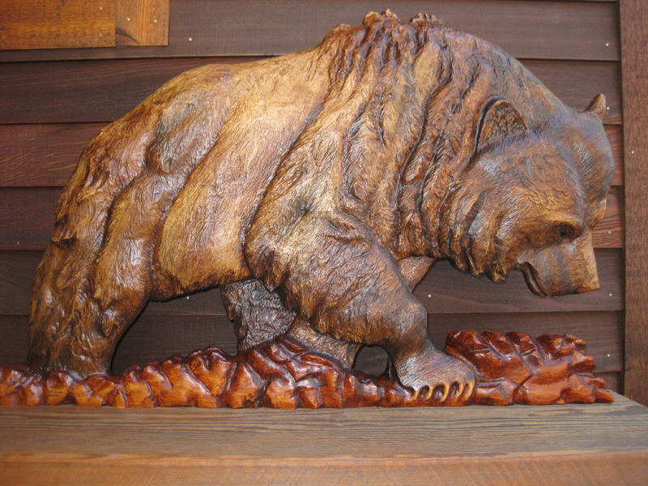

Slide 11
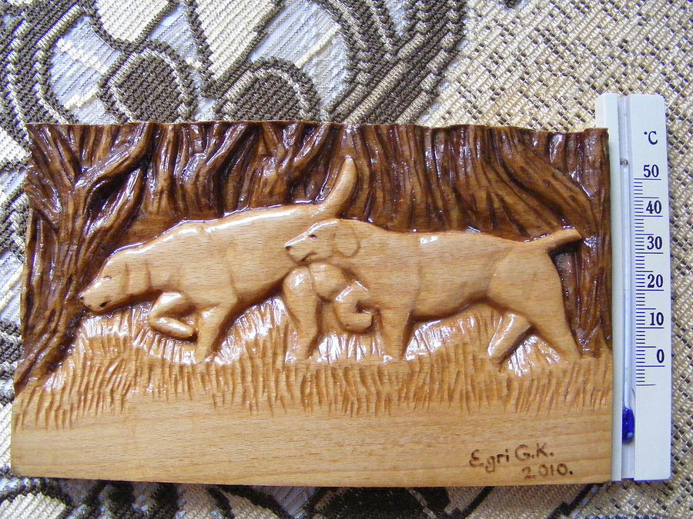

Slide 12
Directions:
1. Select image
2. Select wood
3. Trace board shape onto paper
4. Draw image to fit board dimensions on paper
5. Transfer image to board (homemade carbon copy)
6. Carve (using techniques shown)
7. Be careful (keep tools sharp)

Slide 13
Grading:
3D
-imagery carved to look 3D
-appropriate carving techniques used
Craftsmanship
-clean carving
-appropriate textures
-identifiable imagery
Finishing
-paint or stain
-polyurethane

