Slide 1
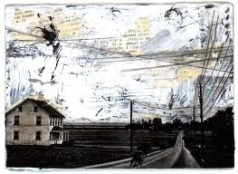
Unread letters
Advanced Mixed media

Slide 2
Objectives:
Create an original composition using mixed media processes and Gel Medium Transfers
Students will integrate unread letters and digital imagery
Students will write, interpret, and integrate unread letters into a single, unique composition.

Slide 3
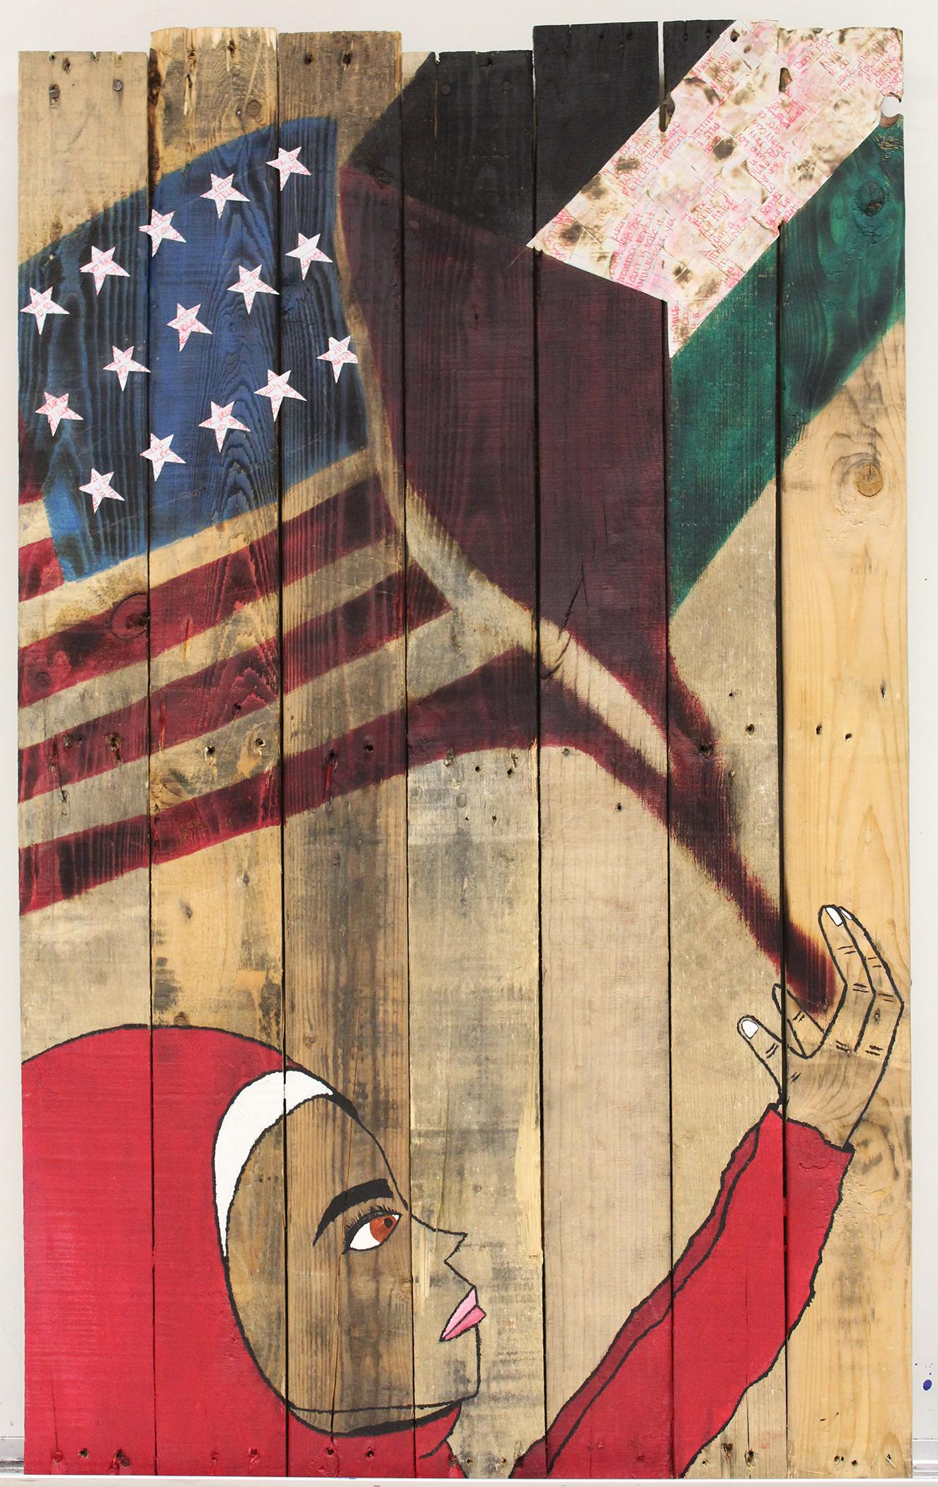

Slide 4
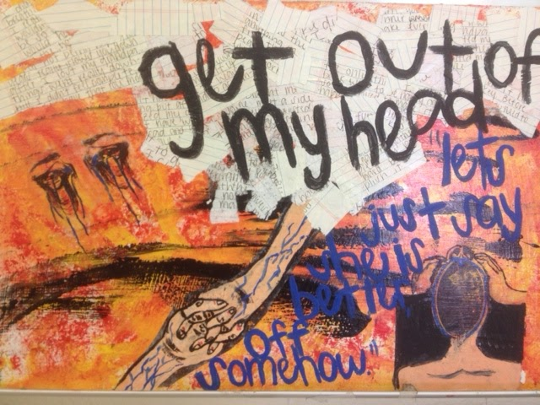

Slide 5
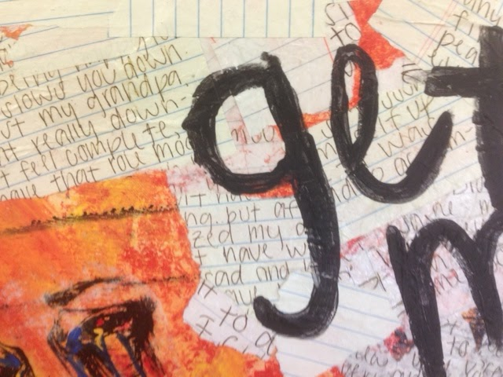

Slide 6
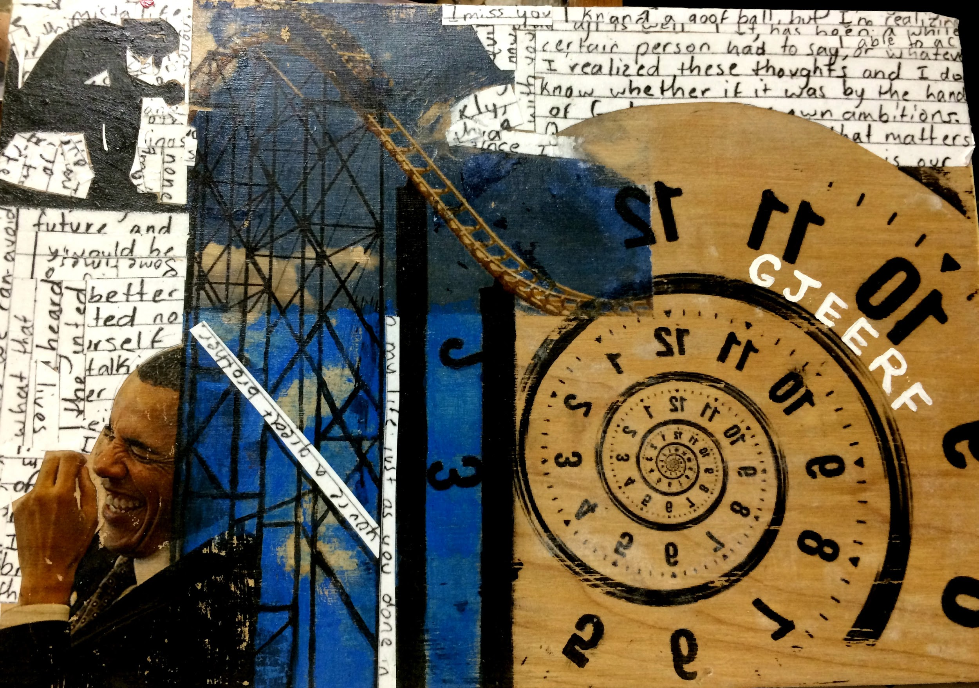

Slide 7
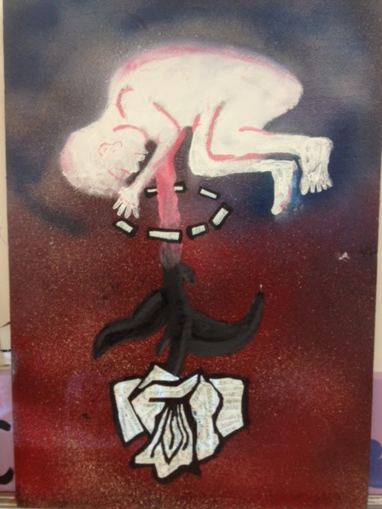

Slide 8
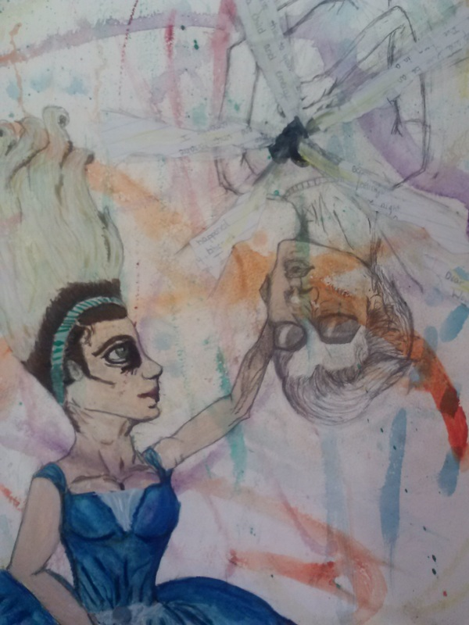

Slide 9
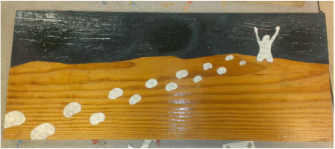

Slide 10
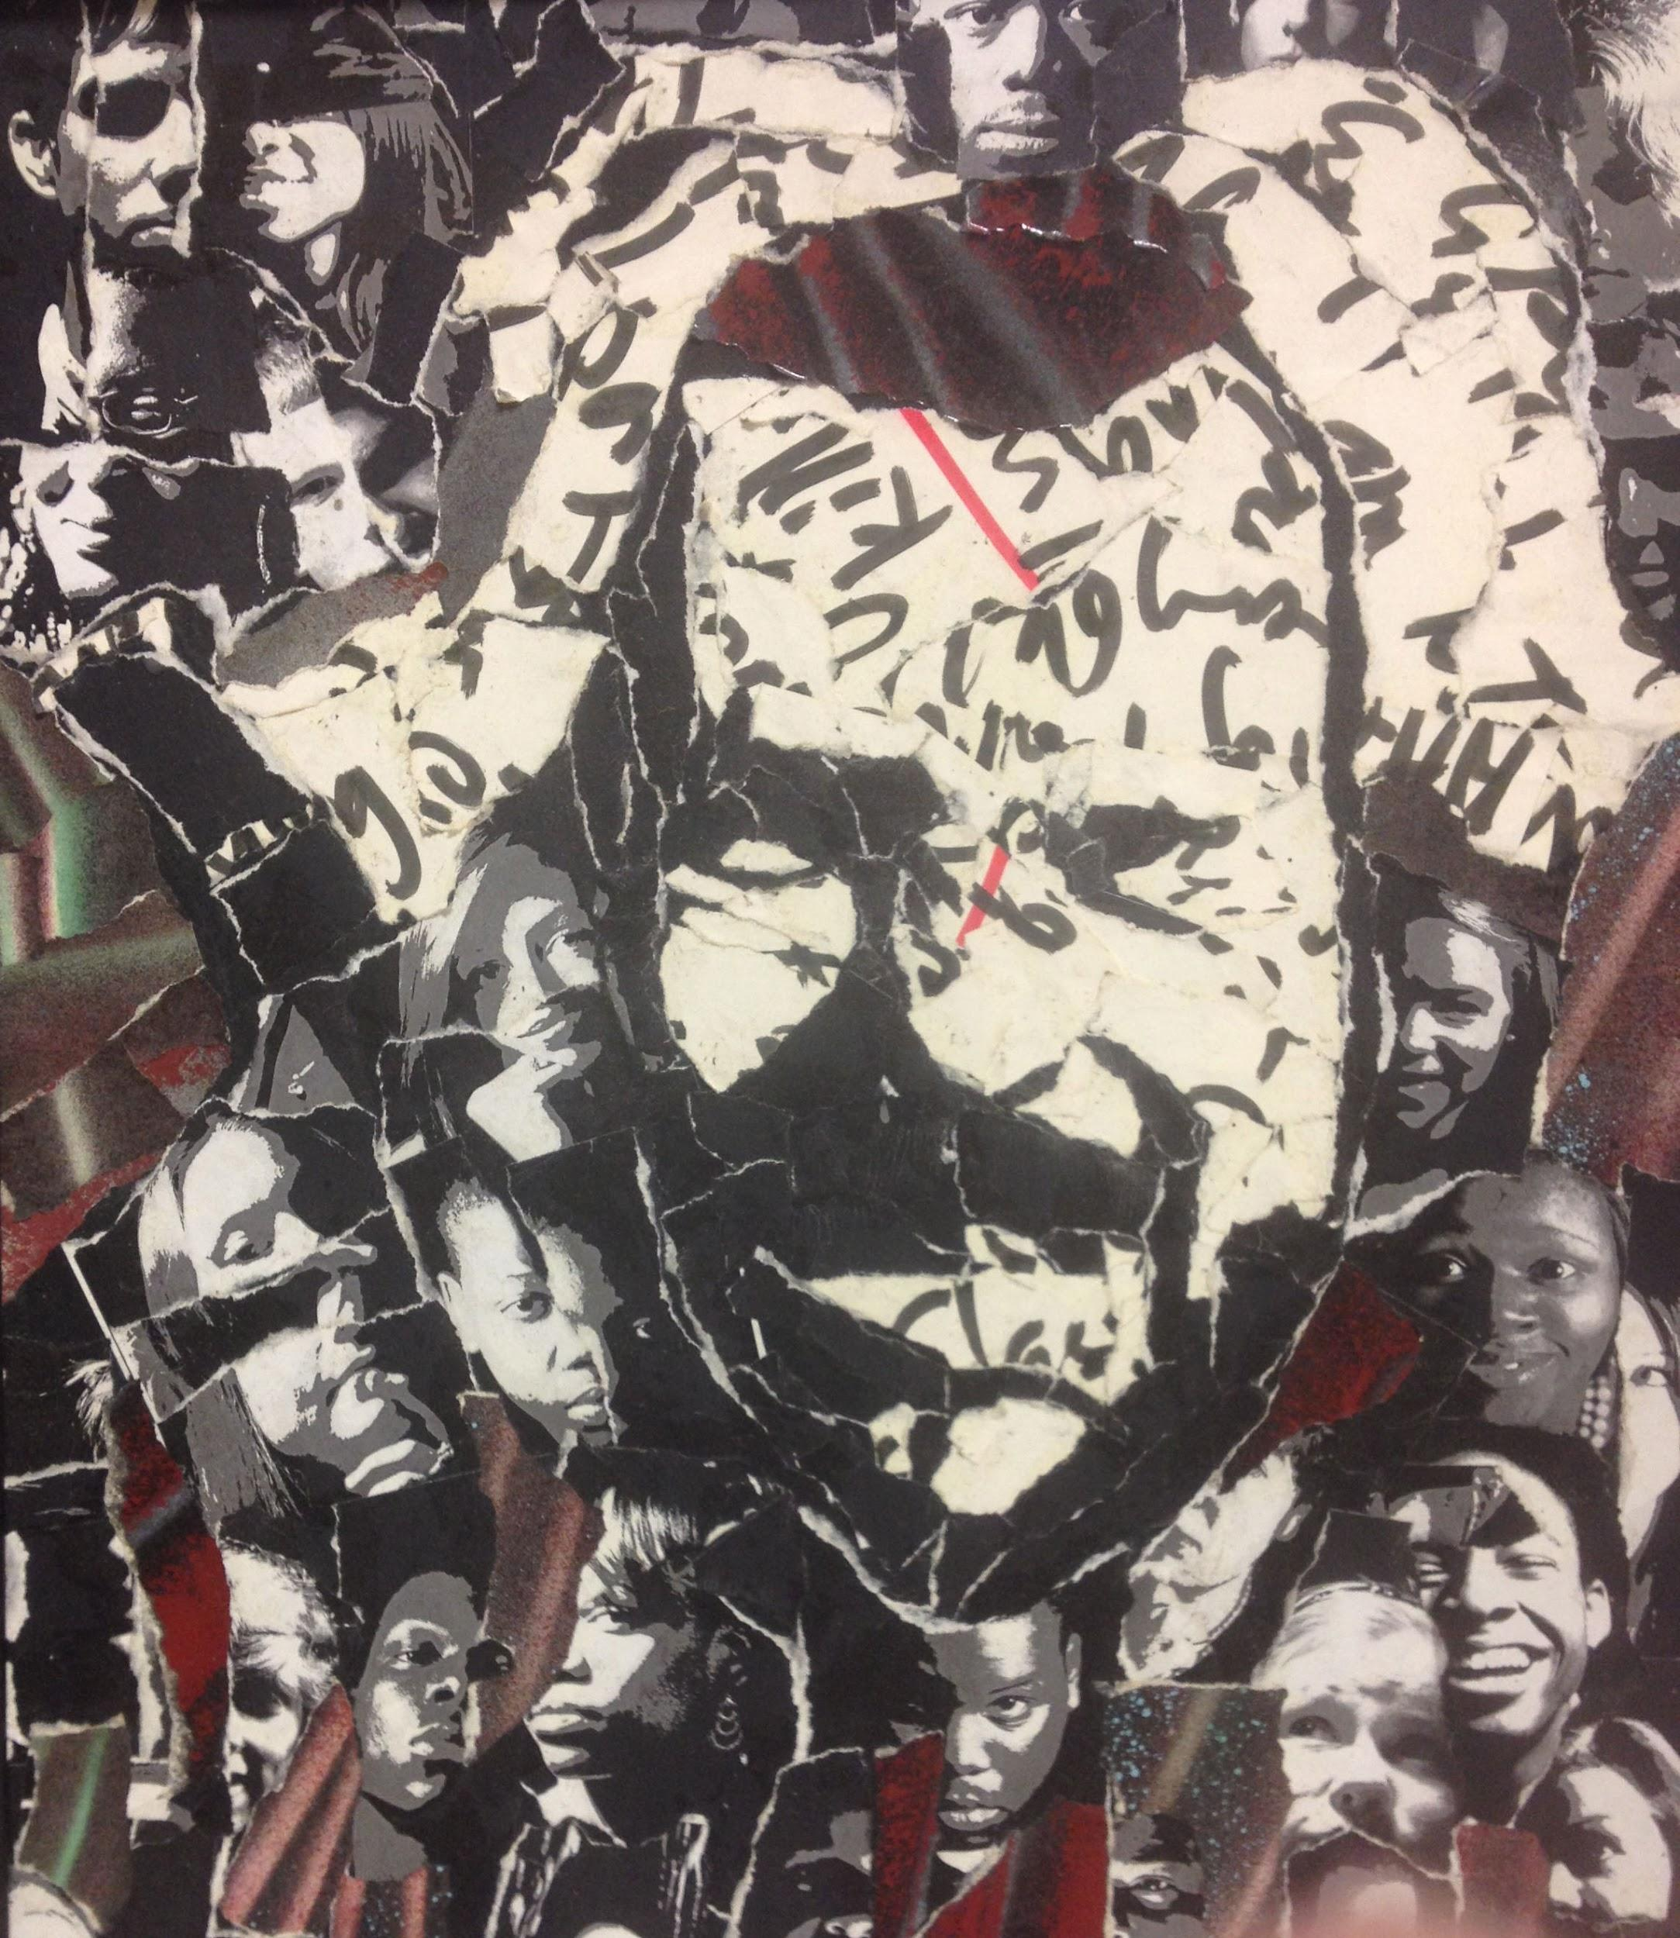

Slide 11
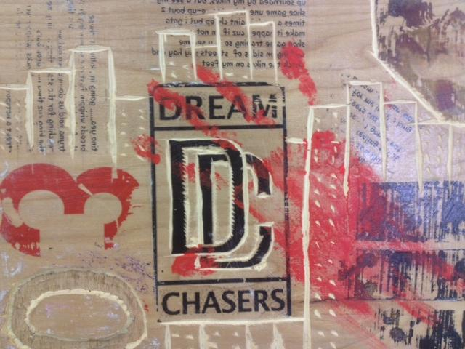

Slide 12
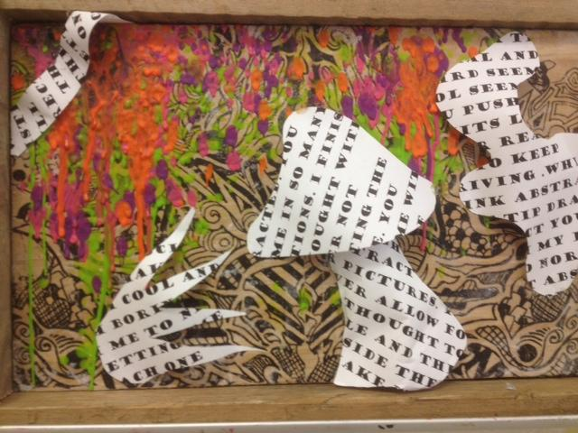

Slide 13
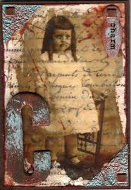
Step 1:
Write a letter to someone that no one will ever read

Slide 14
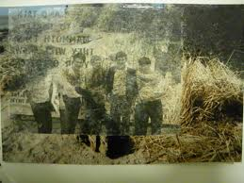
Locate images that support or illustrate the premise of your letter
Be creative
Be subtle
Be inventive

Slide 15
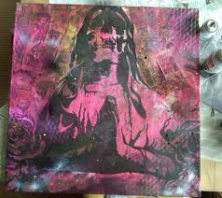
Mixed Media
Using various combinations of art mediums in a single, cohesive, unified image

Slide 16
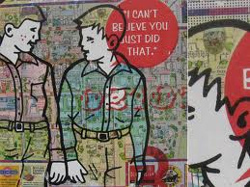

Slide 17
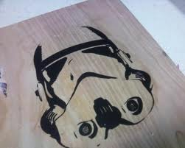
Gel Medium Transfers
Surface treatment that transfers ink from a printed surface to another material (canvas, wood, etc.)

Slide 18
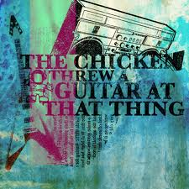

Slide 19
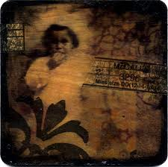

Slide 20
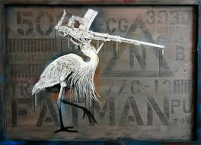

Slide 21
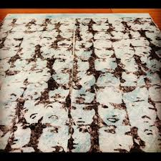

Slide 22
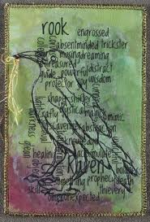

Slide 23
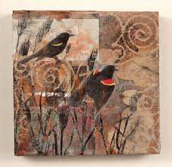

Slide 24
1. Write letter (or type)
2. Locate or take pictures to support idea of letter (you can be as specific as you wish)
3. Create ground using paint, magazines, and/or other different mediums
4. Print imagery in high contrast black and white
5. Transfer images onto ground
6. Continue to paint/ work into images to integrate them into final composition

Slide 25
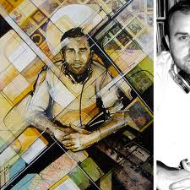

Slide 26
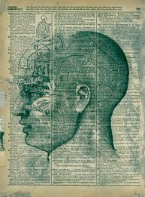
Final images must include the original letter or pieces of it incorporated into the composition

Slide 27
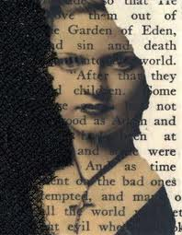

Slide 28
How to make a gel medium transfer

