Slide 1
The Eyes Have It
Art 4 exam

Slide 2
Directions:
Create an original work of art that combines an “eye” with your theme for this semester.
The idea is to “look back” over the work you have done and culminate with one last piece in the series.
Make it Creative, Crafted well, and Sincere
On the back, include a 10 sentence or more artist statement describing your work, your theme, and how it relates to you.

Slide 3
Materials: Black Drawing paper and Colored pencils

Slide 4
Grading:
Creativity
use of materials
Craftsmanship
relation to theme
10 sentence artist statement

Slide 5
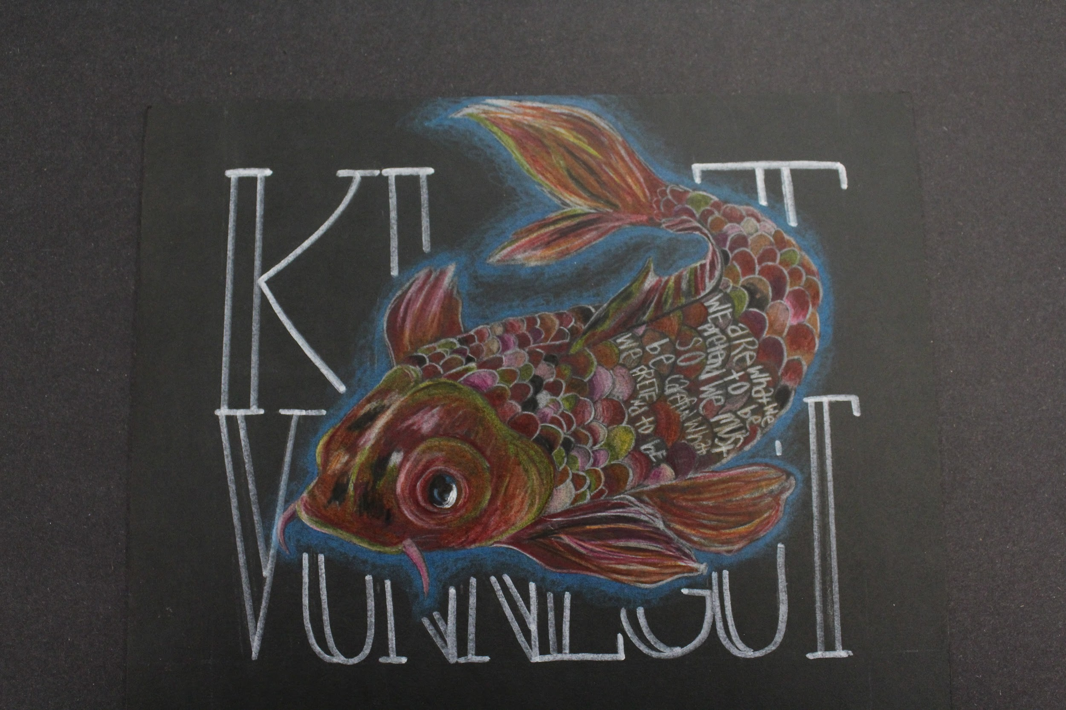

Slide 6
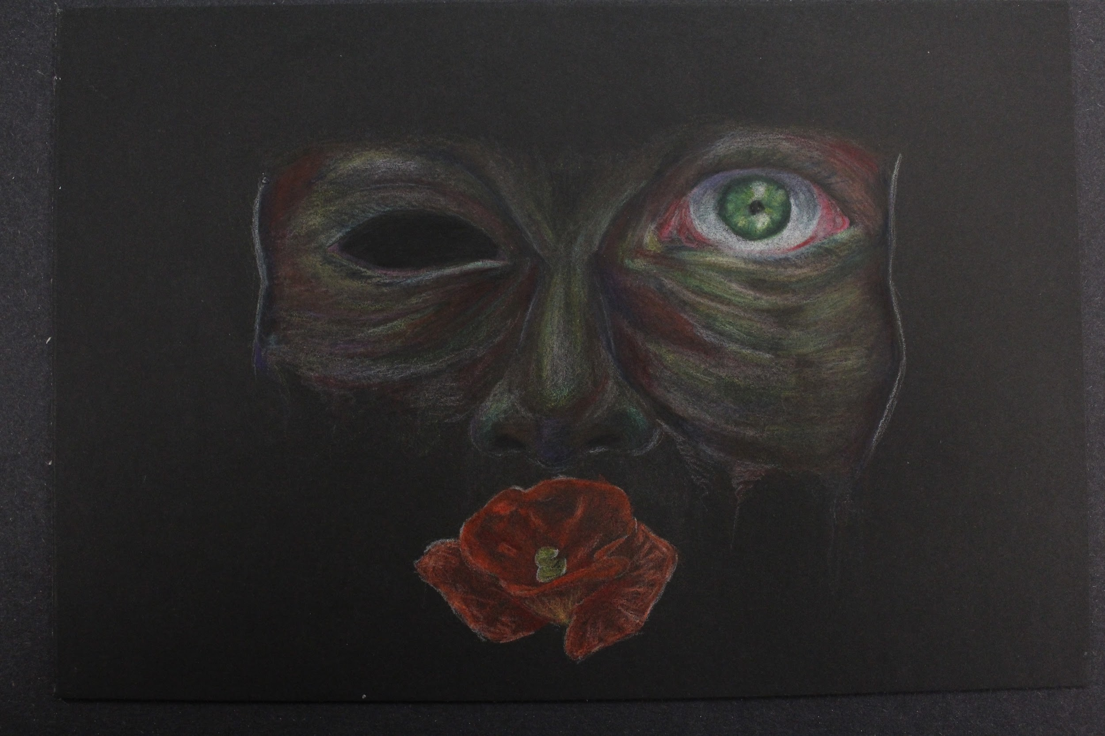

Slide 7
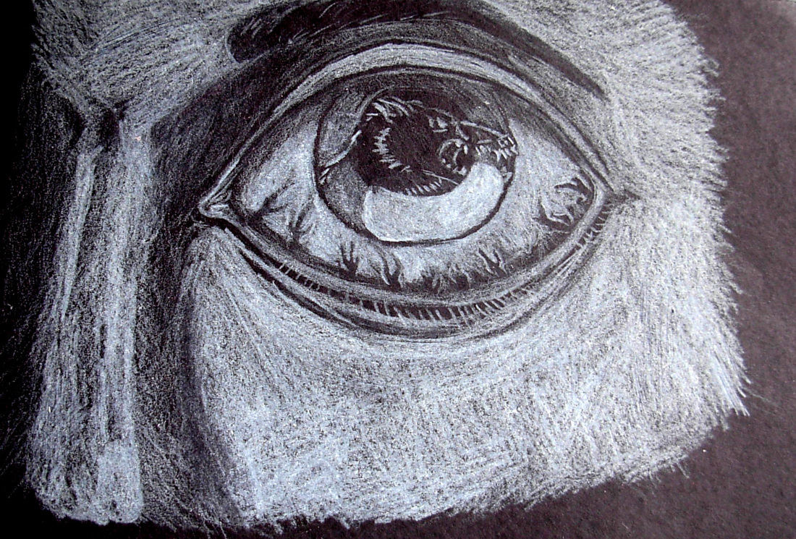
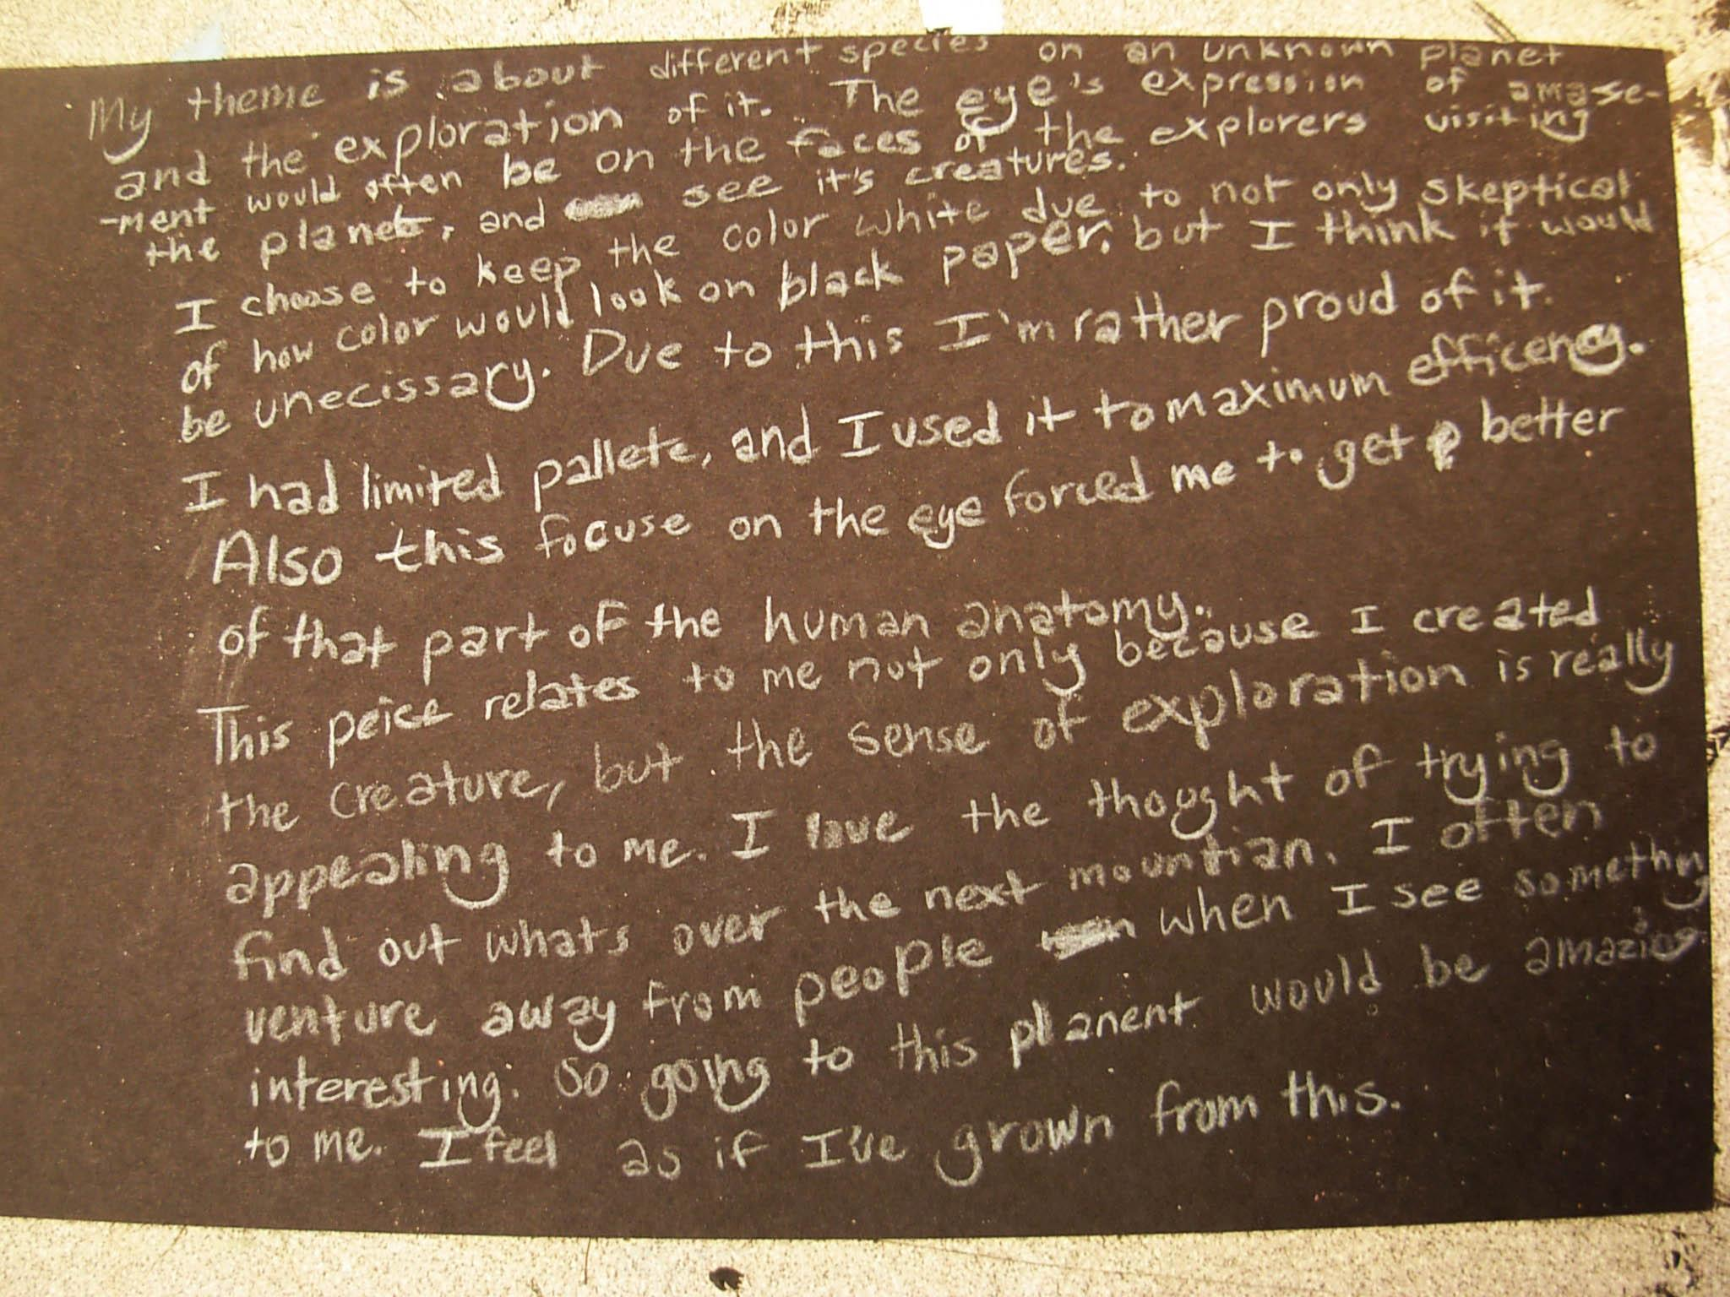

Slide 8
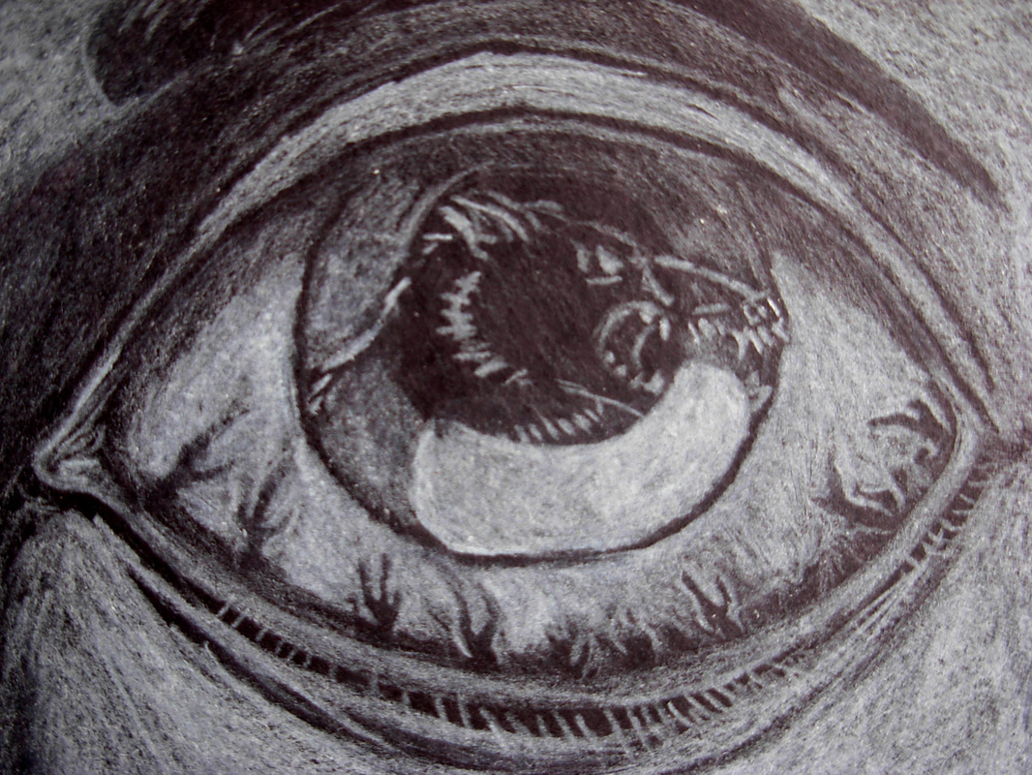

Slide 9
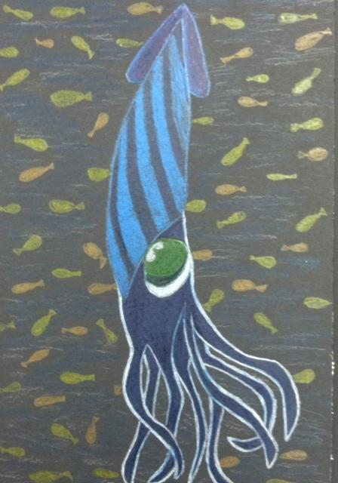

Slide 10
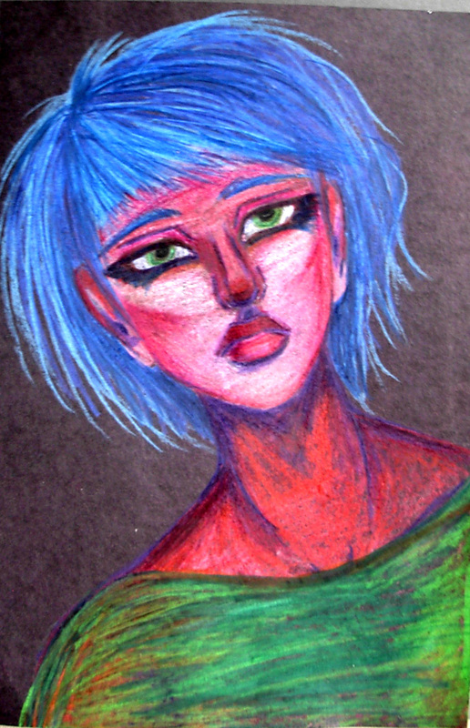
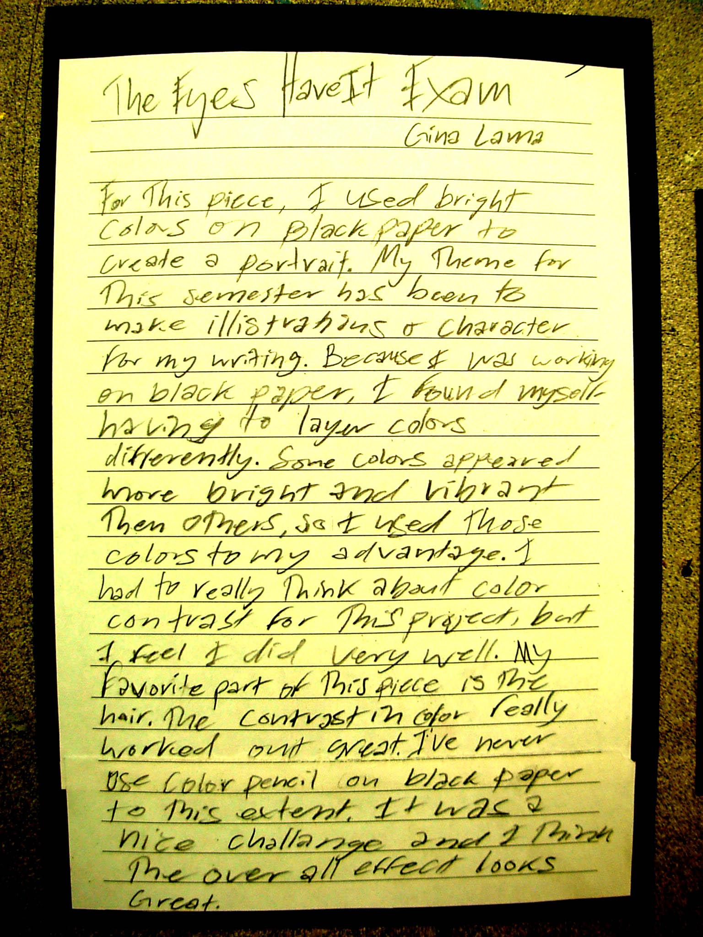

Slide 11
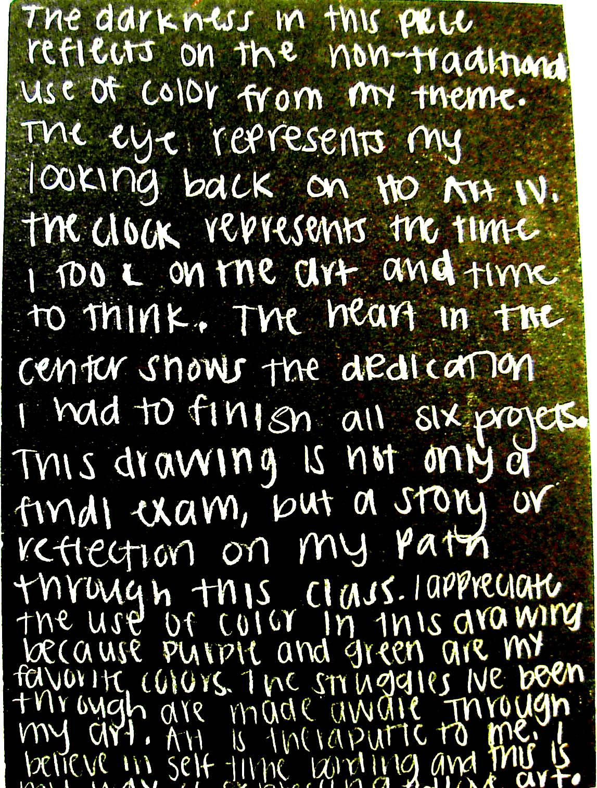
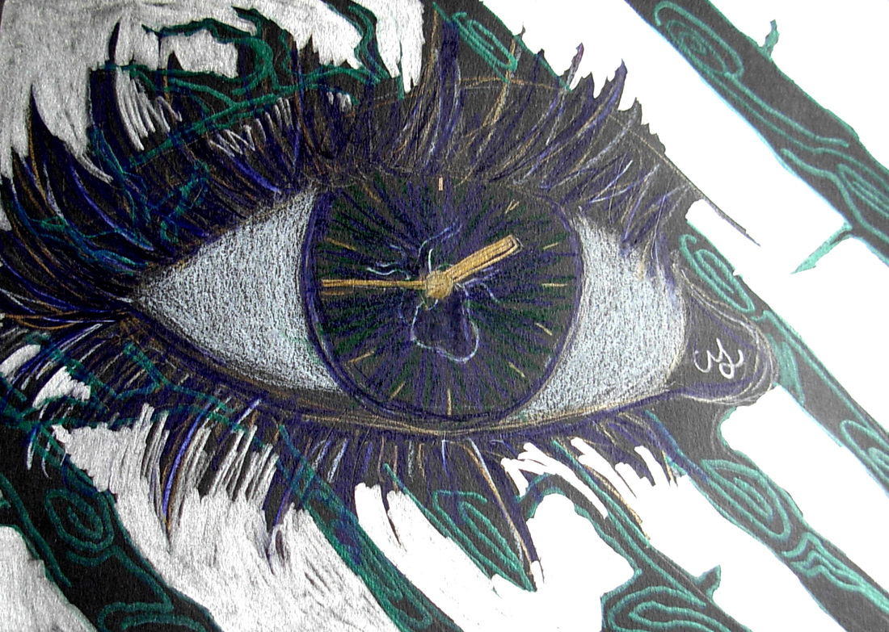

Slide 12
Go

