Slide 1
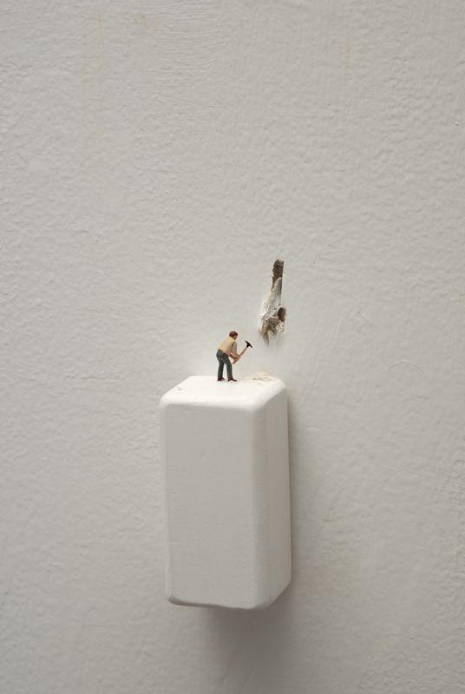
Size Matters
advanced art final exam (art 5)

Slide 2
Objective:
Advanced Art Students will create original works of art for their final exam

Slide 3
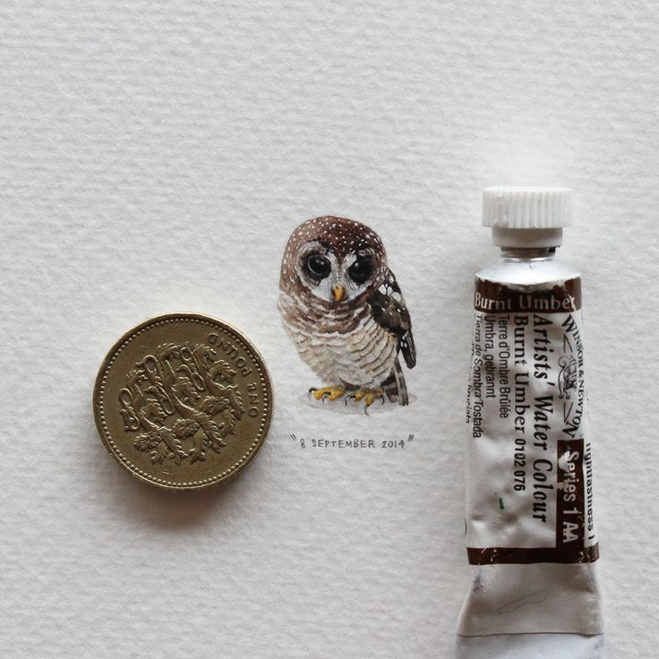
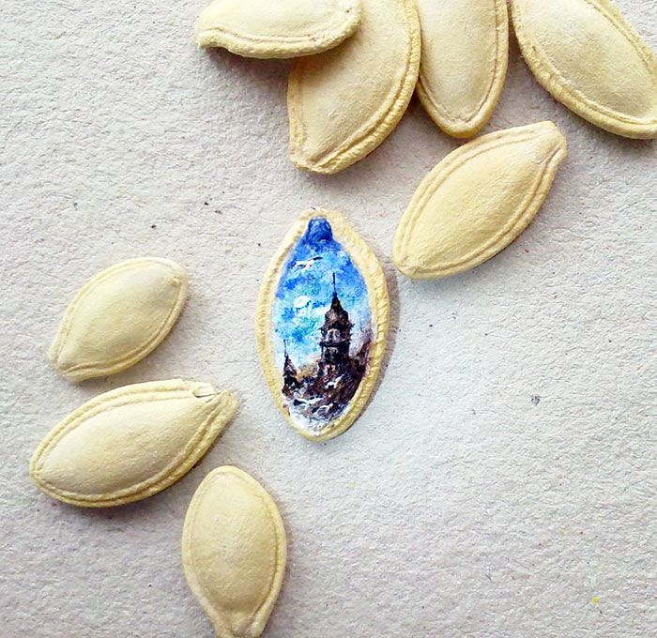

Slide 4
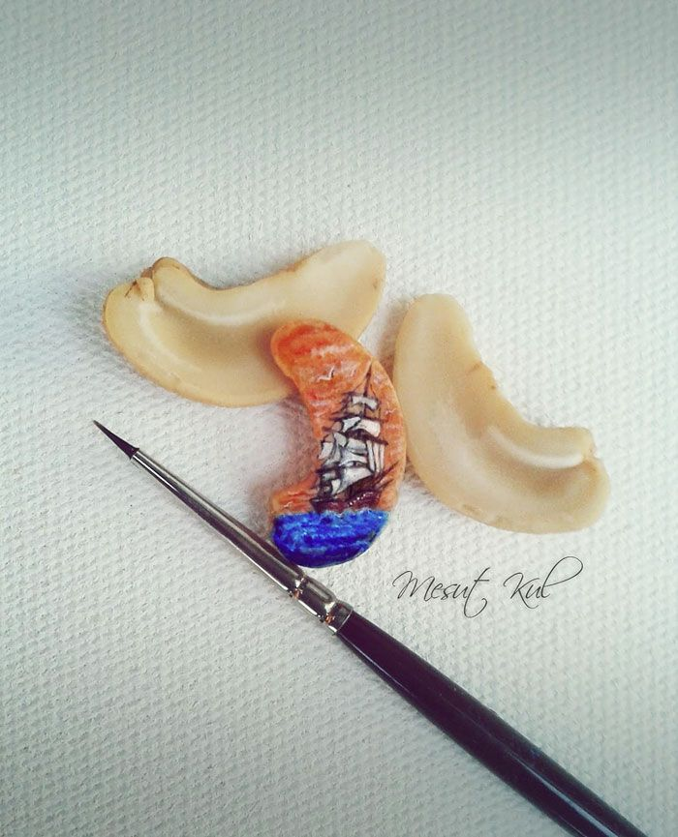
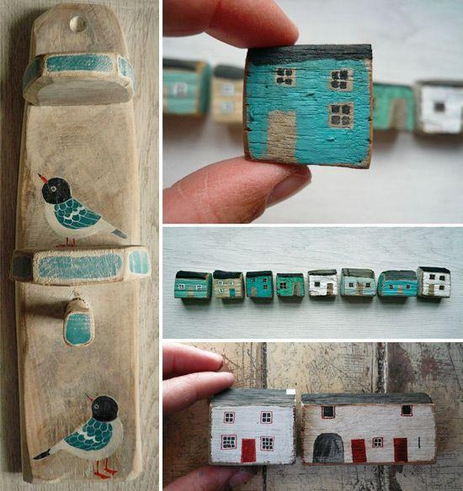

Slide 5
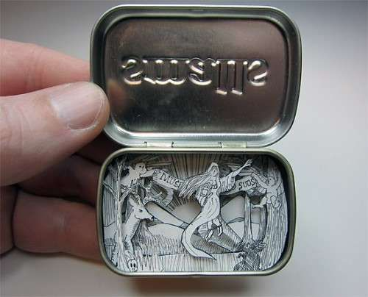
Requirements/Grading
work must be well crafted
any method/material can be used
work must be tiny/small (3in. x 5in.) or
smaller
work must be completely original
work must follow your chosen theme
finished work needs to be accompanied by a complete (10 sentence or more) artist statement that explains your finished piece

Slide 6
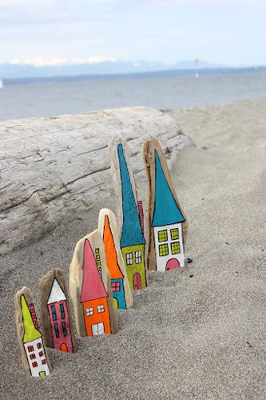
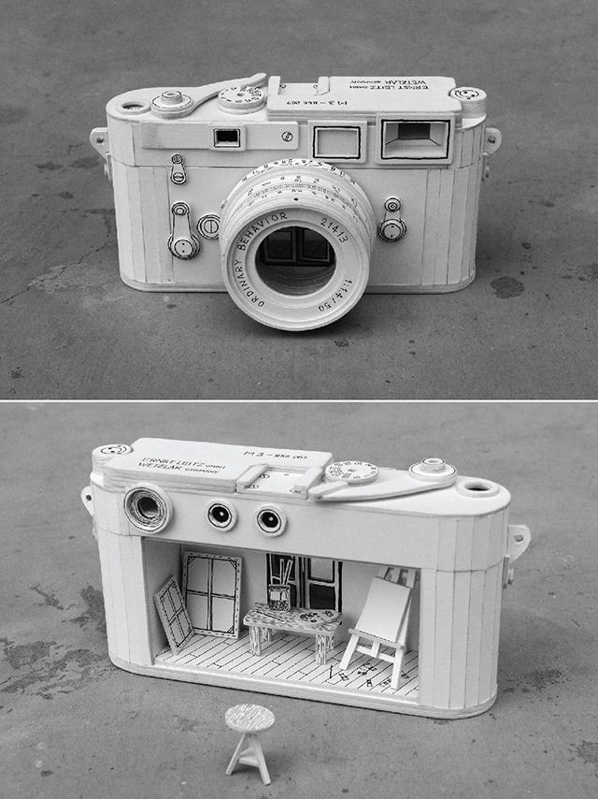

Slide 7
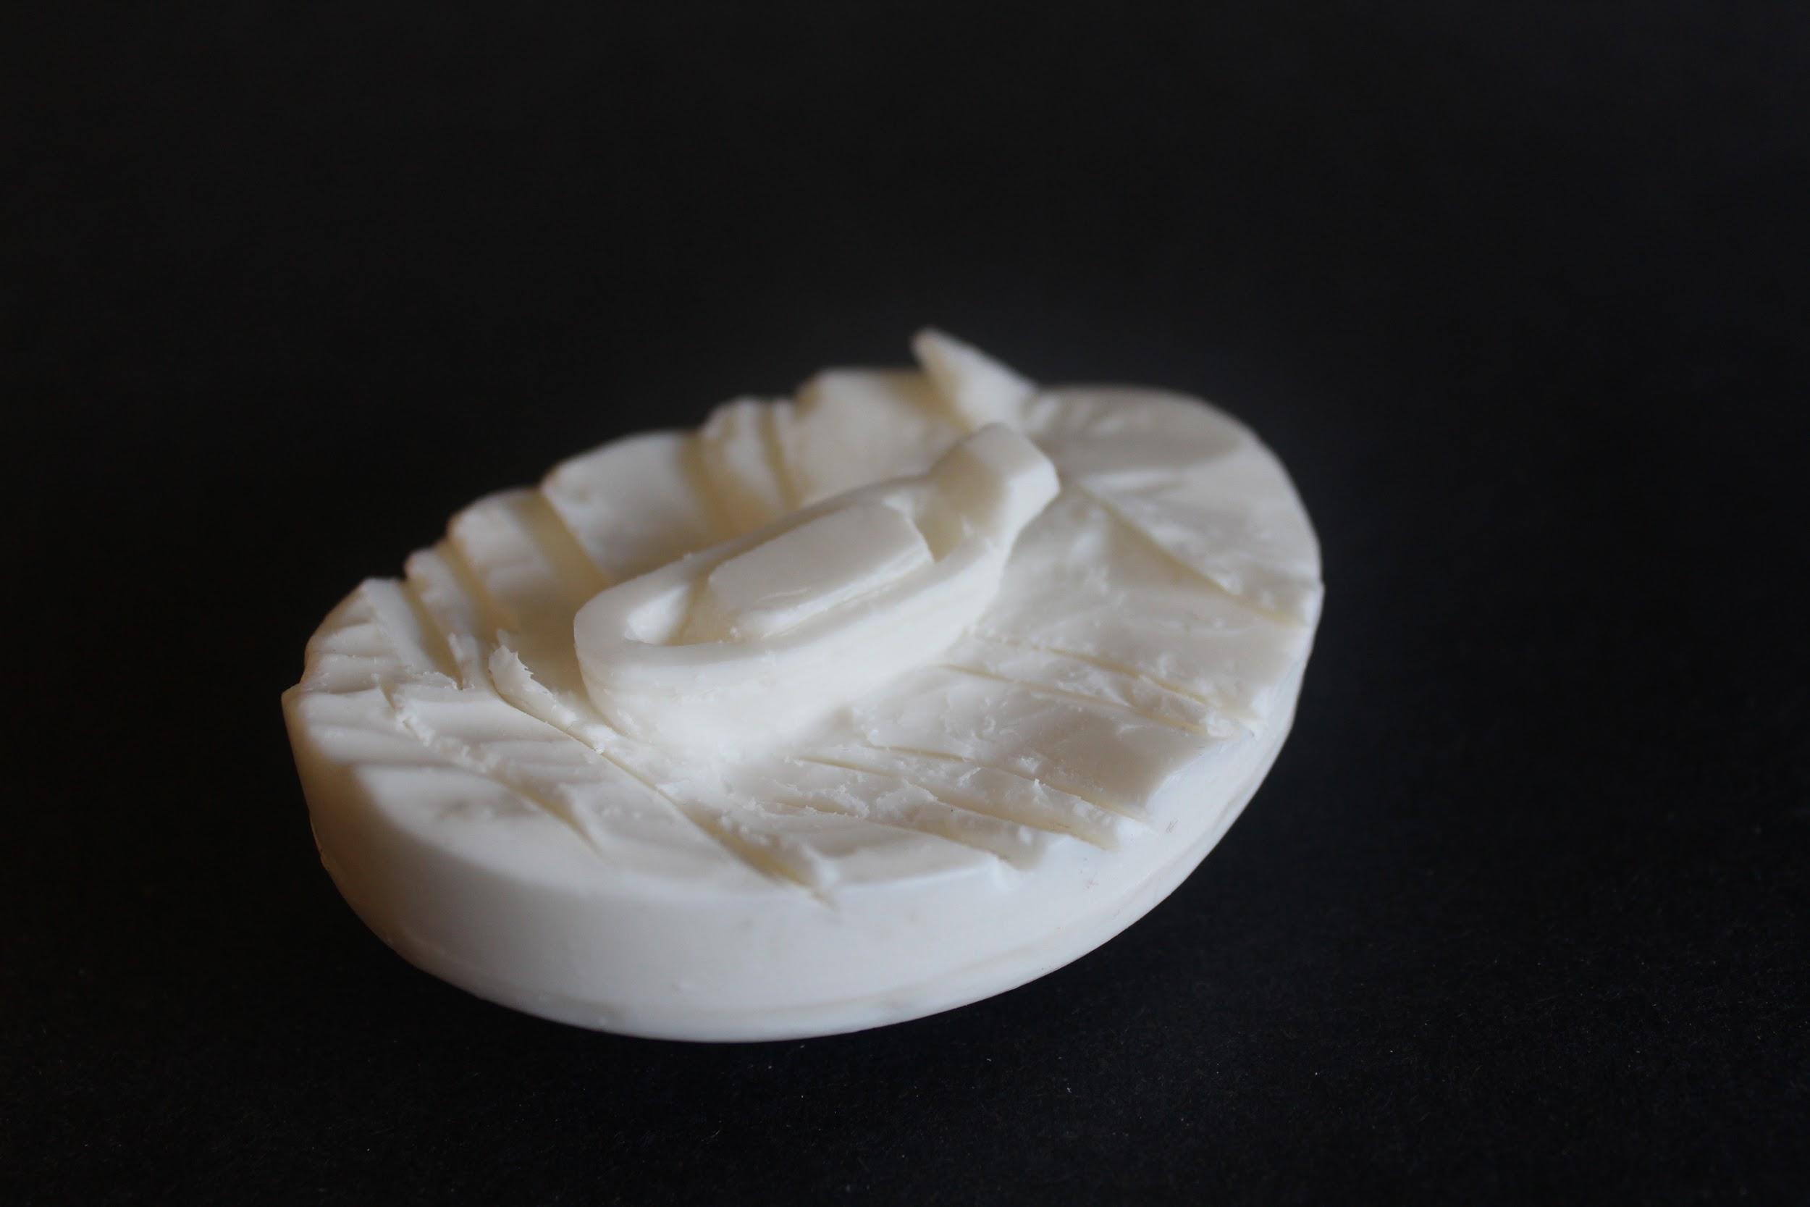

Slide 8
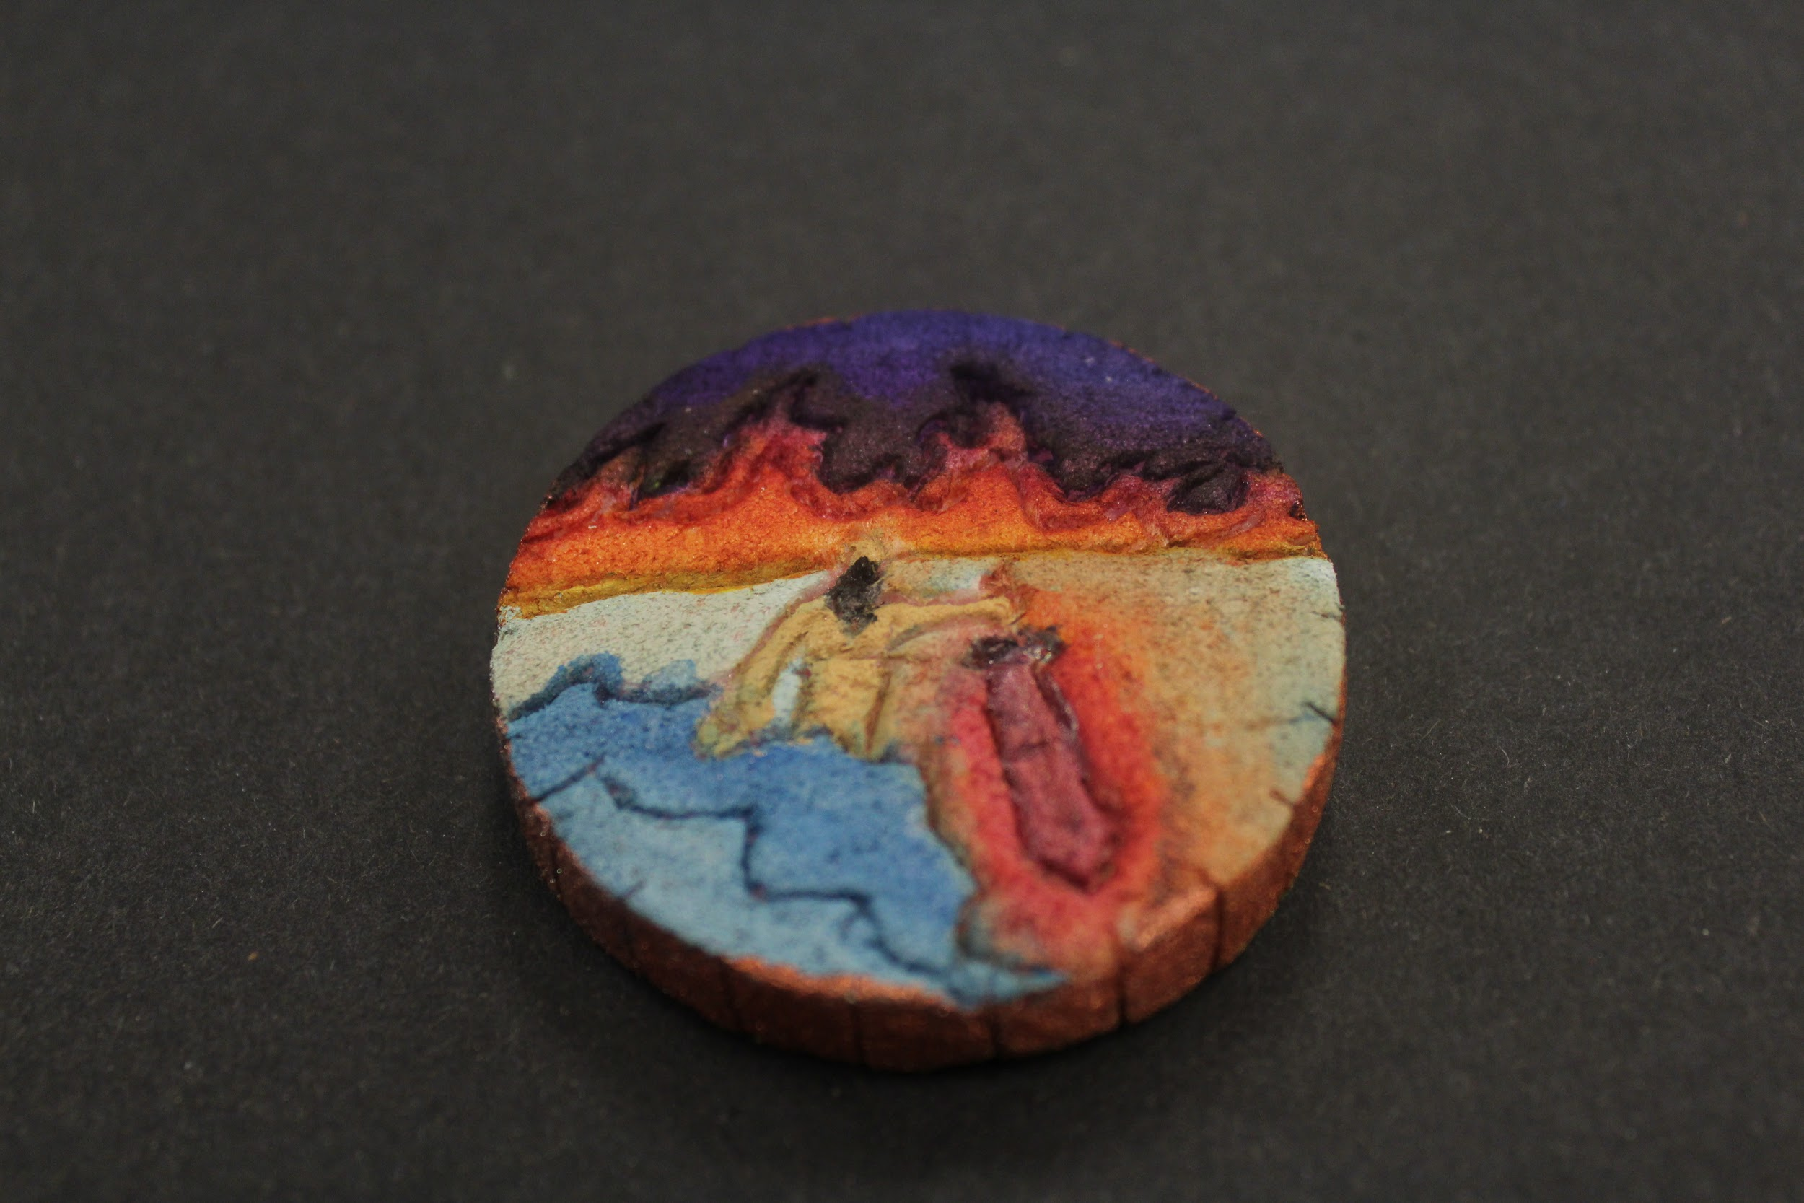

Slide 9
