Slide 1
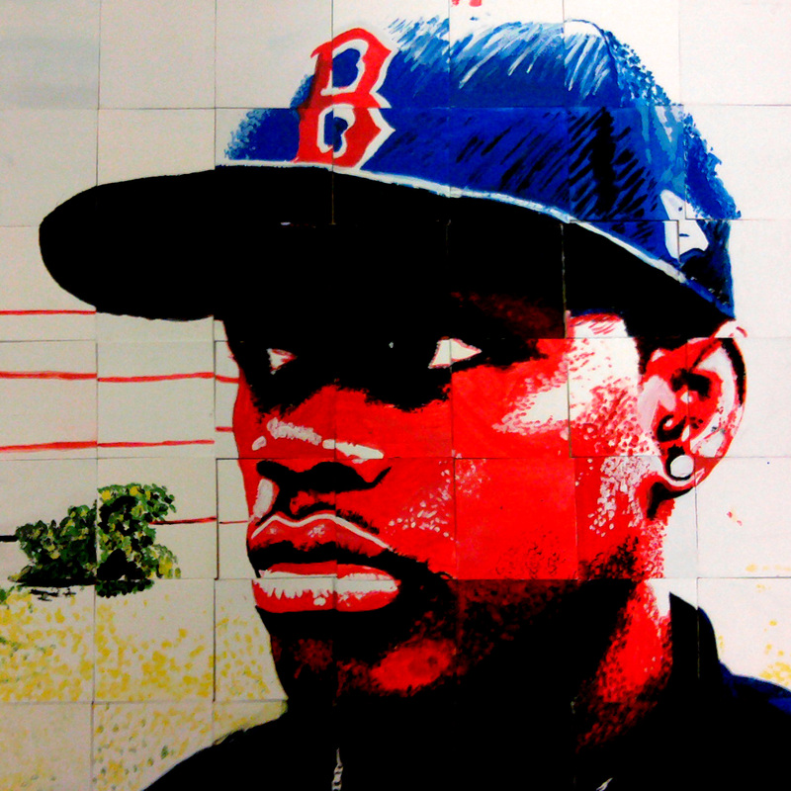
Self Portrait
Painting Mastery

Slide 2
Objectives
You will create a self portrait using acrylic paint.
You will build on your painting knowledge from Art1 and develop your skills in paint mixing, shading, highlighting, neutralizing, blending, and glazing.

Slide 3
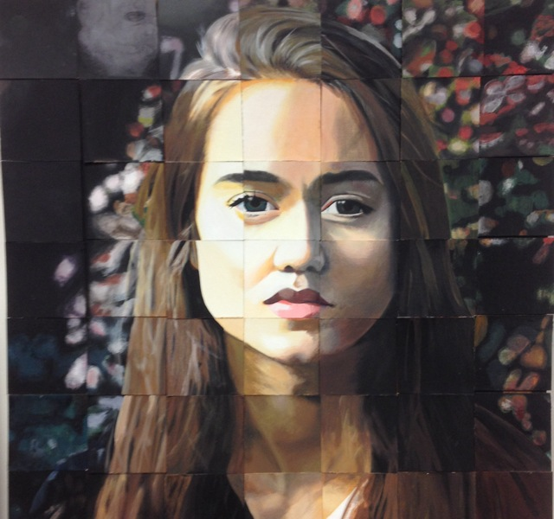

Slide 4
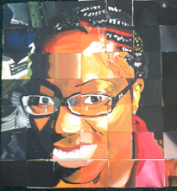

Slide 5
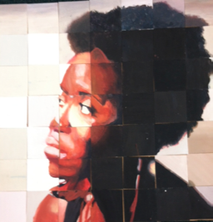

Slide 6
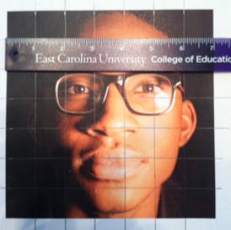
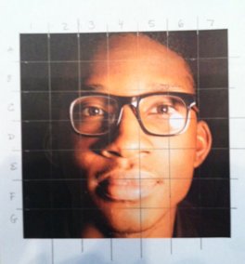
Draw a One Inch grid on photo
Label Grid

Slide 7
Cut up scrap matt board to glue photo squares onto, you’ll need 49
Cut good matt board into 4”x4” squares to paint on, you’ll need 49

Slide 8
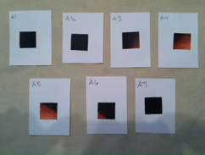
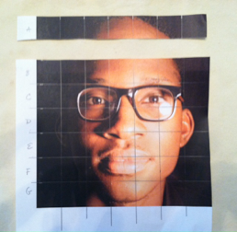
Cut off the top row
Glue squares of picture to pre-labeled cards

Slide 9
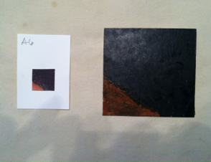
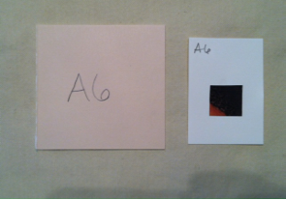
Write the number of the little card on the back of the 4 inch card
Paint card with paint (do not draw with pencil). Match colors,shapes, and proportions

Slide 10
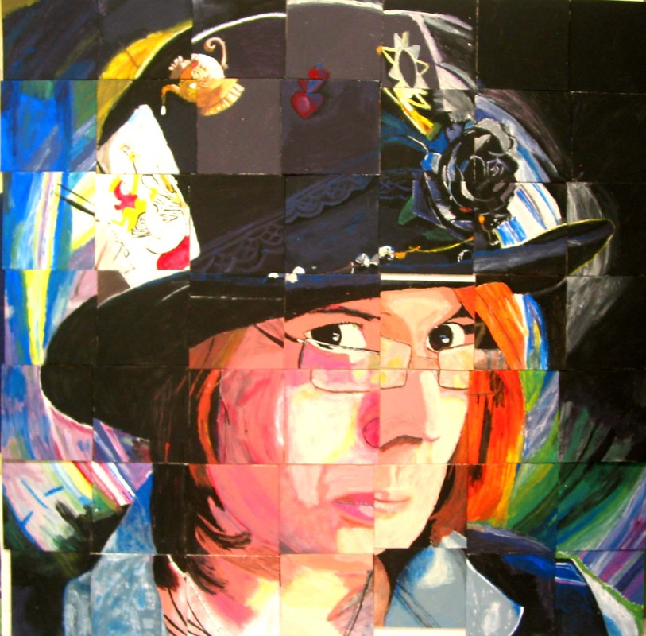

Slide 12
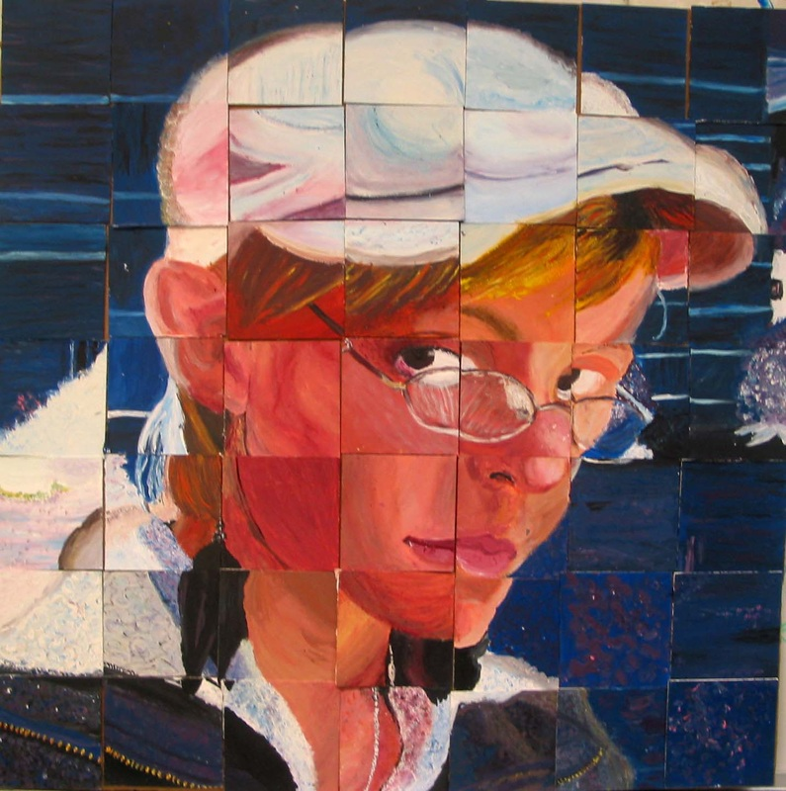

Slide 13
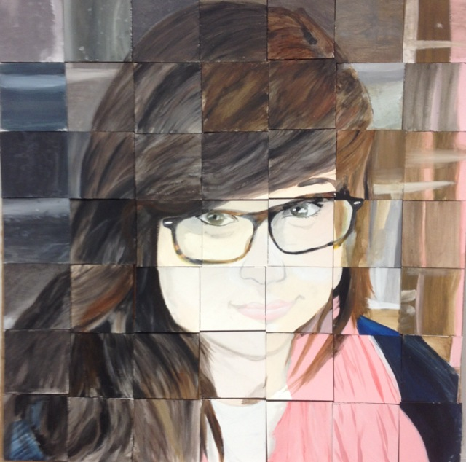

Slide 14
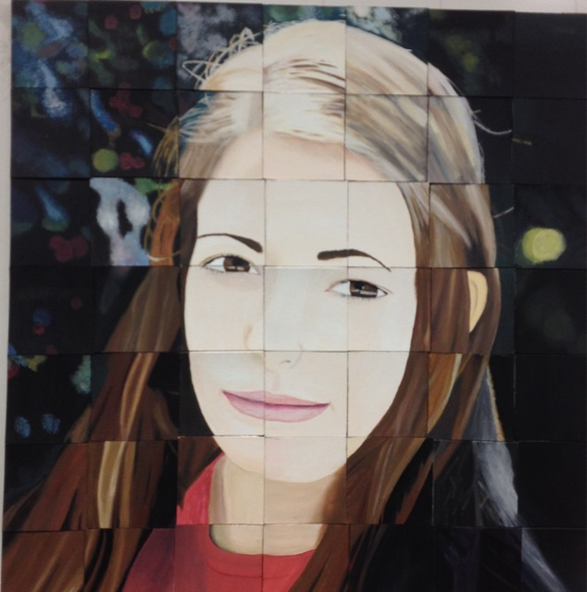

Slide 15
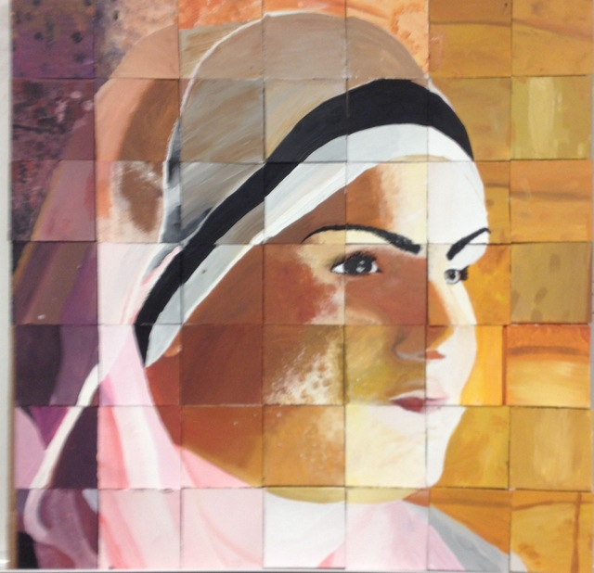

Slide 16
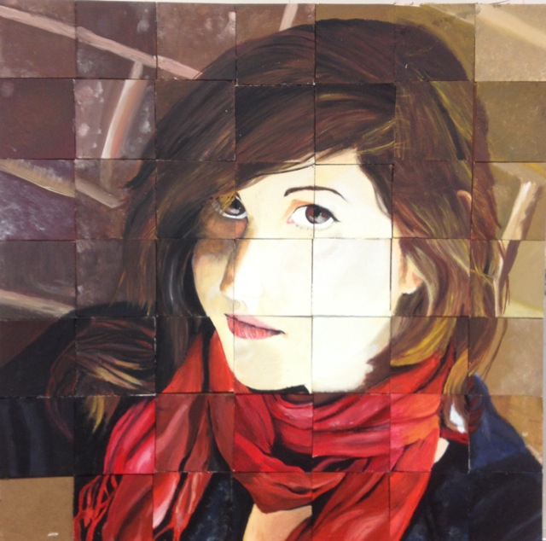

Slide 17
