Slide 1
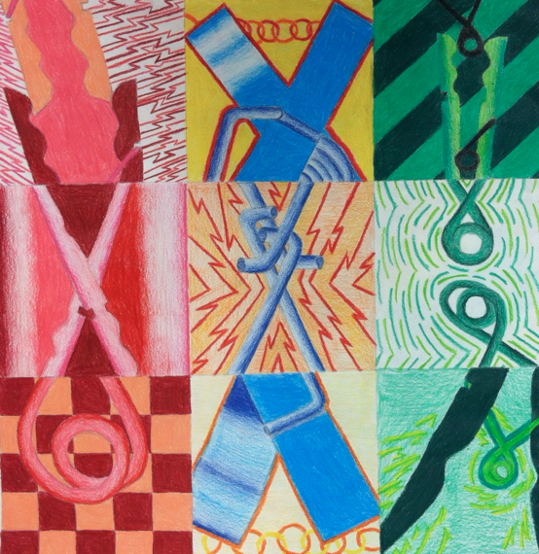
Pop Art Clothespins
Art II

Slide 2
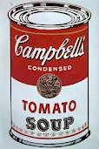
Pop Art Movement
Pop art emerged during the 1950’s in England and found it’s way to the U.S. in the 1960’s. The most well known pop artist in the U.S. was Andy Warhol. Warhol presented images of Coke bottles and Campbell’s soup cans in new ways or in greatly enlarged sizes. He wanted to shake viewers out of accustomed ways of looking at the most trivial trappings of modern life.

Slide 3
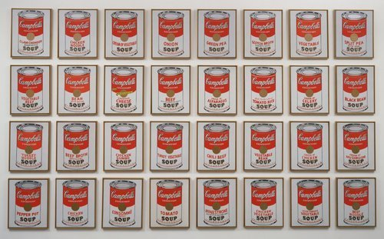
Andy Warhol’s
Campbell’s Soup Cans
1962

Slide 4
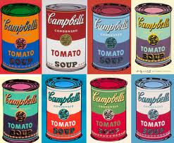
Andy Warhol’s
Campbell’s Soup Cans

Slide 5
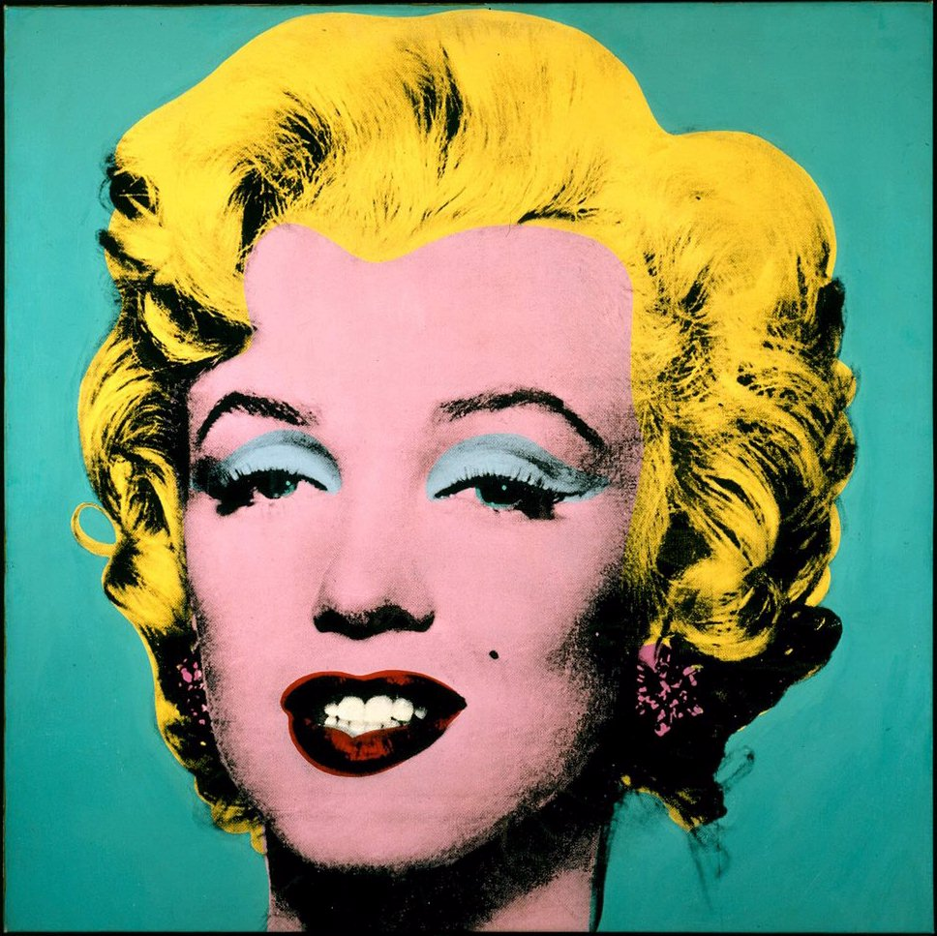
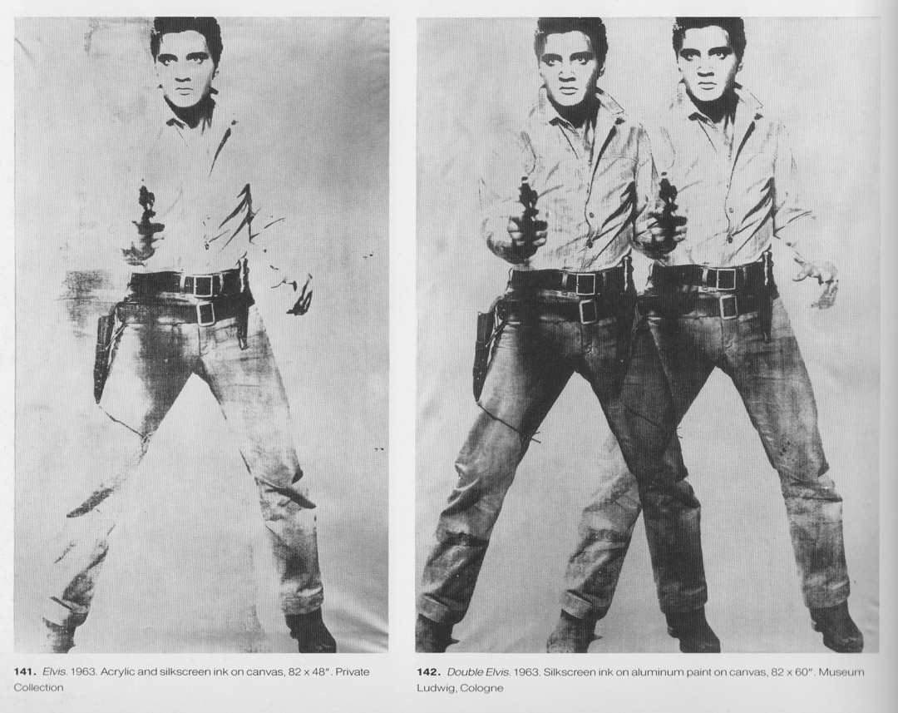

Slide 6
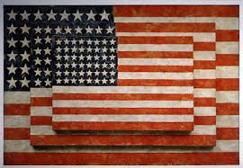
Jasper Johns

Slide 7
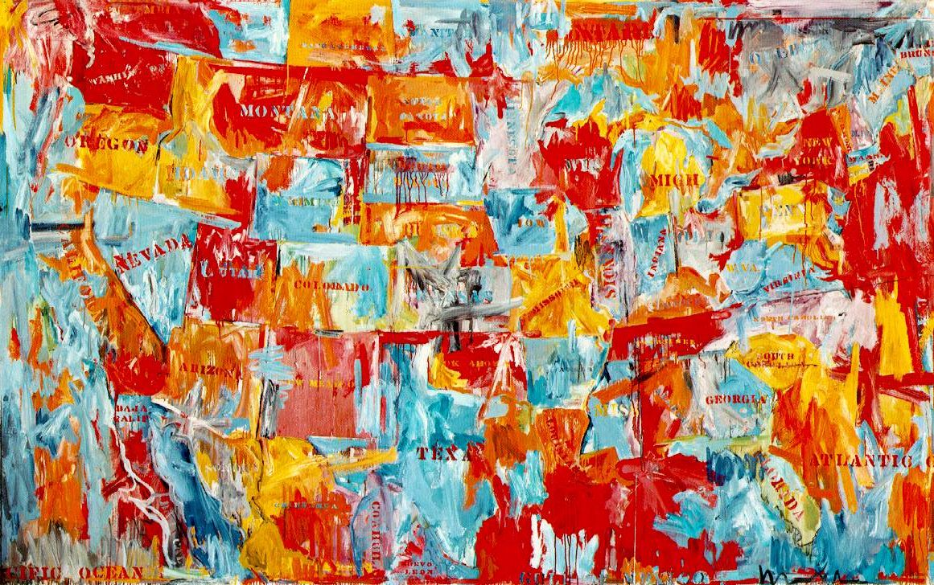

Slide 8
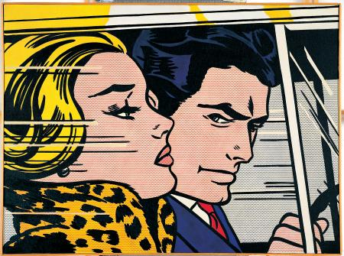
Roy Lichtenstein

Slide 9
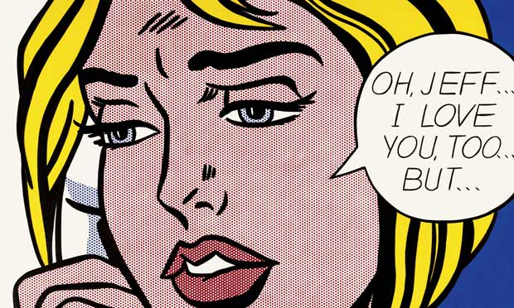

Slide 10
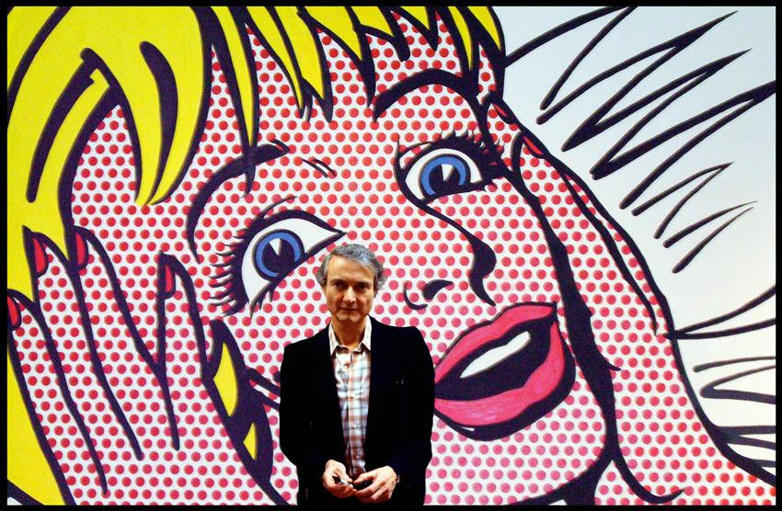

Slide 11
Common objects presented in an extraordinary way

Slide 12
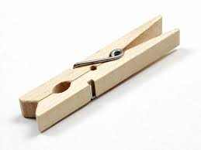
We will be creating original art out of the object…..

Slide 13
What do you see?

Slide 14
What do you see?
Creative use of clothespins
visually appealing
excellent use of color
Strong composition

Slide 15
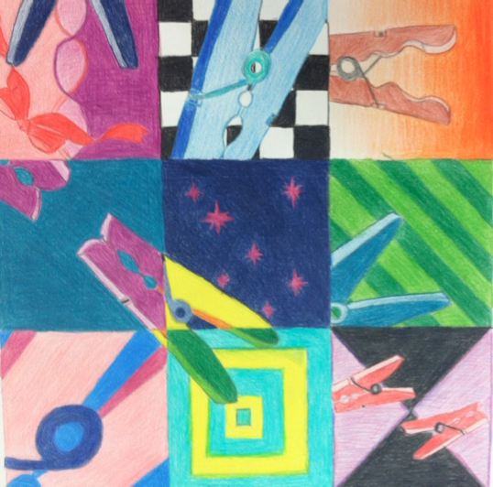
What do you see?

Slide 16
What do you see?
clothespins used throughout
bright, colorful, proportionate
needs multiple views/sizes

Slide 17
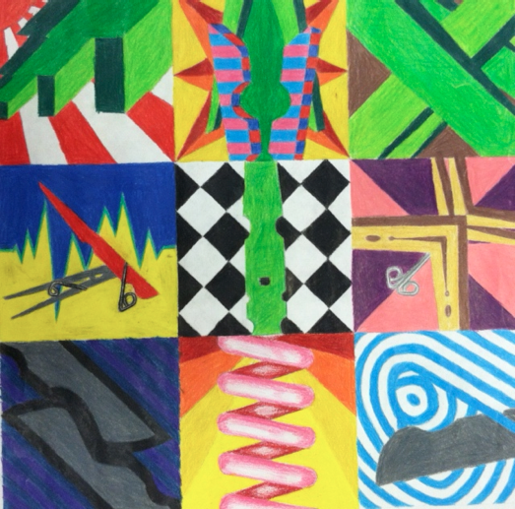
What do you see?

Slide 18
What do you see?
creative use of clothespins
multiple views
proportion off a touch
bright and bold

Slide 19
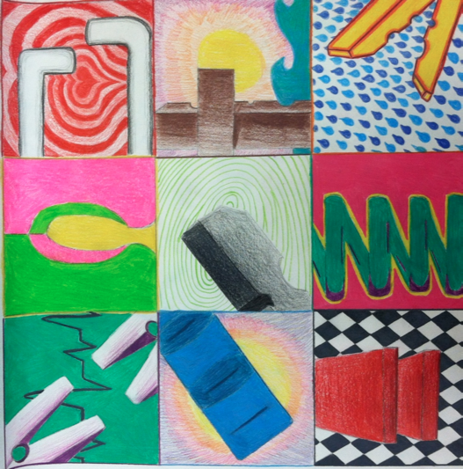
What do you see?

Slide 20
What do you see?
good contrast
multiple views of clothespins
original composition
clothespins have volume

Slide 21
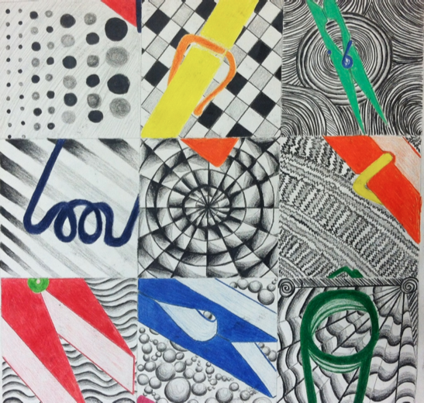
What do you see?

Slide 22
What do you see?
original composition
great visual texture
good contrast
2 blocks a bit lacking

Slide 23
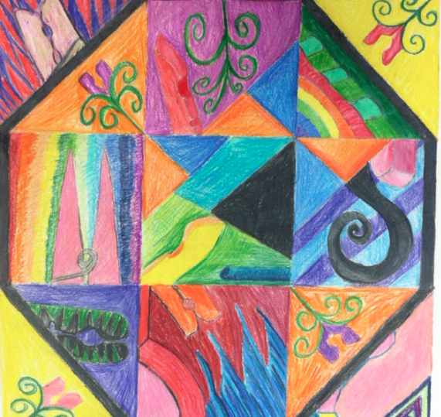
What do you see?

Slide 24
What do you see?
hard to distinguish
good color
needs more clothespins

Slide 25
DIRECTIONS
-Do 10-15 thumbnail drawings of clothespin. Zoom in, crop etc.
-Color each composition to create a unique design.
-Cut out 9 of the best compositions and arrange in sketchbook.
-Arrange 2” compositions into one large composition. flip, rotate.
-Consider emphasis, composition, colors, balance, and visual flow.
-When composition is strong, glue 2” pieces in place.
-On 18”X24” paper, center a 15”X15” square.
-Divide 15” square into 9, 5” squares lightly.

Slide 26
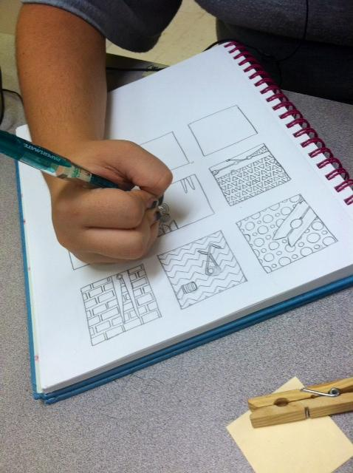
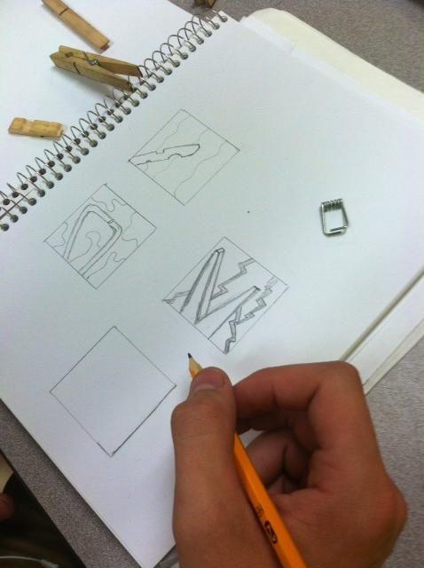
Do 10-15 thumbnail drawings of clothespin. Zoom in, crop etc.
Add interesting backgrounds (Bonus if you develop a theme)

Slide 27
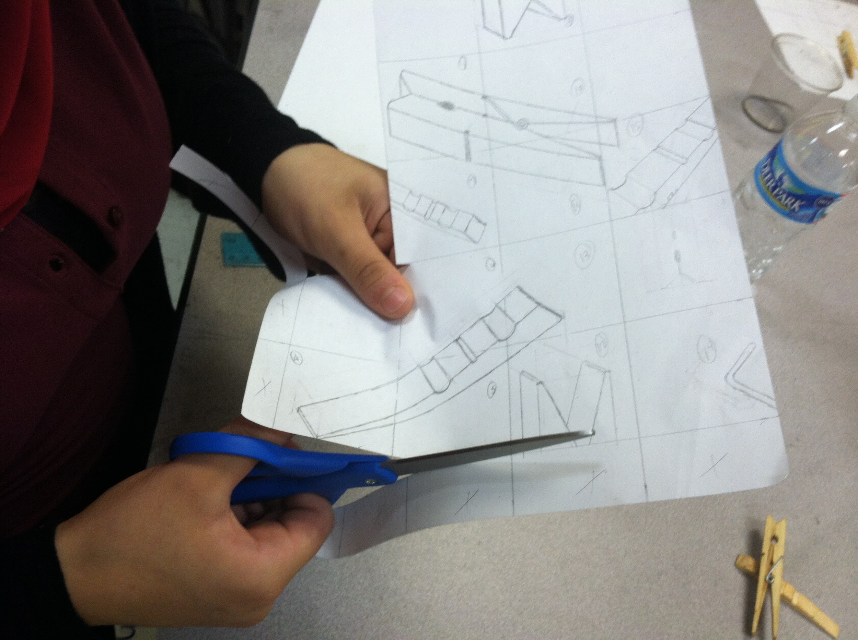

Slide 28
