Slide 1
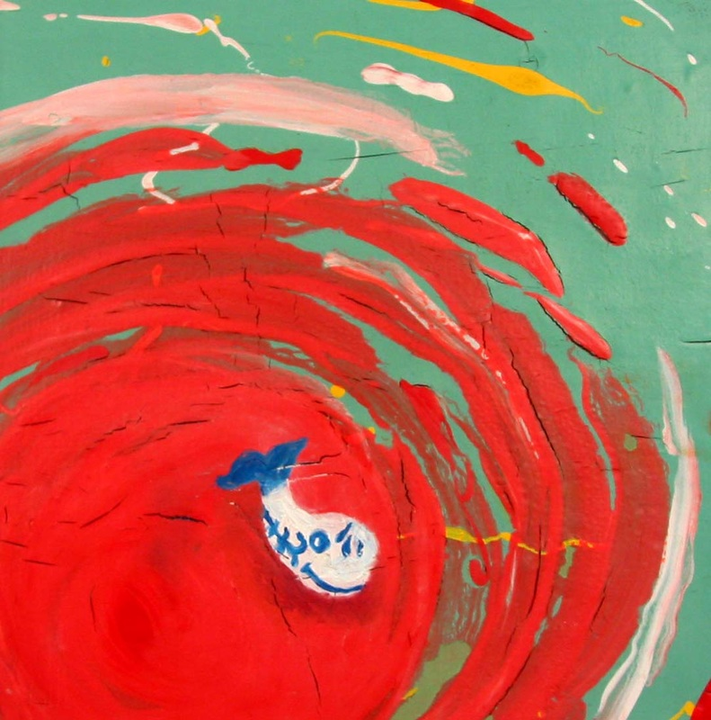
Polymer Lift
Art Proficient

Slide 2
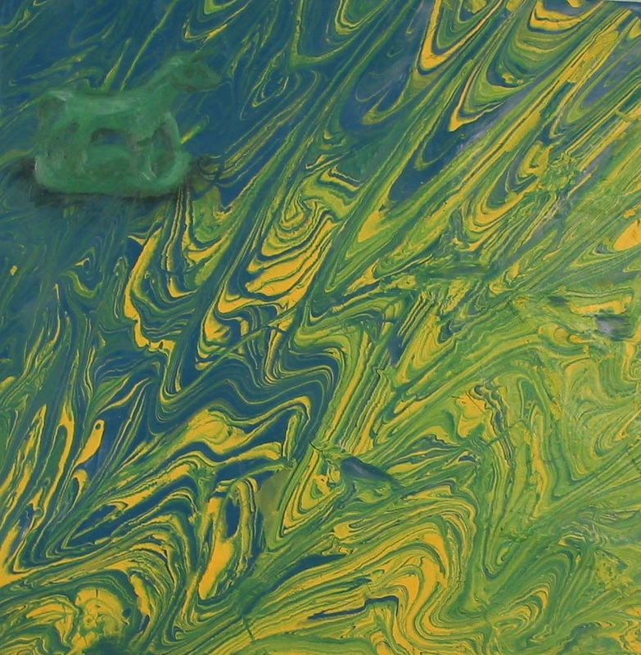
Objective:
Students will use multiple layers of acrylic paint and gel medium to create “lifts” of paint that can be peeled or “lifted” off of a surface and attached to another.

Slide 3
Directions:
Students apply masking tape in a 6 in by 6in square to a piece of glass (not plexiglass)
Clear gel gloss medium is applied to the inside of the tape square (slightly overlap the tape but do not cross)
a layer of acrylic paint is applied to dry gel gloss medium. Paint does not have to be an even coat. Designs, patterns, drips, and splatters are ok. 100% coverage is not necessary at this point.
A different color of acrylic paint is applied to dry previous layer (hair dryer speeds the process).
Different layers of acrylic paint are applied in sequence until glass is no longer transparent.
paint on an additional 8-10 layers of paint (drying in between)
At this point, any color of acrylic is acceptable because it will not be visible in finished product.
When all layers of paint have been applied and are dry the Lift is ready to be removed.
Using an xacto knife, cut the borders of the lift on top of the initial tape box through to the glass.
Pick and edge and peel the lift off the glass.

Slide 4
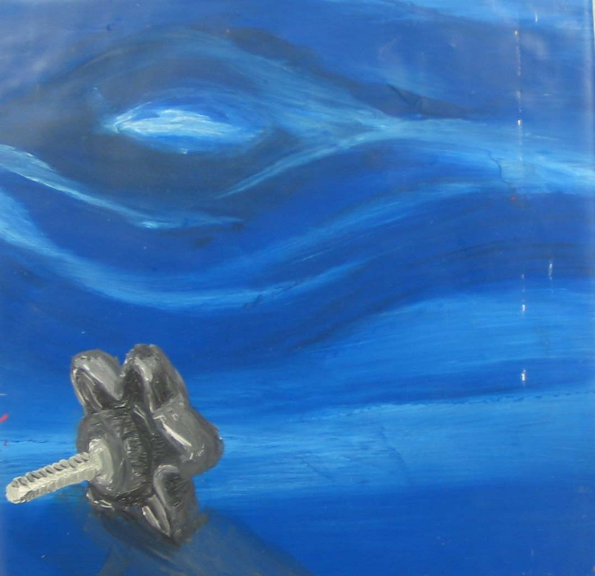
Finished lifts are attached to masonite boards using gel medium as adhesive. Tiny objects are then painted on the surface of finished lifts using oil paint.

Slide 5
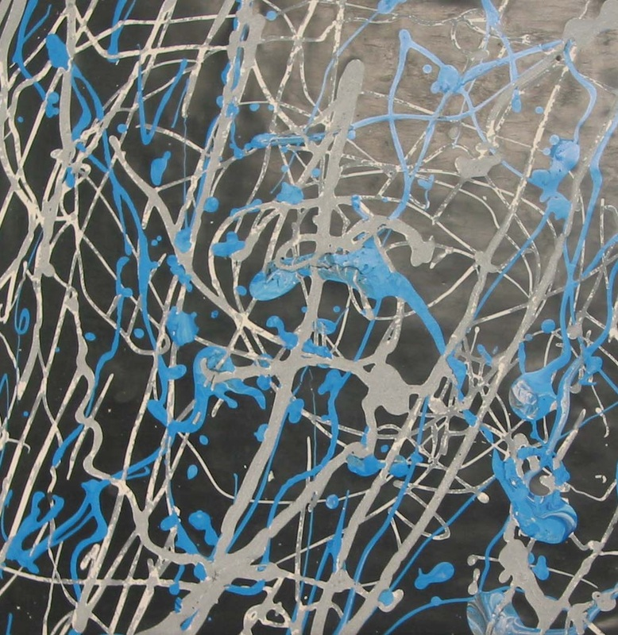
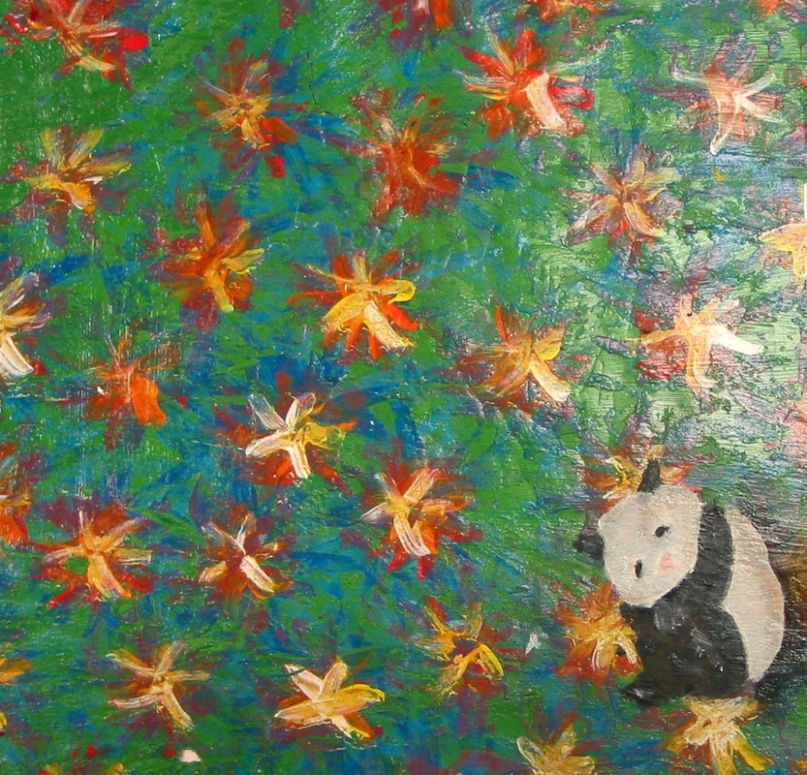

Slide 6
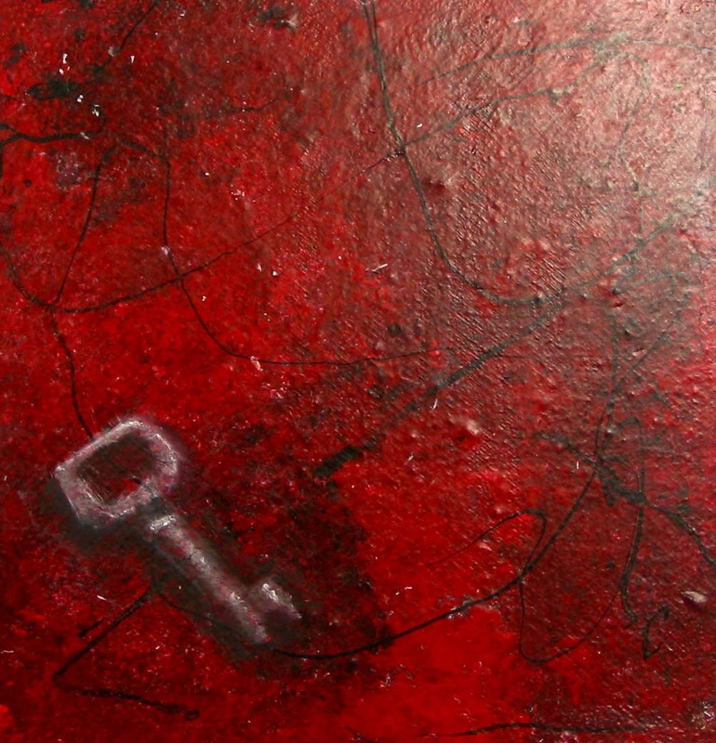
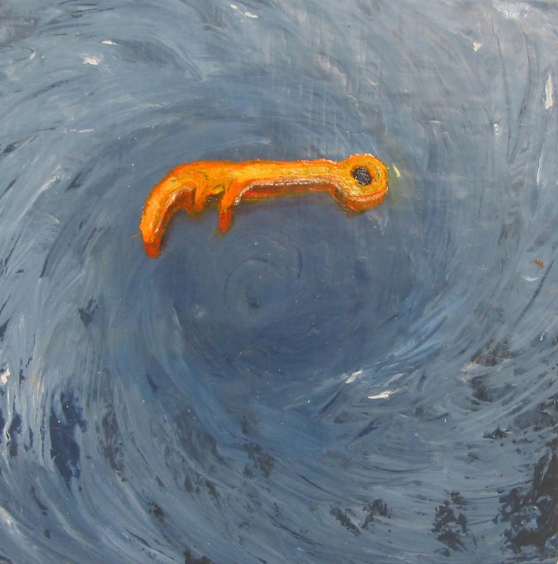

Slide 7
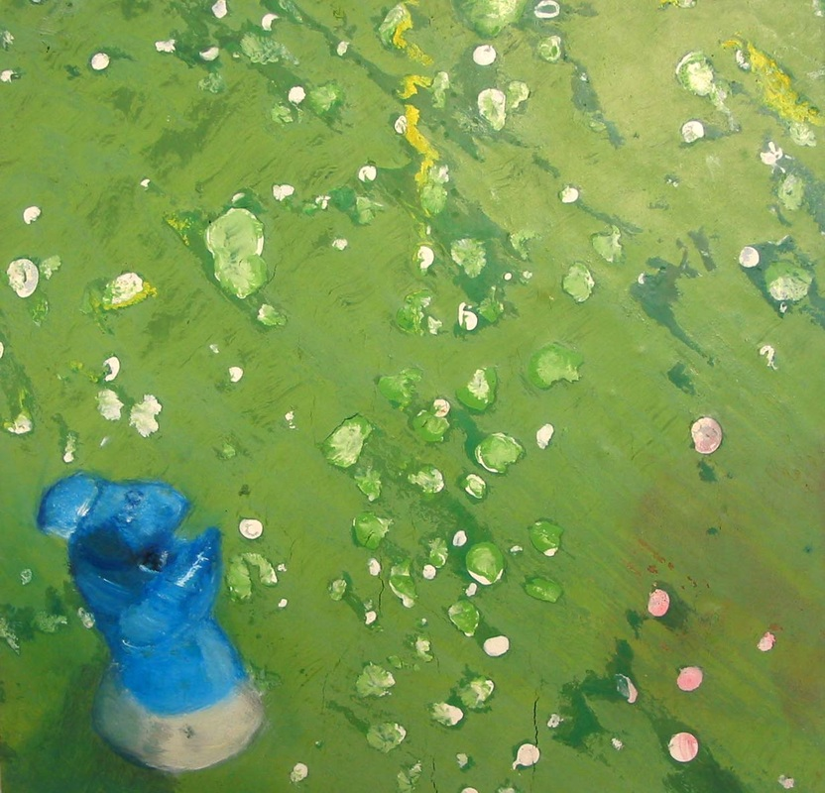
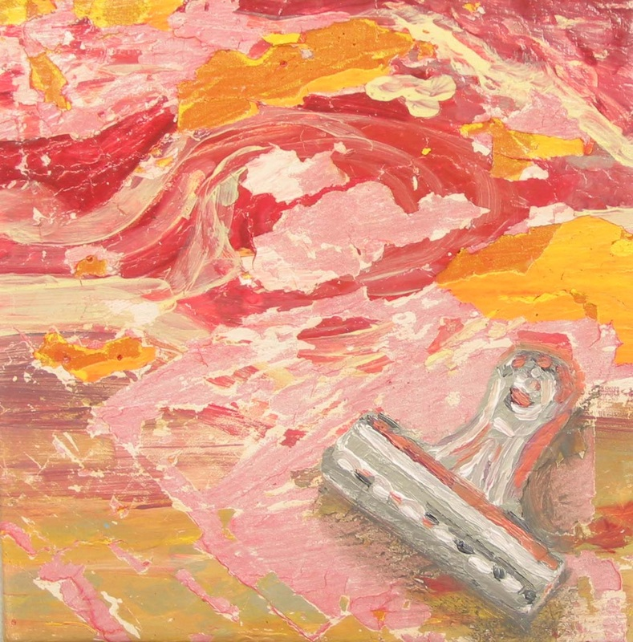

Slide 8
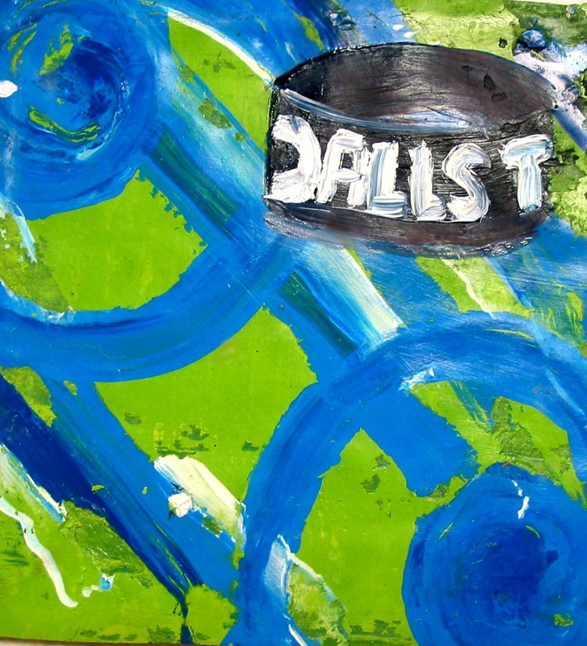
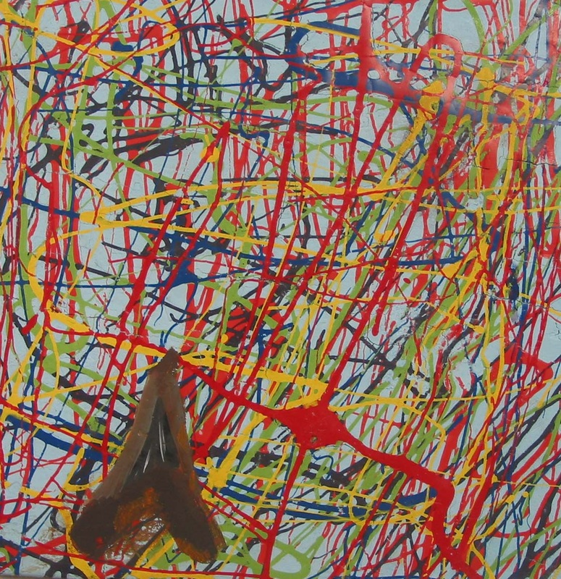

Slide 9
