Slide 1
Plaster Carving
reduction carving process

Slide 2
What is Plaster

Slide 3
Traditional plaster is made of hydrated lime, sand, and water. When mixed, traditional plaster has the consistency of runny peanut butter. As plaster sets, the lime within the plaster mix absorbs Carbon Dioxide and is essentially converted back into limestone, resulting in a hard and durable material.

Slide 4
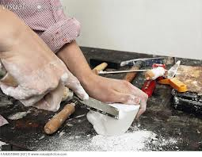

Slide 5
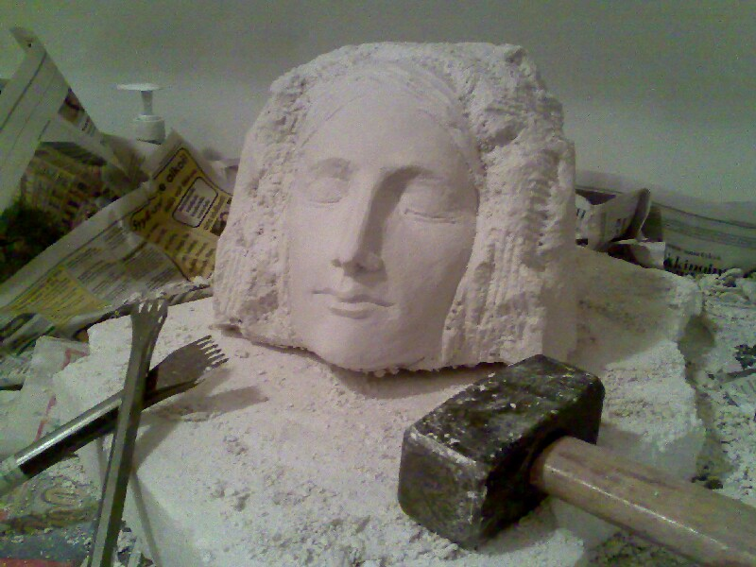

Slide 6
Directions
Mix plaster using the “mt. Fuji” method (fill container ¼ full of COLD water and sprinkle in dry plaster until a “mountain” begins to form and no longer sinks into the water)
Mix plaster thoroughly with hand until all lumps are gone
Pour plaster into desired container (solo cup, pringles can, paper milk carton, etc.)
Allow plaster to set (roughly 20-30 mins.)
Remove set plaster from container
Carve using chisels, x acto knives, scrapers, etc..

Slide 7
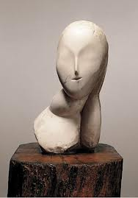
Constantine Brancusi

Slide 8
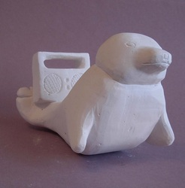
Student work

Slide 9
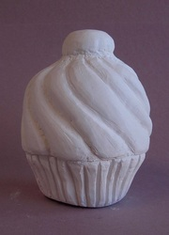
Student work

Slide 10
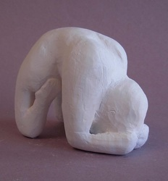
Student work

Slide 11
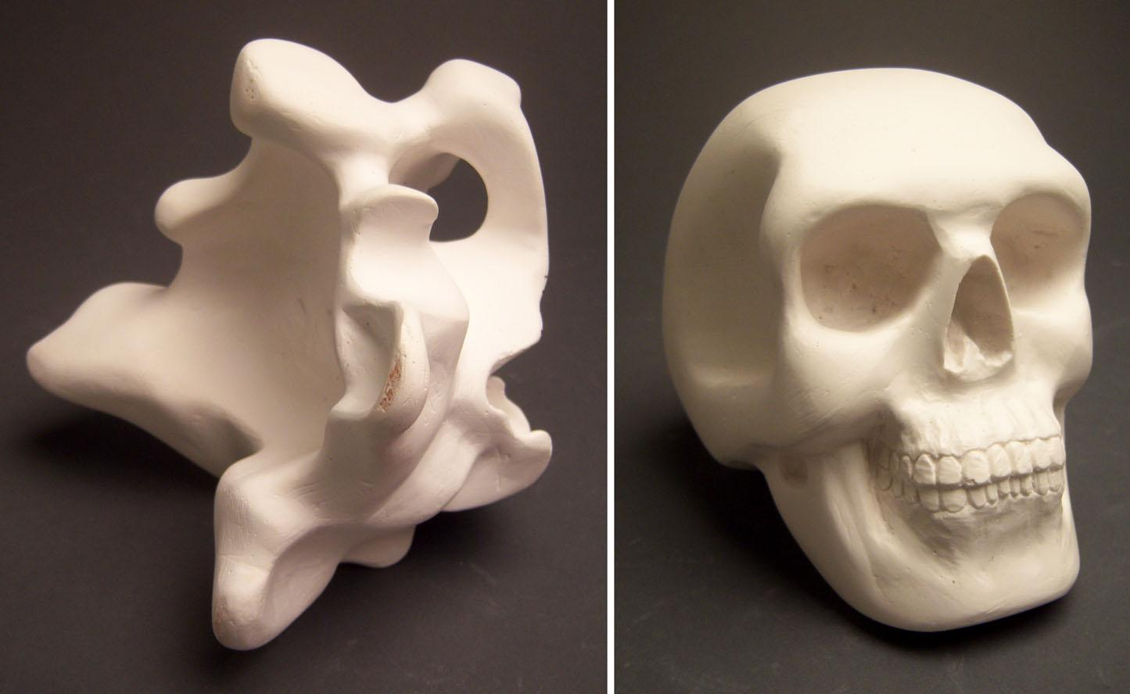
Student work

Slide 12
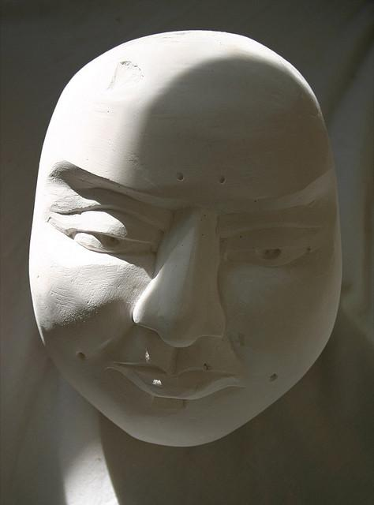

Slide 13
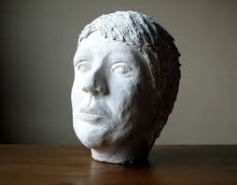

Slide 14
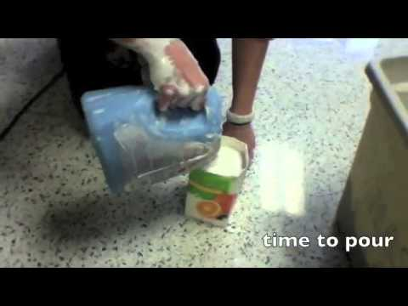
How to video on mixing and carving Plaster

