Slide 1
Palette Poetry
an environmental and literary collaboration

Slide 2
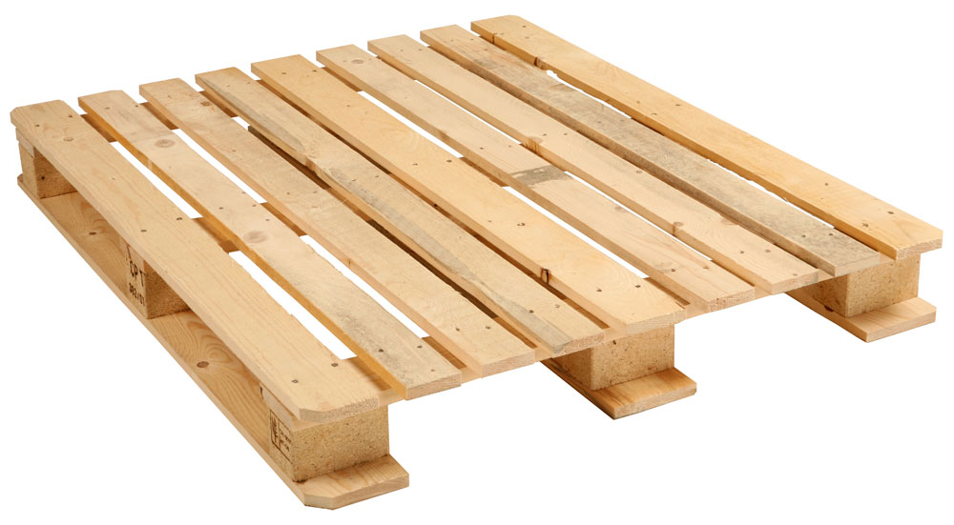

Slide 3
Objectives:
Recycle old pallets into Art
Write and incorporate poetry into Art

Slide 4
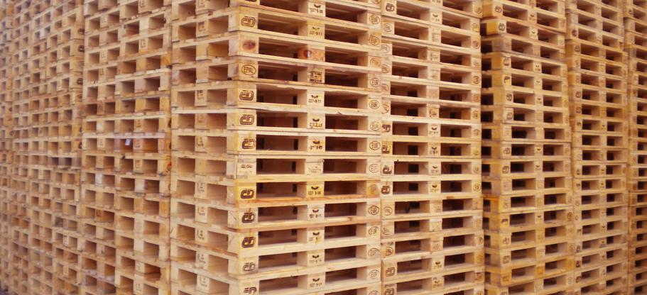
Step 1
Write
a
Poem
Step 2
Illustrate
your
Poem
using
palette
wood
as
material
Options
Paint
Cut
Sand
Hammer
Attach
Collage
Break
Carve
Etc.

Slide 5
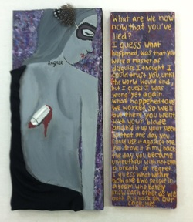
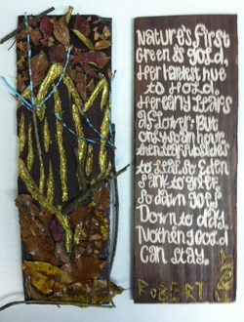

Slide 6
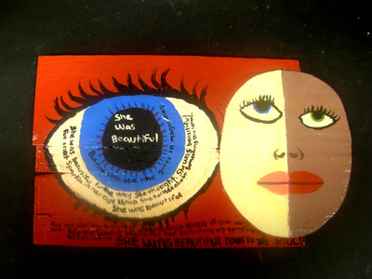

Slide 7
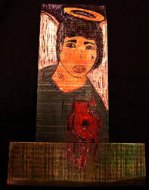
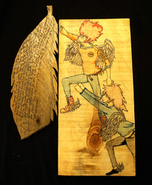

Slide 8
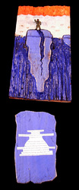

Slide 9
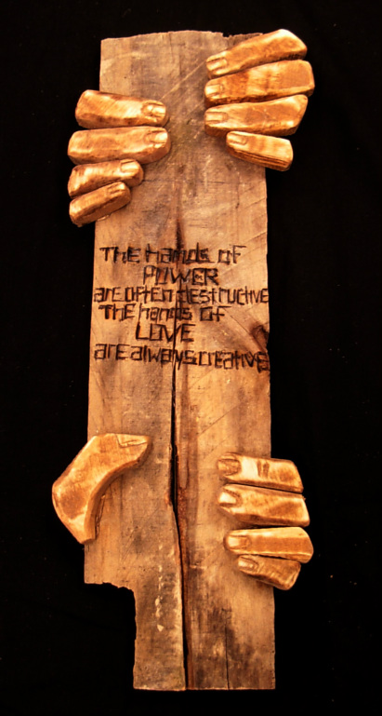

Slide 10
Ordinary Material
Extra Ordinary Artwork

