Slide 1
How to Be Original
Art Intermediate

Slide 2
This Project/Exercise is designed to push your limits of Creative thought processes which lead to development of new and original ideas. (get your creative juices flowing)

Slide 3
Objectives:
strategize
conceptualize
find relationships
recognize design possibilities

Slide 4
Choose one word from each of the 3 packets:
Place
Animal
Thing

Slide 5
Combine all 3 items
Into a Single, Original, Interesting Composition

Slide 6
Media/Materials
Water color
ink

Slide 7
Examples

Slide 8
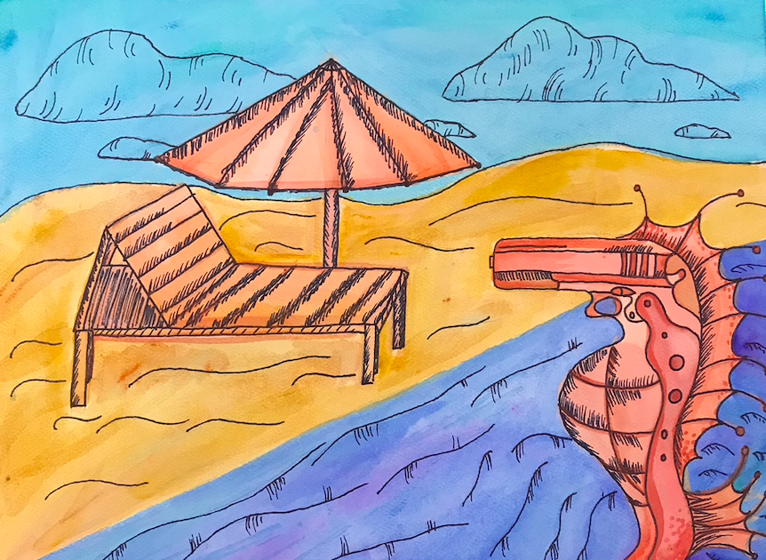

Slide 9
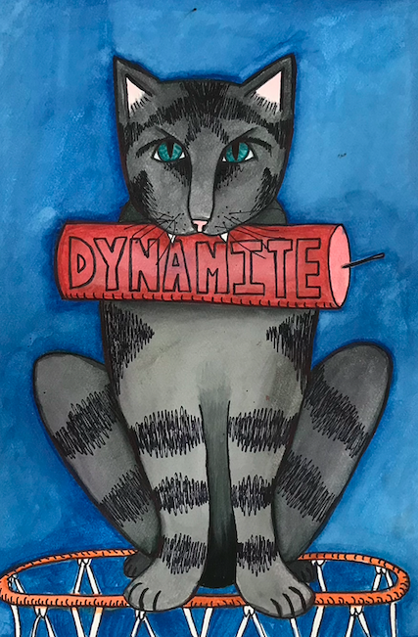

Slide 10
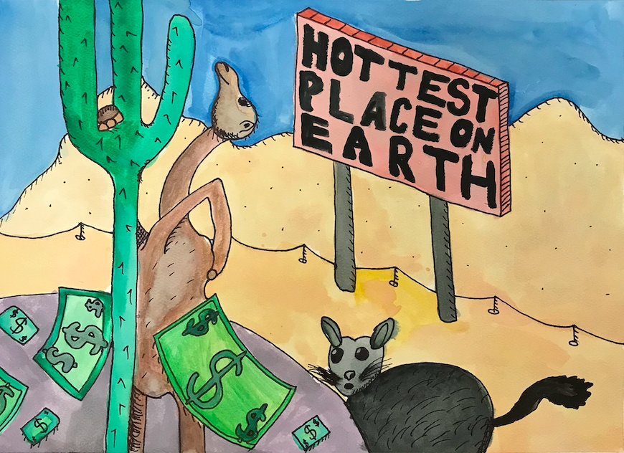

Slide 11
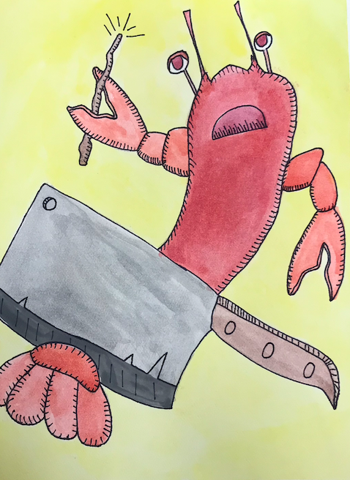

Slide 12
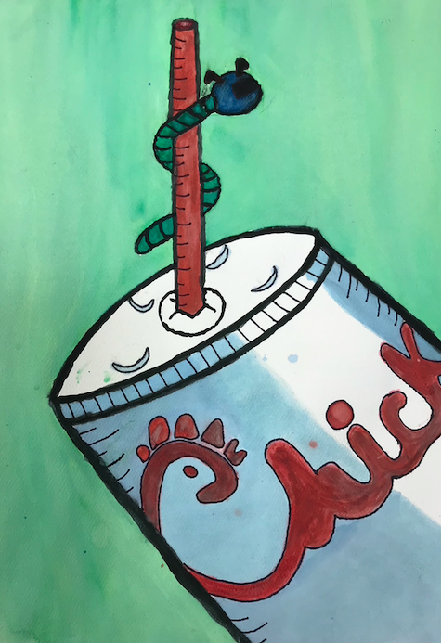

Slide 13
Avoid Cliches’
Have fun with this

