Slide 1
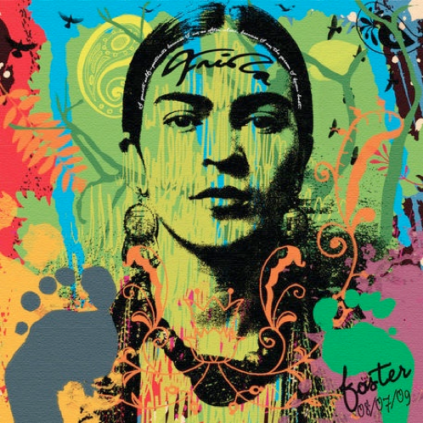
High Contrast Portraits
Art 1

Slide 2
During this project you will
Explore facial anatomy
Practice using the grid drawing system
Create a interesting ground using spray paint and stenciling!!!

Slide 3
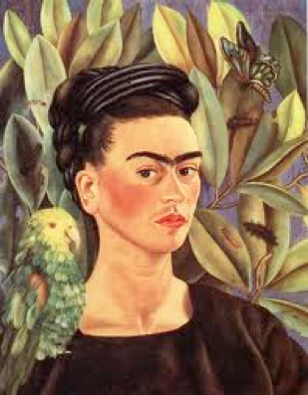
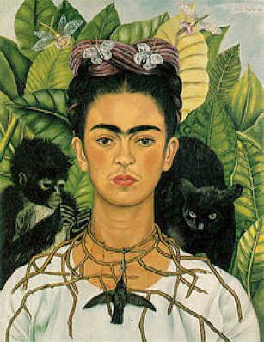
who is this a self portrait of?

Slide 4
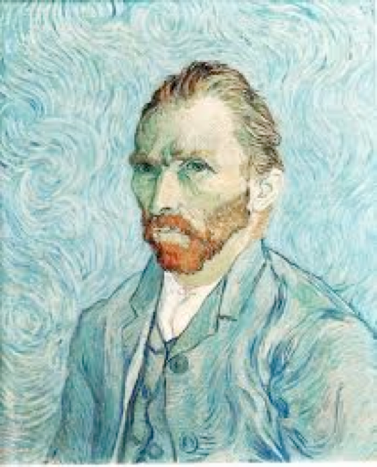

Slide 5
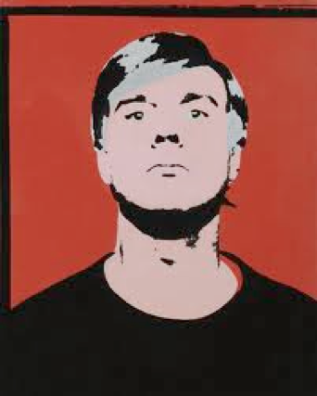
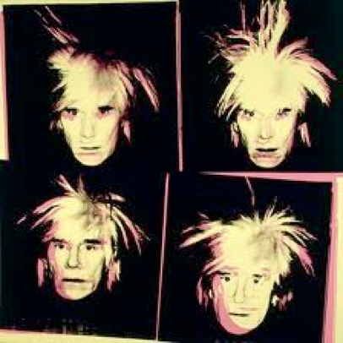

Slide 6
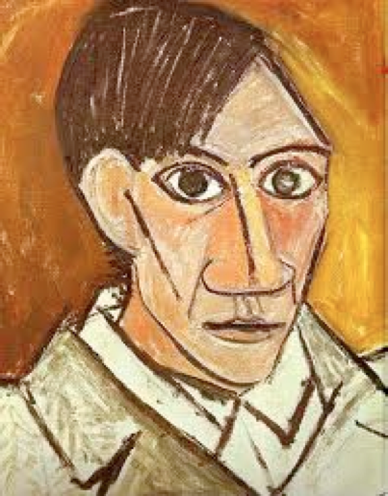

Slide 7
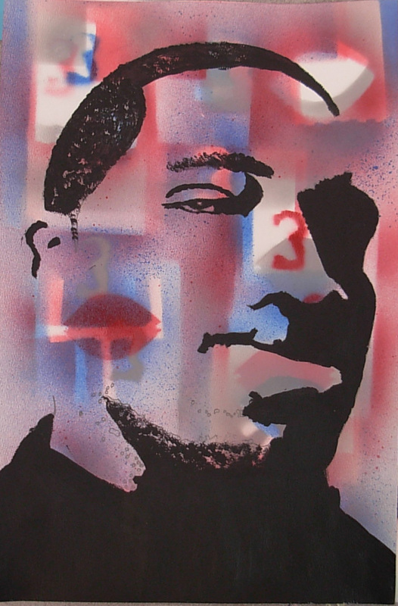
Now it’s your turn

Slide 8
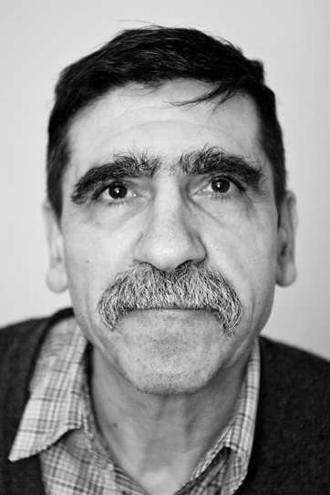
Step One:
Have your picture taken
by your awesome Art Teacher!

Slide 9
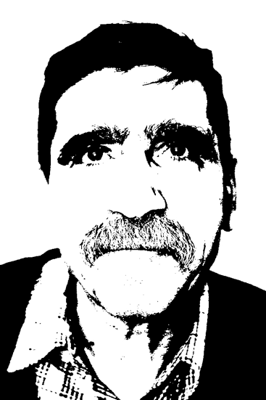
Step Two:
Edit your portrait to eliminate
ALL Values except for
Black and White
Thanks Awesome Art Teacher !!!!

Slide 10
Step 3:
Enlarge your picture from 6” x 9” to 12” x 18”
using the grid drawing method

Slide 11
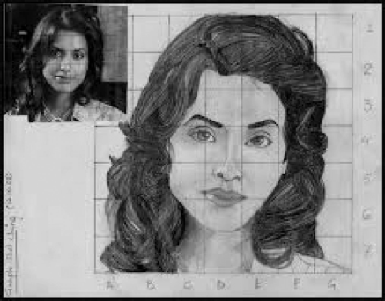
Grid Drawing Method
A grid drawing is created
by drawing a grid over a
resource image, and then
redrawing the grid on a
separate sheet of paper
typically in larger proportion.

Slide 12
How to crop photo, draw 1 inch grid, and draw 2 inch grid

Slide 13
But are we drawing out our self portraits on
just plain white paper???
NO WAY!

Slide 14
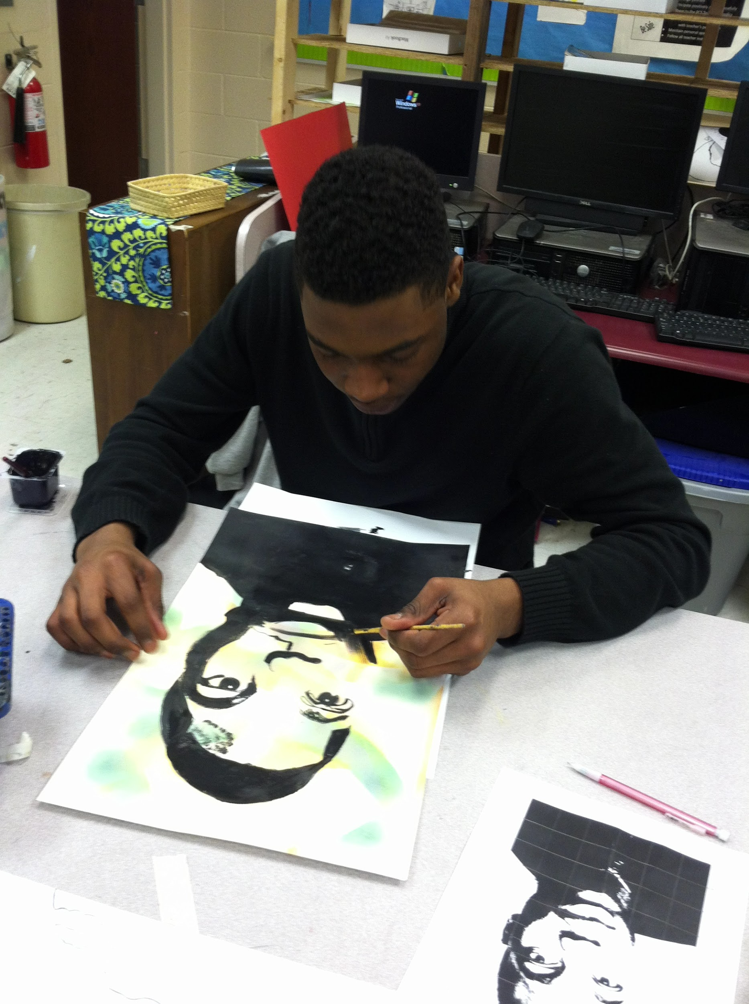
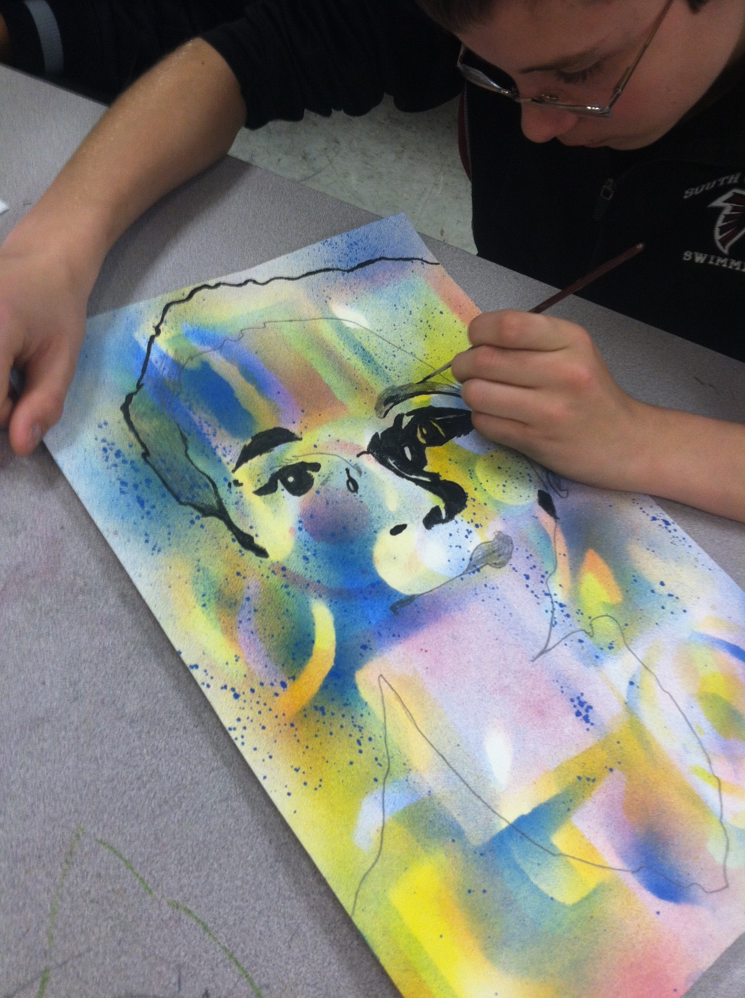

Slide 15
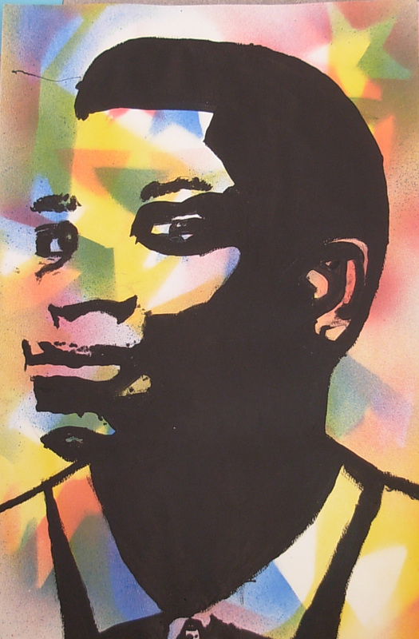
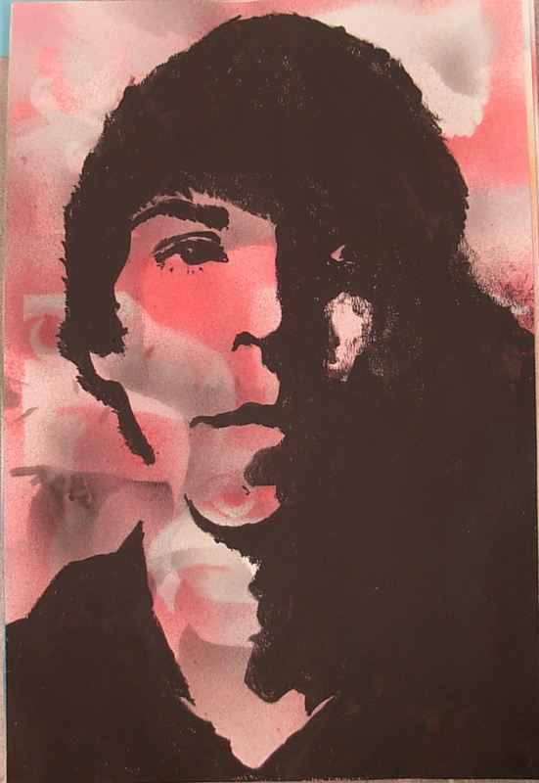

Slide 16
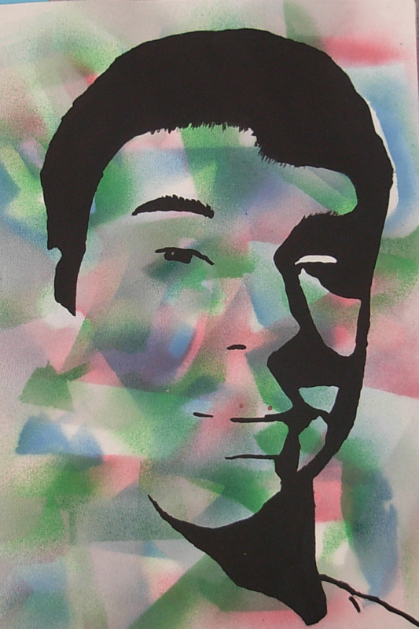
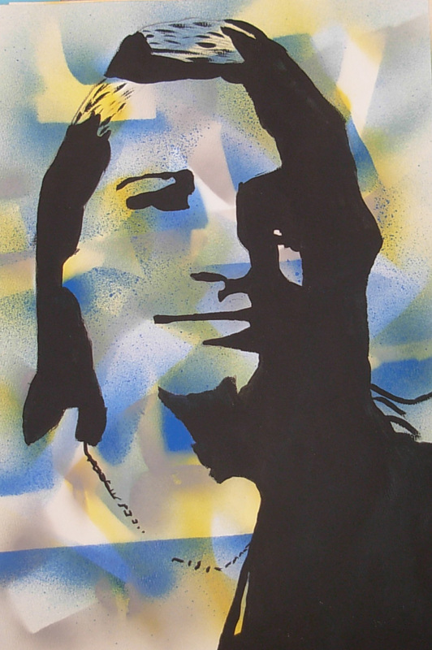
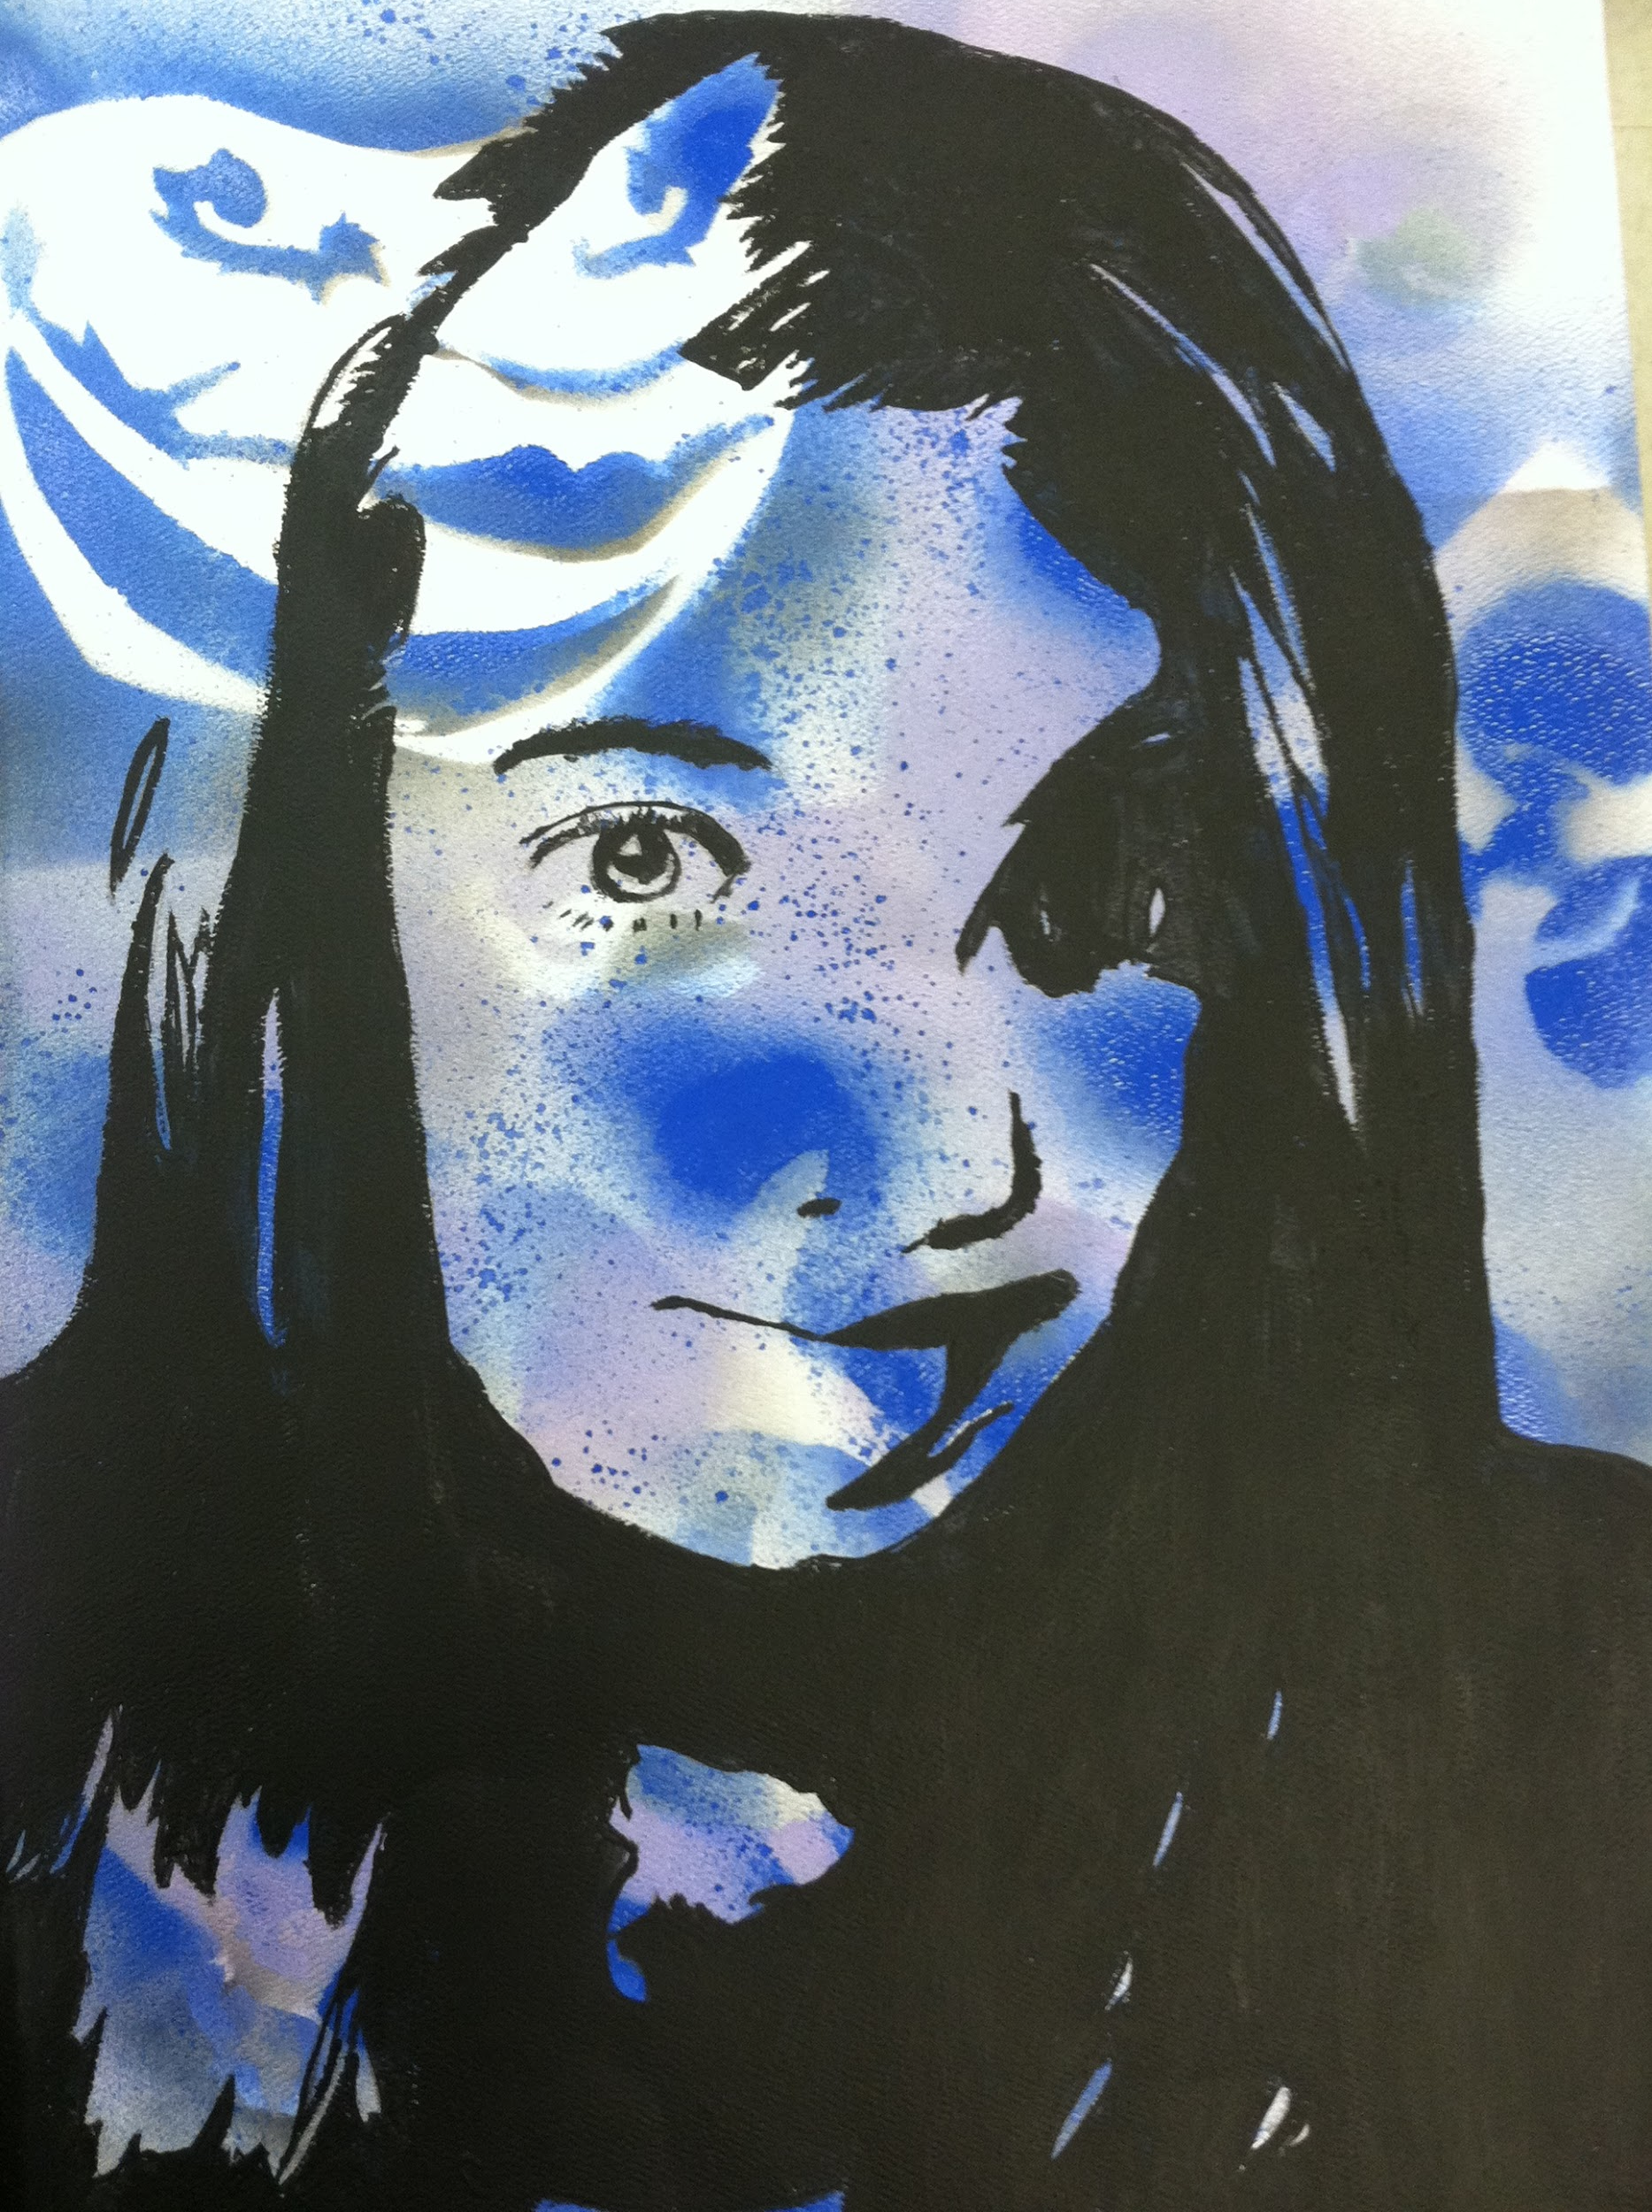

Slide 17
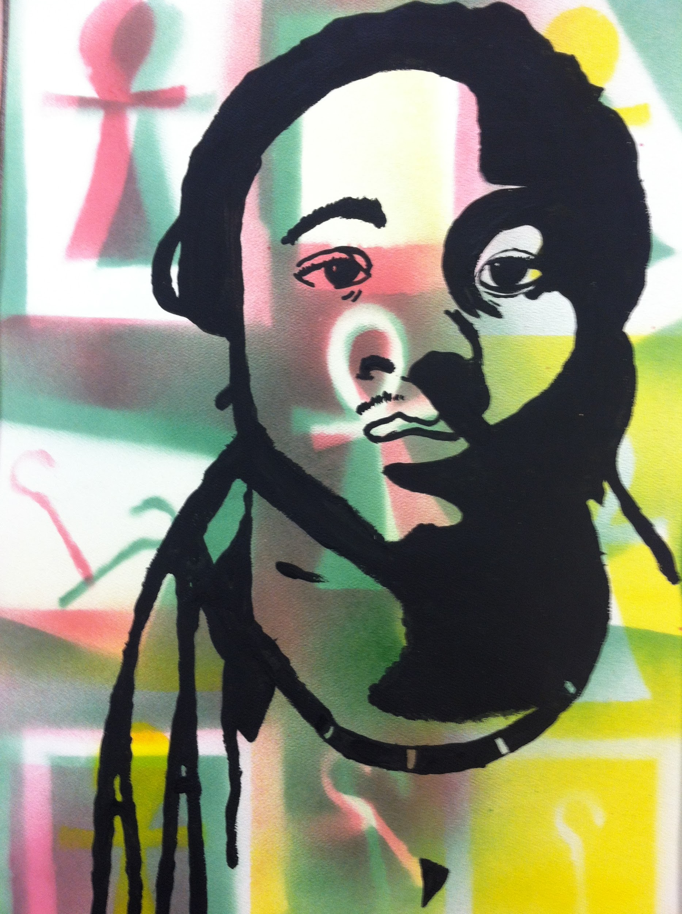
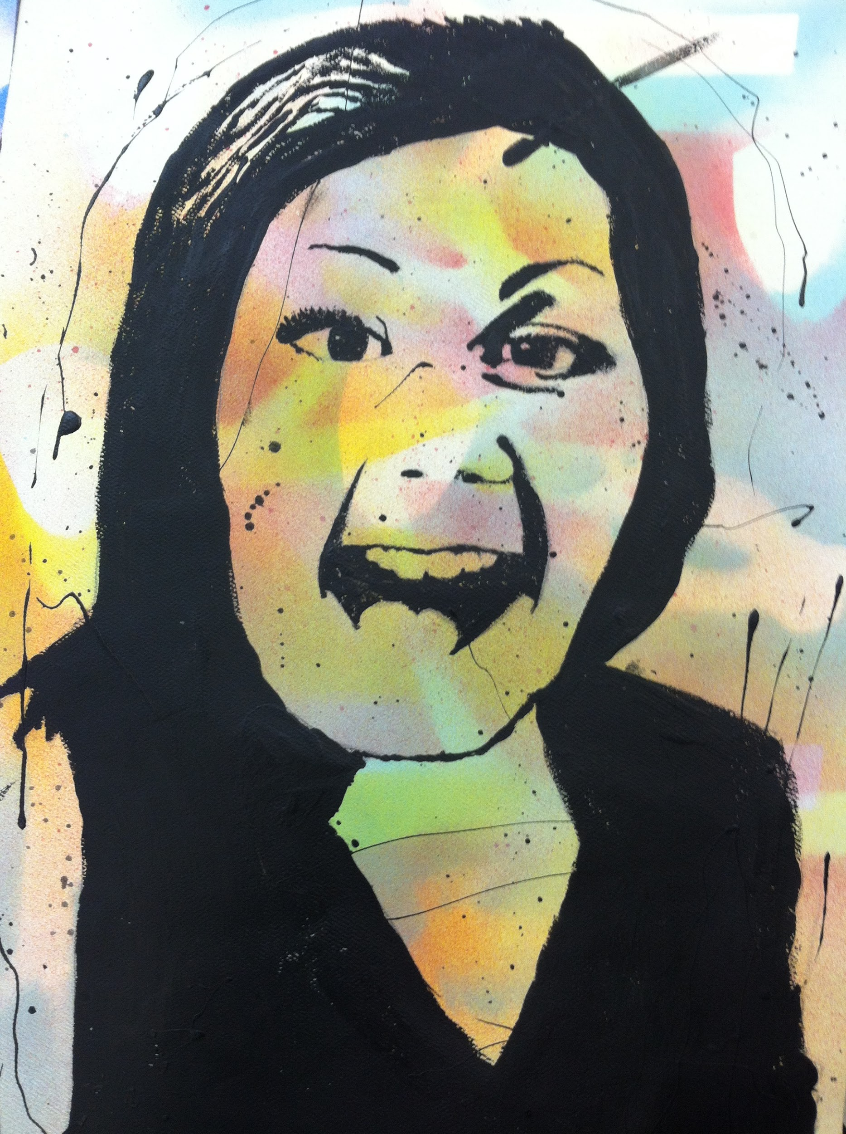

Slide 18
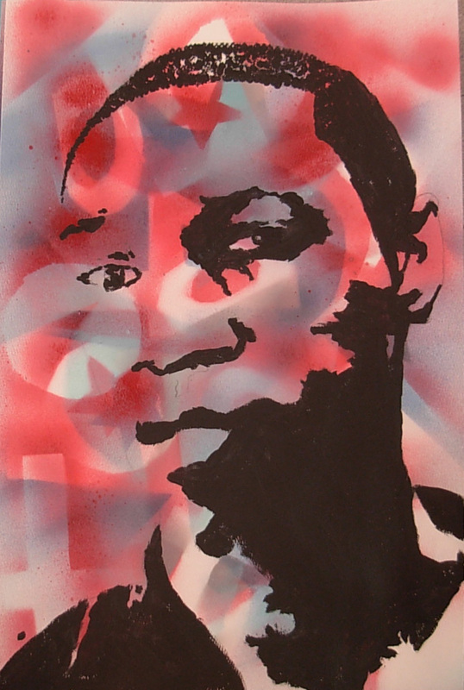
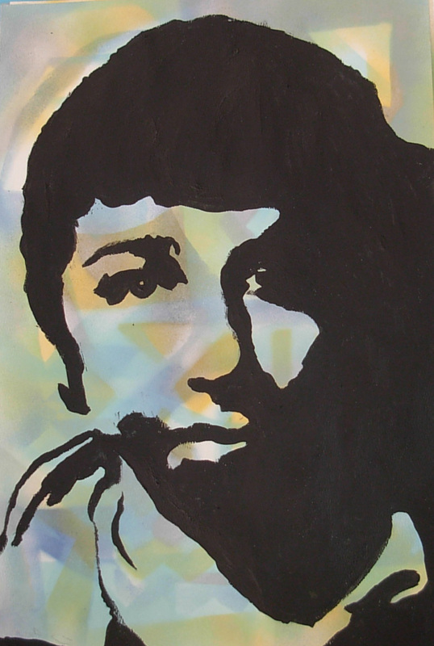

Slide 19
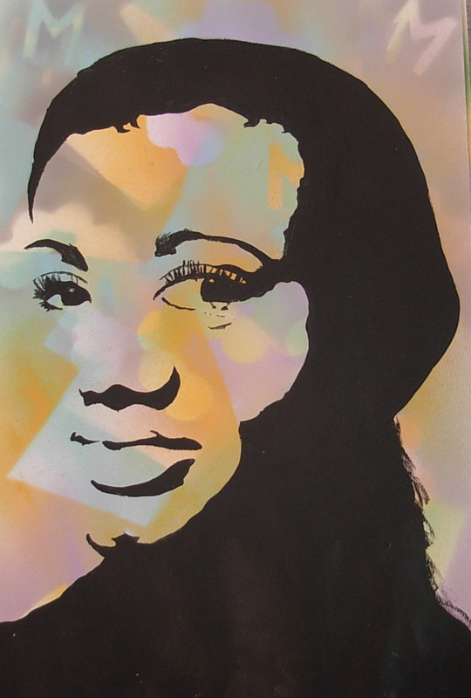

Slide 20
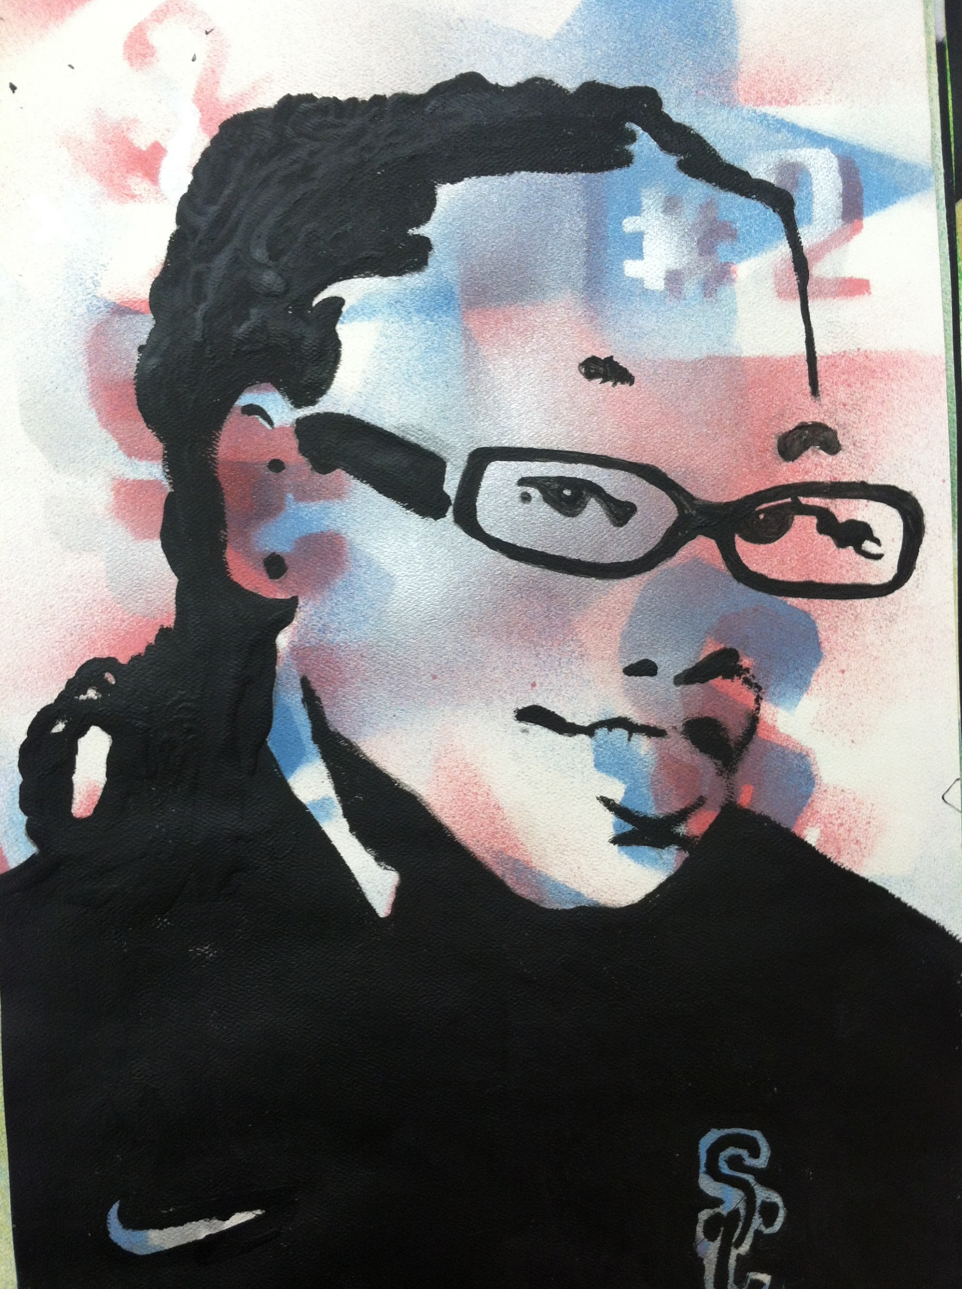
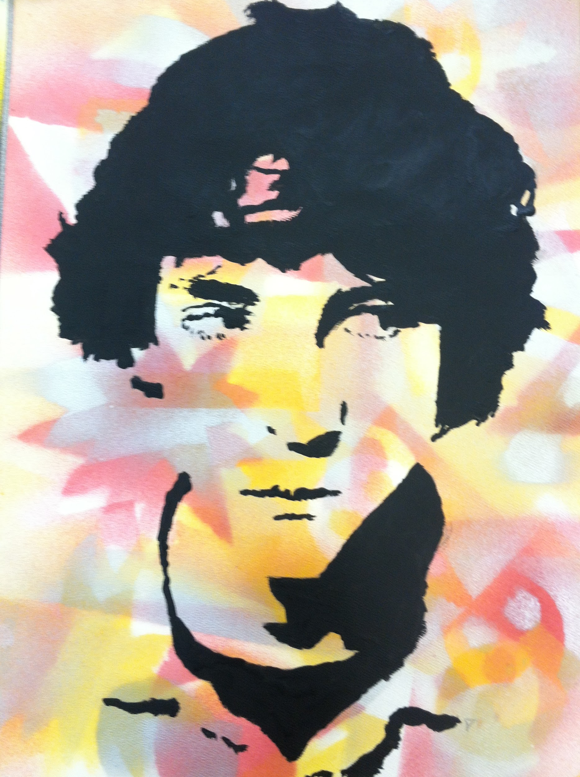

Slide 21
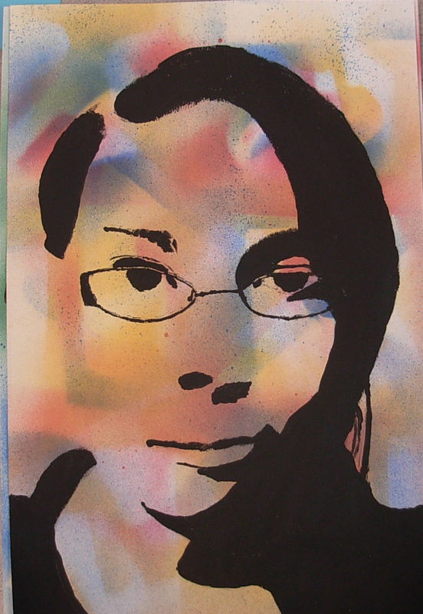
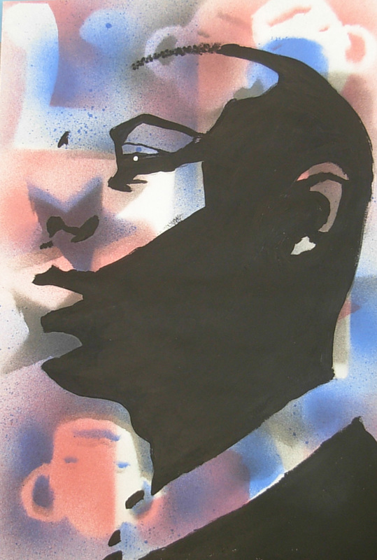

Slide 22
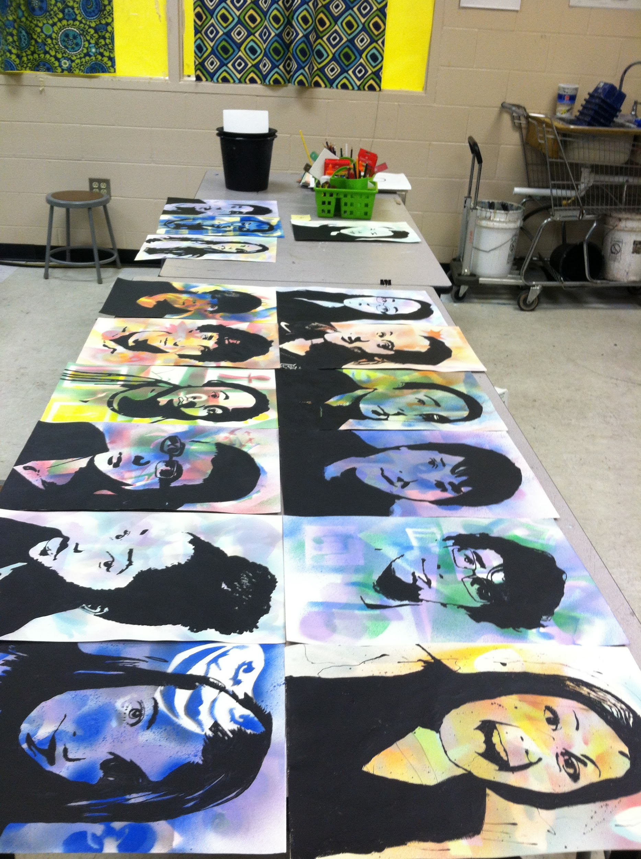

Slide 23
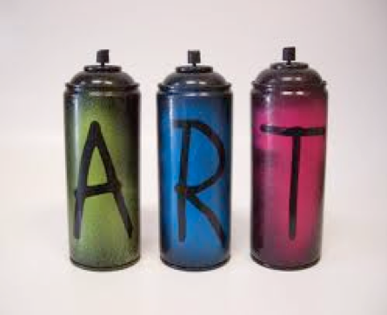
SPRAY PAINT GROUNDS

Slide 24
SPRAY PAINT GROUNDS
Step One: Cut out 3 INTERESTING shapes
1 Small -height of your index finger
1 Medium- height of your fist
1 Large- height of your open hand
Keep your negative shapes too!

Slide 25
Video Demonstration

