Slide 1
Fruit Progression
Art 2 Exam

Slide 2
Art 2 has been all about strengthening your observational skills and using them to make your artwork better.
Using Colored Pencils: draw an apple 4 times as realistic as possible
1-draw apple
2-Draw apple with 2 bites taken out
3-Draw apple with 3 more bites taken out
4- Draw the remains of the apple (core)
Hint- include cast shadows and highlights to enhance realism

Slide 3
A

Slide 4
B

Slide 5
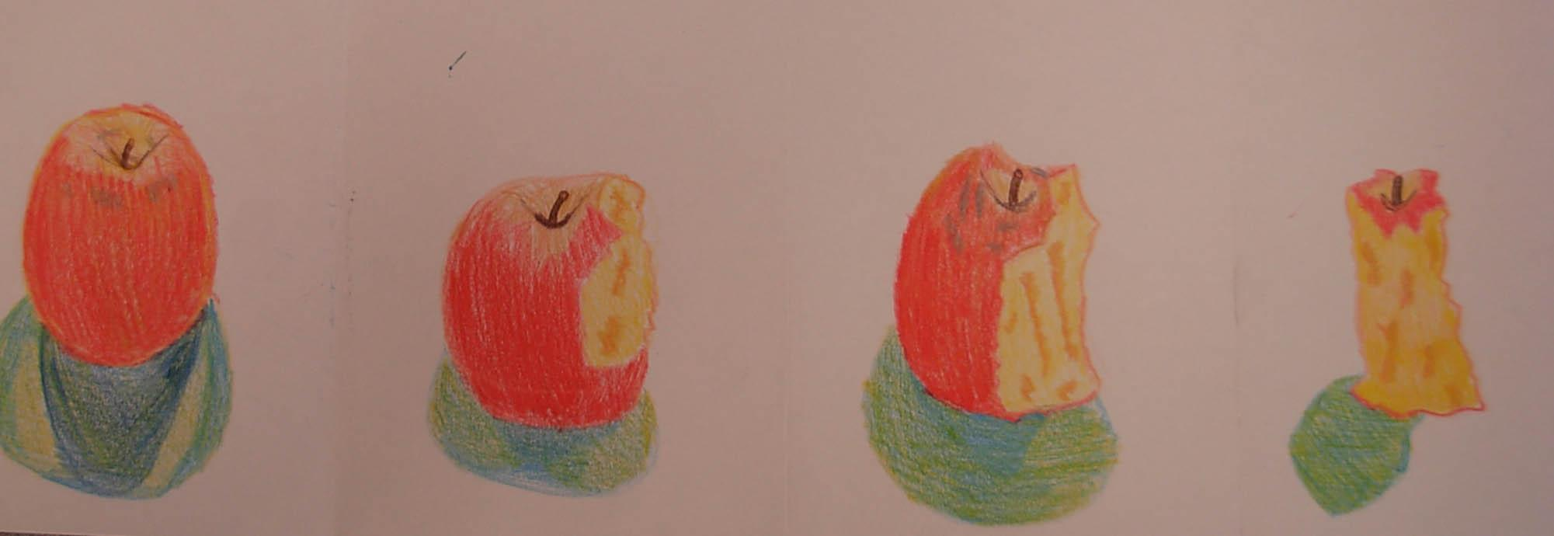
C

Slide 6
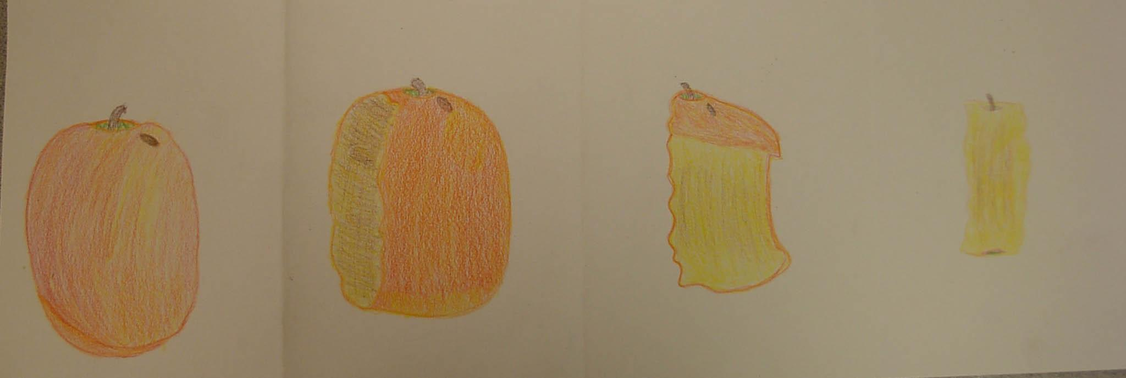
D

Slide 7
A
B
C
D

