Slide 1
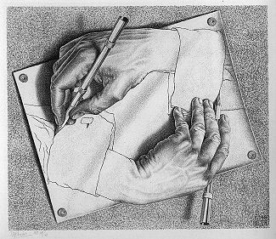
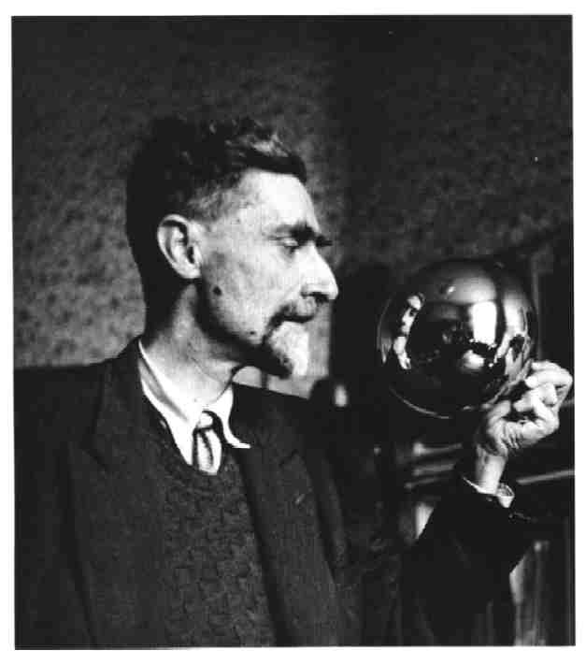
M.C. Escher
“Drawing Hands”
Notes:
1

Slide 2
-M.C Escher lived from 1898-1972
-He was a sickly child, and was placed in a special school at the age of seven; he failed the second grade. Although he excelled at drawing, his grades were generally poor.
-In his early years, Escher sketched landscapes and nature.
-Although Escher did not have mathematical training—his understanding of mathematics was largely visual and intuitive
-Escher's art became well known, both among scientists and mathematicians
Notes:
Week 1

Slide 3
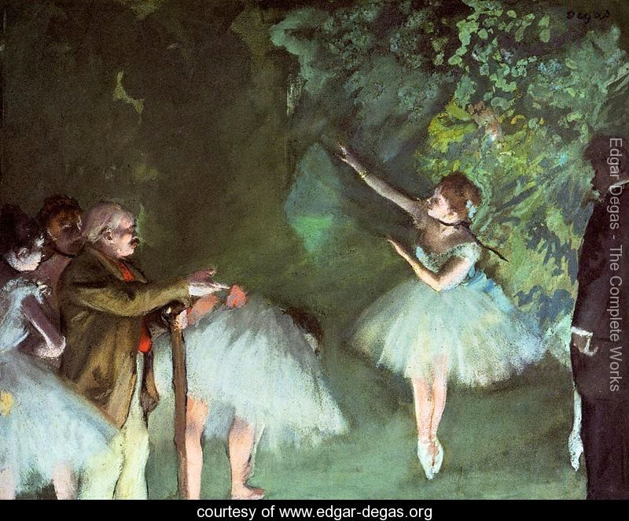
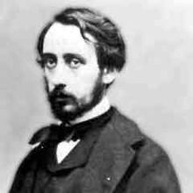
Edgar Degas
“Ballet Rehearsal”
Notes:
1

Slide 4
1834 – 27 September 1917
French Artist especially identified with the subject of dance
one of the founders of Impressionism (19th-century art movement characterized by the depiction of realities of the world around them and light in its changing qualities)
He always painted indoors, preferring to work in his studio, either from memory, photographs, or live models
Notes:
Week 1

Slide 5
Art Vocab
LINE
Defines space, contours, outlines and defines mass and volume.
Notes:
Week 1

Slide 6
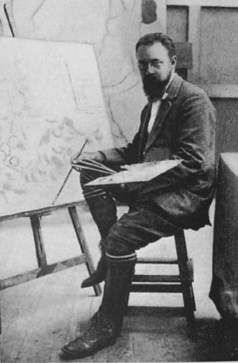
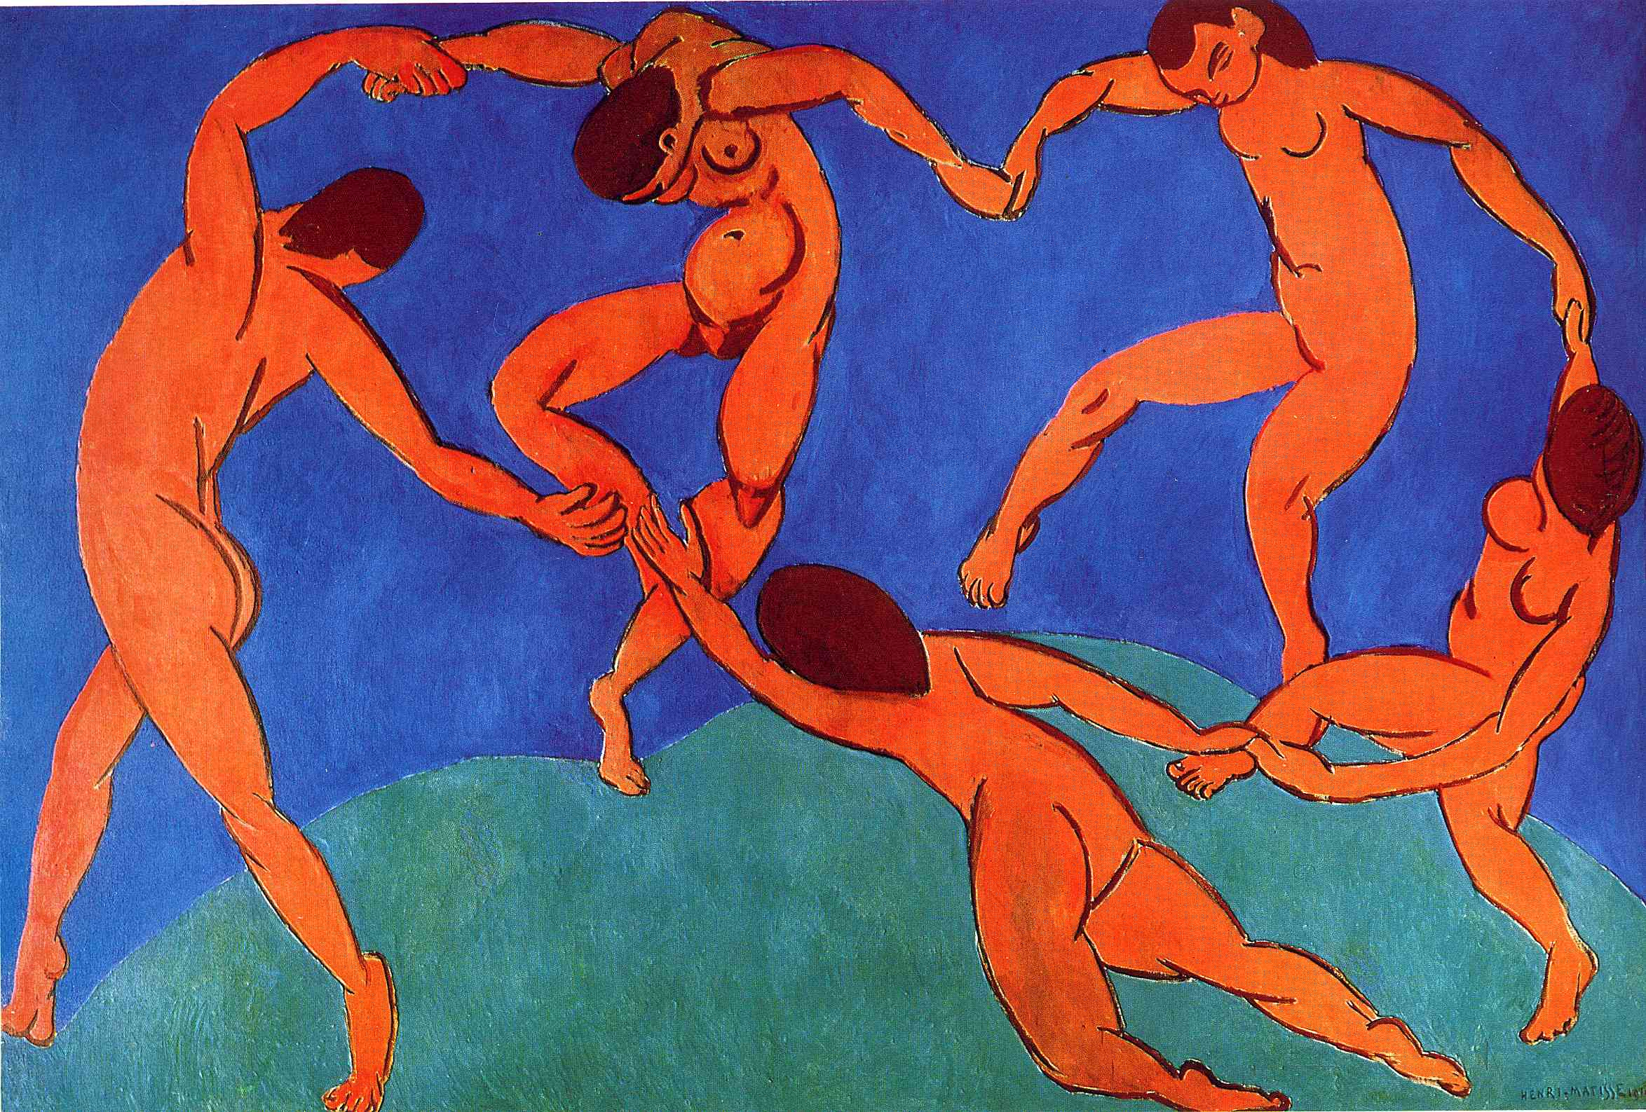
“Dance II”
Mattise
Notes:
2

Slide 7
Henri Matisse lived from 1869 – 1954
French artist, known for both his use of colour
defined the revolutionary developments in the visual arts
initially labelled a Fauve (wild beast- modern artists whose works emphasized painterly qualities and strong color
Notes:
2

Slide 8
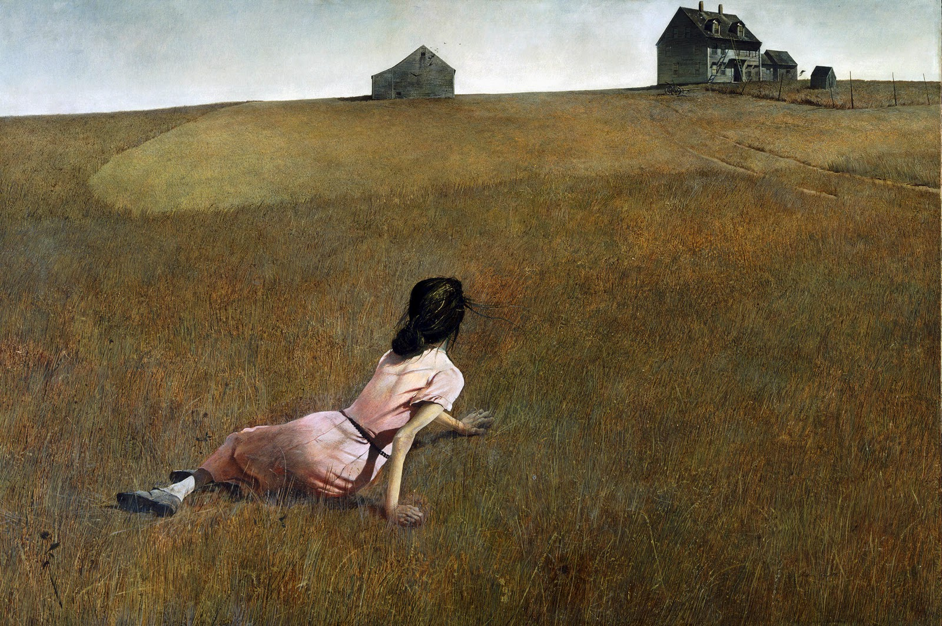
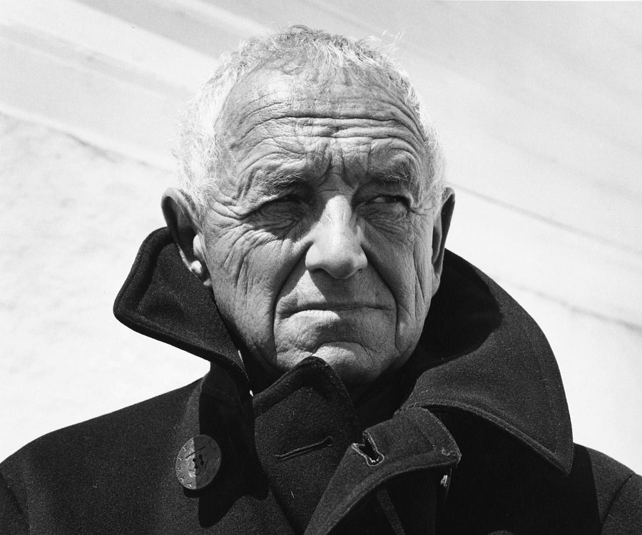
Andrew Wyeth
“Christina’s World”
Notes:
2

Slide 9
Andrew Newell Wyeth July 12,1917 – January 16, 2009
Wyeth's was homeschooled by his father
In his art, Wyeth's favorite subjects were the land and people around him, this style is called Regionalism
“Christina’s World” depicts his neighbor, Christina Olson, Wyeth was inspired by Christina, who, crippled from polio and unable to walk, spent most of her time at home
Notes:
2

Slide 10
Art Vocab
VALUE
The lightness and the darkness of a hue (color).
Notes:
2

Slide 11
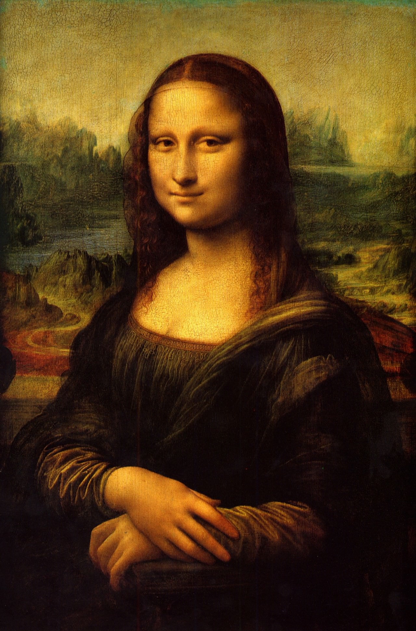
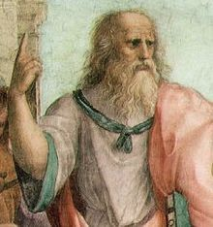
Leonardo Da Vinci
Mona Lisa
Notes:
3

Slide 12
Leonardo da Vinci 1452 –1519
Considered a universal genius or “Renaissance Man” for his mastery of a variety of subjects ranging from painting to paleontology
Also known for his inventions which included a flying machine and s submarine
his mind and personality seem to us superhuman, while the man himself mysterious and remote
Notes:
3

Slide 13
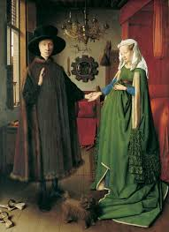
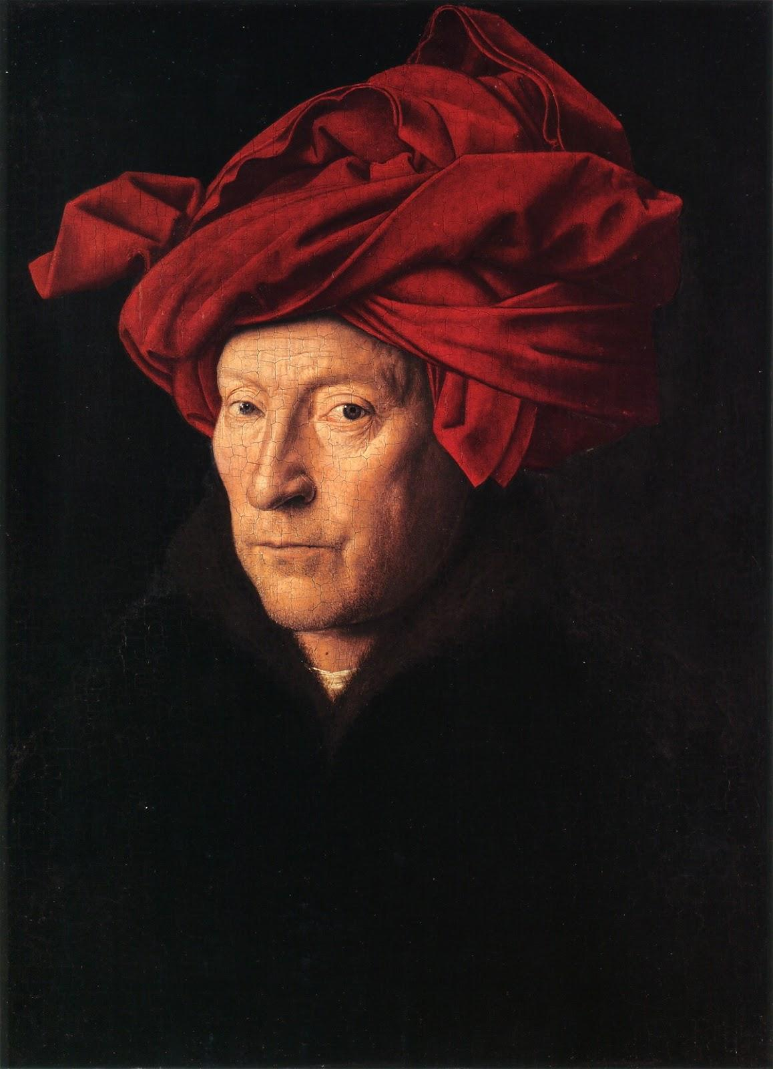
Jan Van Eyck
“Arnolfini Wedding”
Notes:
3

Slide 14
Jan van Eyck (1390 – 1441)
It is considered one of the most original and complex paintings in Western art, because of its beauty, complex iconography,
The view in the mirror shows two figures who are witnessing the marriage
Groom is raising his hand to take marriage oath
The bare feet indicate this event is taking place on holy ground.
The little dog symbolizes fidelity (Fido- to trust in Latin)
The wife is not pregnant, this was a style of fashion of the time and Mrs.Arnolfini is holding her dress up. They never had children.
Notes:
3

Slide 15
Art Vocab
Color
Derived from light

Slide 16
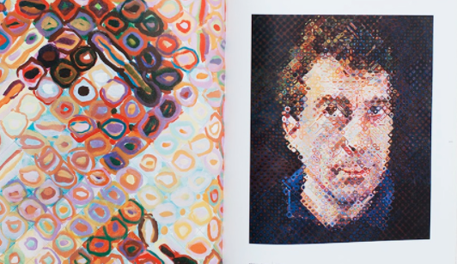
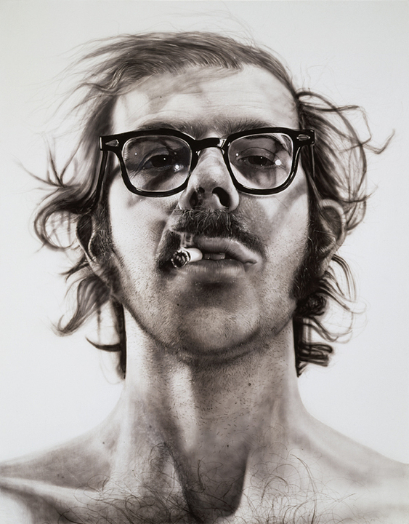
Chuck Close
“Bill 1990”
Notes:
4

Slide 17
Chuck Close 1940-present
American painter/artist and photographer who achieved fame as a photorealist, through his massive-scale portraits
spinal artery collapse in 1988 left him severely paralyzed
Close puts a grid on the photo and on the canvas and copies cell by cell.
each square within the grid is filled with color shapes which give the cell a perceived 'average' hue, which makes sense from a distance

Slide 18
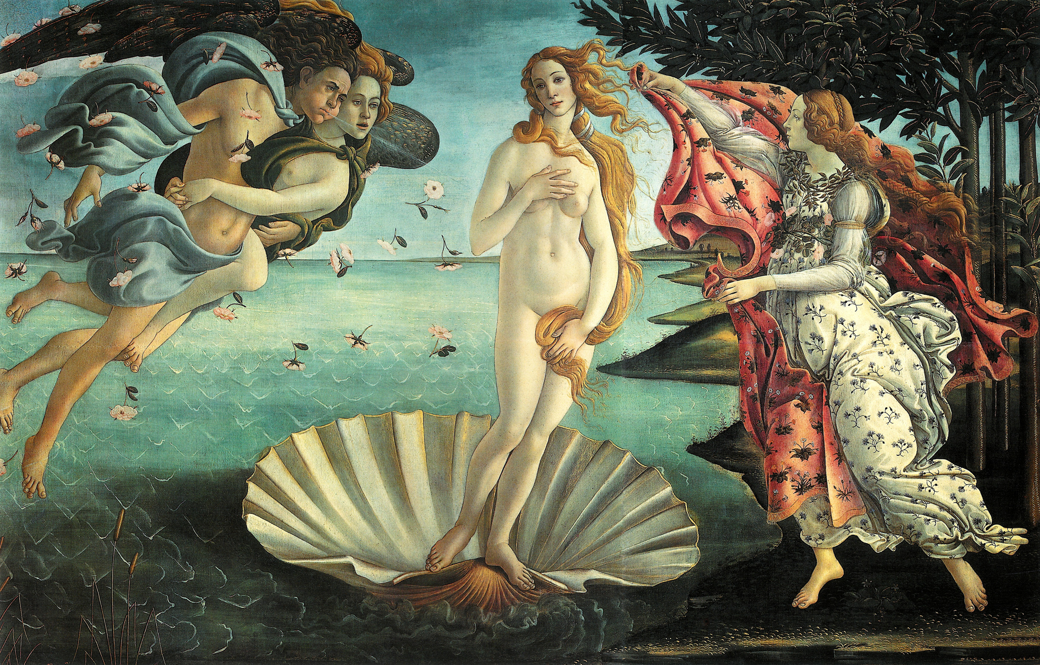
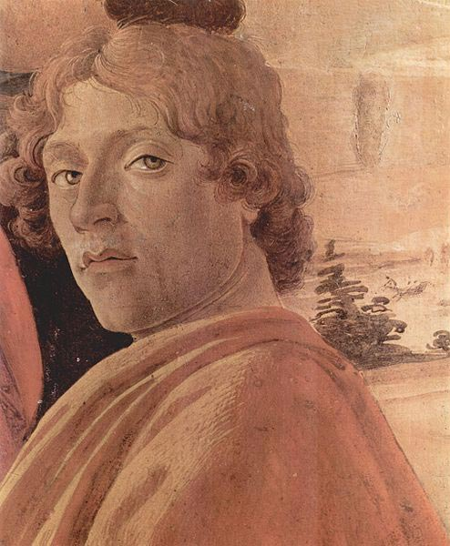
Sandro
Botticelli
“The Birth of Venus”
Notes:
4

Slide 19
Sandro Botticelli 1445–1510)
Italian painter of the Early Renaissance
he suffered from an unrequited love for a married noblewoman and she served as the model for The Birth of Venus despite the fact that she had died years earlier, in 1476
His linear style is emphasized by the soft continual contours and pastel colors

Slide 20
Art Vocab
Unity
The harmony of all visual elements.

Slide 21
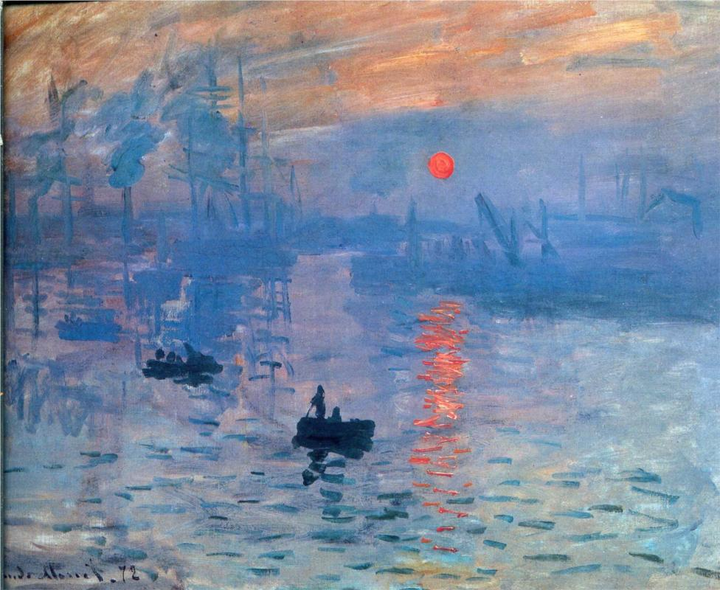
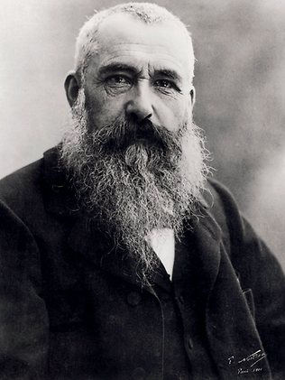
Monet
“Impression,Sunrise”
Notes:
5

Slide 22
Claude Monet 1840 – 1926
founder of French Impressionist painting
The term "Impressionism" is derived from the title of his painting Impression, soleil levant (Impression, Sunrise)
He often painted the same scene many times in order to capture the changing of light and the passing of the seasons

Slide 23
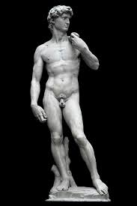
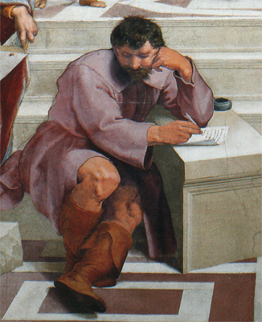
Michelangelo
“David”
Notes:
5

Slide 24
Michelangelo di Lodovico Buonarroti Simoni 1475 – 1564
Italian sculptor, painter, architect, and poet of the High Renaissance
Sculpted “david” before the age of 30
Michelangelo's impassioned and highly personal style resulted in Mannerism (exaggeration of proportion, balance, and ideal beauty)

Slide 25
Art Vocab
Space
Indicates the area above, around, between, below, or within objects.

Slide 26
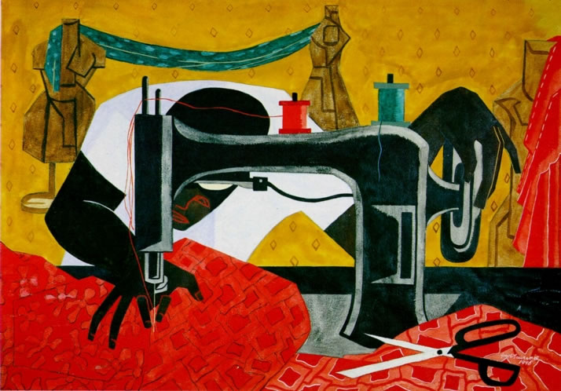
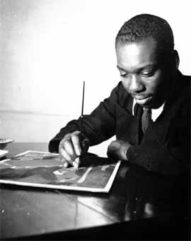
Jacob Lawrence
“The Seamstress”
Notes:
6

Slide 27
Jacob Lawrence 1917 – 2000
African-American painter known for his portrayal of African-American life
Considered his artistic style as “dynamic cubism”
brought the African-American experience to life using blacks and browns juxtaposed with vivid colors

Slide 28
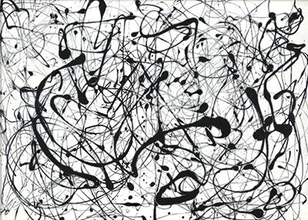
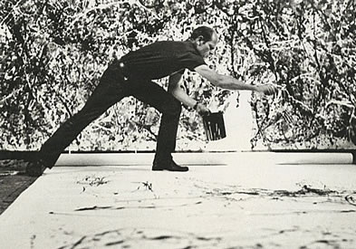
“No 14 Gray”
Jackson Pollack
Notes:
6

Slide 29
Paul Jackson Pollock 1912 – 1956
a major figure in the abstract expressionist movement (spontaneous, automatic, or subconscious creation)
known for his unique style of drip painting.
had a volatile personality, and struggled with alcoholism for most of his life
died at the age of 44 in an alcohol-related single-car accident when he was driving

Slide 30
Art Vocab
Texture
The way things look or feel if they might be touched.

Slide 31
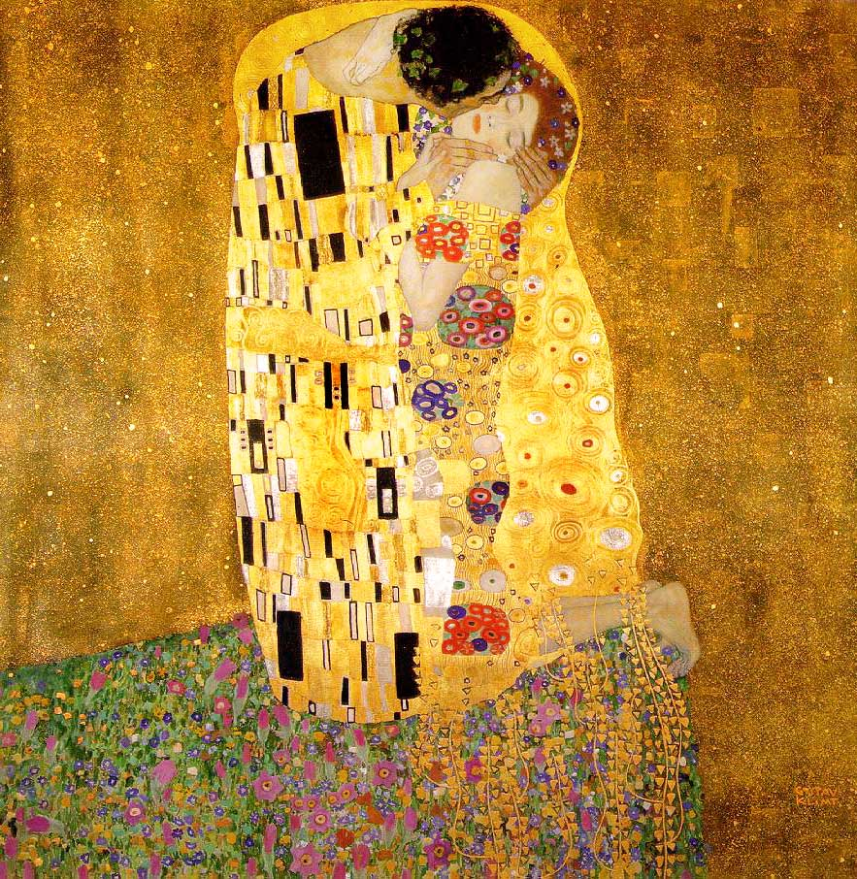
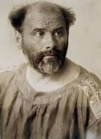
Gustav Klimt
“The Kiss”
Notes:
7

Slide 32
Gustav Klimt 1862 –1918
Austrian symbolist painter. Symbolist- French artists of the late 1800s who rejected realism and used symbols to evoke ideas and emotions.
Influenced by Japanese art and its methods.
Late in his career he went through a "golden phase", in which many of his works include gold leaf
Klimt's work was an important influence on his younger contemporary Egon Schiele

Slide 33
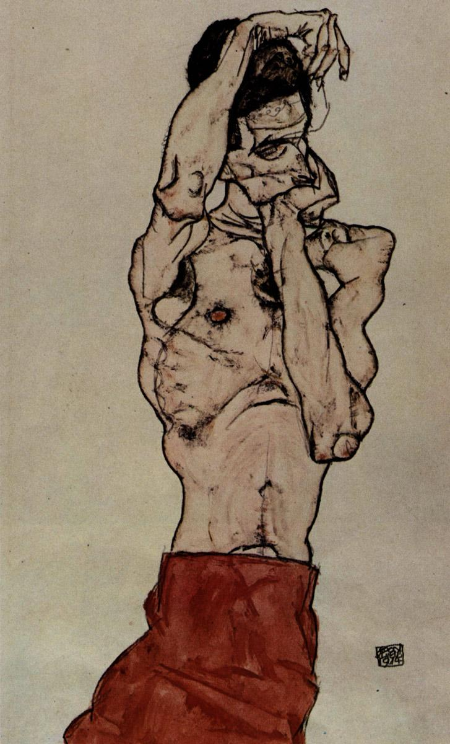
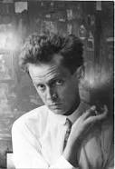
Egon Schille
Notes:
7

Slide 34
Egon Schiele 1890 –1918
Austrian painter
Studied under Gustav Klimt
His work is noted for its intensity and its sexuality, and the many self-portraits the artist produced, including naked self-portraits.
Many of his paintings featured figurative distortions, that included elongations, deformities

Slide 35
Art Vocab
Balance
The equilibrium of various elements in a composition.
Symmetrical- equal balance on each side of an imaginary middle line.
Asymmetrical- Un-equal distribution on each side of an imaginary middle line.

Slide 36
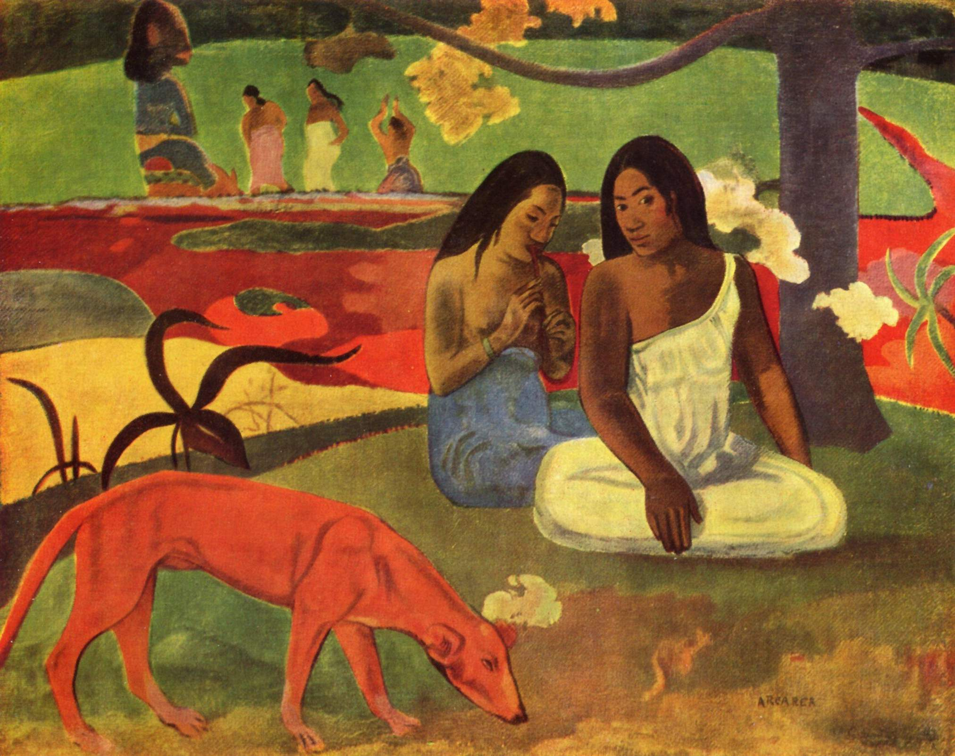
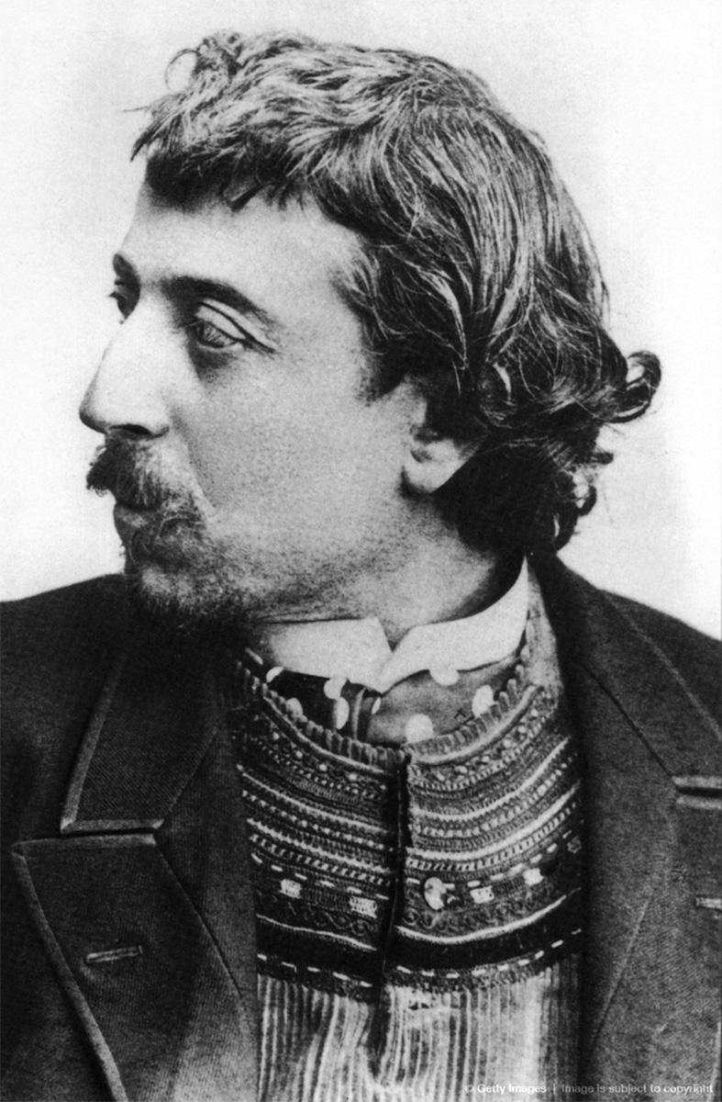
Paul Gauguin
“Arearea” Translation: joyousness
Notes:
8

Slide 37
Henri Paul Gauguin 1848 – 1903
French post-Impressionist artist
recognized for his experimental use of color and synthetist style that were distinctly different from Impressionism
spent approximately 6 months on the island of Martinique in 1887
Completed 11 known paintings during his stay in Martinique

Slide 38
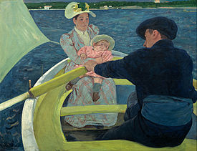
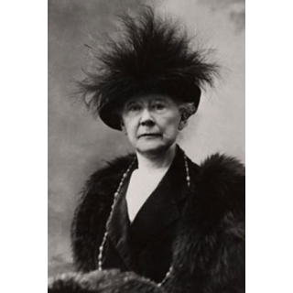
Mary Cassatt
“The Boating Party”
Notes:
8

Slide 39
Mary Stevenson Cassatt 1844 – 1926
American painter and printmaker, but spent much of her life in France
Cassatt often created images of the social and private lives of women
She often emphasized the intimate bonds between mothers and children.

Slide 40
Art Vocab
Shape
An enclosed space defined by other art elements.

Slide 41
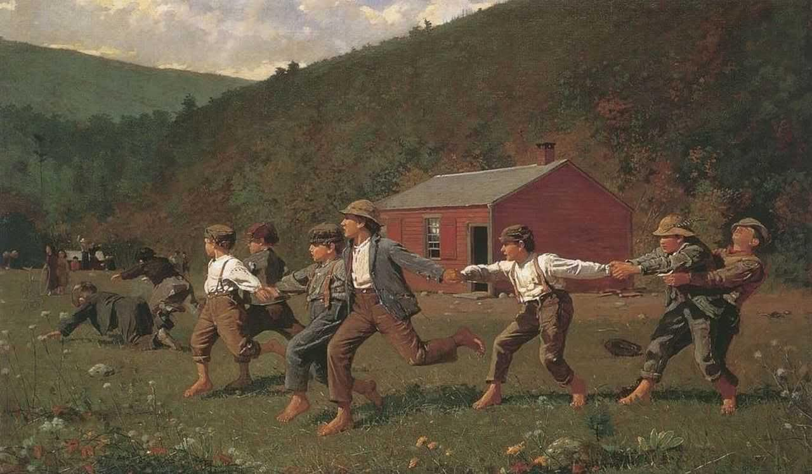
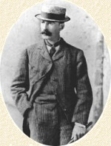
Windslow Homer
“Crack the Whip”
Notes:
9

Slide 42
Winslow Homer 1836 –1910
American landscape painter and printmaker
Largely self-taught, Homer began his career working as a commercial illustrator
His work is characterized by clean outlines, simplified forms, dramatic contrast of light and dark
Homer believed that artists "should never look at pictures" but should "stutter in a language of their own."

Slide 43
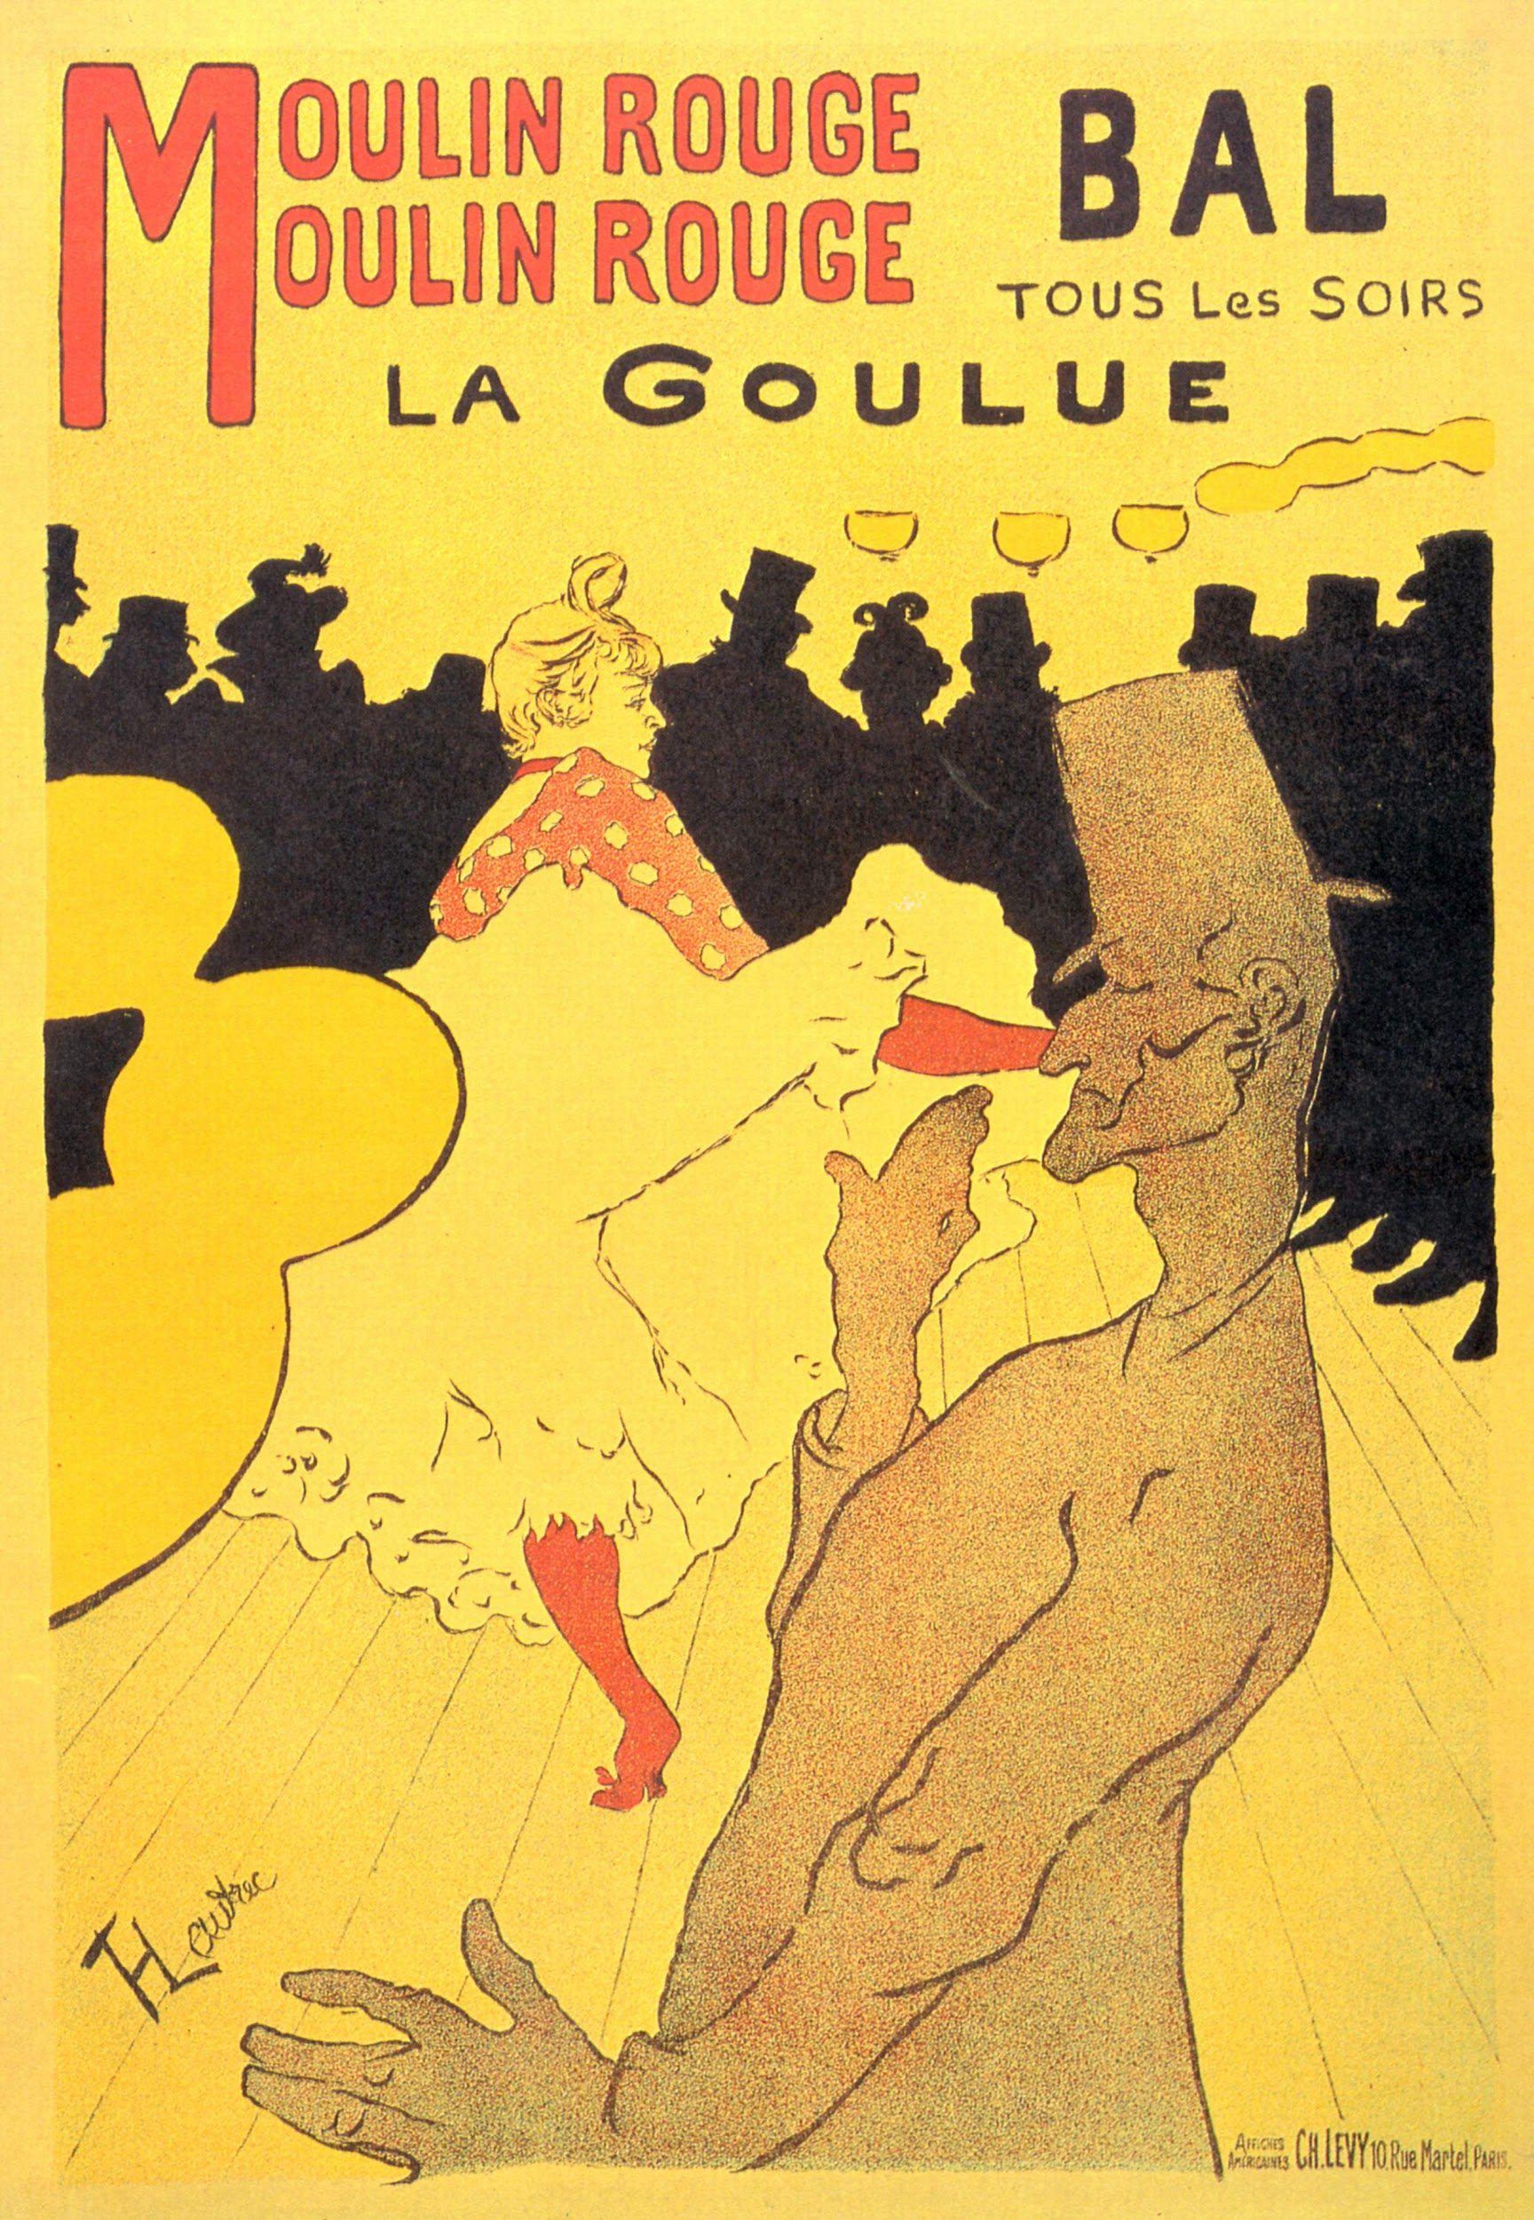
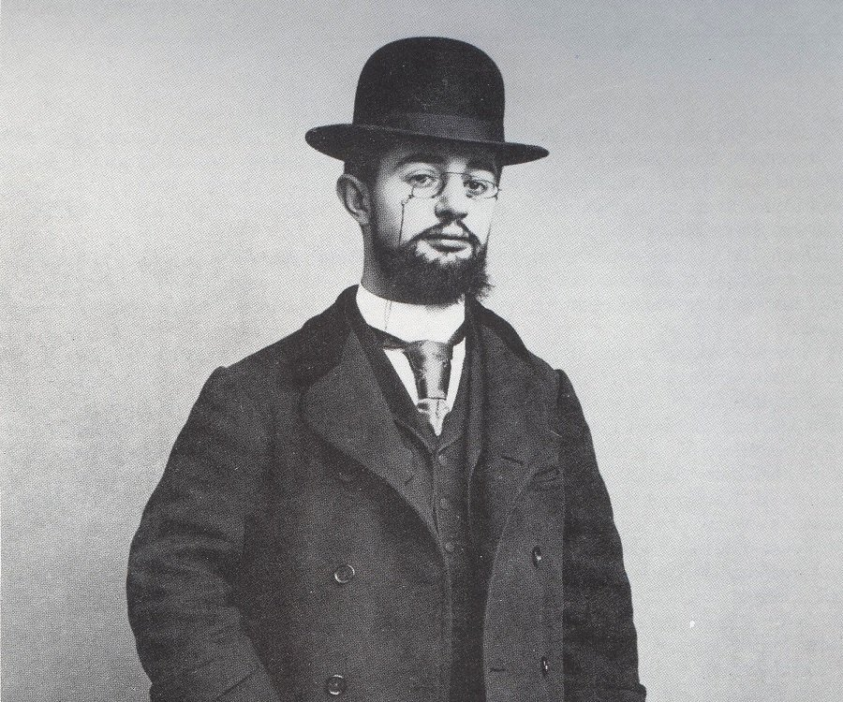
“Moulin Rouge”
Toulouse Lautrec
Notes:
9

Slide 44
Henri Toulouse-Lautrec 1864 1901
French painter, printmaker, and illustrator immersed in the colourful and theatrical life of Paris in the late 19th century
Produced a collection of enticing, elegant, and provocative images of the modern, sometimes decadent, French life
Fascinated by the lifestyle of the "urban underclass" and incorporated those characters into his paintings
He was mocked for his short stature and physical appearance, which led him to drown his sorrows in alcohol

Slide 45
Art Vocab
Proportion
The relationship of all parts of a composition to each other and to the whole design.

Slide 46
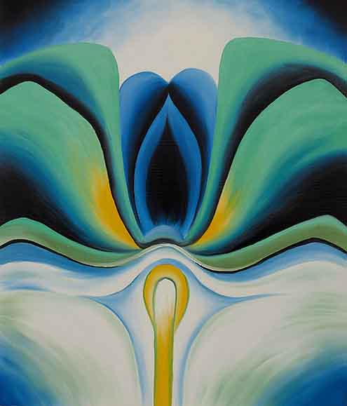
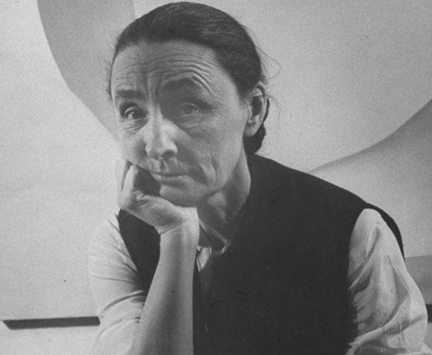
Georgia Okeefe
“Blue Flowers”
Notes:
10

Slide 47
Georgia Totto O'Keeffe 1887 – 1986
American artist.
Best known for her paintings of enlarged flowers, New York skyscrapers, and New Mexico landscapes
Her explanation of enlarging: "it is only by selection, by elimination, and by emphasis that we get at the real meaning of things."
magnified depictions of objects imbued a sense of awe and emotional intensity

Slide 48
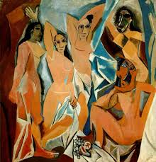
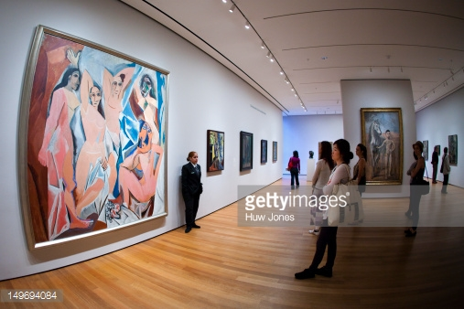
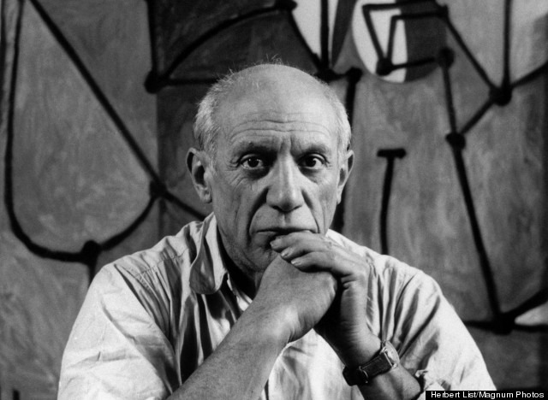
“Les Demoiselles D'Avignon”
Pablo Picasso
Notes:
10

Slide 49
Pablo Picasso 1881 – 1973)
Spanish painter, sculptor, printmaker, ceramicist, stage designer, poet and playwright who spent most of his adult life in France.
known for co-founding the Cubist movement
Picasso demonstrated extraordinary artistic talent in his early years, painting in a naturalistic manner (realism)
his style changed as he experimented with different theories, techniques, and ideas
Henri Matisse motivated Picasso to explore more radical styles which led to his creation of Cubism
Cubism: objects are analyzed, broken up and reassembled in an abstracted form and viewed from a multitude of viewpoints to represent the subject in a greater context.

Slide 50
Art Vocab
Emphasis
Center of interest which draws the eye.

Slide 51
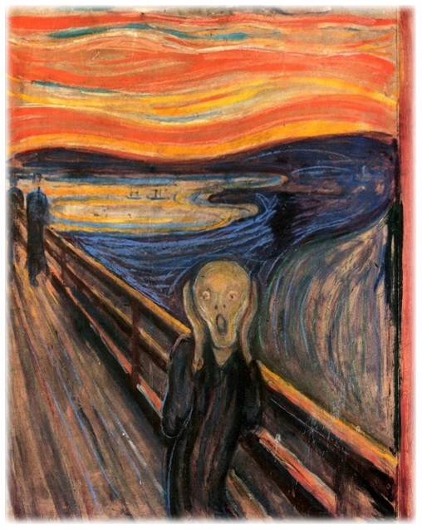
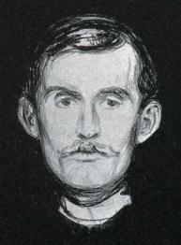
Edvard Munch
“The Scream”
Notes:
11

Slide 52
Edvard Munch 1863-1944
Norwegian expressionist painter and printmaker
Mother died young and Munch was raised by his father
Father instilled a deep rooted fear in Munch by telling him that if he sinned in any way he would be doomed to hell
This resulted in various forms of mental illness in Munch and his siblings
“Sickness, insanity, and death were the angels that surrounded my cradle and have followed me throughout my life”

Slide 53
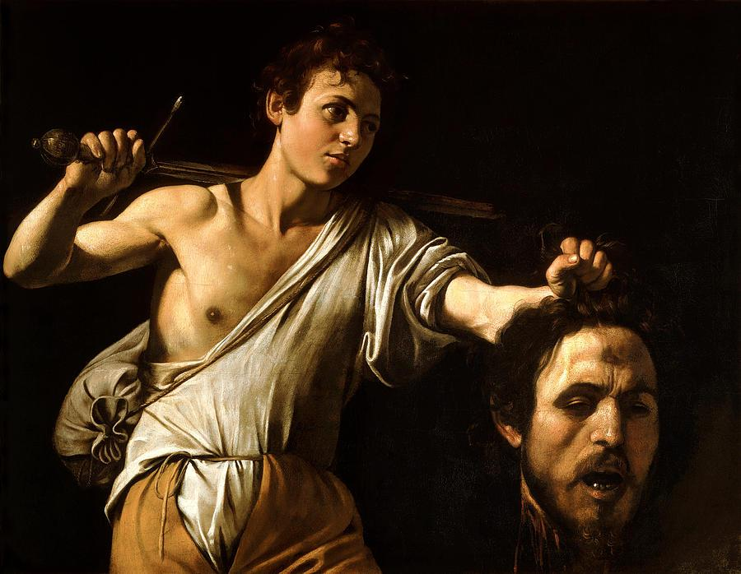
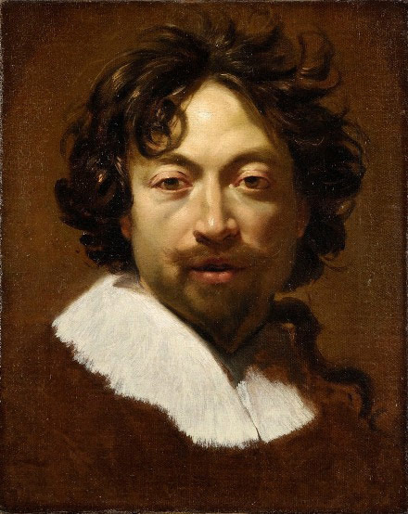
Caravaggio
“David and Goliath”
Notes:
11

Slide 54
Caravaggio 1571 – 1610
Caravaggio scorned traditional idealized interpretation of religious subjects
Often chose subjects that are susceptible to a dramatic or violent emphasis
Took his models from the streets, plain working men, and painted them realistically.
Often included himself in his paintings (Goliath)
He used a lantern hung to one side of his shuttered studio while painting his models
The dramatic illumination heightens the emotional tension, focuses the details, and isolates the figures

Slide 55
Art Vocab
Rhythm
Repeated use of similar elements and is the smooth transition from one part to another.

Slide 56
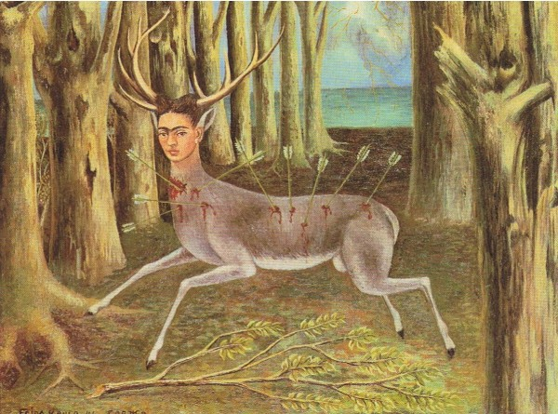
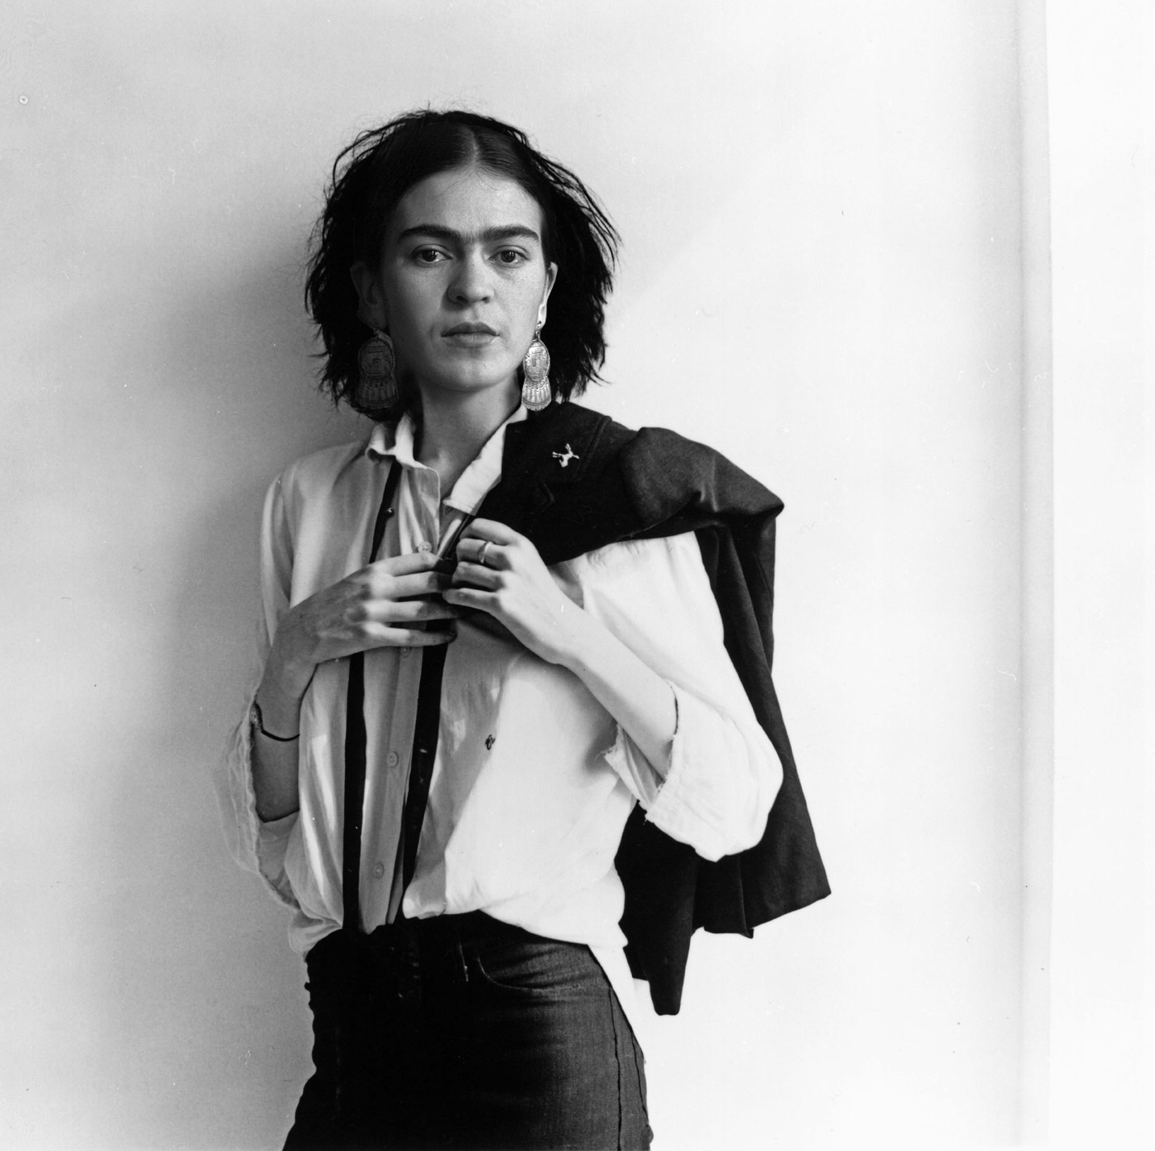
Frida Khalo
Pobre venadito
Poor Little Deer
Notes:
12

Slide 57
Frida Kahlo de Rivera 1907 – 1954
·Mexican painter of the indigenous culture of her country
·Her style combined realism, Symbolism, and Surrealism
·She suffered extreme back and leg pain the majority of her life due to a trolley accident
·She was often confined to her bed for months
·Much of her art is a reflection of the life she led and
the suffering she endured

Slide 58
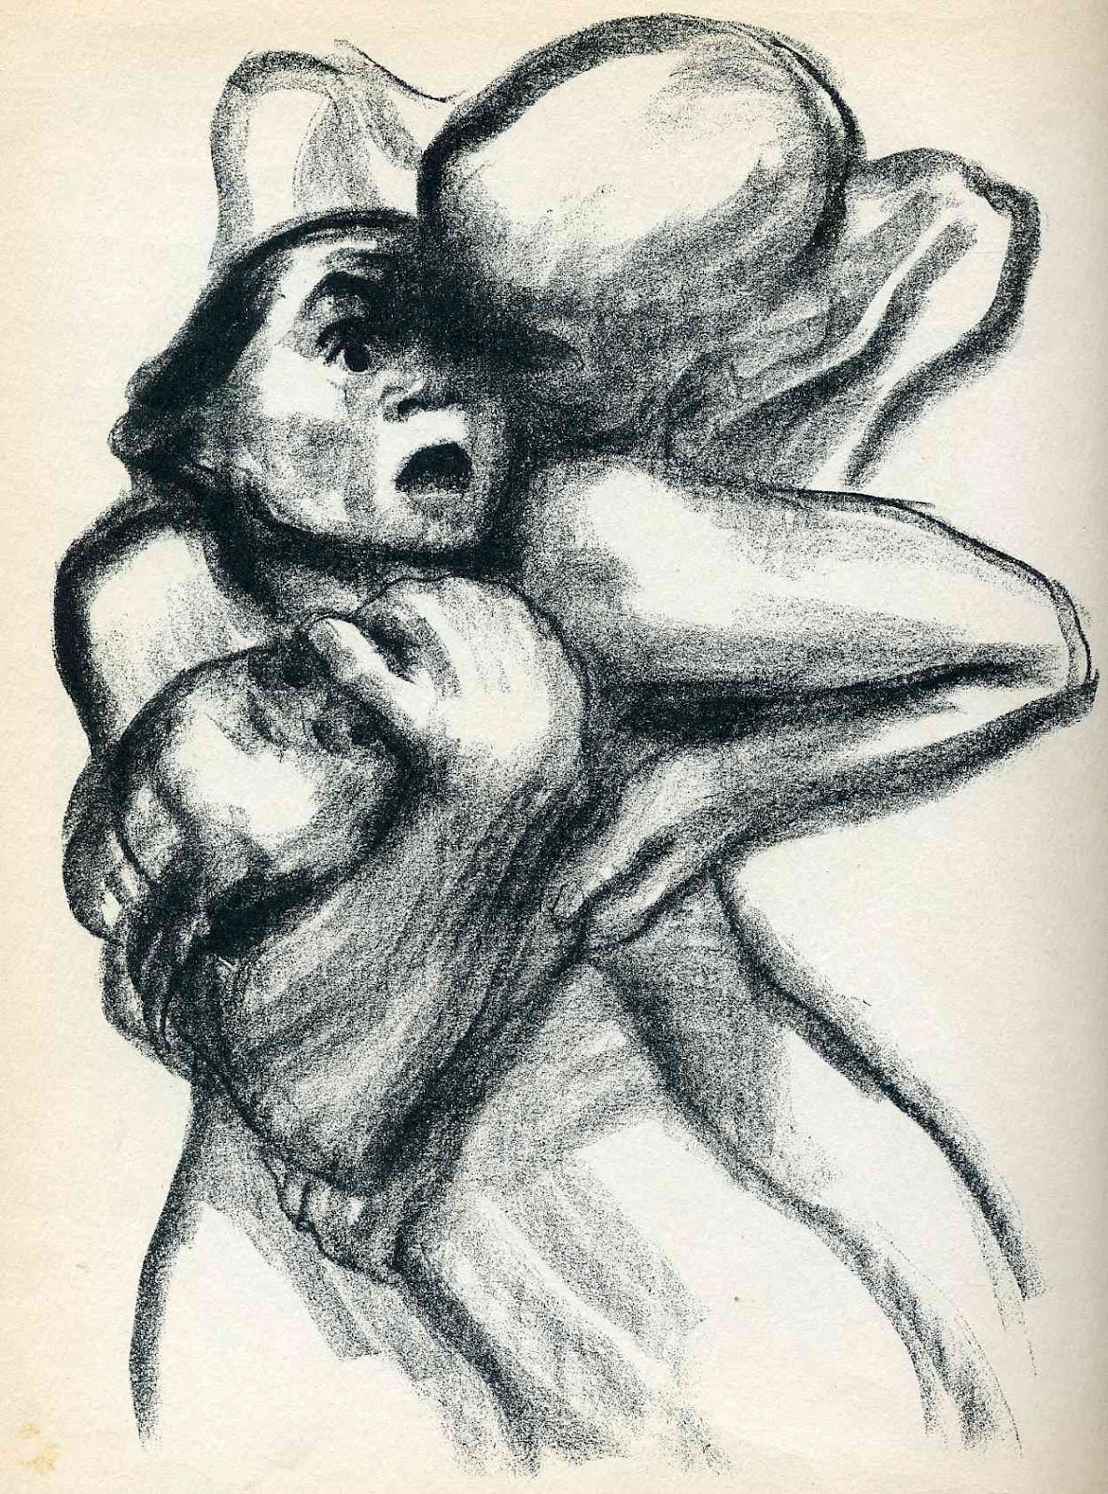
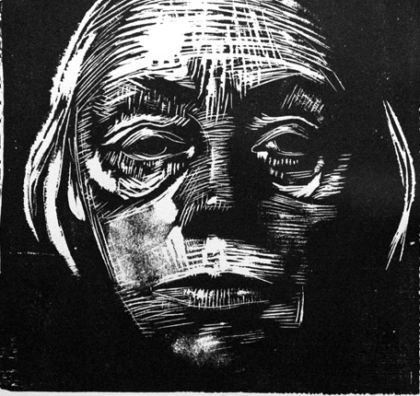
Kathe Kollwitz
“Death Seizing a Woman”
Notes:
12

Slide 59
Käthe (Schmidt) Kollwitz 1867 – 1945
German artist, who worked with drawing, etching, lithography, woodcuts, painting, printmaking, and sculpture
Much of her work depicts the effects of poverty, hunger, and war on the working class
As a doctor’s wife living in a poor Berlin neighborhood, she witnessed daily the pain of distressed families and the plight of working class women

Slide 60
Art Vocab
Repetition
The use of line, shape, color, or motif in more than one place in a composition.

Slide 61
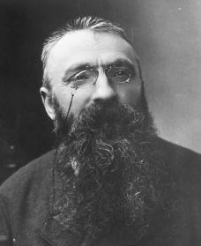
Auguste Rodin
“The Thinker”
Notes:
13

Slide 62
Auguste Rodin 1840 –1917
French sculptor who is considered the originator of modern sculpture
Rodin possessed a unique ability to model a complex deeply pocketed surface in clay.
His most original work departed from traditional themes of mythology and allegory
He modeled the human body with realism and celebrated individual character
Often oversized the hands in his work to prove his abilities

Slide 63
Salvador Dali
“Rose Meditative”
Notes:
13

Slide 64
Salvador Dalí 1904 – 1989
Prominent Spanish surrealist painter
Surrealism: Dream-like imagery with unnerving illogical scenes painted with photographic precision that allow the unconscious to express itself
highly imaginative, and also enjoyed indulging in unusual and grandiose behavior
He used both classical and modernist painting techniques
Dalí grew a flamboyant moustache, influenced by 17th-century Spanish master painter Diego Velázquez. The moustache became an iconic trademark of his appearance for the rest of his life.

Slide 65
Art Vocab
Contrast
Shows the differences between the elements of art (line, color, texture, space, shape).

Slide 66
Grant Wood
“American Gothic”
Sister and Dentist
Notes:
14

Slide 67
Grant Wood 1891 – 1942
Painting was inspired by Gothic revival style cottage he saw in Eldon, Iowa
Gothic style is indicated by the pointed arch style window in the painting
He asked his sister and his dentist to pose as a “farmer and his unmarried daughter”
The highly detailed style and rigid frontal arrangement were inspired by northern renaissance art
Notes:
Ira we have 14 weeks of handouts in here

Slide 68
Art Vocab
Variety
Differences in line, shape, value, and/or scale that give interest to a composition.

