Slide 1
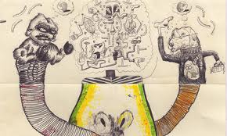
The Exquisite Corpse was Buried in Compost
a project about change and collaboration

Slide 2
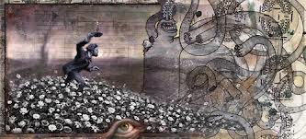
Objective: Students will collaborate to create artwork that pushes the boundaries of creativity and their inner being. Students will visually represent a change through visual art.

Slide 3
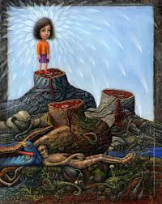

Slide 4
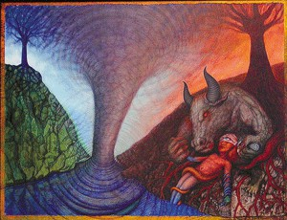

Slide 5
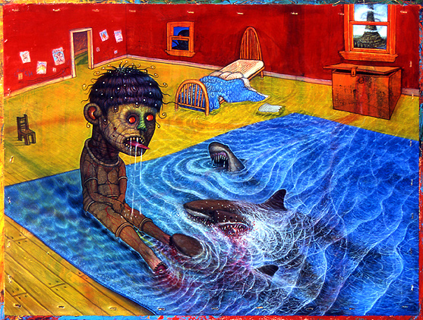

Slide 6
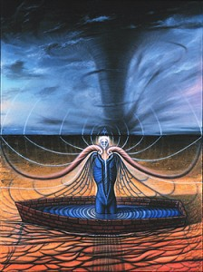

Slide 7
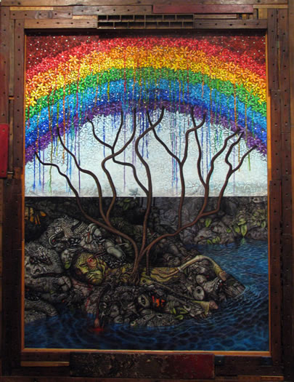
Requirements:
1. final design must have 2 obvious visual zones (ex. Sky and ground)
2. Change must be an obvious theme
3. Collaboration must be evident
4. must combine 2 or more forms of media (ex. pen and watercolor)

Slide 8
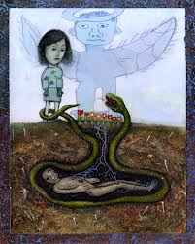
Step 1: Collaborate
Partners will be assigned.
Trade Sketchbooks and fill 3-5 pages with things you like.
( drawings, sketches, magazine images, etc.)
Return sketchbooks
Incorporate at least one item from collaborator into your work.

Slide 9
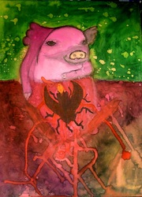
Step 2: Create
Create a work of art that illustrates a form of change. The change can be good, bad, happy, or sad.
Incorporate at least 1 image/item from your collaborator (sketchbook sharing)
Remember:
2 visual zones
collaboration
2 or more media types
obvious form of change

Slide 10
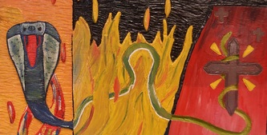

Slide 11
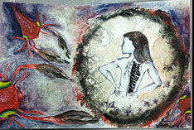

Slide 12
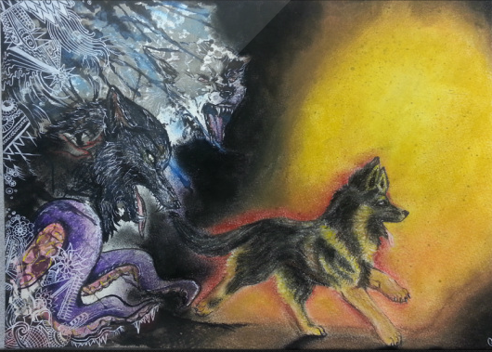

Slide 13
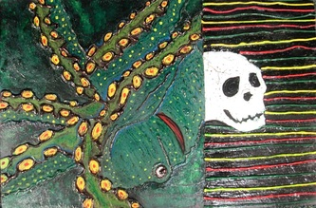

Slide 14
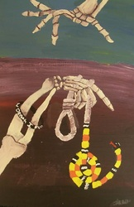

Slide 15
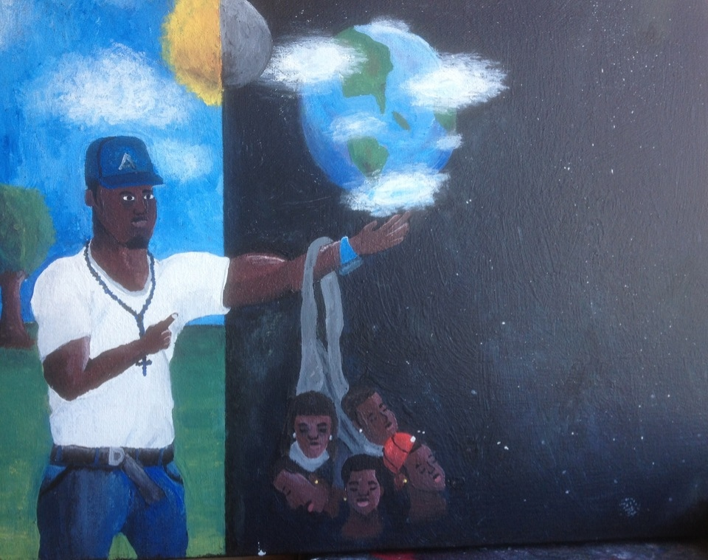

Slide 16
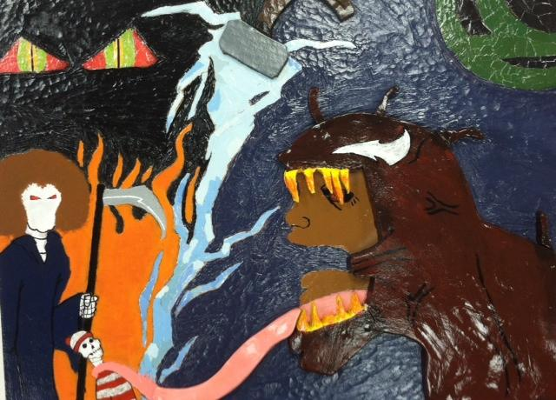

Slide 17
