Slide 1
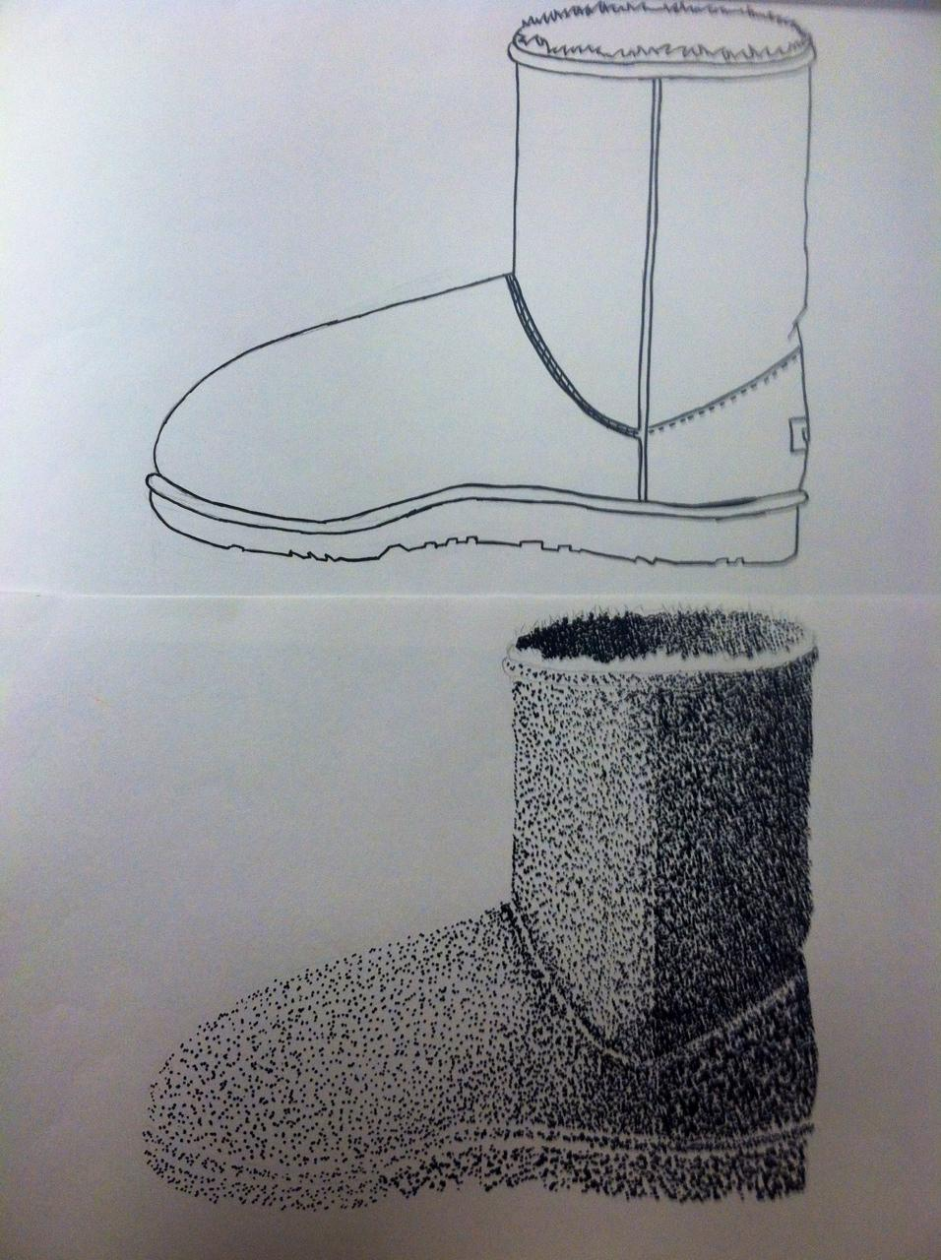
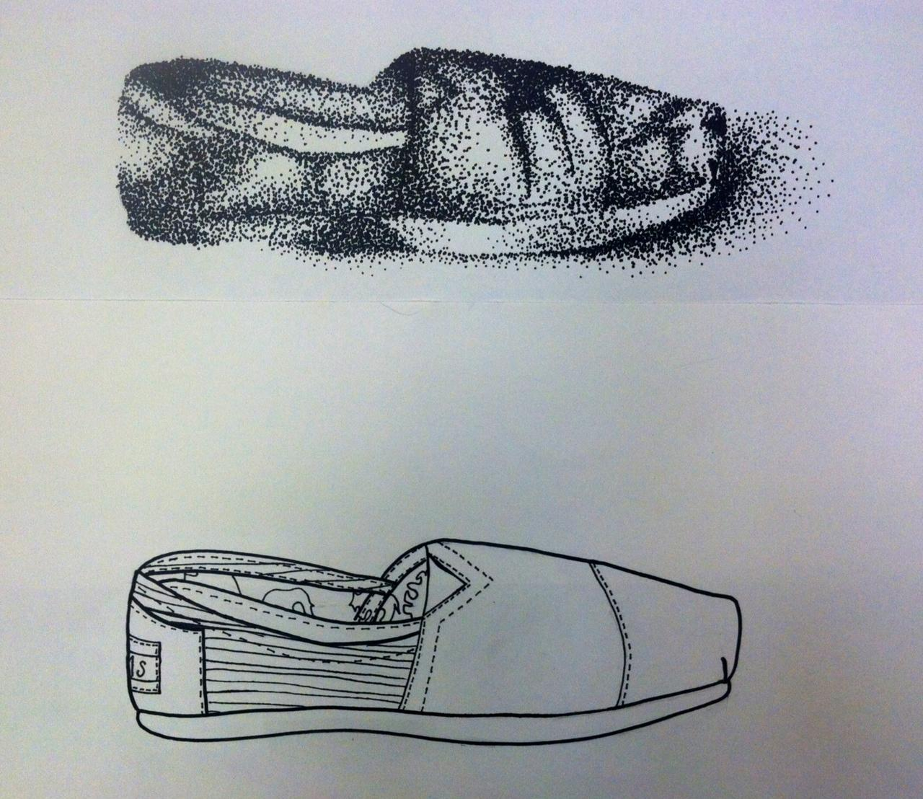
Contour Stippled Shoes
Art I

Slide 2
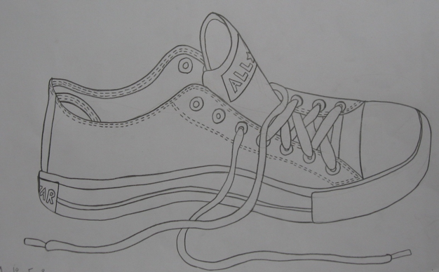
PART ONE - CONTOUR SHOES

Slide 3
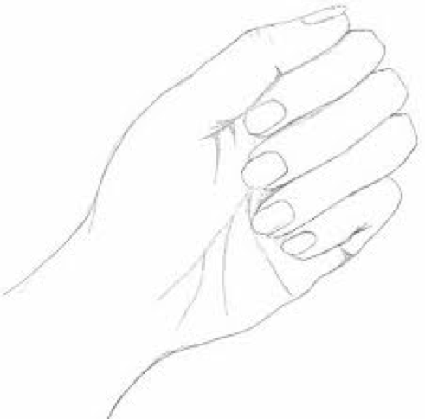
What is Contour Drawing?
Contour Drawing: A Drawing which is composed of only line, shows the outline/edges of the subject.

Slide 4
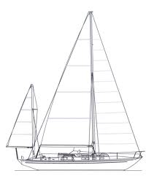
Examples

Slide 5
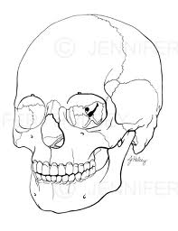
Examples

Slide 6
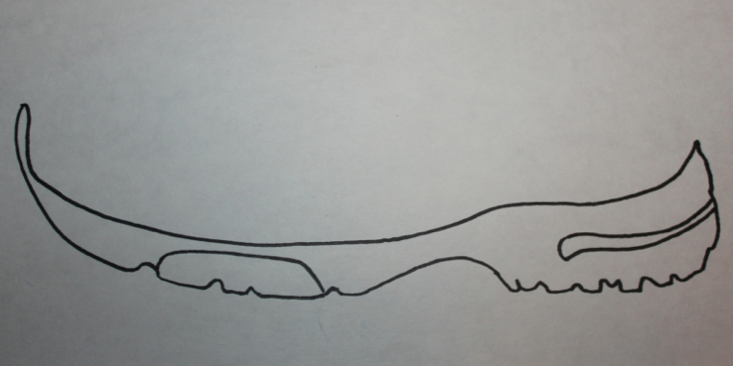
Begin by drawing the foundation of the shoe

Slide 7
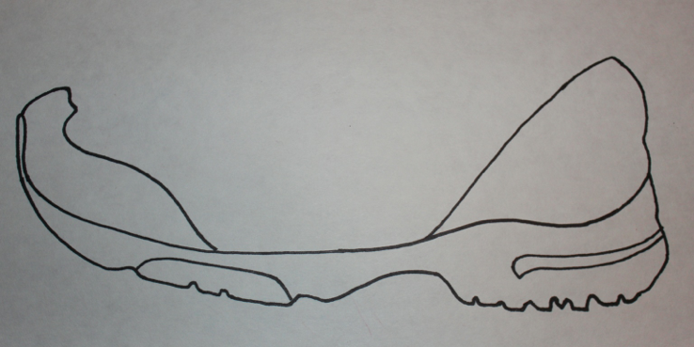
Then add the toe and back of the shoe

Slide 8
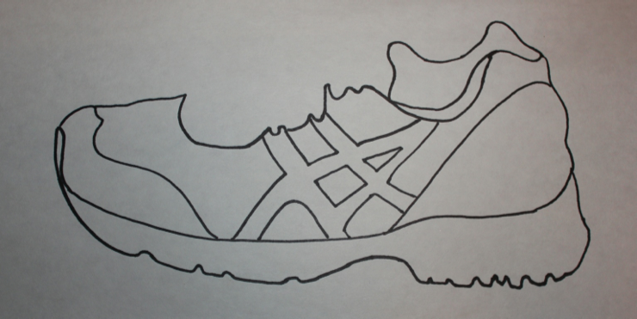
Then add the toe and back of the shoe

Slide 9
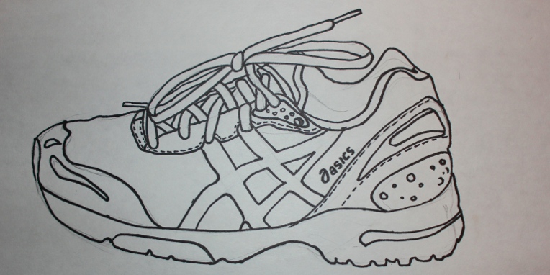
Finish up by adding the laces and shoe details

Slide 10
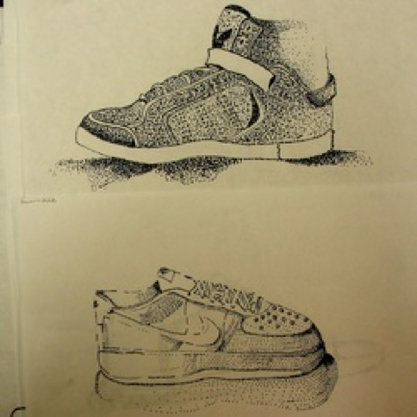
PART 2
PART 2- STIPPLED SHOES

Slide 11
Stippling: A technique of drawing which uses a series of dots to create the image and demonstrate value.
What is stippling?

Slide 12
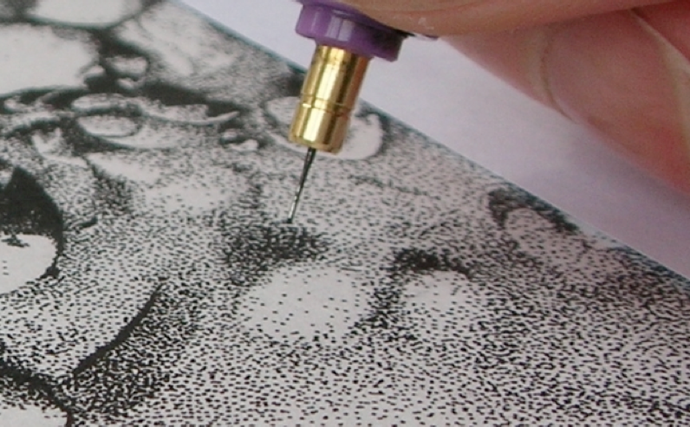

Slide 13
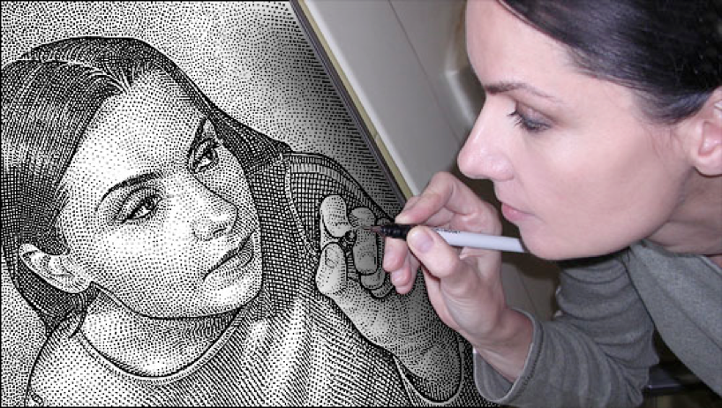

Slide 14
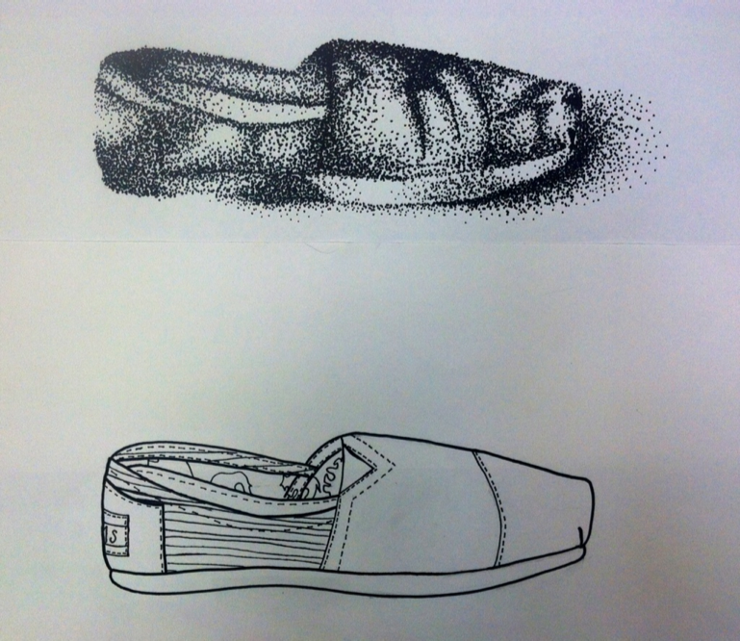

Slide 15
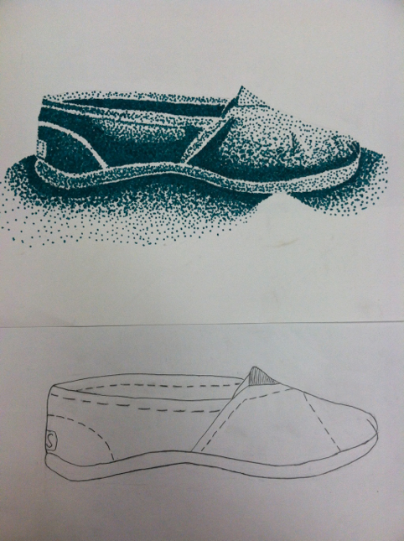

Slide 17
FInished Product
Your should have 2 shoe drawings on 2 separate sheets of paper when completed:
Contour Shoe Drawing
Stippled Shoe Rendering

