Slide 1
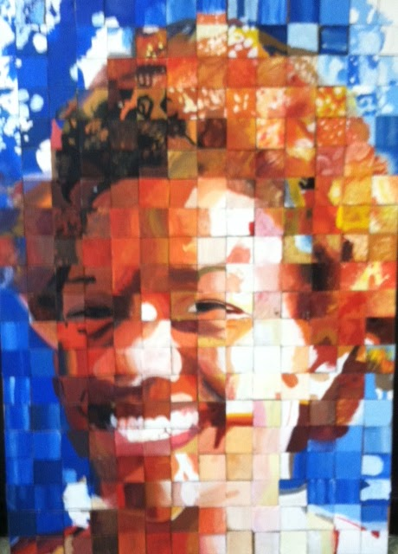
Collaborative Mural
Art 1

Slide 2
During this project you will
- master color mixing
- learn different painting techniques
- gain a better understanding of proportion
- work together to create a piece of art

Slide 3
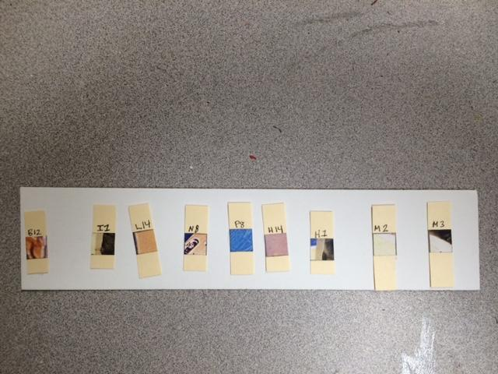
STEP ONE
Get a 9 card strip and write your name on it

Slide 4
What is the image going to be???

Slide 5
paint your cards to find out !!!!

Slide 6
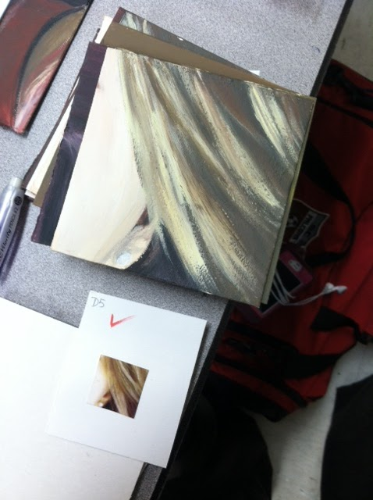
STEP TWO
Paint the tiny card exactly as you see it on a 4 inch card

Slide 7
No pencil……...just paint

Slide 8
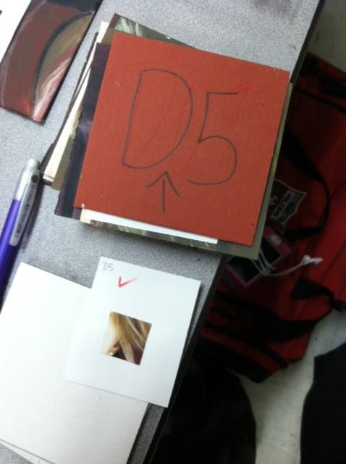
STEP THREE
Carefully write the code on the back (make sure it is turned the correct way)

Slide 9
STEP FOUR
After you have painted all your cards on your strip, have it checked by your teacher

Slide 10
Finished cards will be glued to a large
grid to reveal image

Slide 11
How will I be graded?
1 Project Grade - Whole Class Painting
To receive the whole class grade, students must turn in tiny card strips with all small cards still attached
Missing or incomplete cards= -5 points per card (per student)

