Slide 1
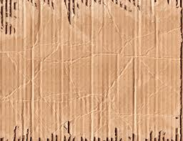
Cardboard Relief
introduction to sculpture

Slide 2
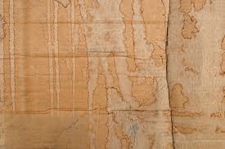
During this project you will
Explore three dimensional art in the form of relief
Fully understand Foreshortening
Plan ahead to create an interesting composition
Continue to build upon prior knowledge of paint mixing and color theory

Slide 3
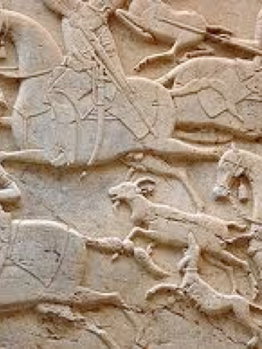
What is Relief?
Relief is a sculptural technique in which sections of a surface have been raised from the background plane, usually by carving away at the negative space.

Slide 4
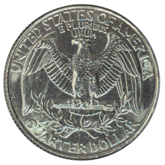
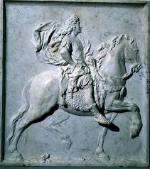
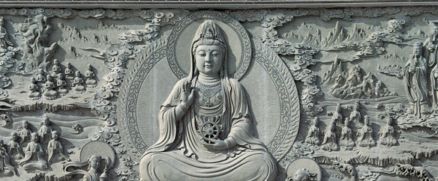
Examples of Reliefs

Slide 5
What is Foreshortening?

Slide 6
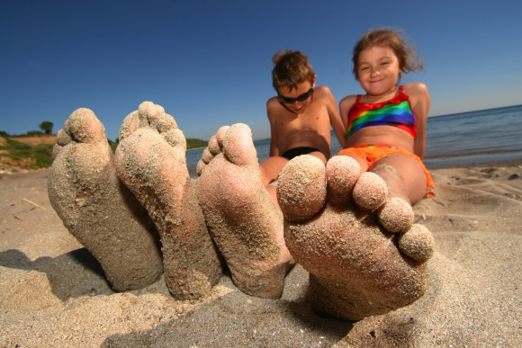

Slide 9
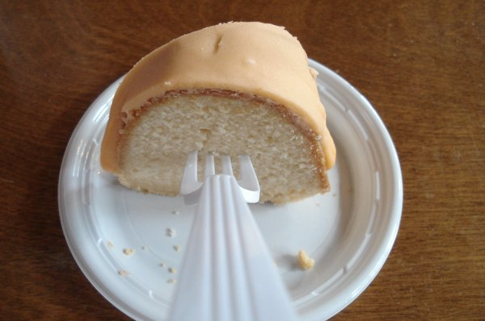

Slide 10
Cardboard Relief Criteria:
Must demonstrate EXTREME Foreshortening
Must have multiple layers (to create relief effect)
Must demonstrate good craftsmanship
Must be awesome and original (not cliche’)

Slide 11
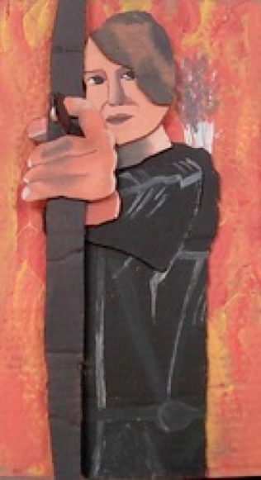
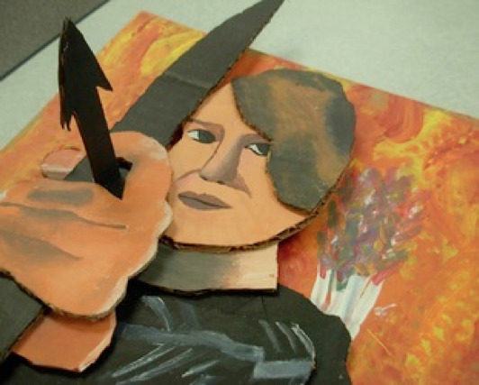
Examples

Slide 12
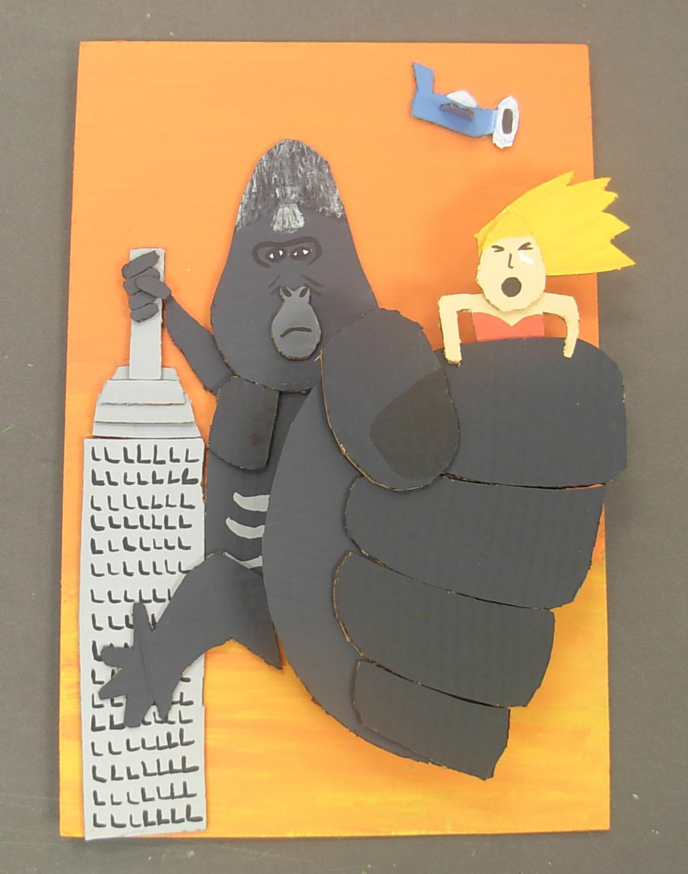

Slide 13
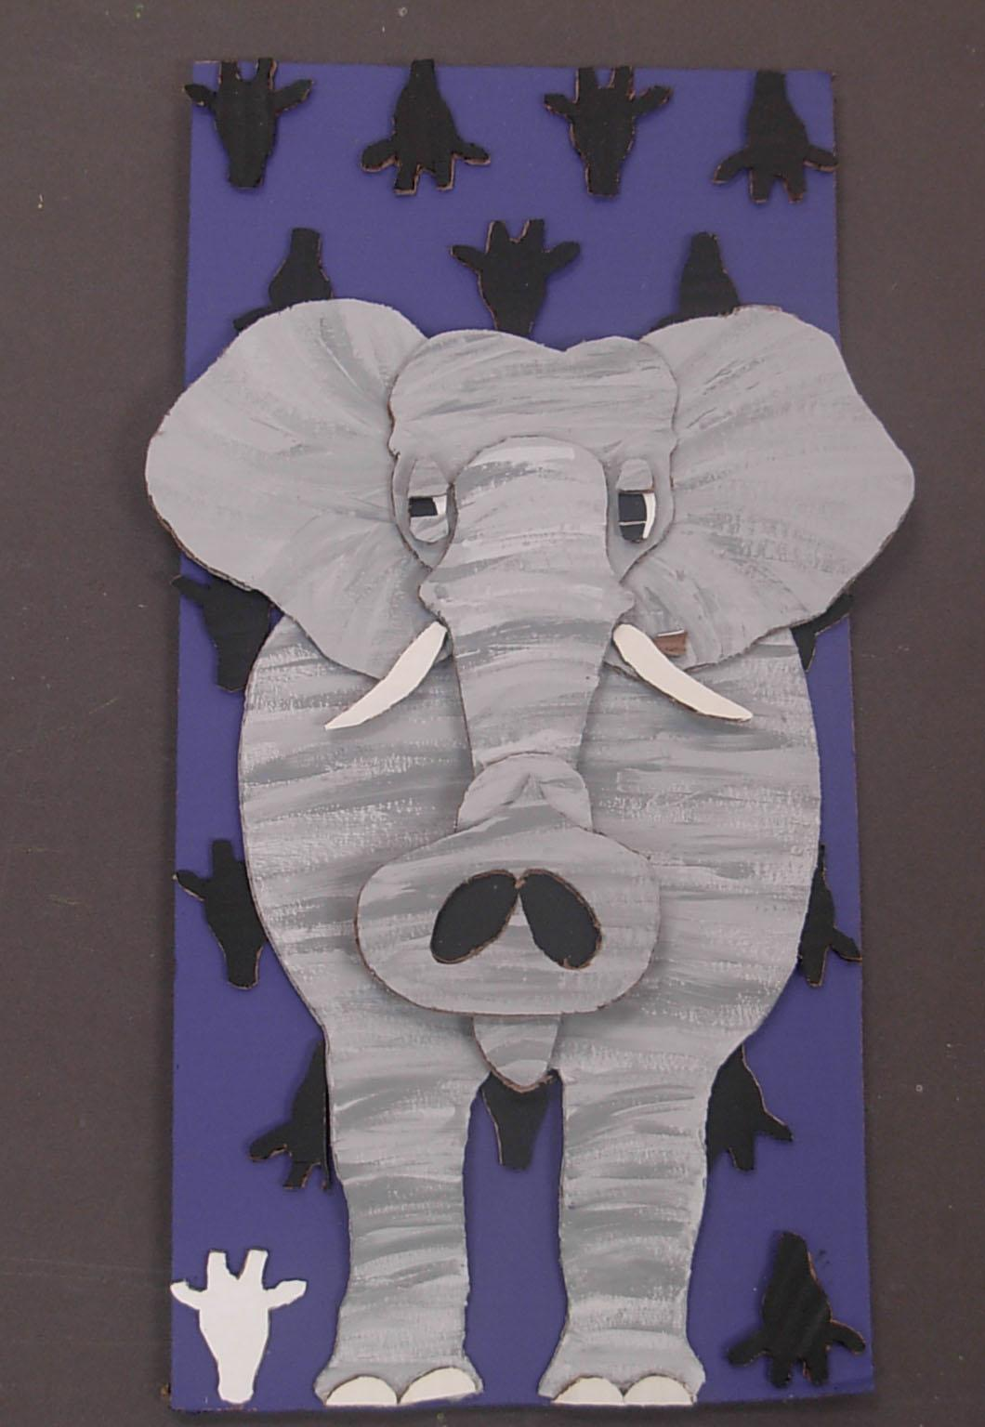

Slide 14
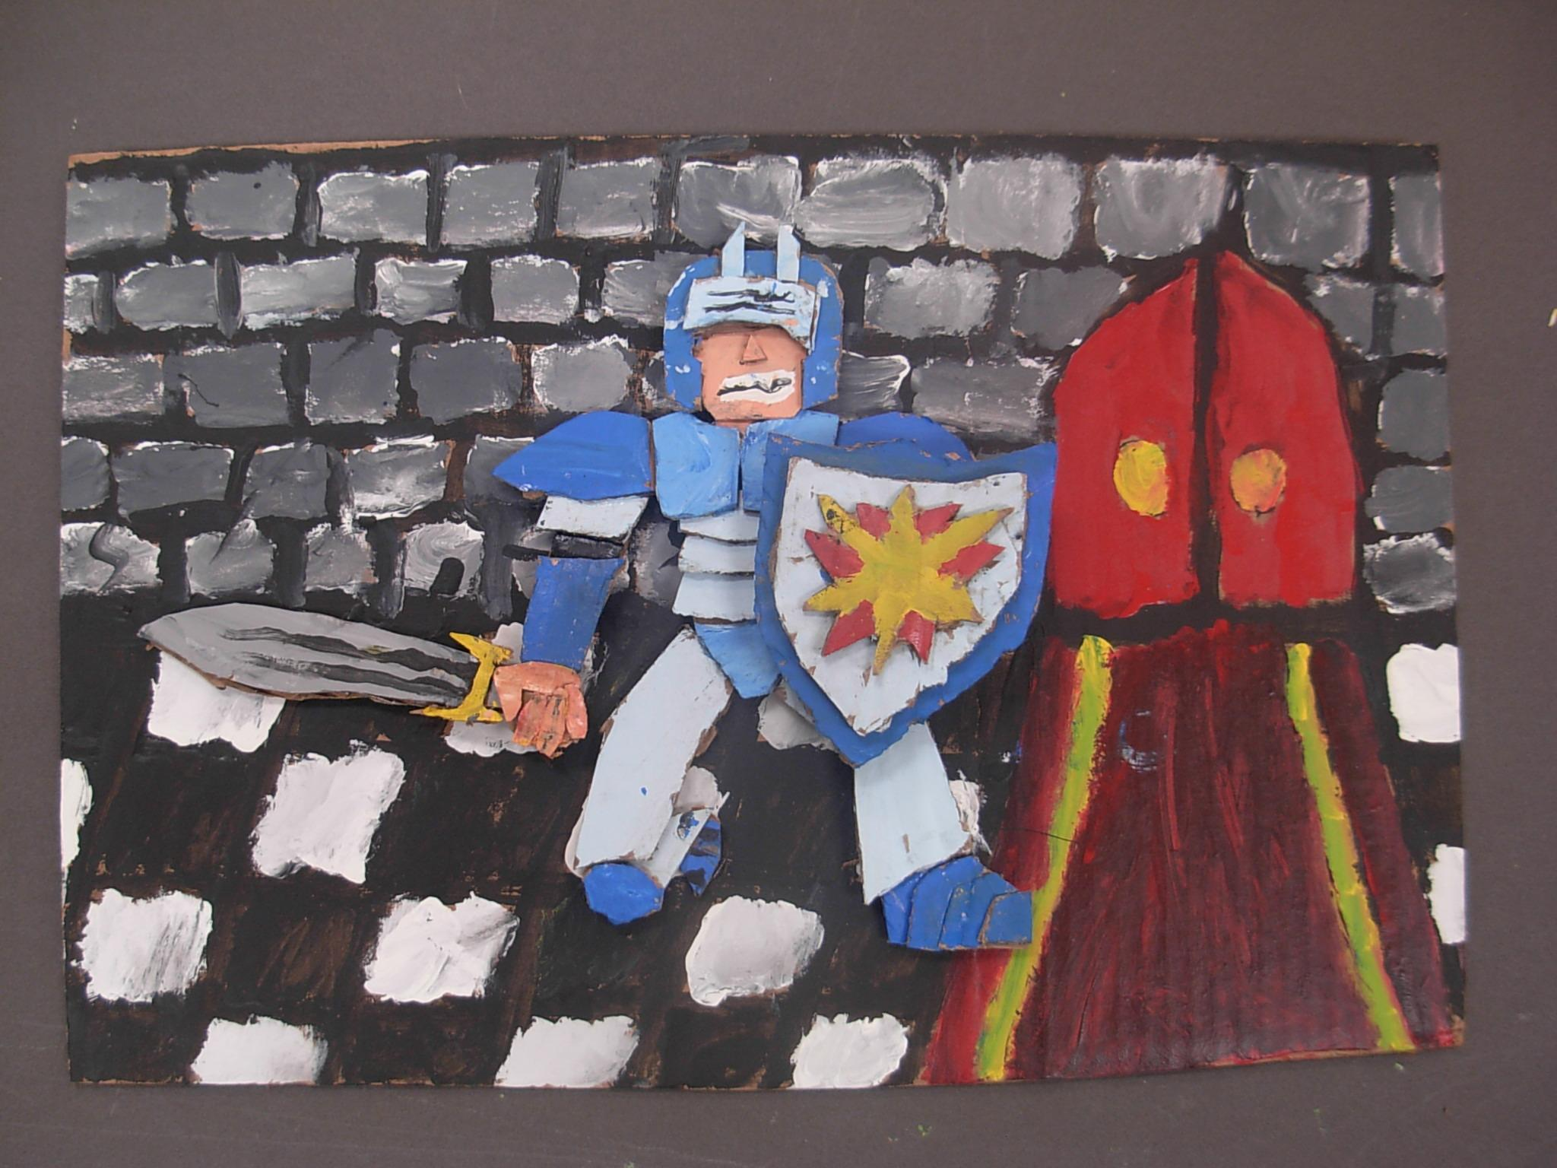

Slide 15
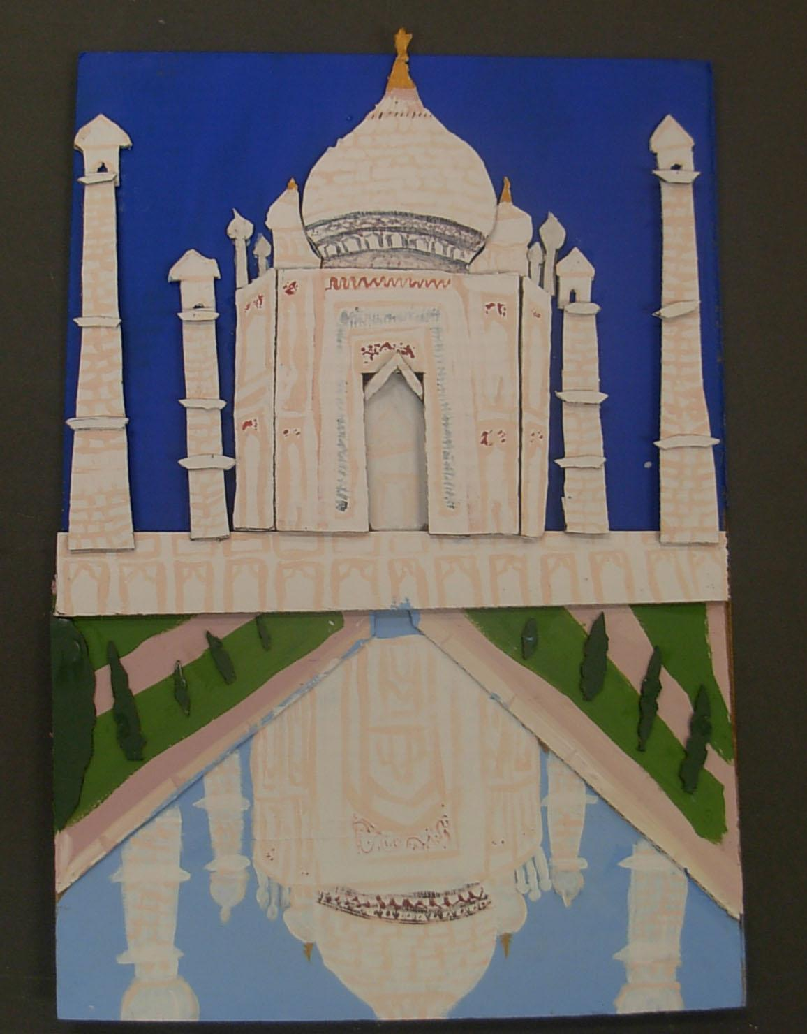

Slide 16
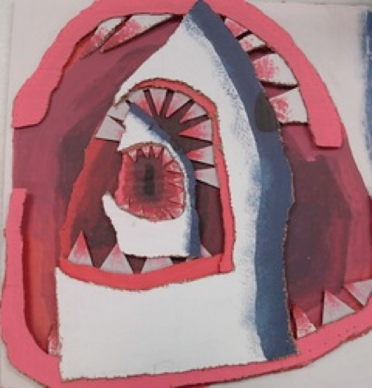

Slide 17
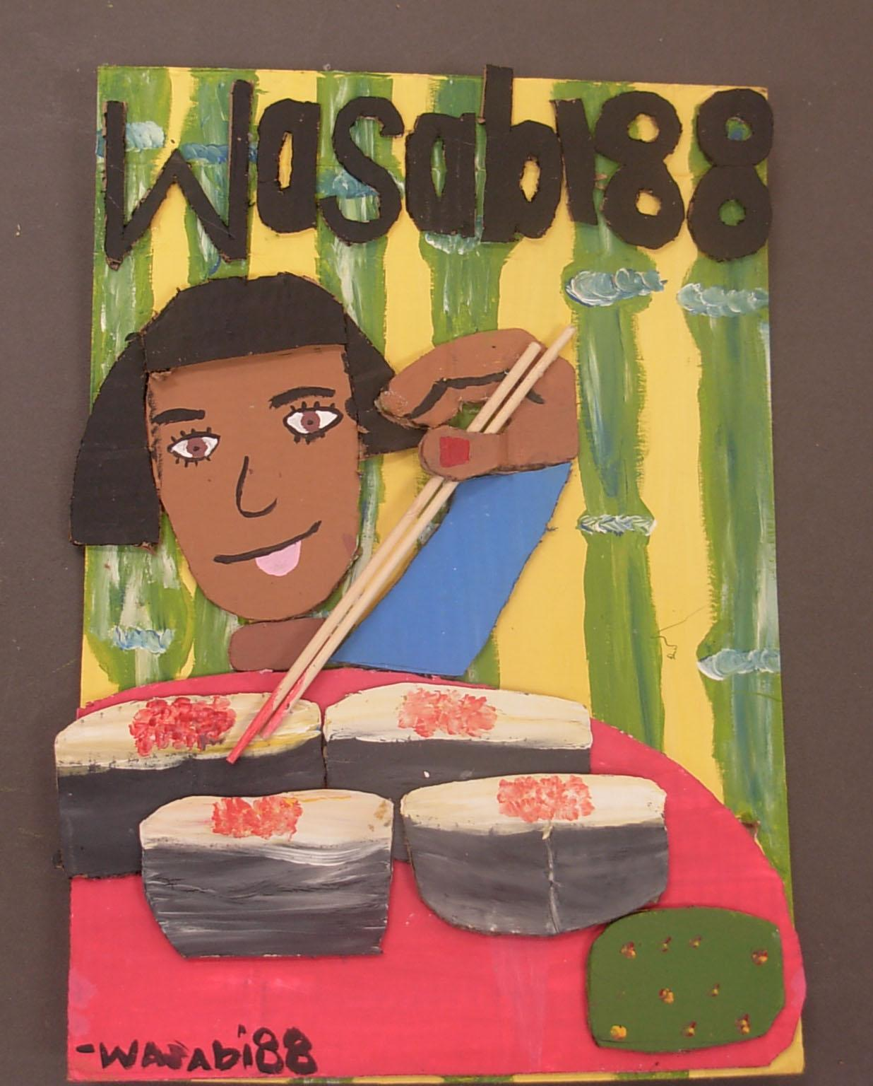

Slide 18
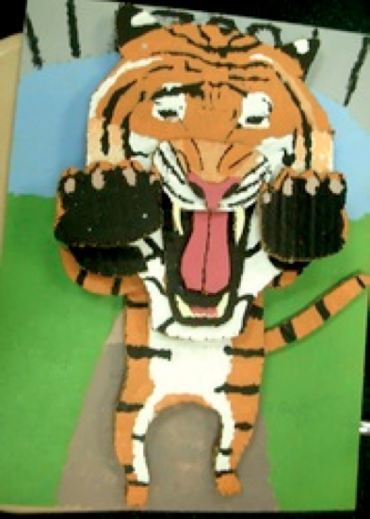

Slide 19
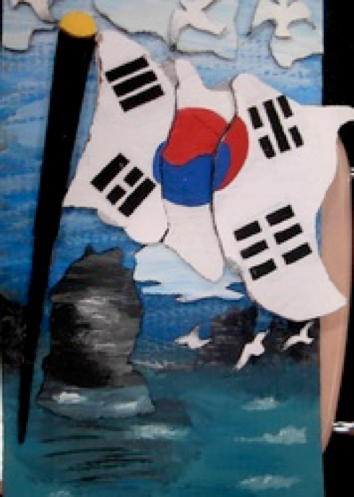

Slide 20
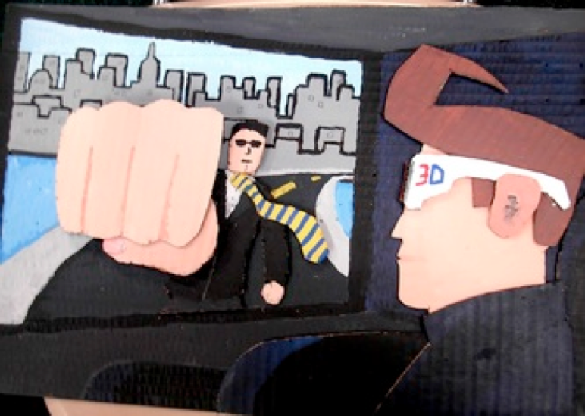

Slide 21
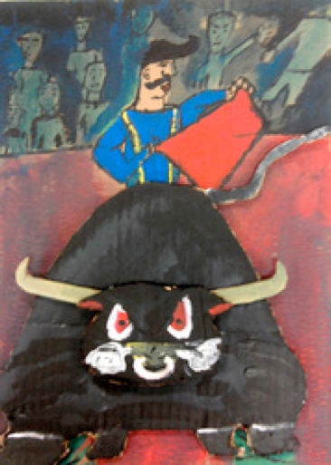

Slide 22
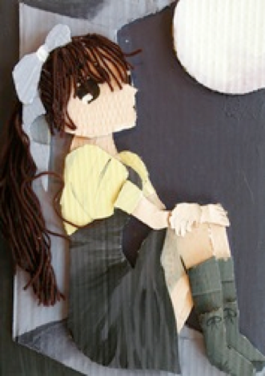

Slide 23
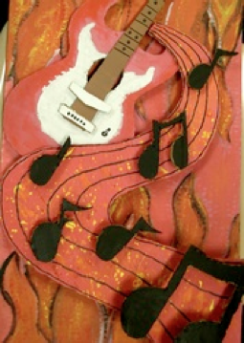
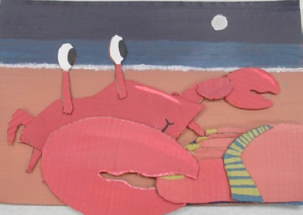
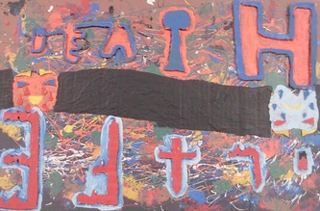
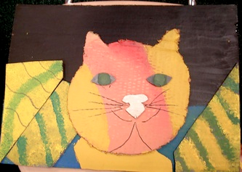
A
B
D
C

Slide 24
How do we begin?
Sketch Original ideas
Push your ideas to utilize EXTREME Foreshortening
Enlarge sketch to 12 by 18 paper
Label pieces to cut out of cardboard
Transfer pieces to cardboard
cut out pieces using scissors and xacto knives
arrange cardboard pieces
paint pieces
glue pieces

Slide 25
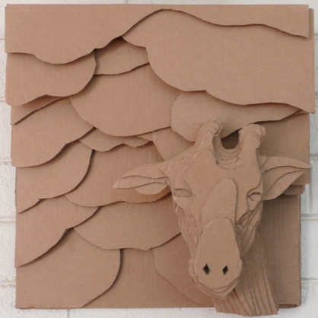
All pieces must be built up from the backboard
Further Back - First
Closest Up- Last

Slide 26
