Slide 1
5 Drawings in 5 Days
Objective: To Dramatically increase drawing and rendering skills

Slide 2
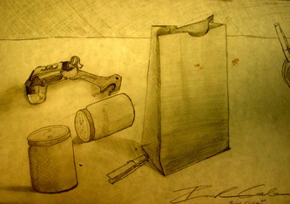
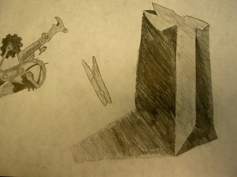
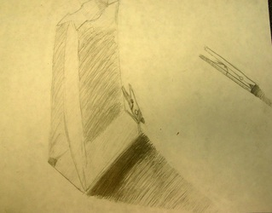
Day 1: Paper Bags

Slide 3
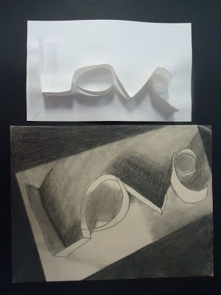
Day 2: Paper Name

Slide 4
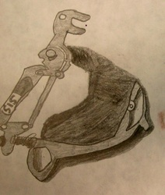
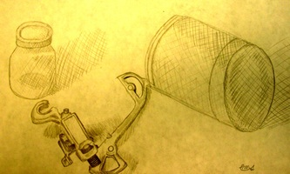
Day 3: Bike parts

Slide 5
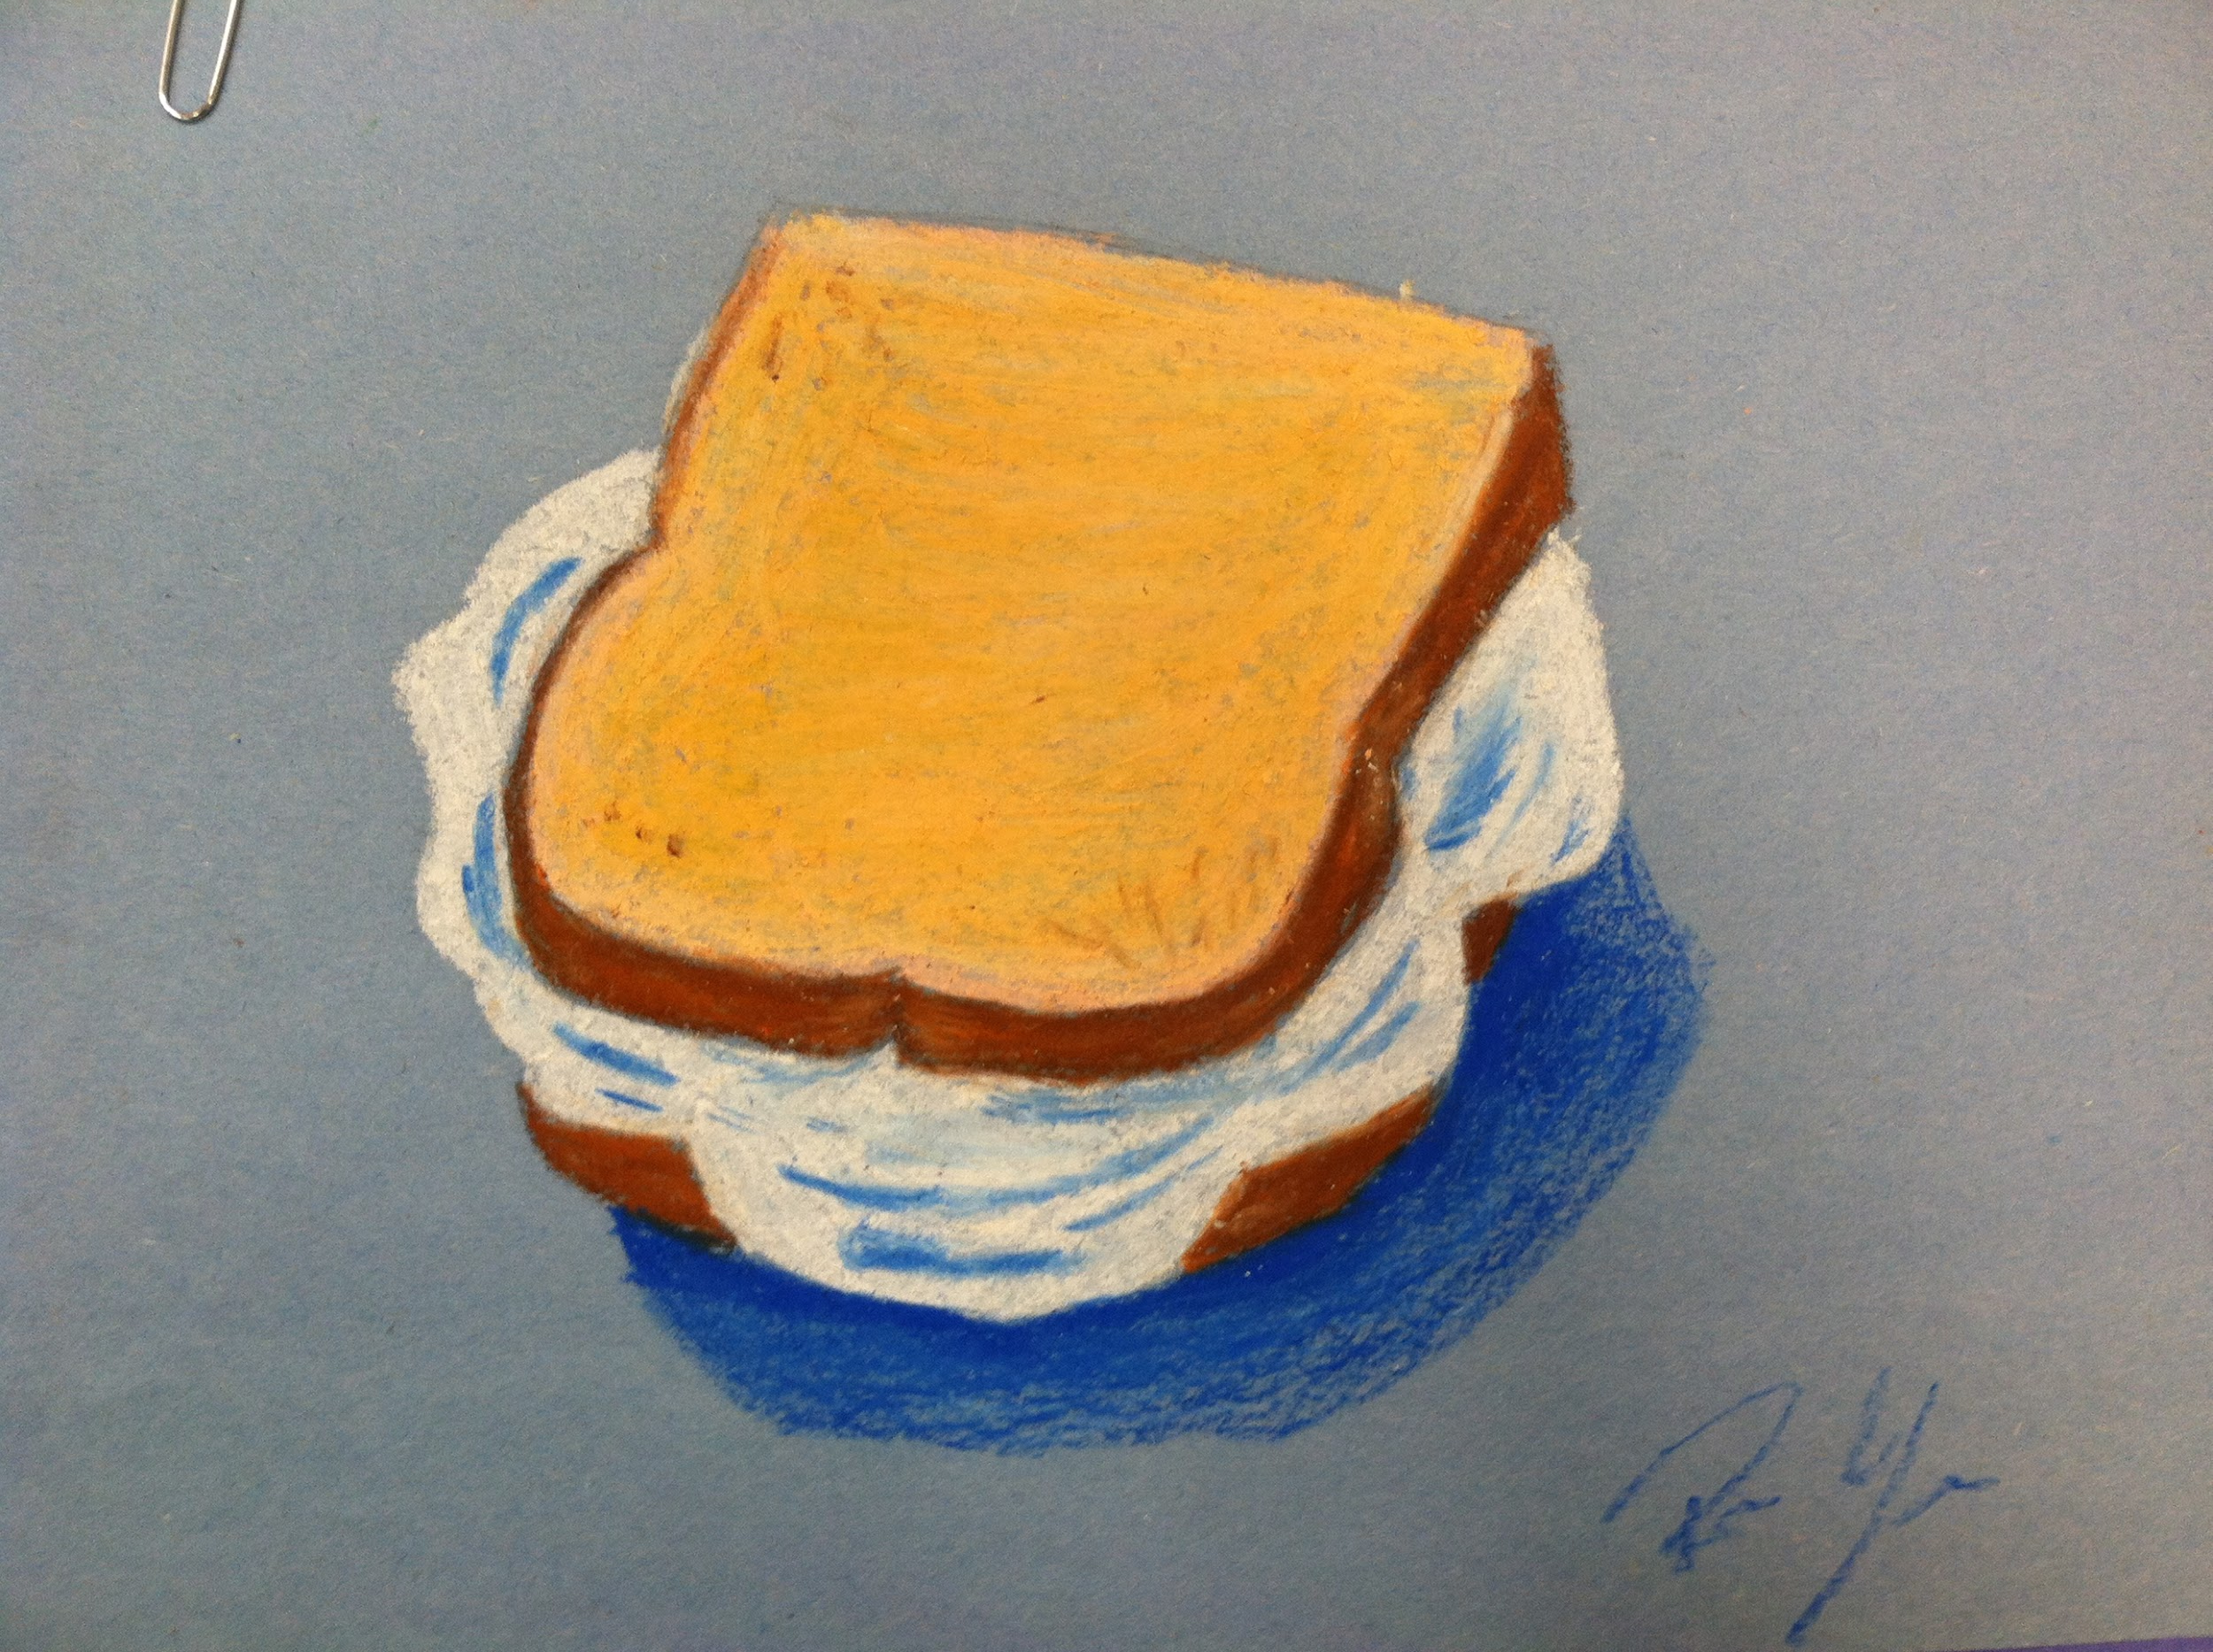
Day 4: Shaving Cream Sandwiches

Slide 6
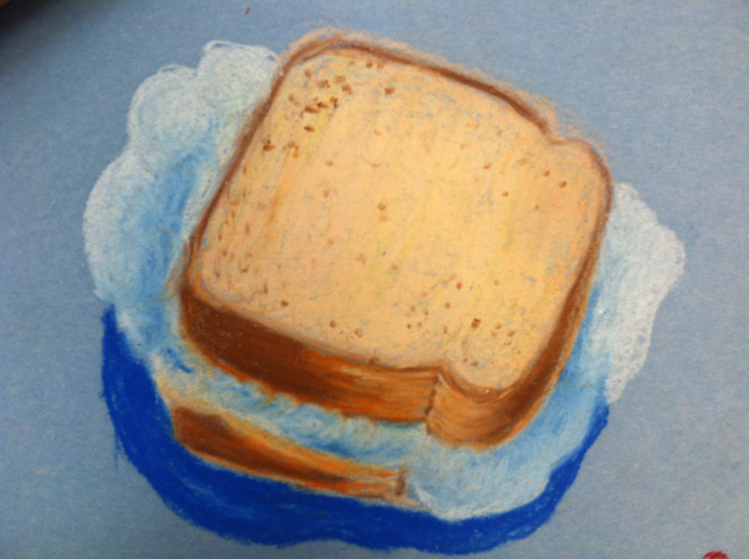
Day 4: Shaving Cream Sandwiches

Slide 7
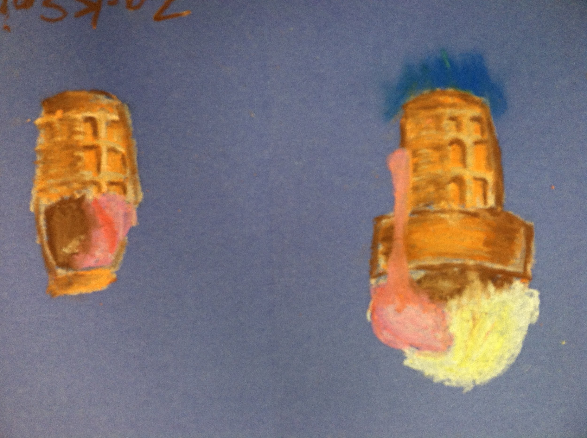
Day 5: ice cream cones

Slide 8
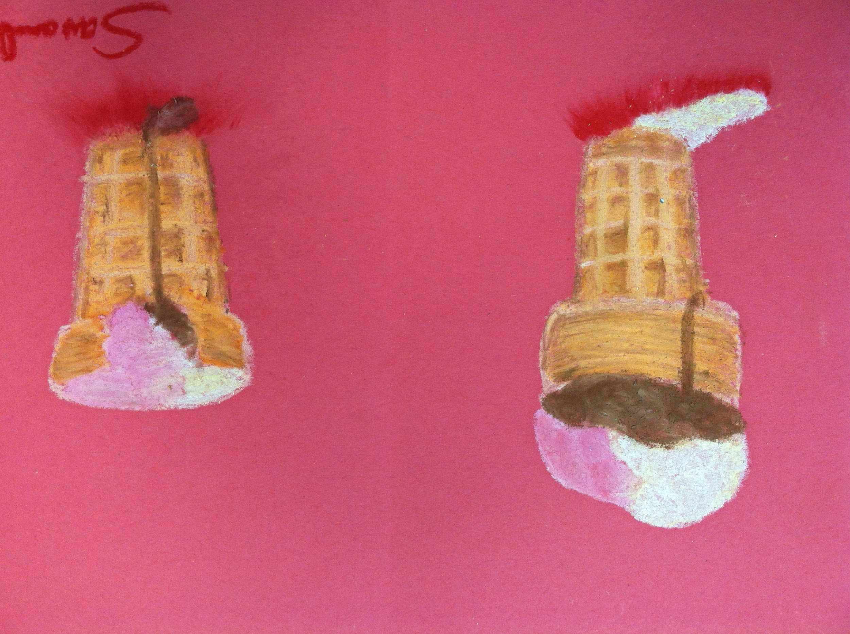
Day 5: ice cream cones

Slide 9
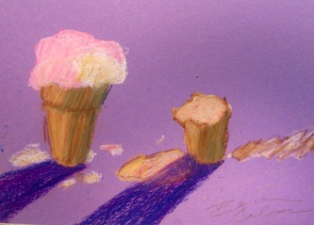
Day 5: ice cream cones

Slide 10
Each drawing is due at the end of the class (1 per day)
All 5 drawings will be turned in together and give a single grade for all 5
Let your eyes do the work!!!

