Slide 1
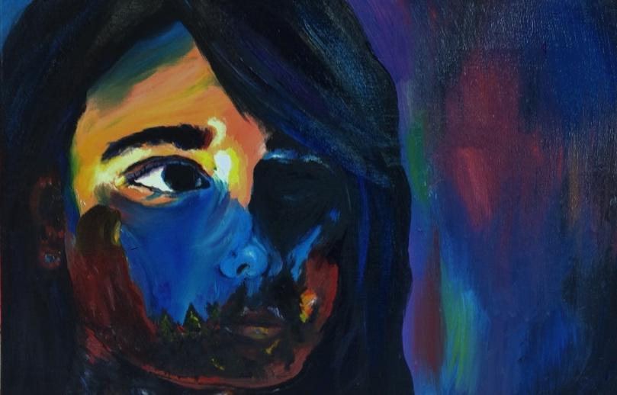
Transparent Image
Overlay
Art Advanced

Slide 2
Objectives:
Students will create a likeness of themselves using oil paint and stretched canvas
Students will become familiar with the image overlay process

Slide 3
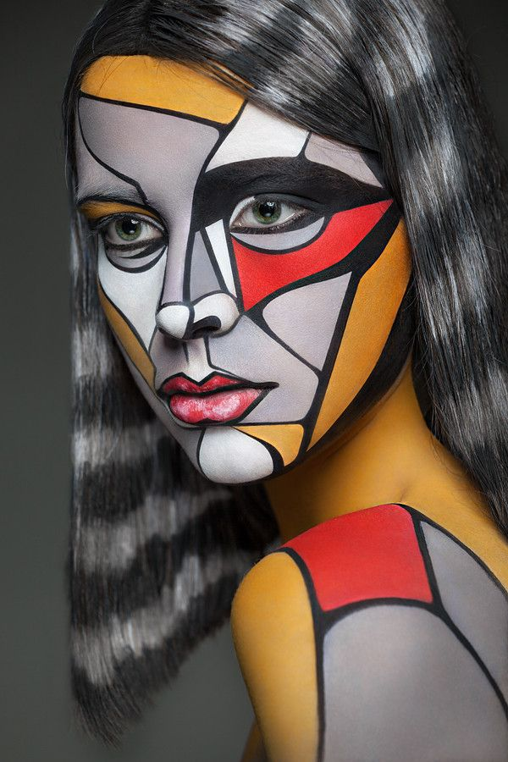
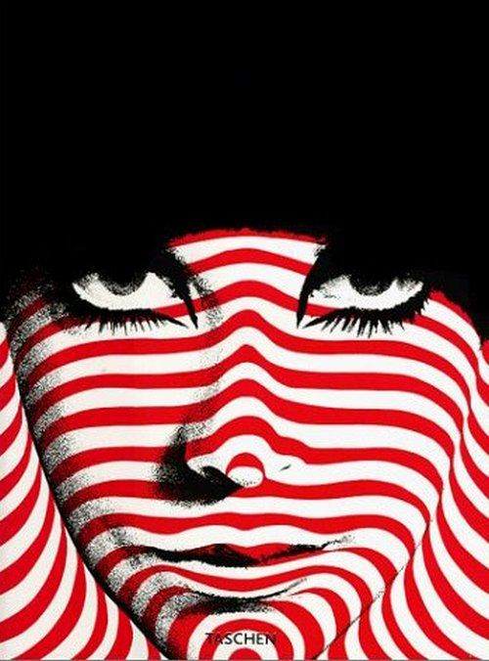

Slide 4
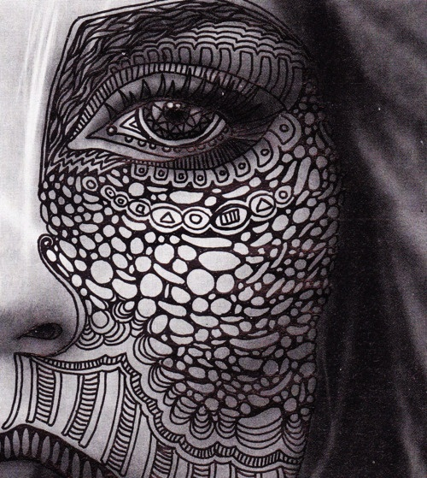

Slide 5
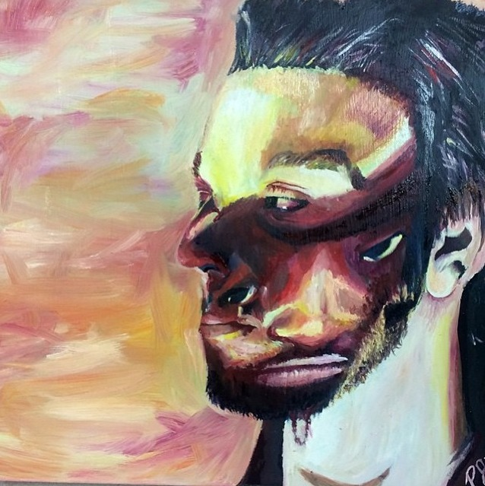

Slide 6
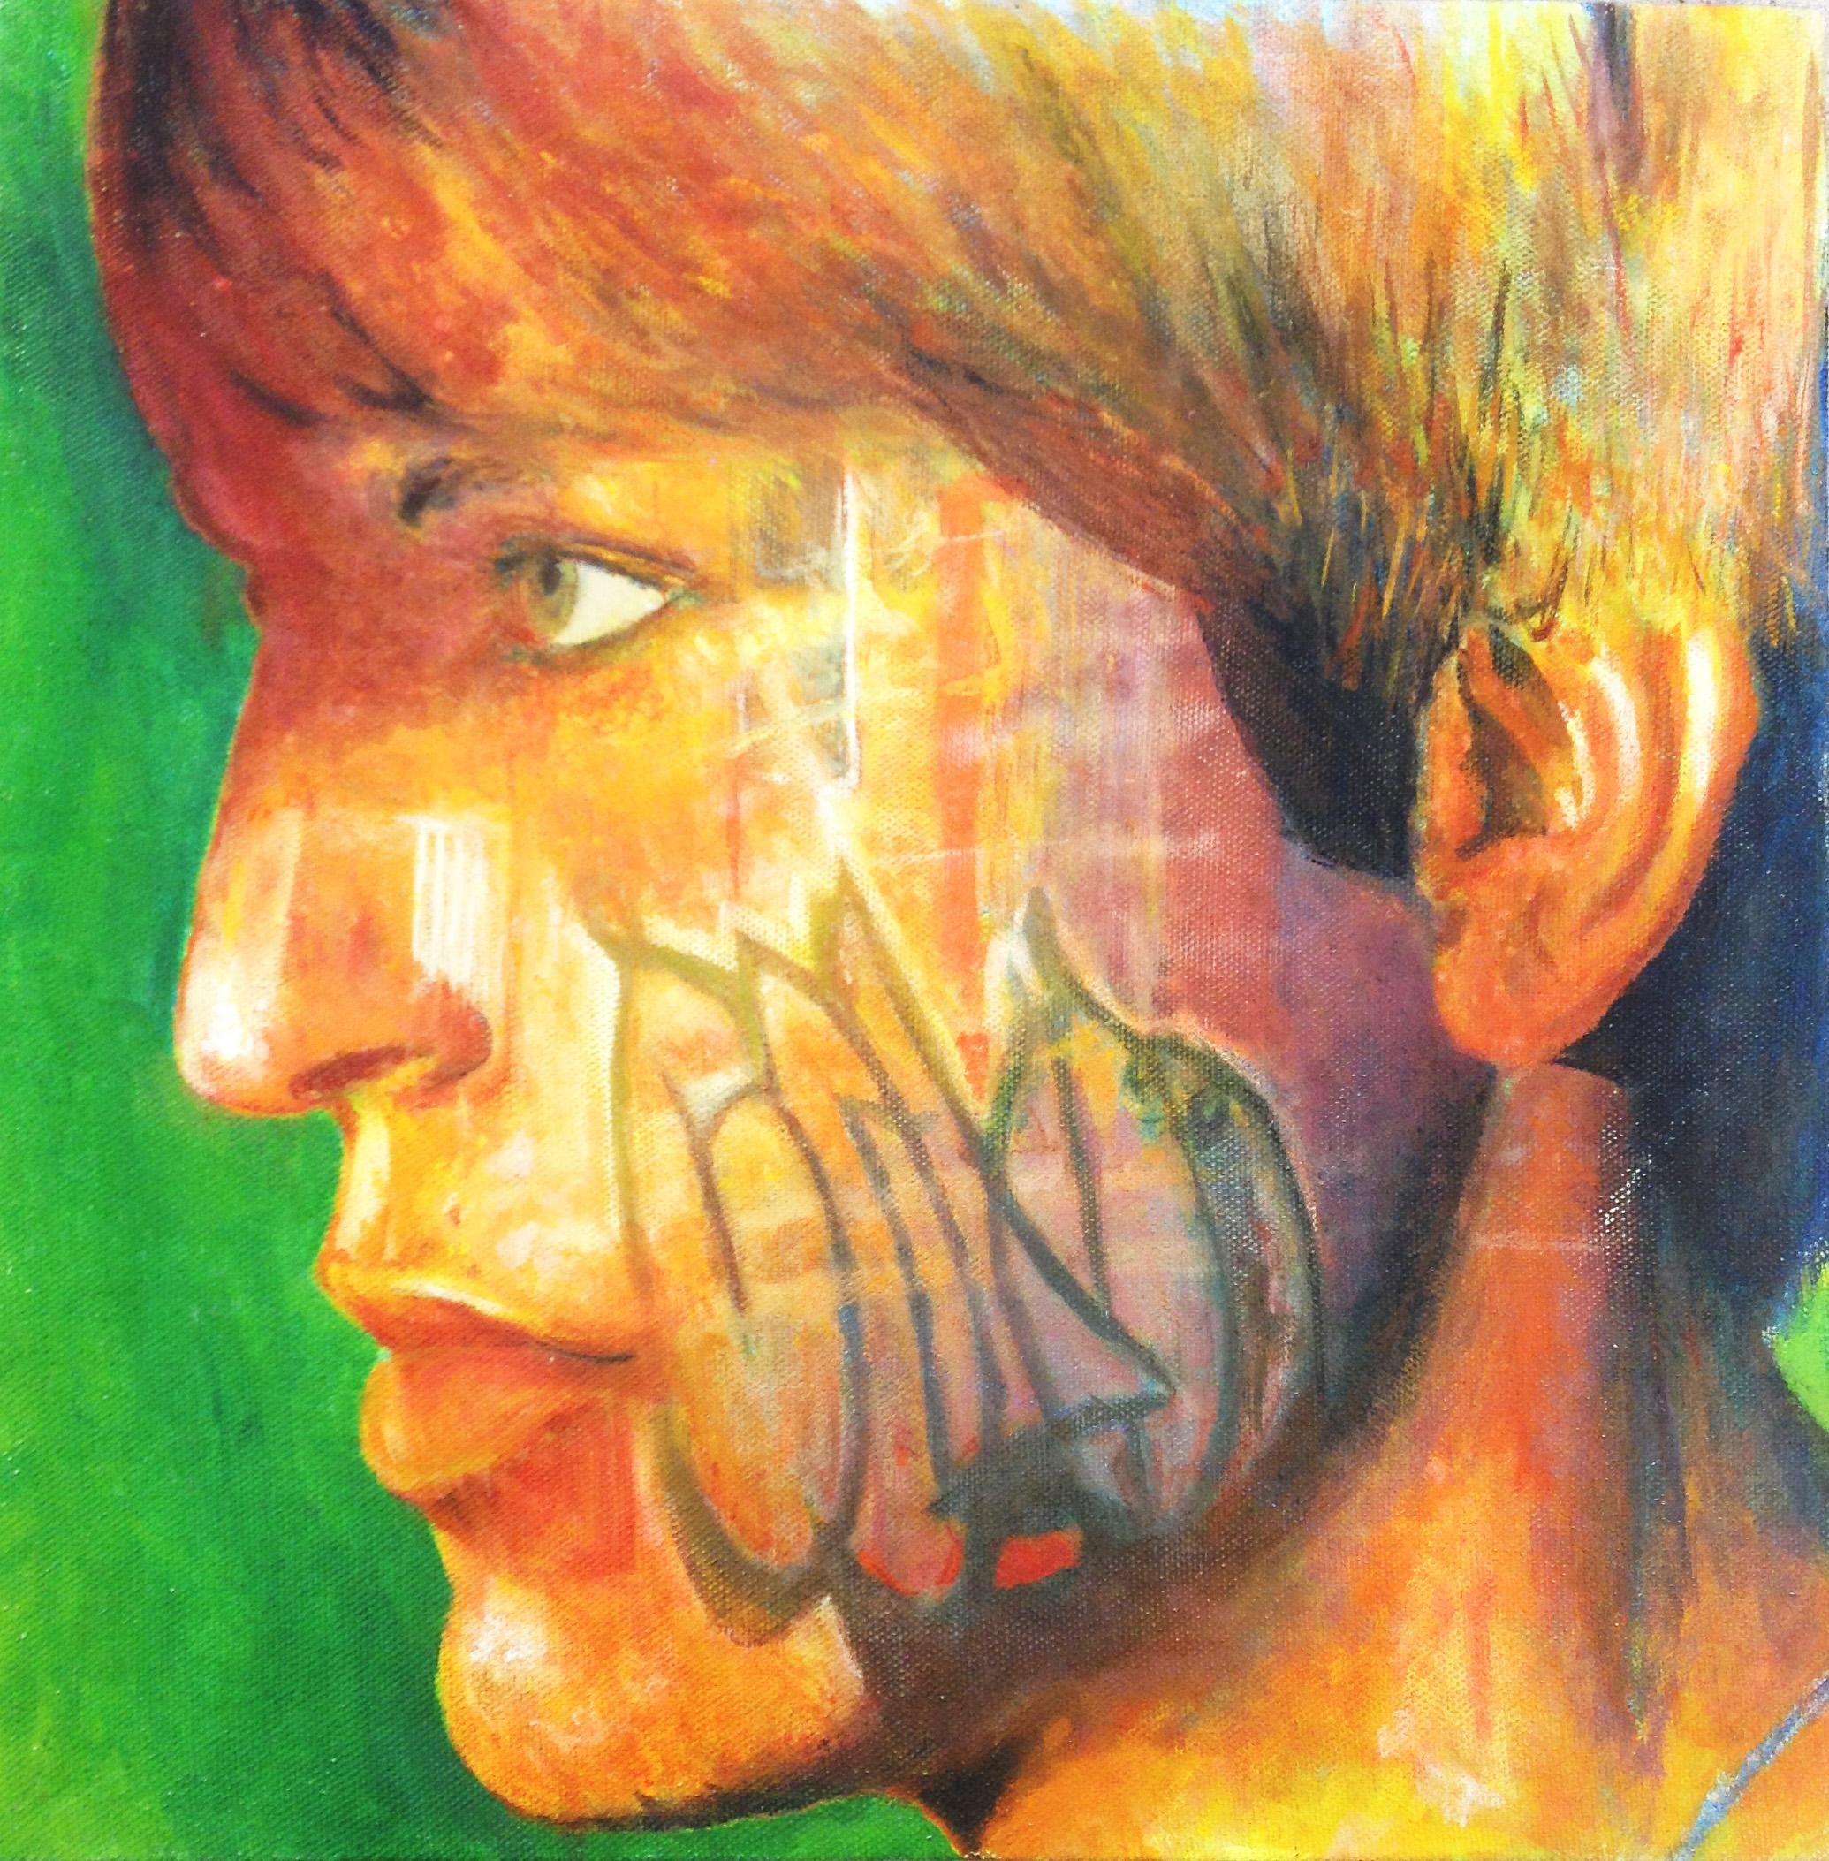

Slide 7
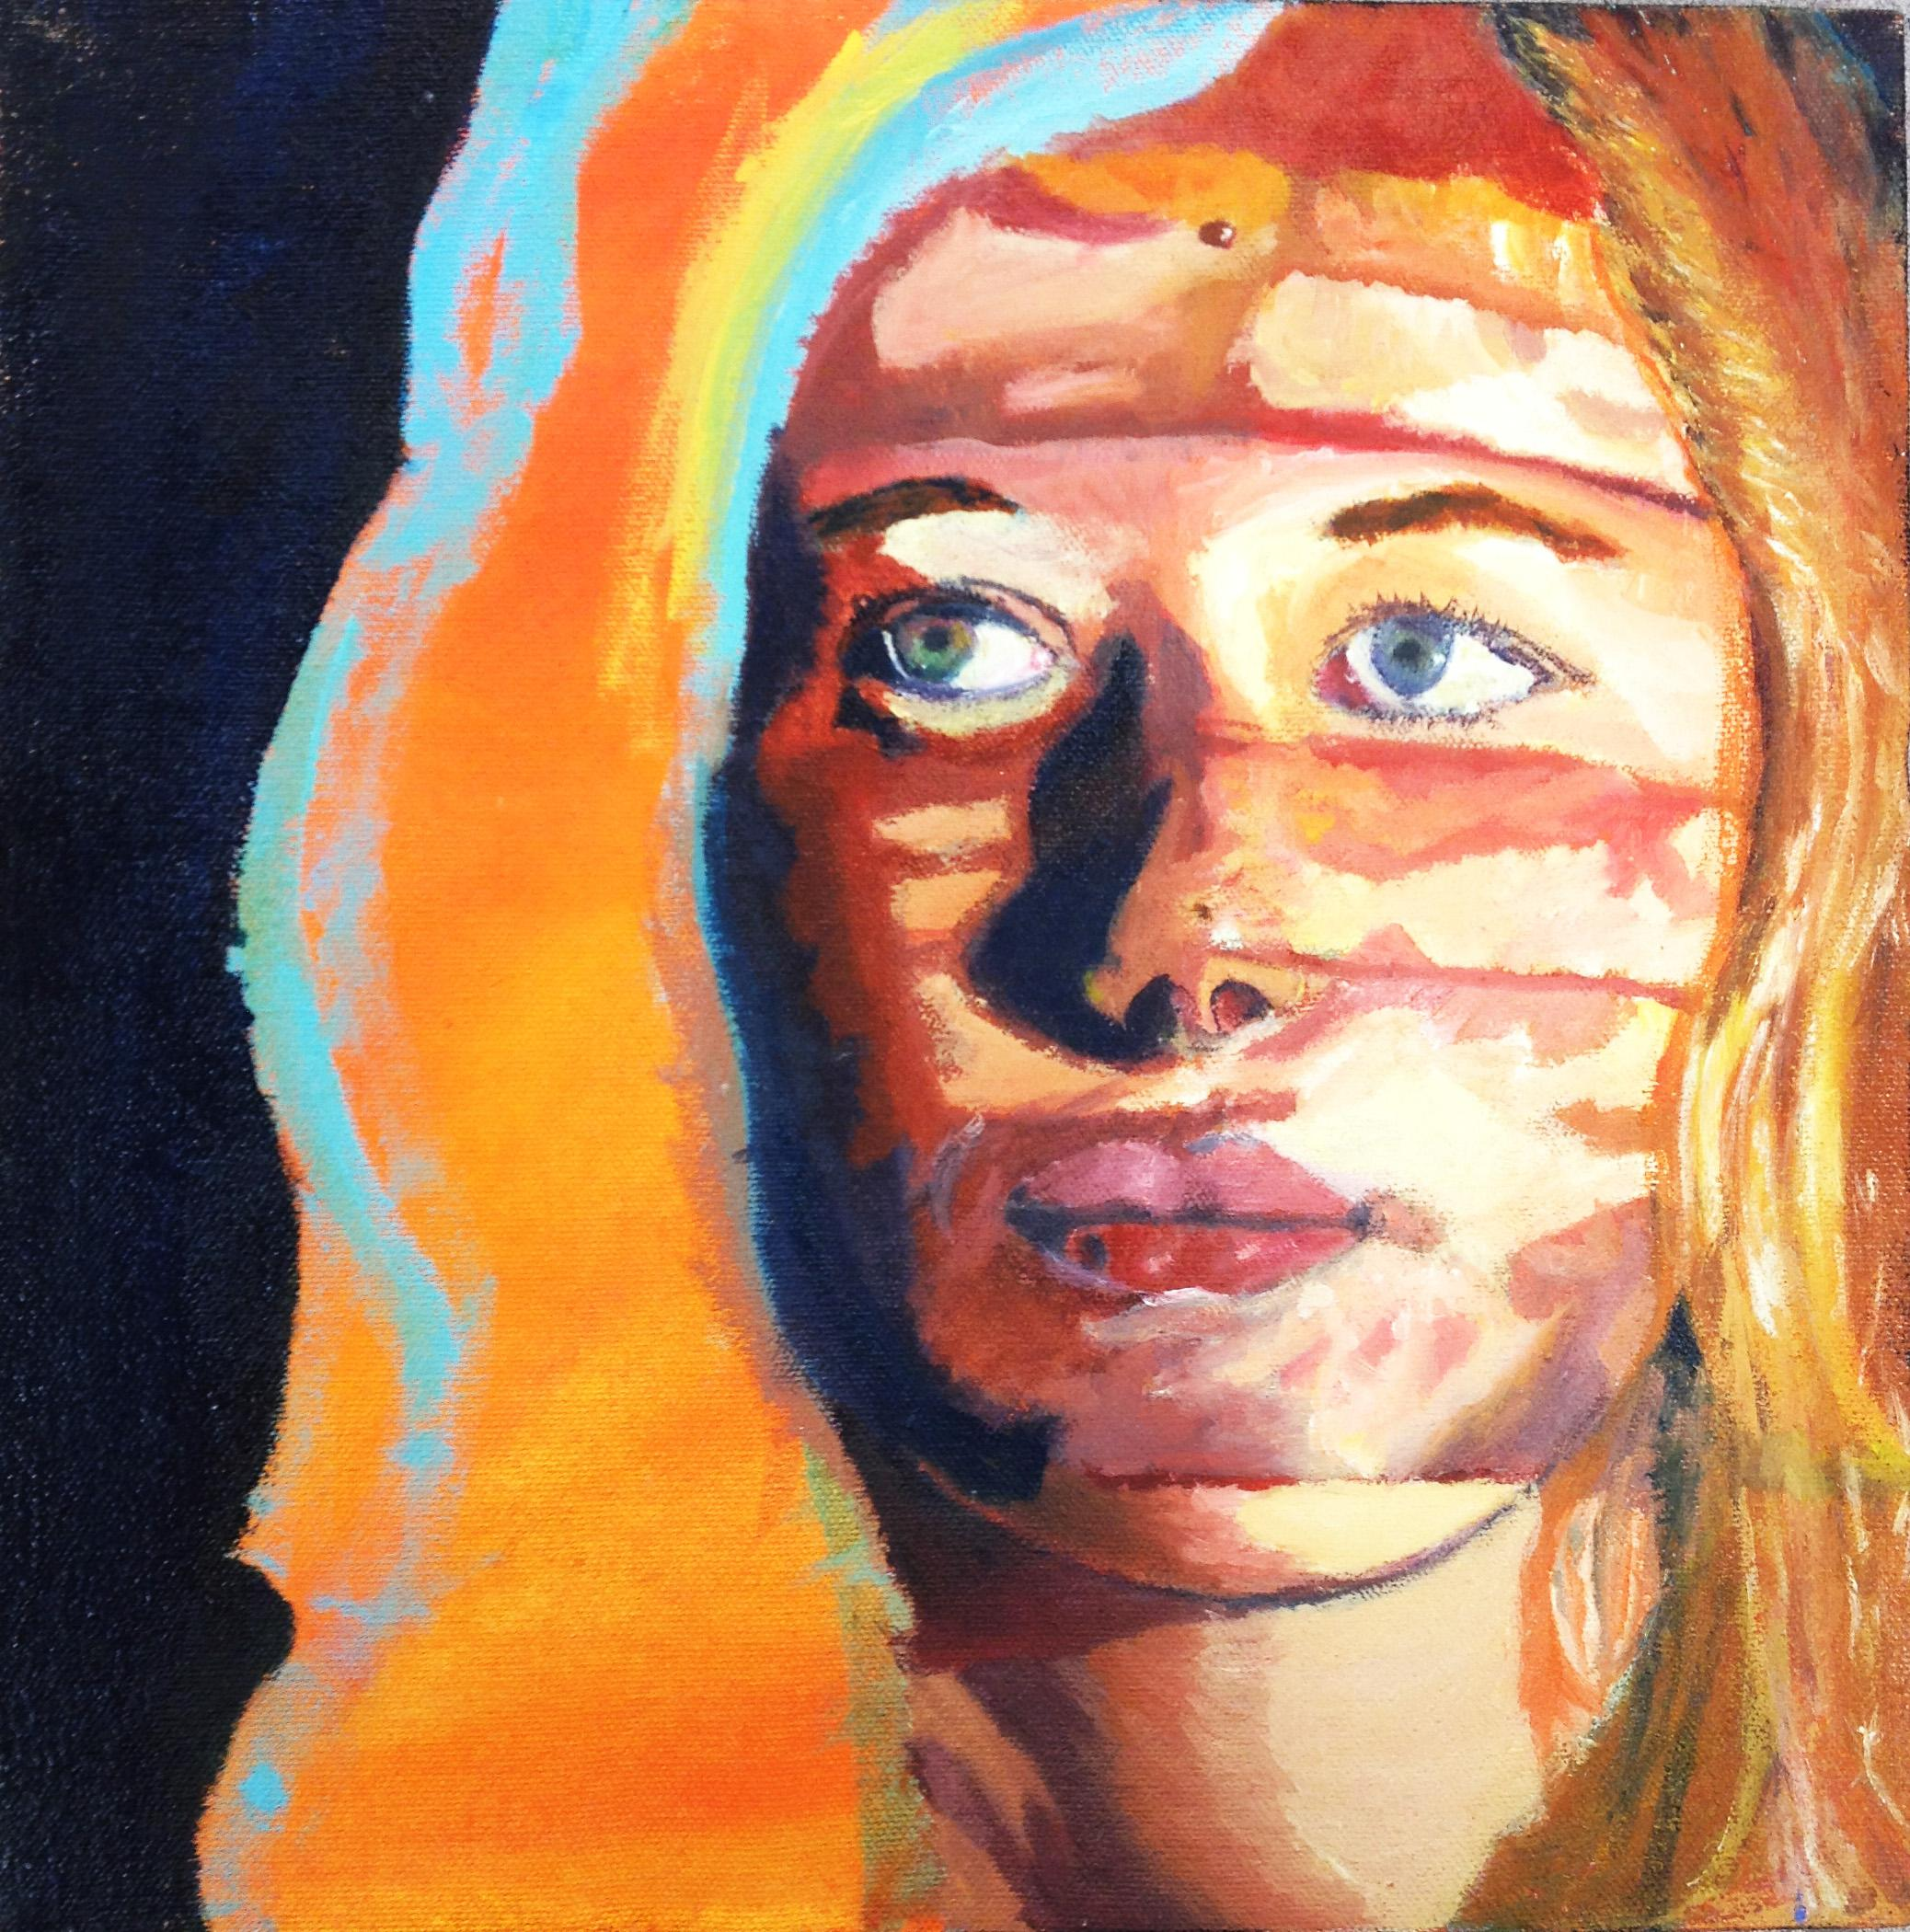

Slide 8
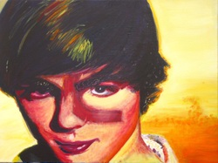

Slide 9
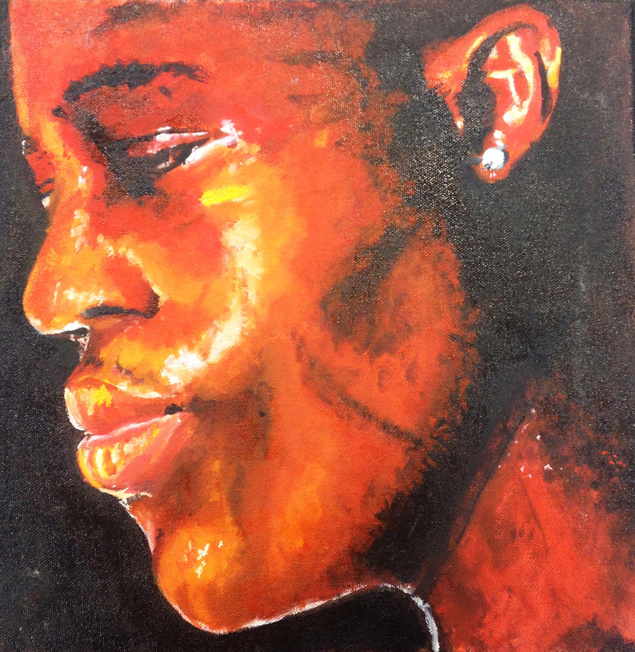

Slide 10
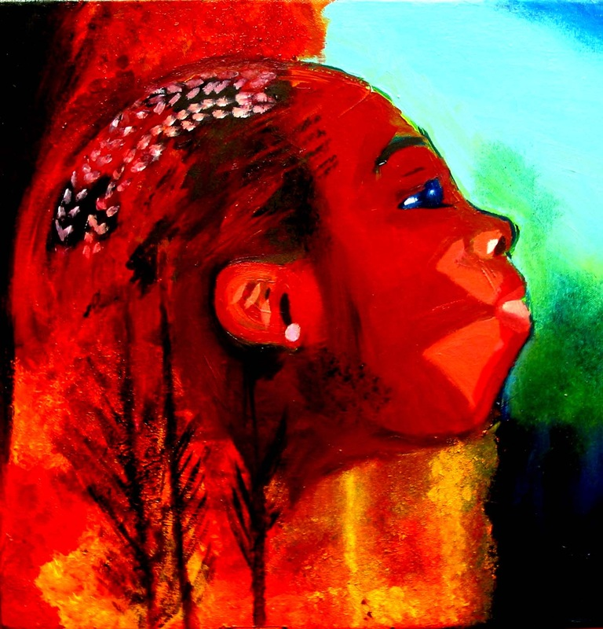
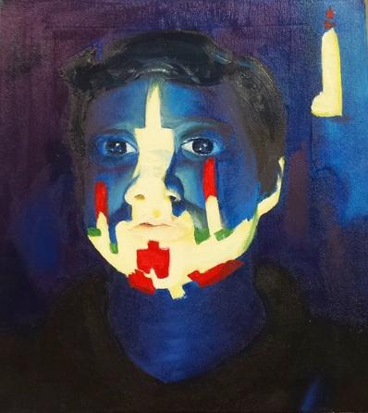

Slide 11
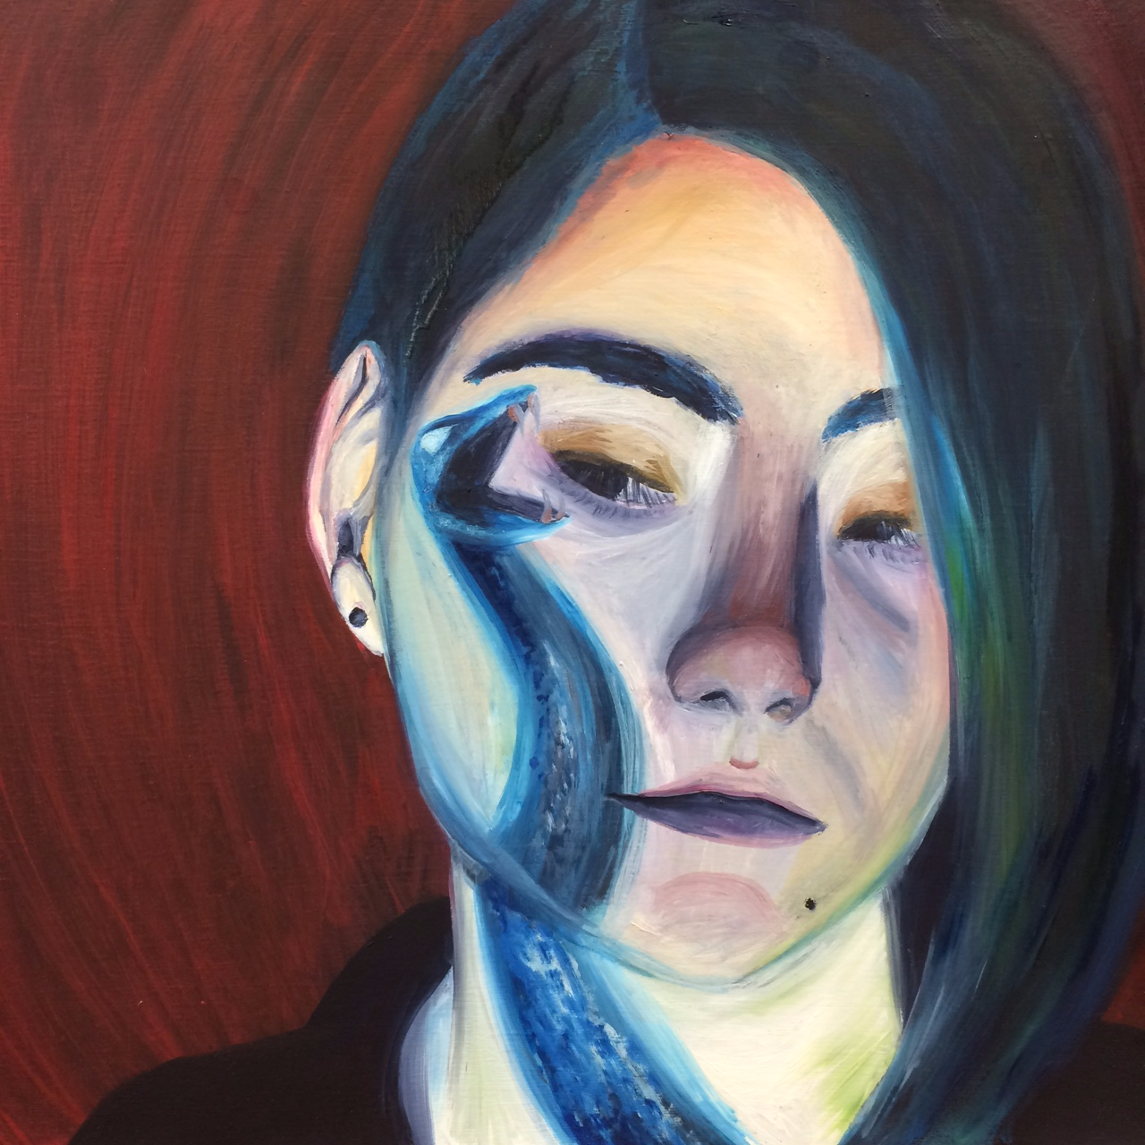

Slide 12
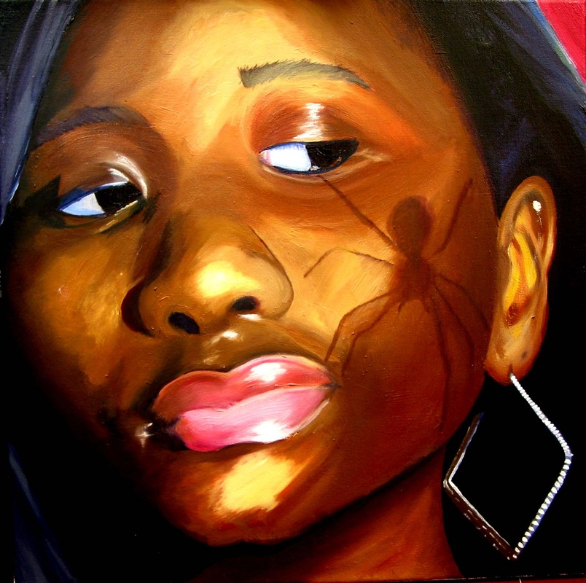
Images can be found in magazines, online, or hand drawn and digitally scanned or photographed

Slide 13
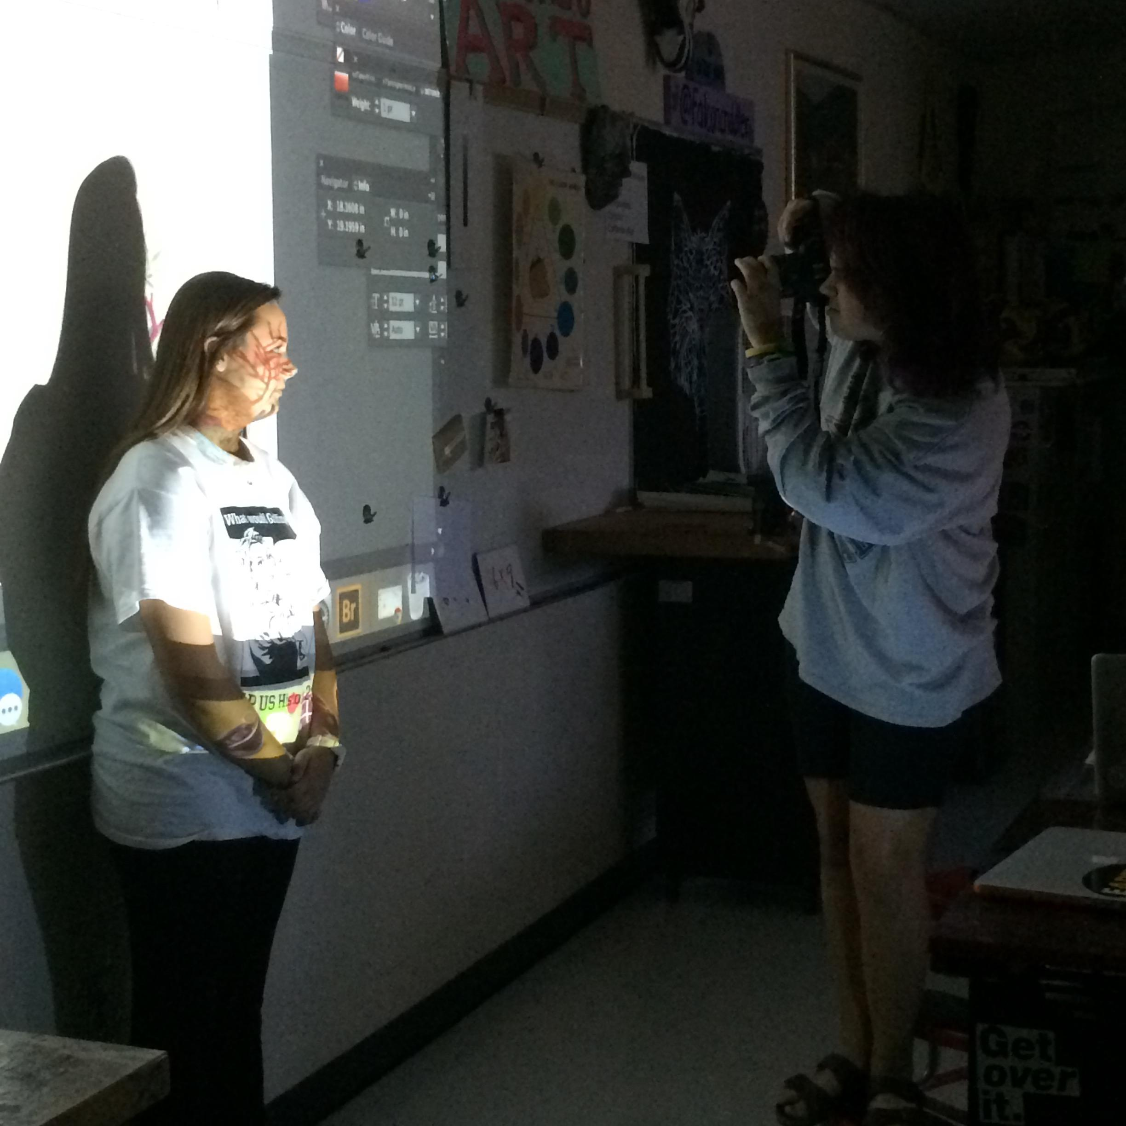
Using LCD projector, project digitized image onto face and photograph

Slide 14
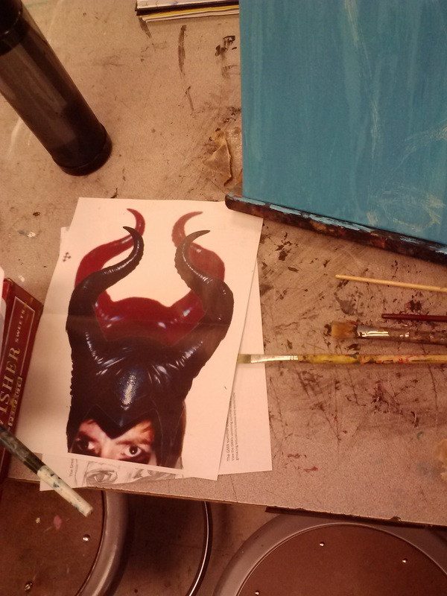
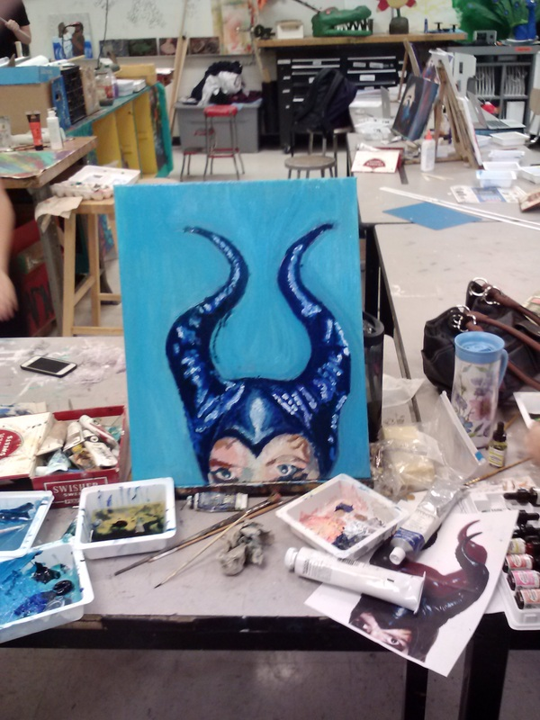
Print out photograph and Paint using oil paint

Slide 15
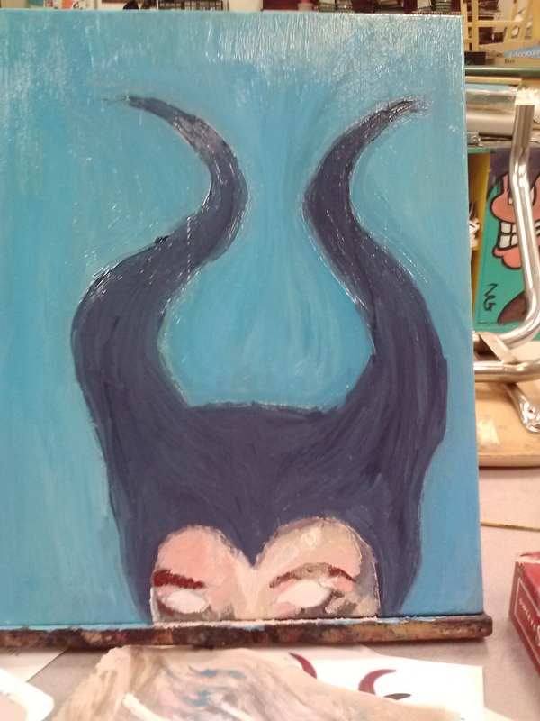
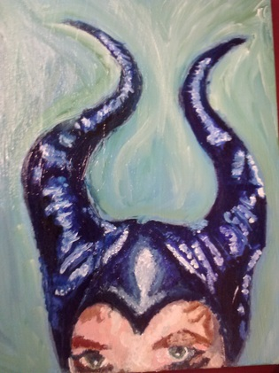

Slide 16
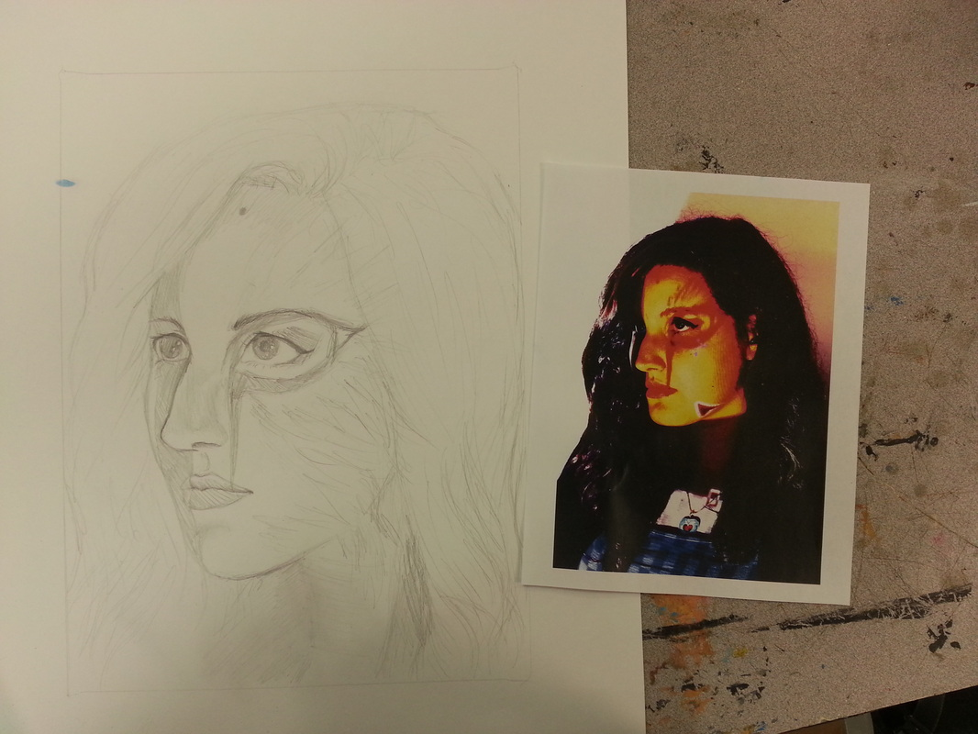
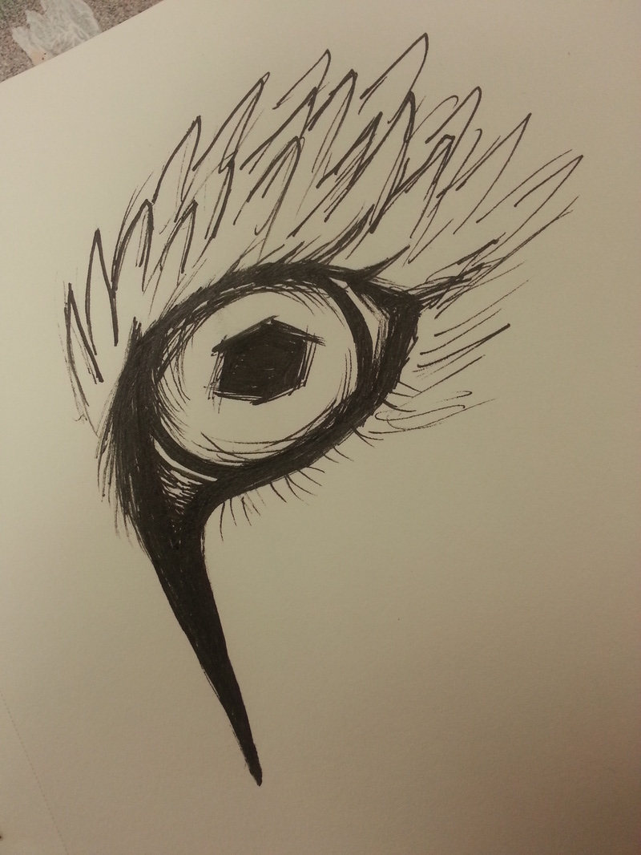
Hand Drawn Images

Slide 17
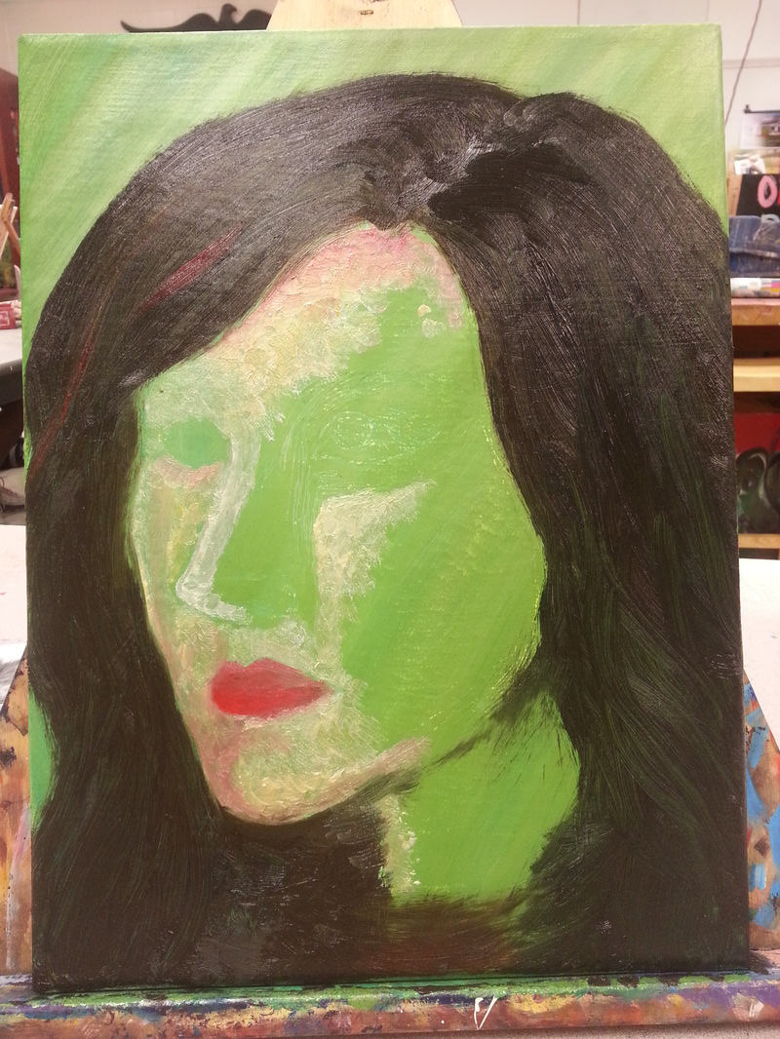
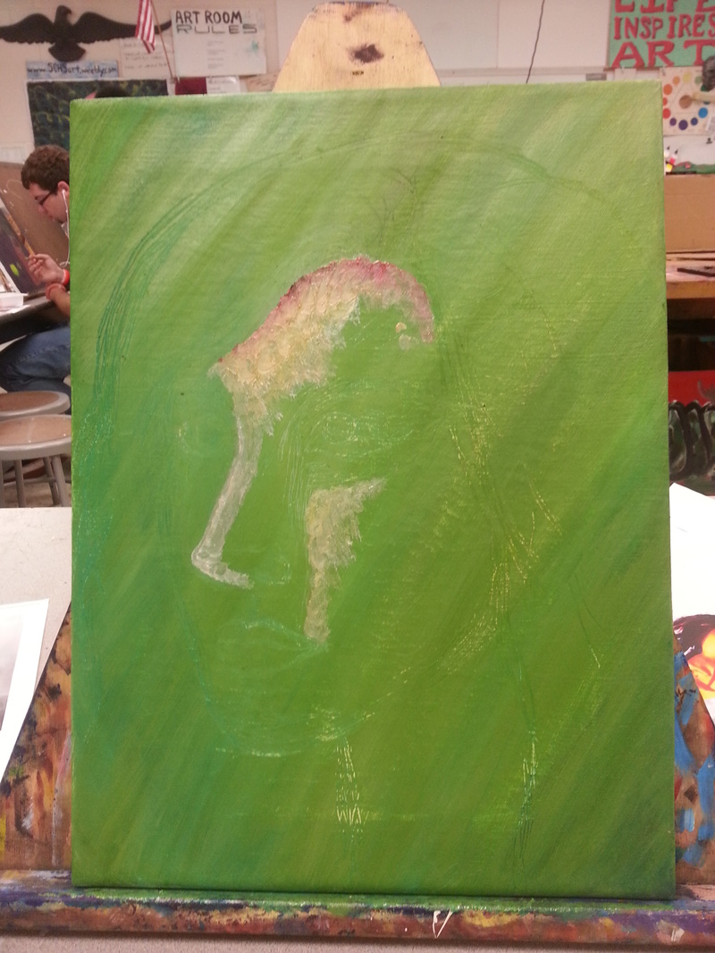

Slide 18
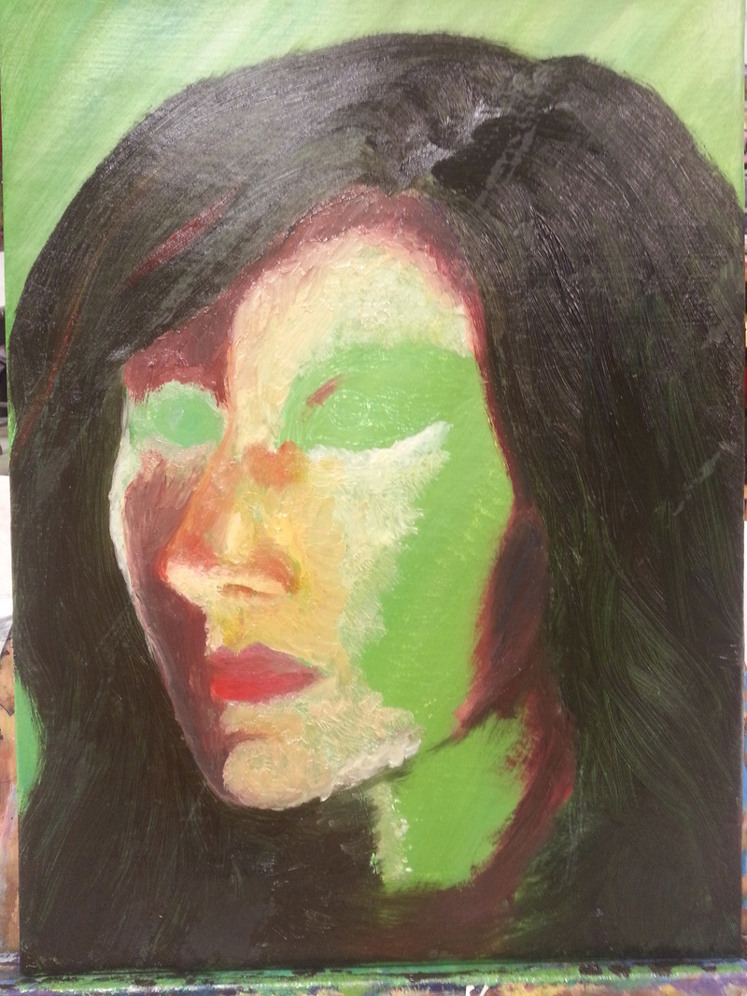
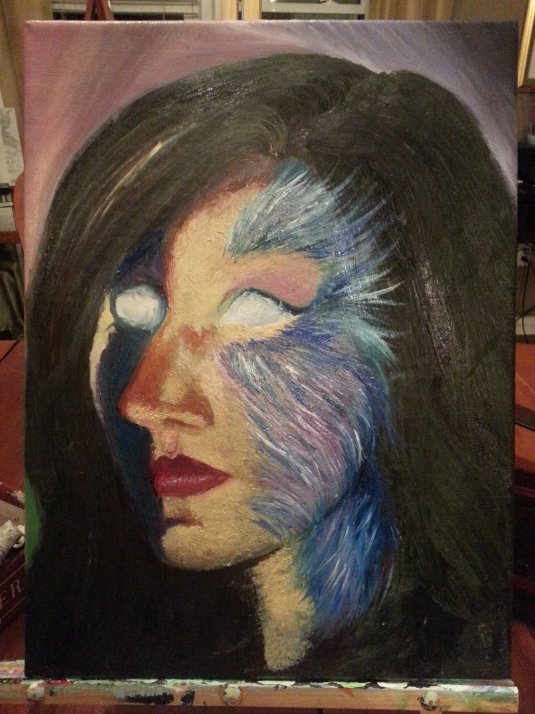

Slide 19
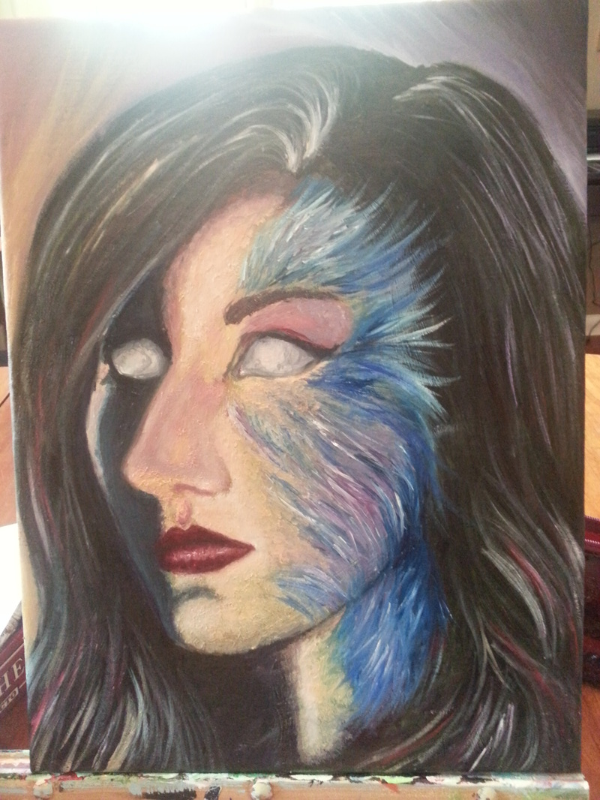
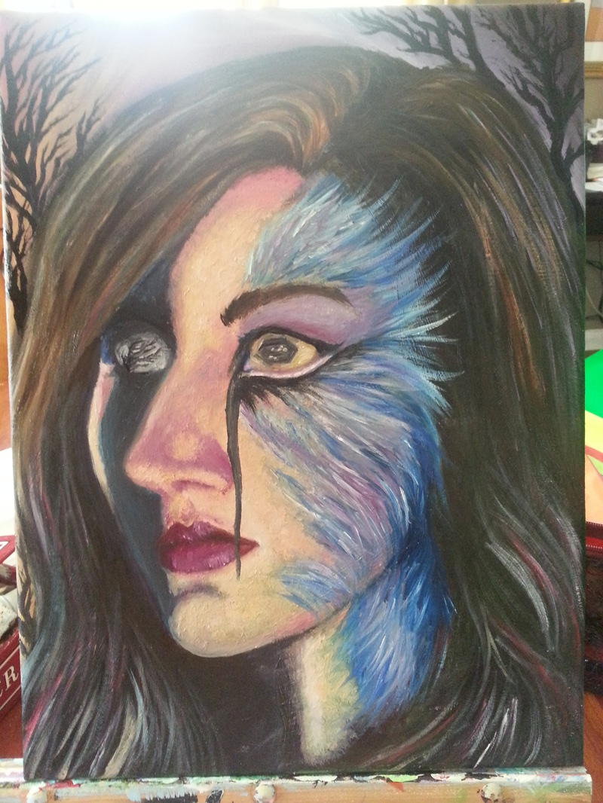

Slide 21
Directions:
Locate multiple High Contrast images to be projected onto your face while standing in front of the projector
Take a photo of projected image while it is on face
Adjust photo with projected image in photoshop
Print photo
Stretch a canvas to paint on
Prime canvas
Using picture as a reference, render your likeness using oil paint on stretched canvas

Slide 22
Grading:
Integration of image onto face (does not look like a sticker just stuck there)
Realism of Image (looks like you)
Originality/Creativity
Use of oil paint
Canvas construction

