Slide 1
Paper Mache
....entering the third dimension

Slide 2
Objectives:
Students will fully understand 3-Dimensional Sculpture
Students will create wearable hats out of paper mache
Students will create a 3D sculpture of an object that represents them

Slide 3
What is Paper Mache?

Slide 4
Process

Slide 5
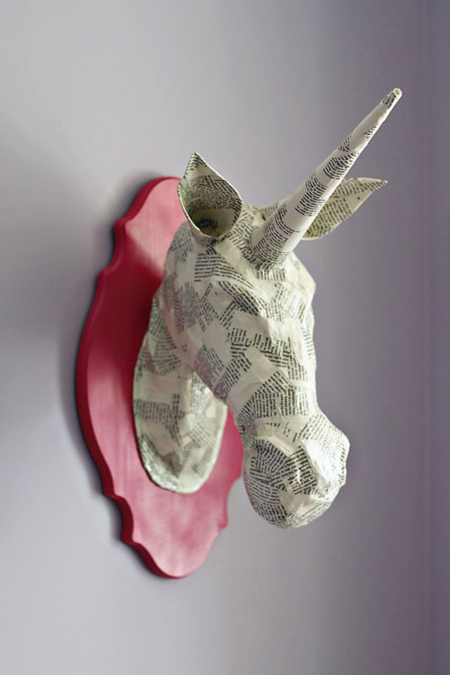

Slide 6
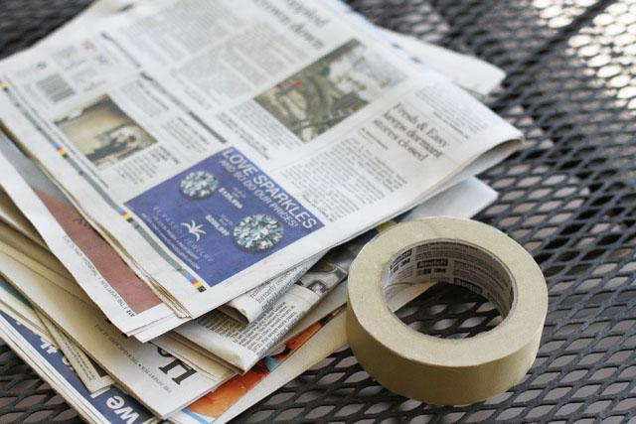
Materials

Slide 7
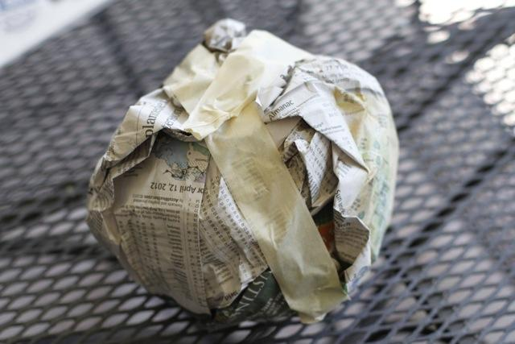
Create mass

Slide 8
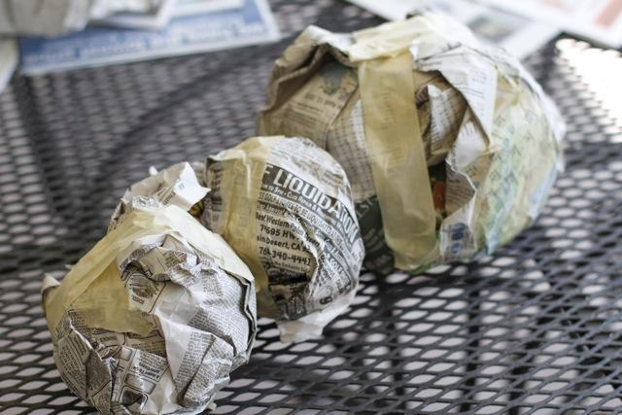
Create Forms

Slide 9
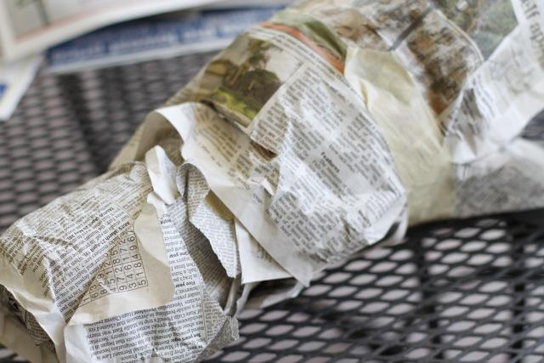
Add "skin" to forms

Slide 10
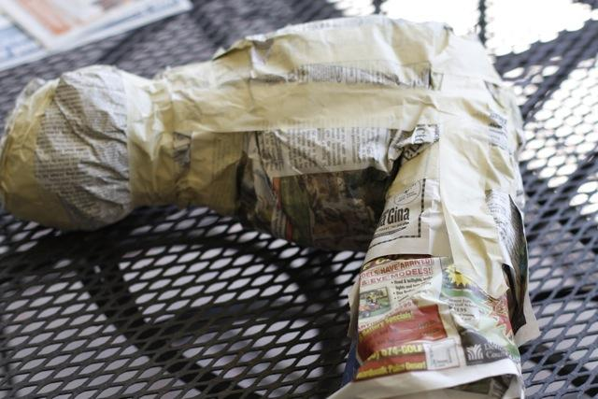
Combine forms

Slide 11
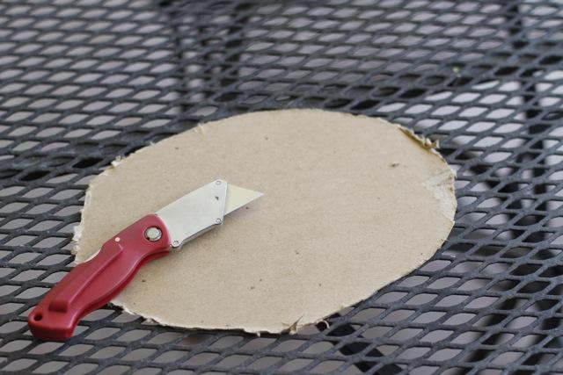
Details using cardboard

Slide 12
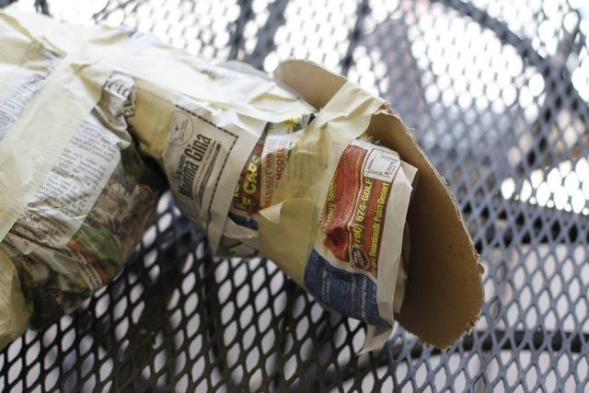
Attach "details"

Slide 13
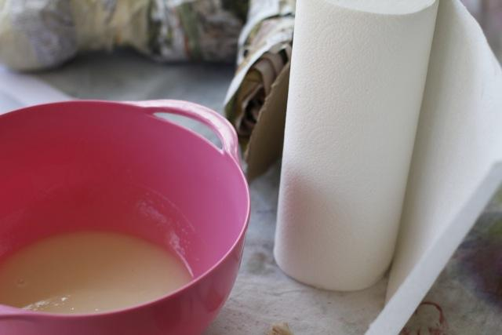
Glue-water and Newspaper strips

Slide 14
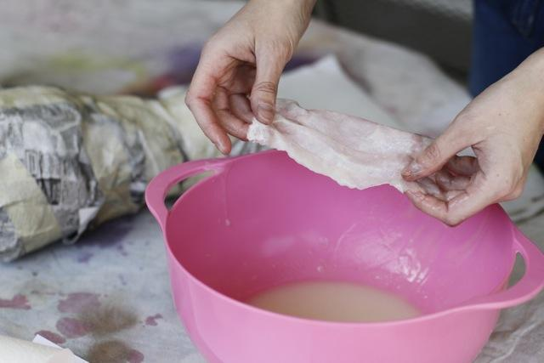
Dip strips in glue water

Slide 15
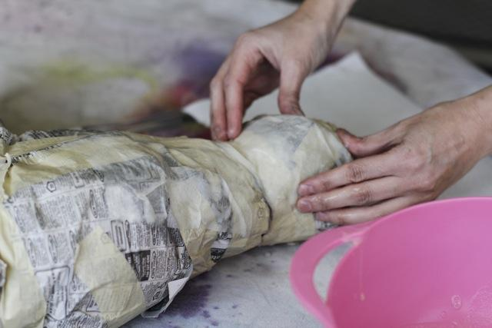
place wet strips on forms

Slide 16
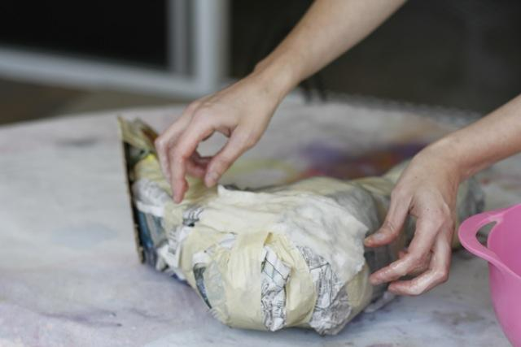
cover entire form with multiple layers

Slide 17
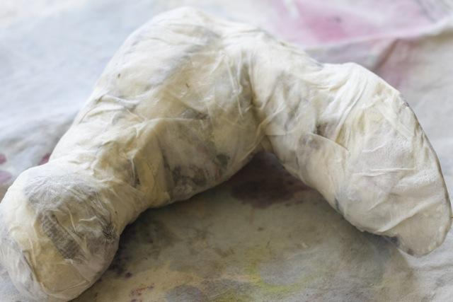
use paper towels for final layer

Slide 18
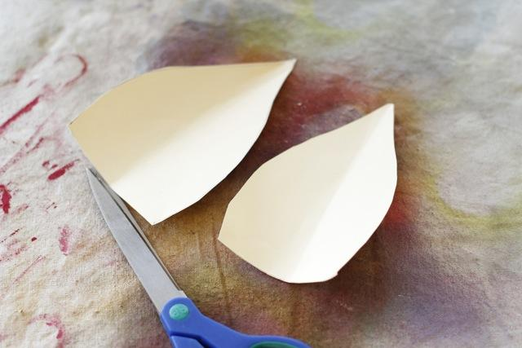
create appendages

Slide 19
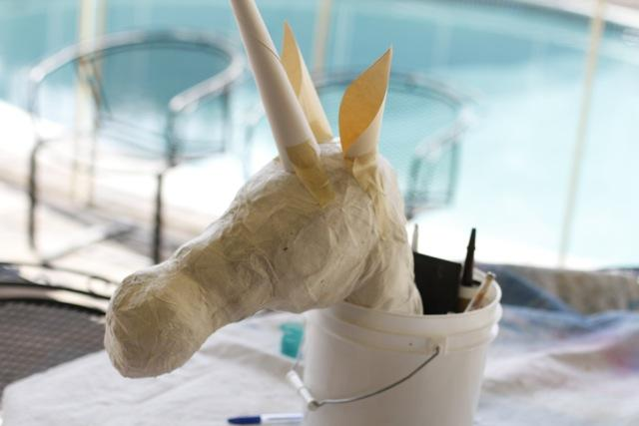
Attach with tape then paper mache to forms

Slide 20
Add fine details using paper, cardboard and/or tape

Slide 21
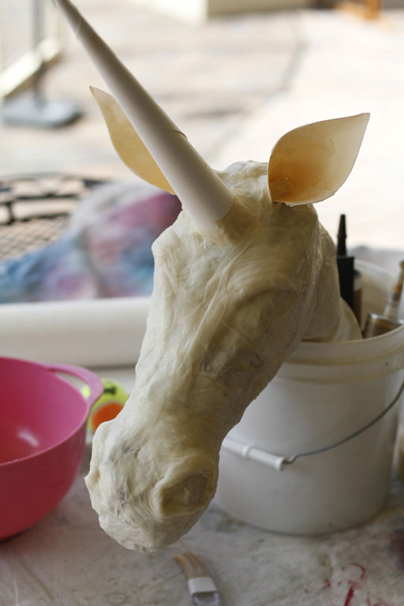
paper mache

Slide 22
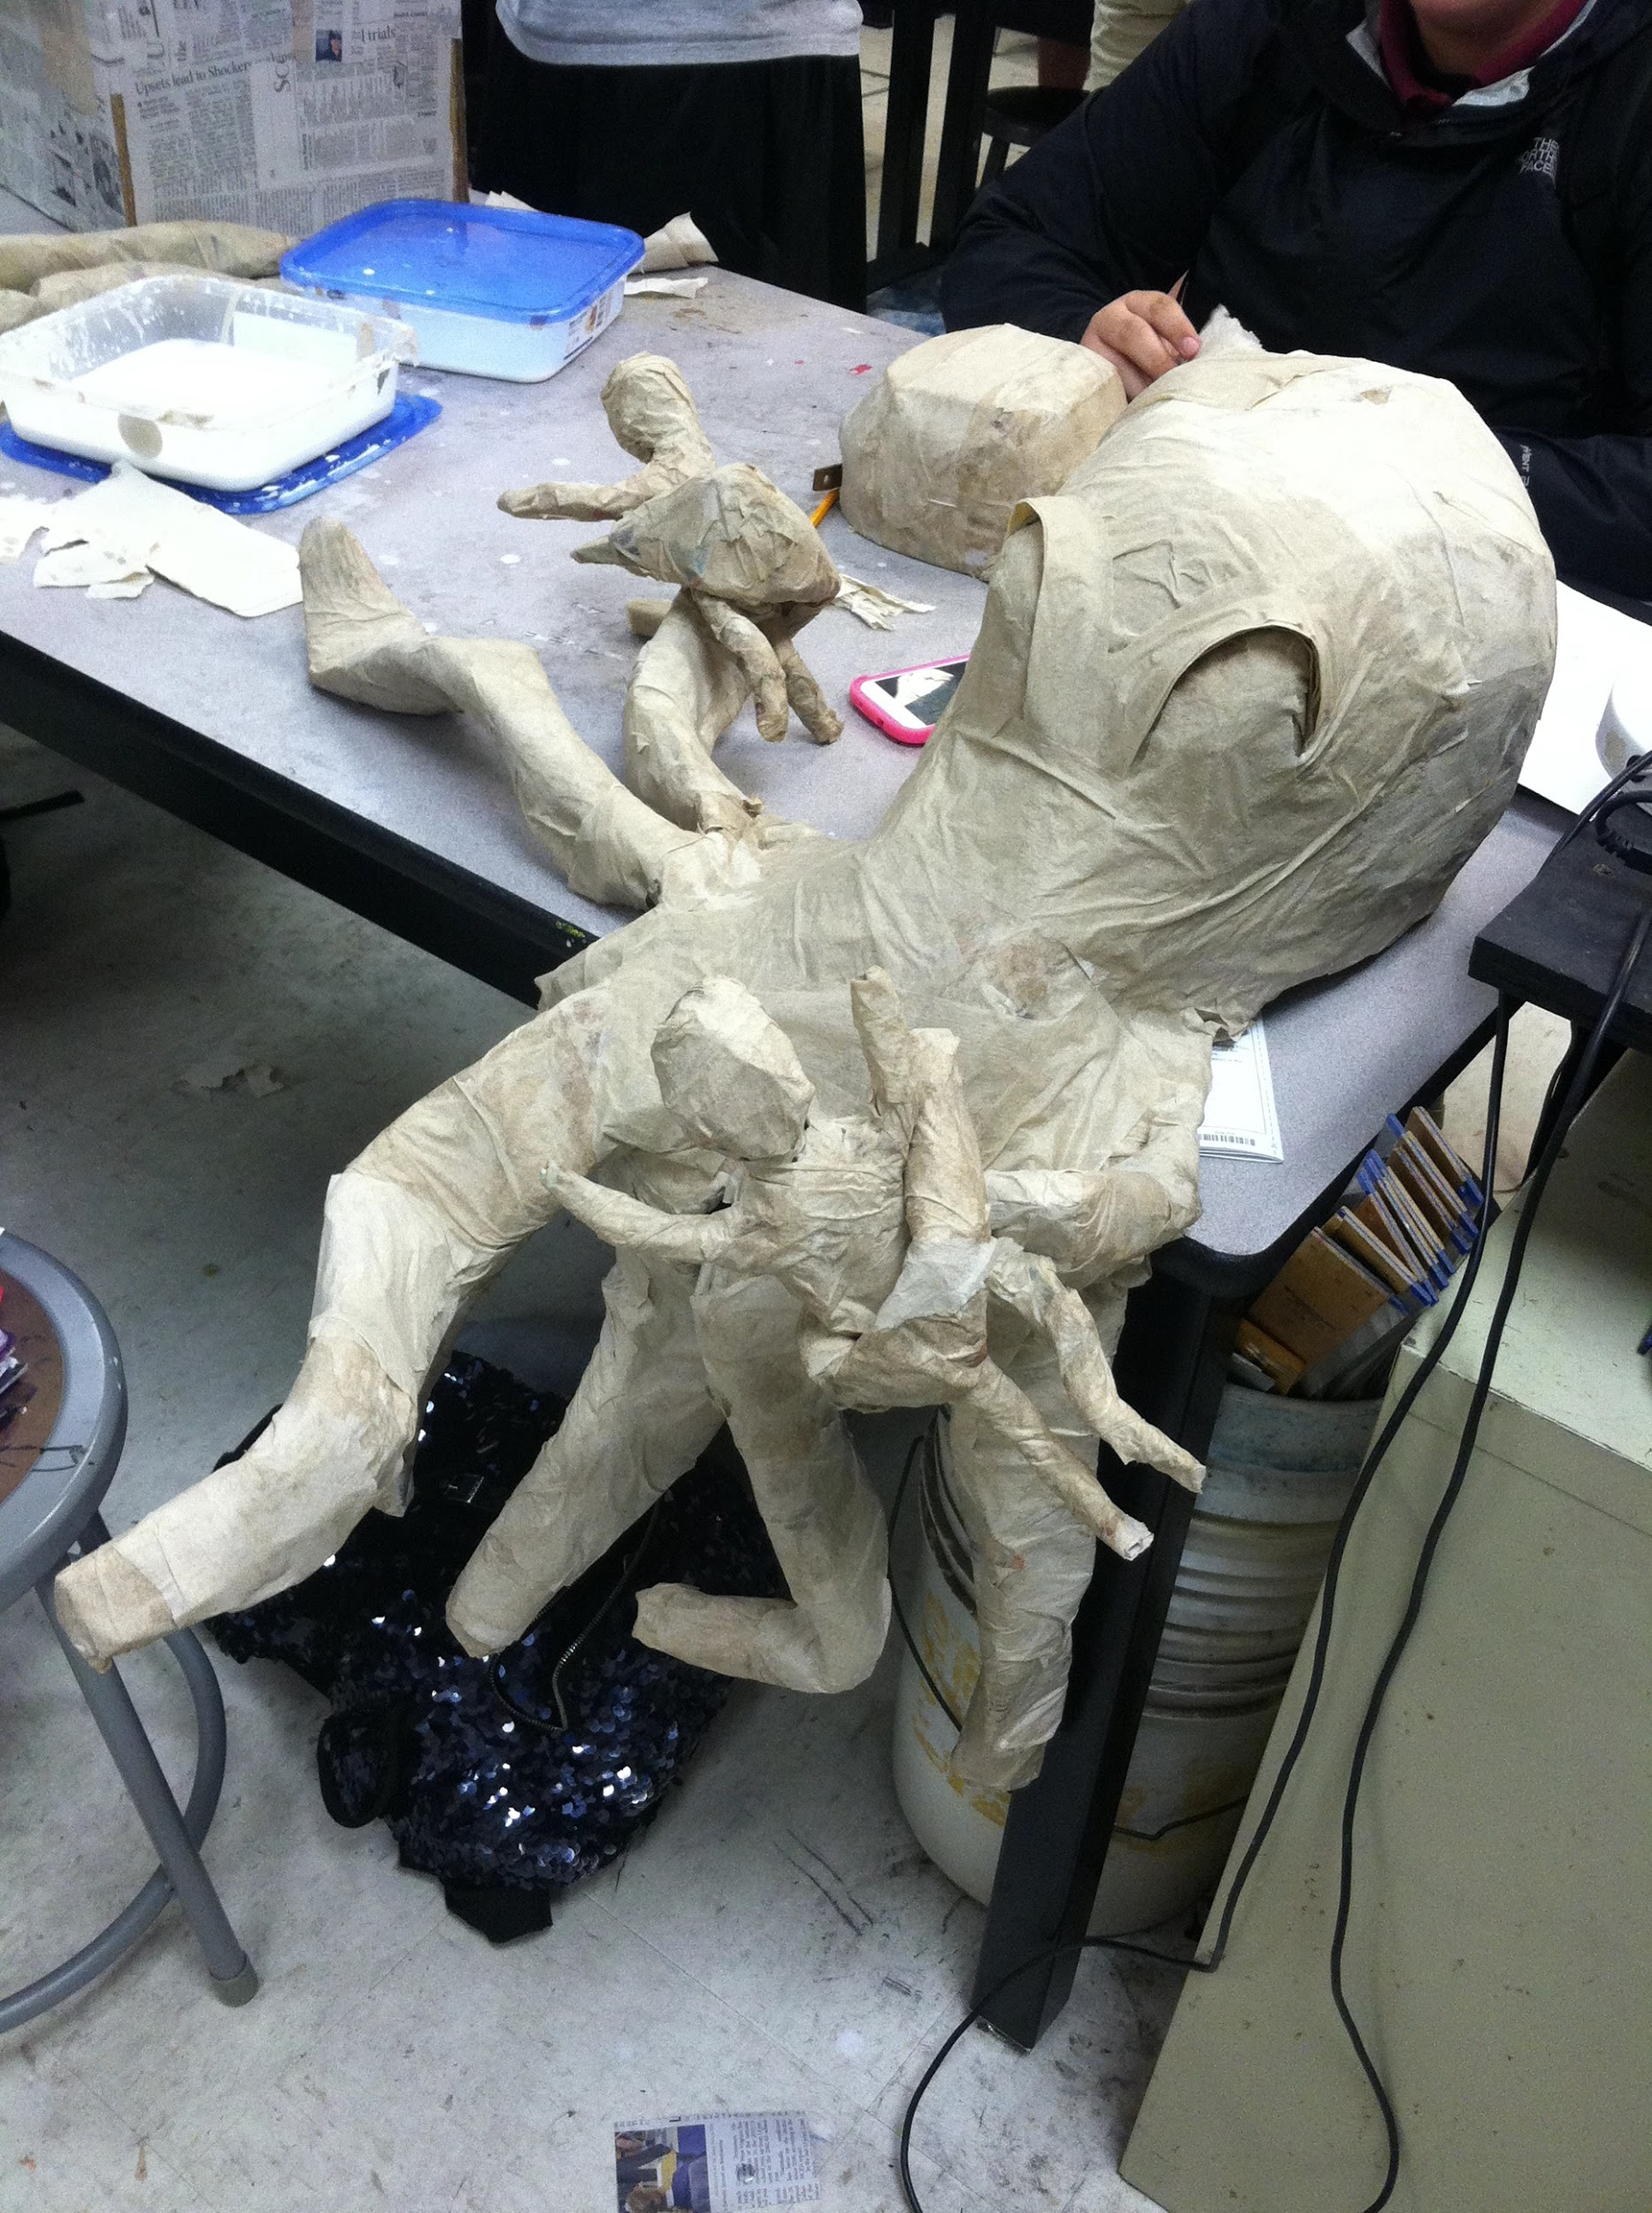
paper mache

Slide 23
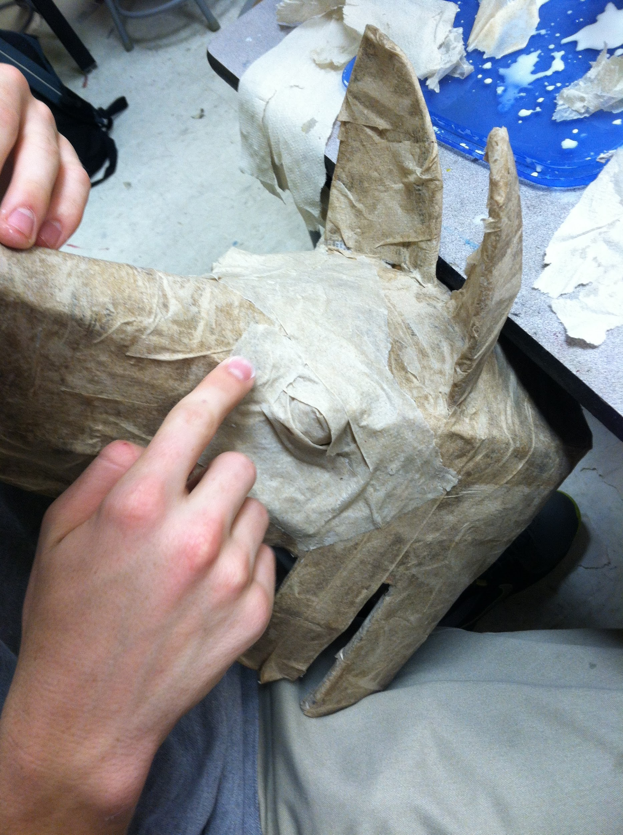
paper mache

Slide 24
Finished Paper Mache is smooth, solid, and ready for paint

Slide 25
Directions
1. Make a headband that fits your head
2. Set the headband on the table in front of you and "envision" the sculpture around it.
3. Sketch ideas
4. Construct out of paper, cardboard, etc.
5. Paper mache
6. Paint
7. Wear

Slide 26
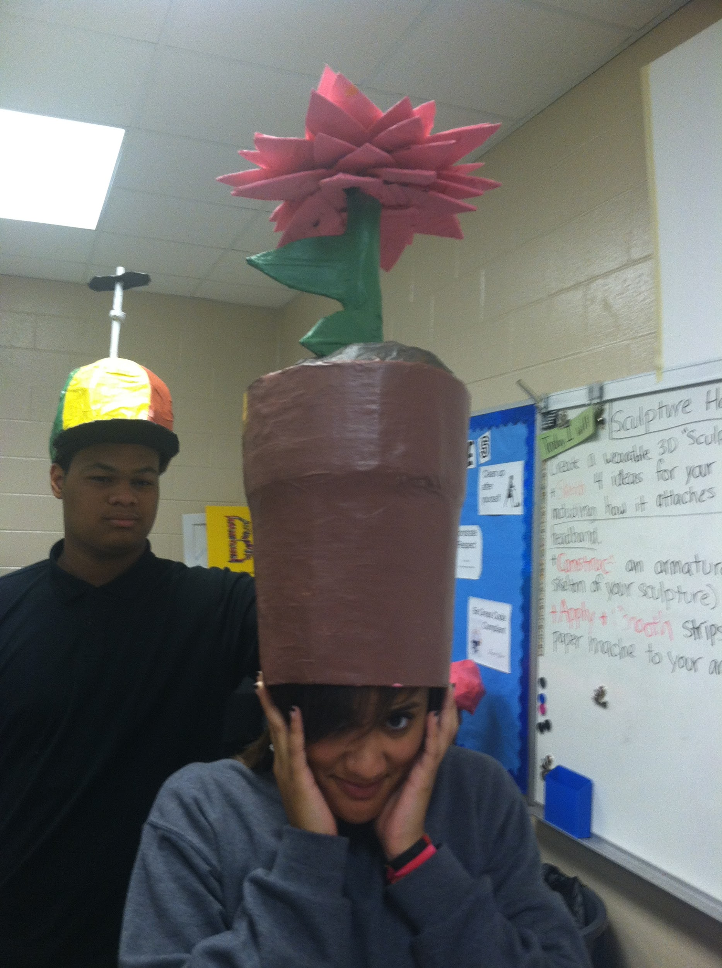

Slide 27
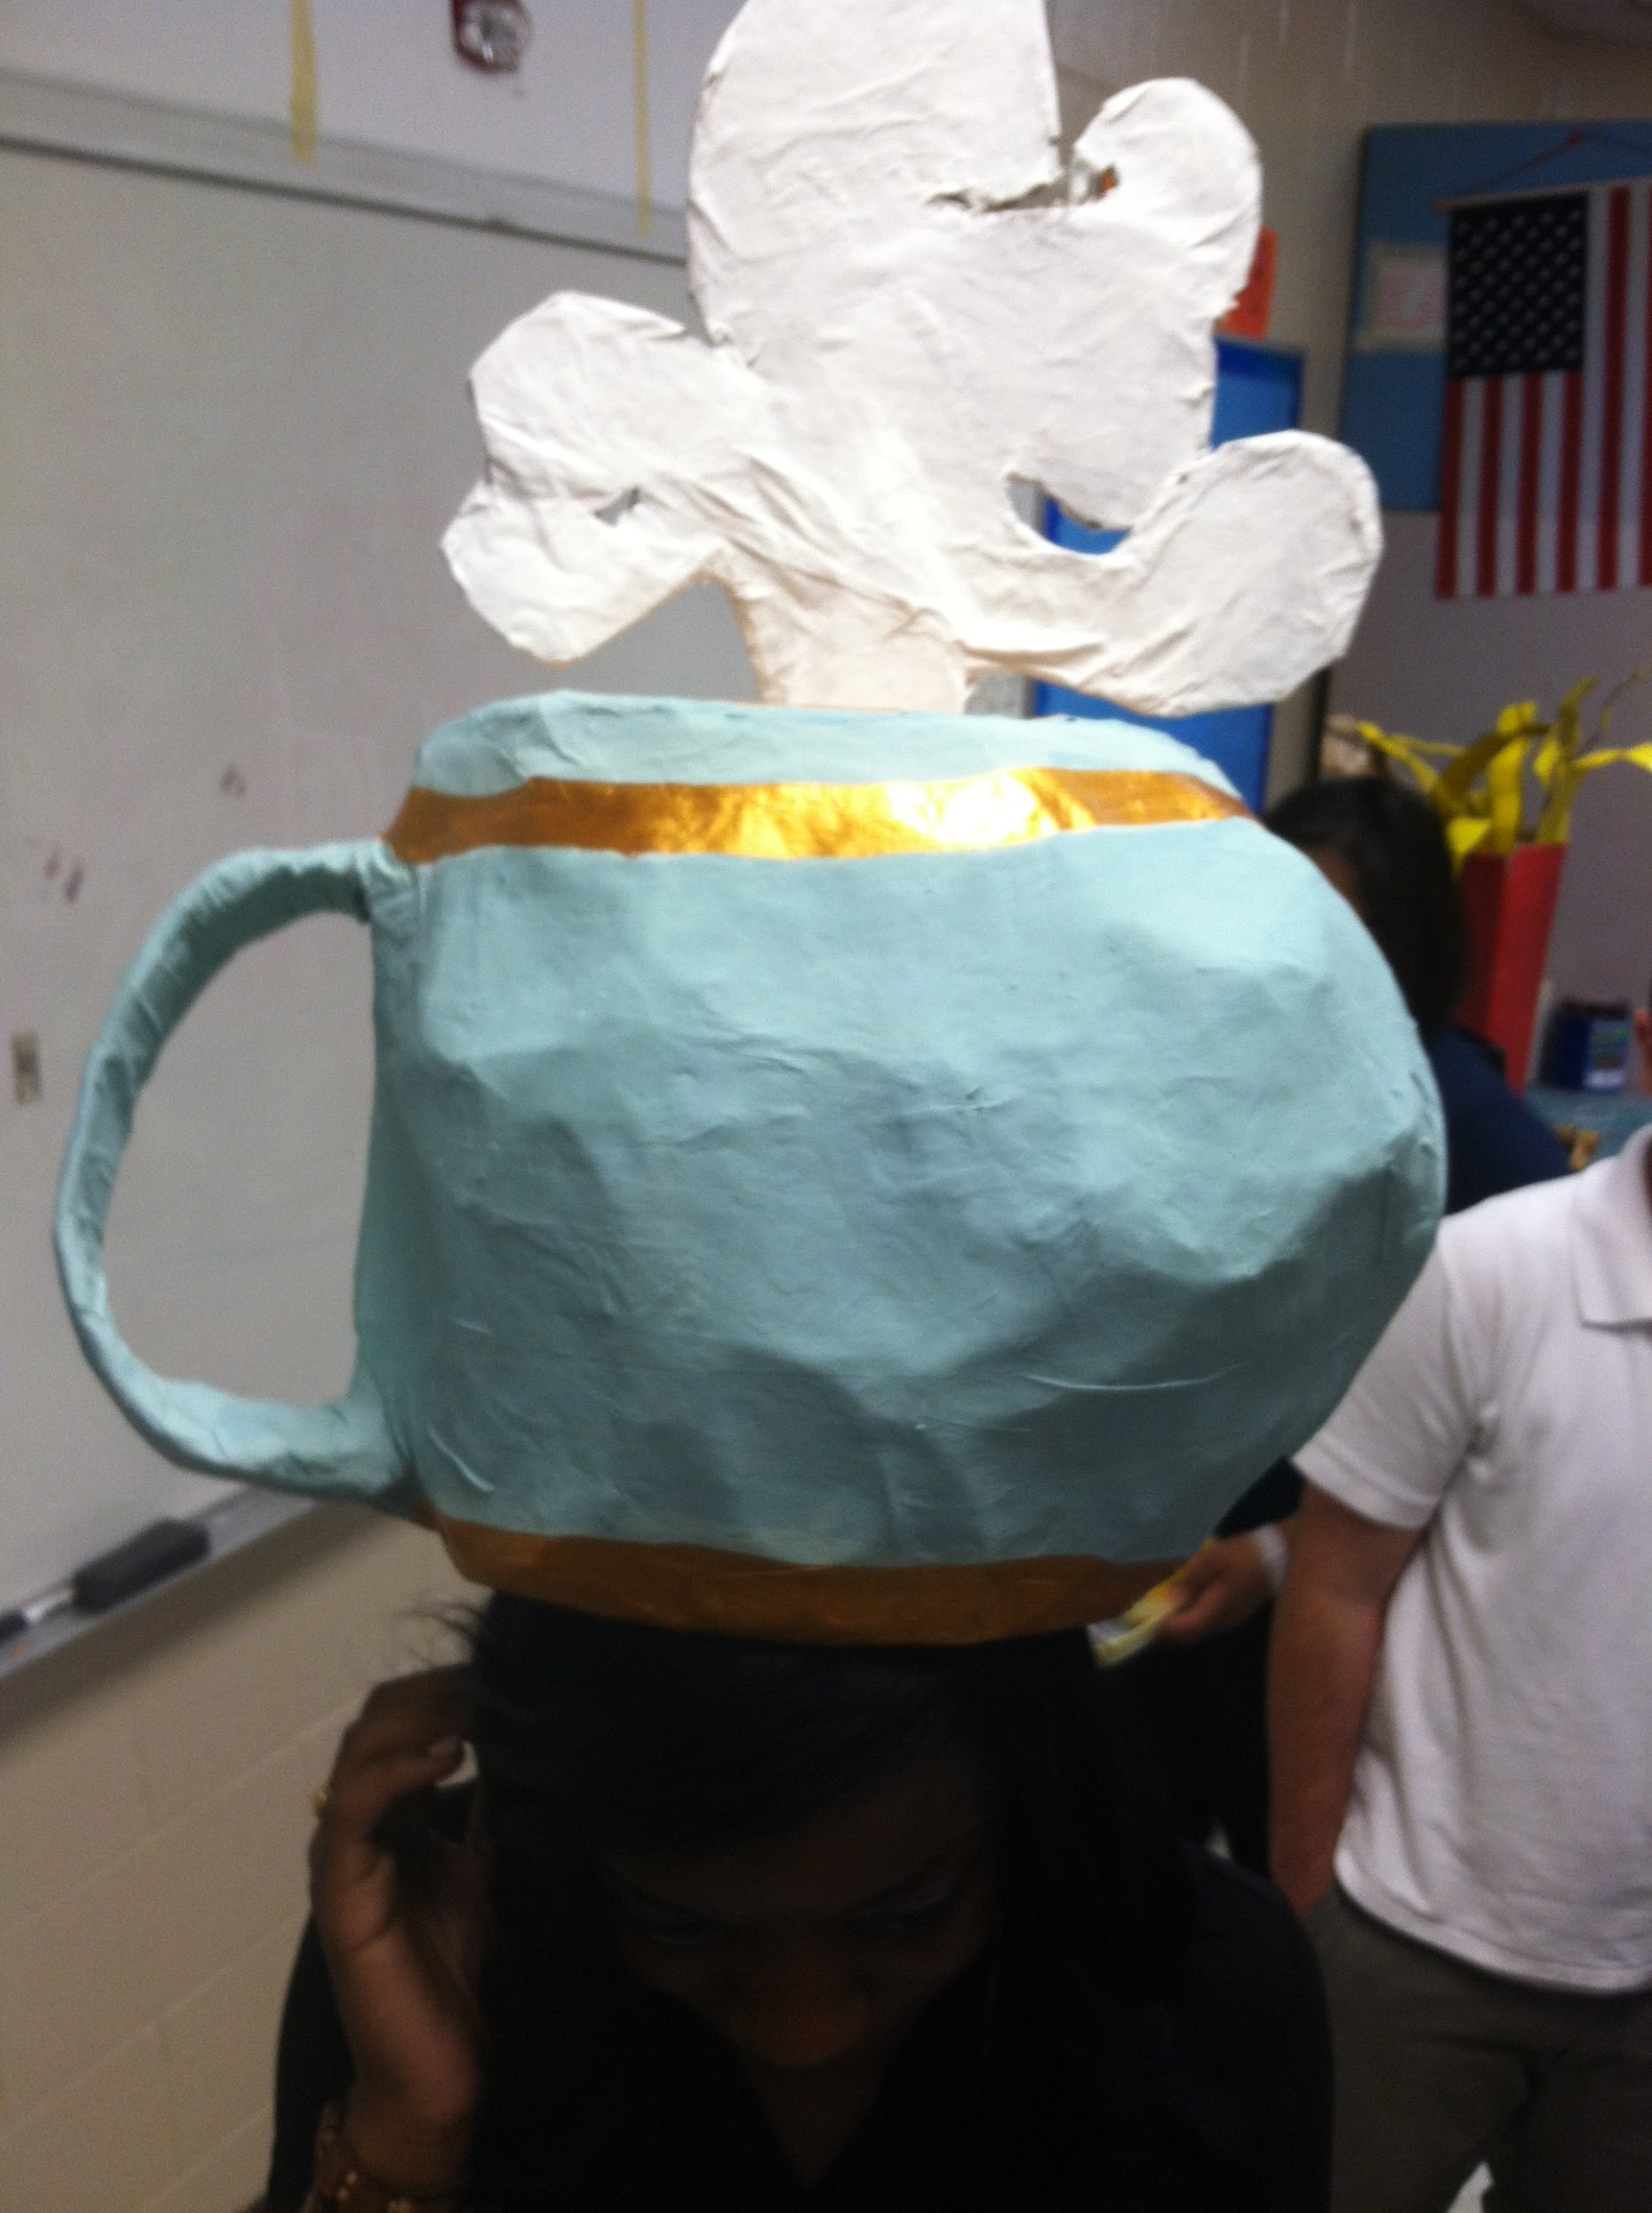

Slide 28
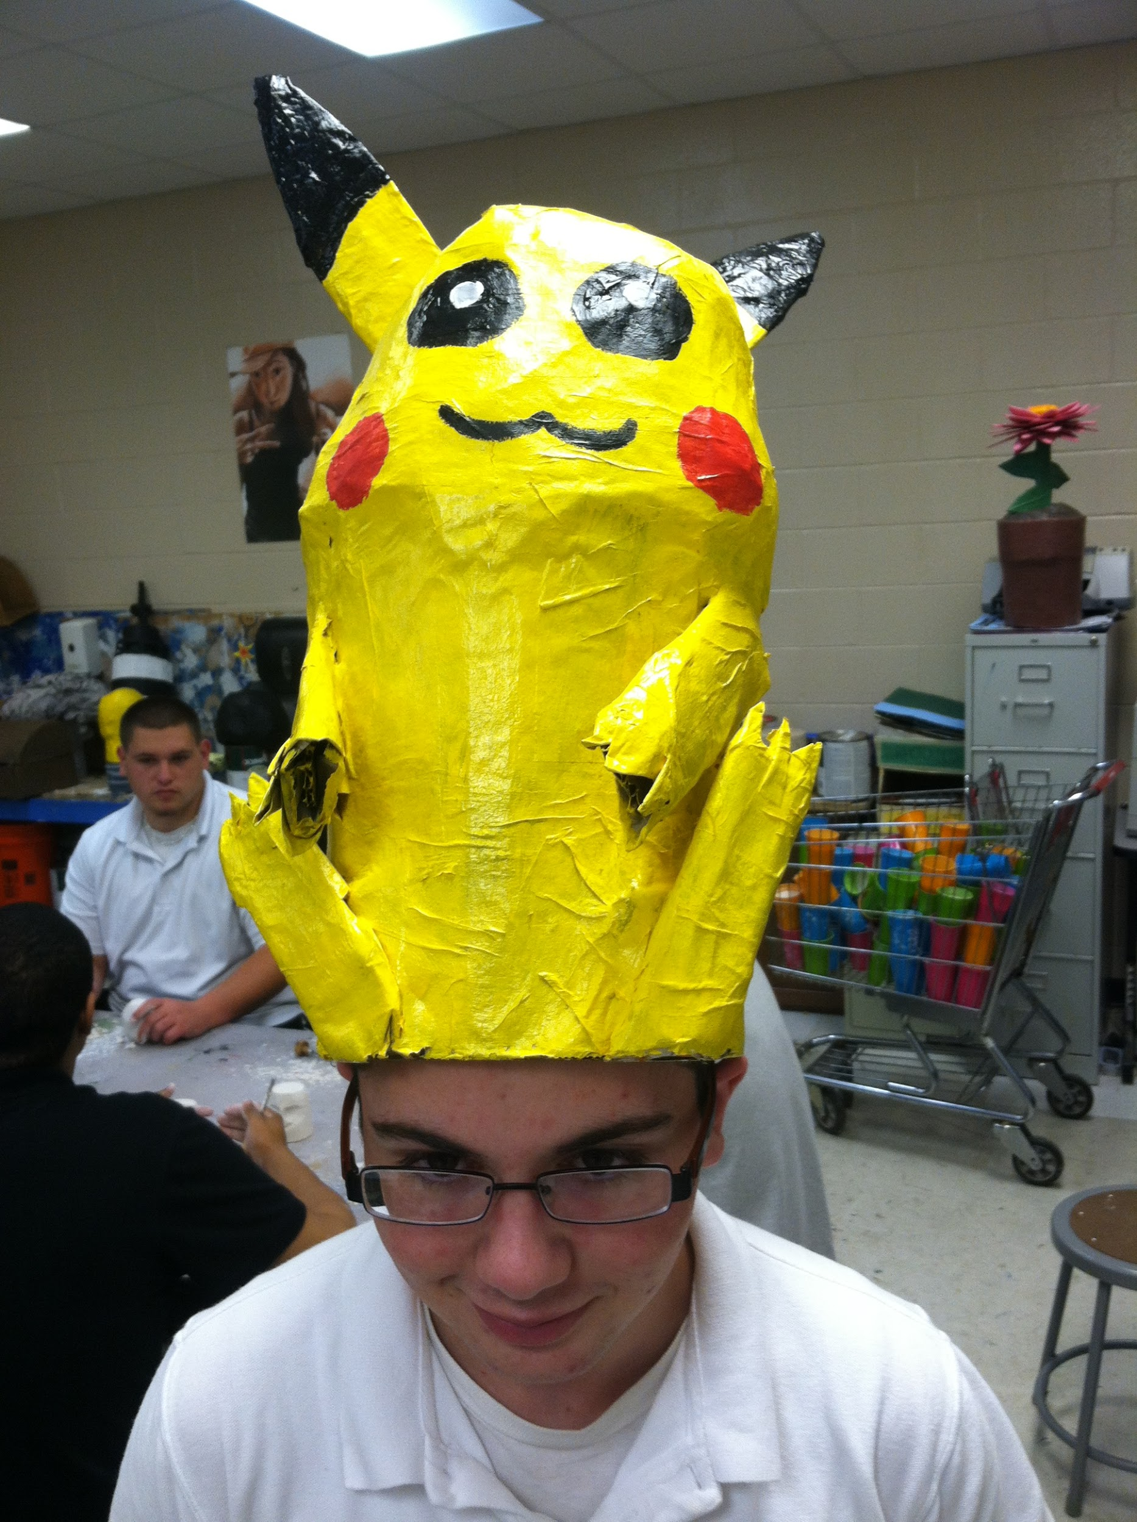

Slide 29
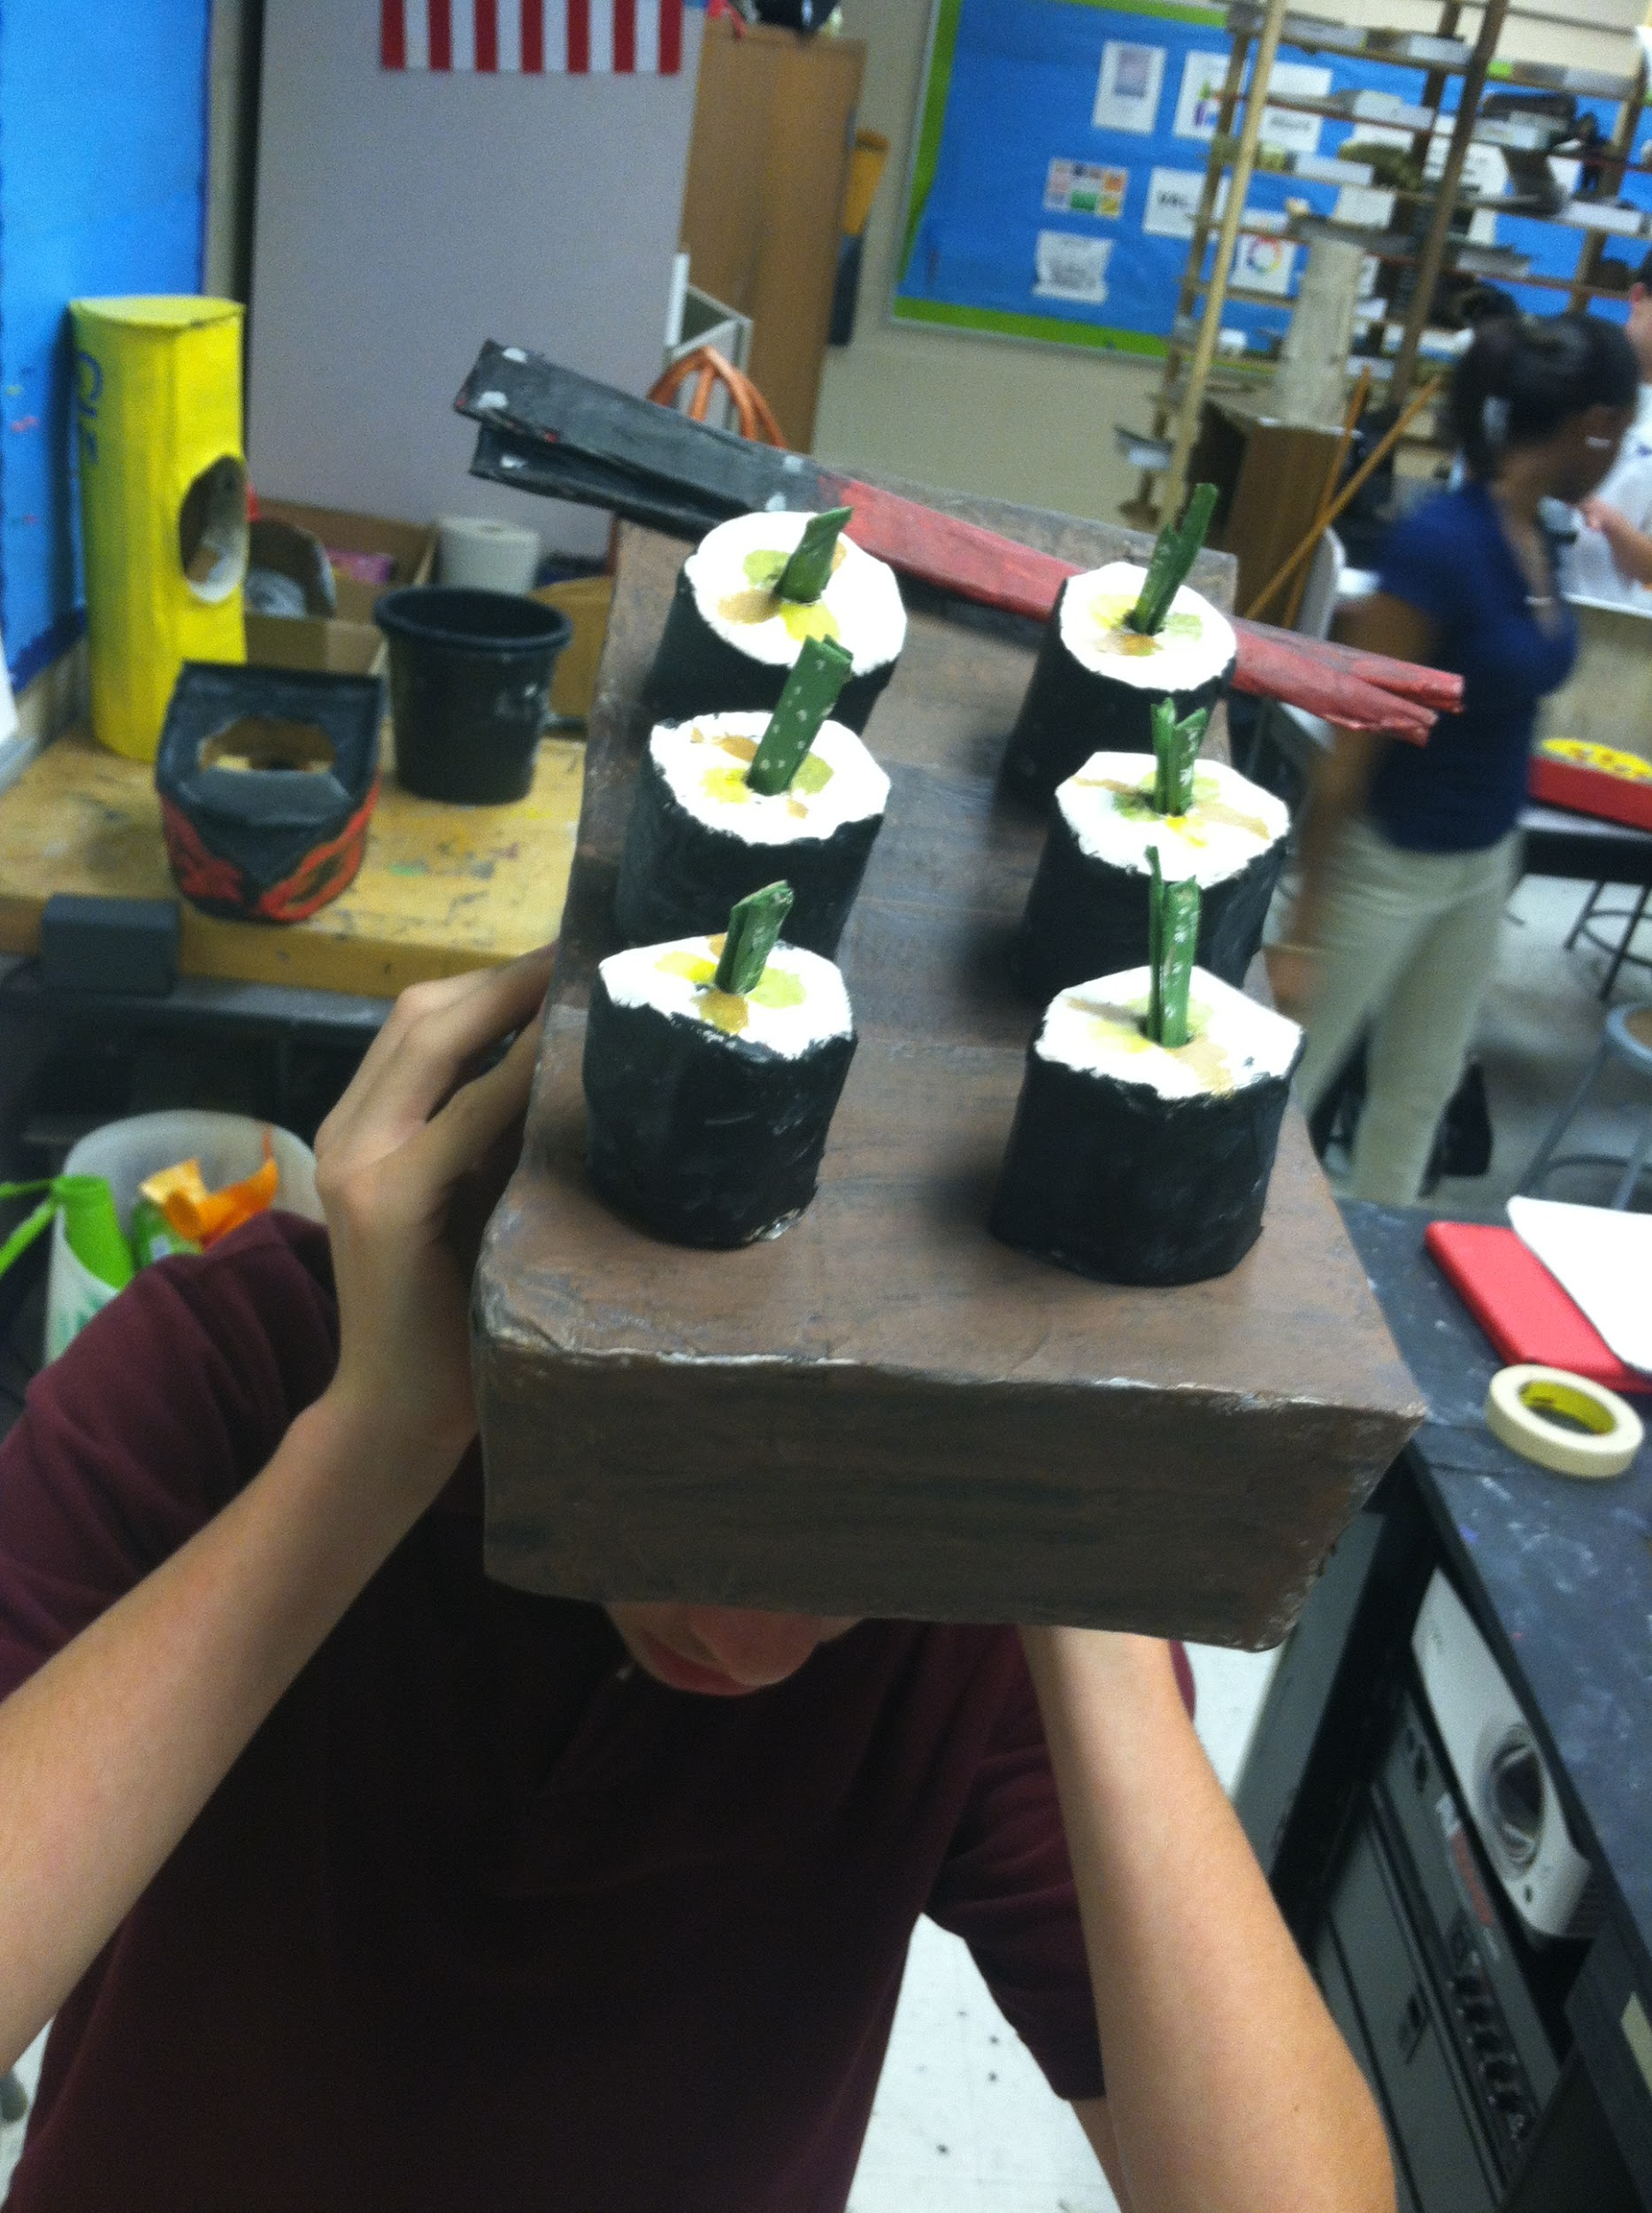

Slide 30
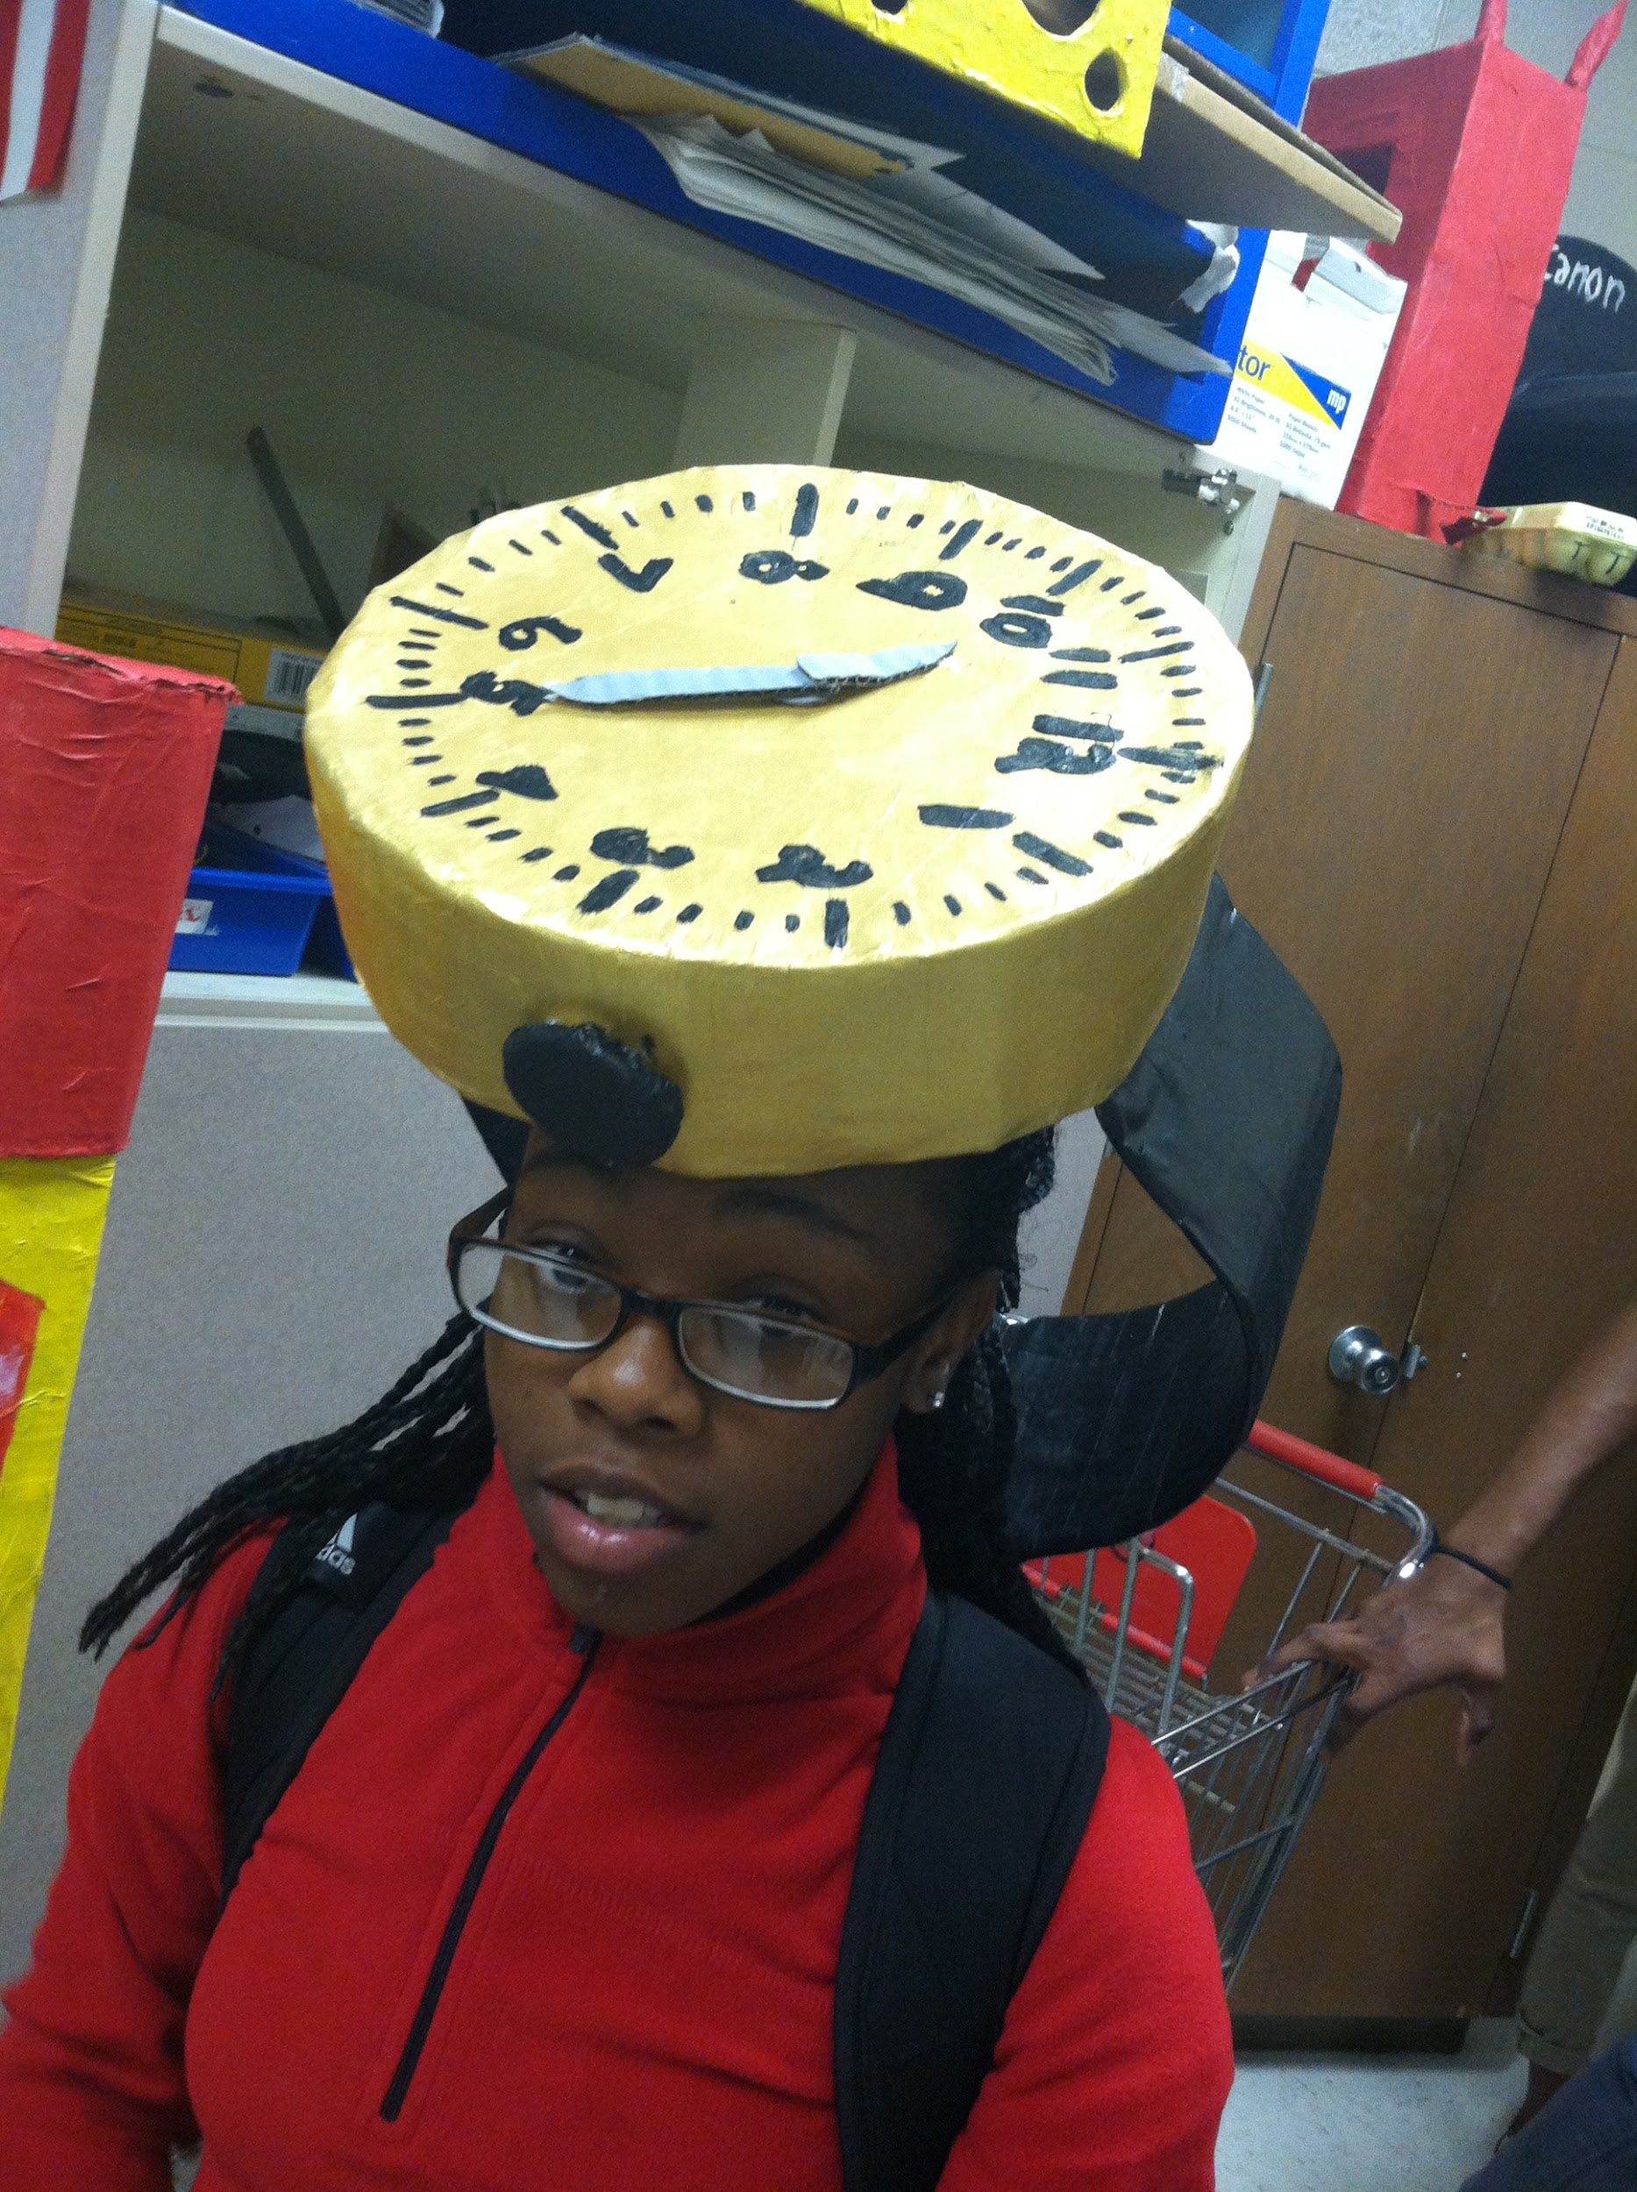

Slide 31
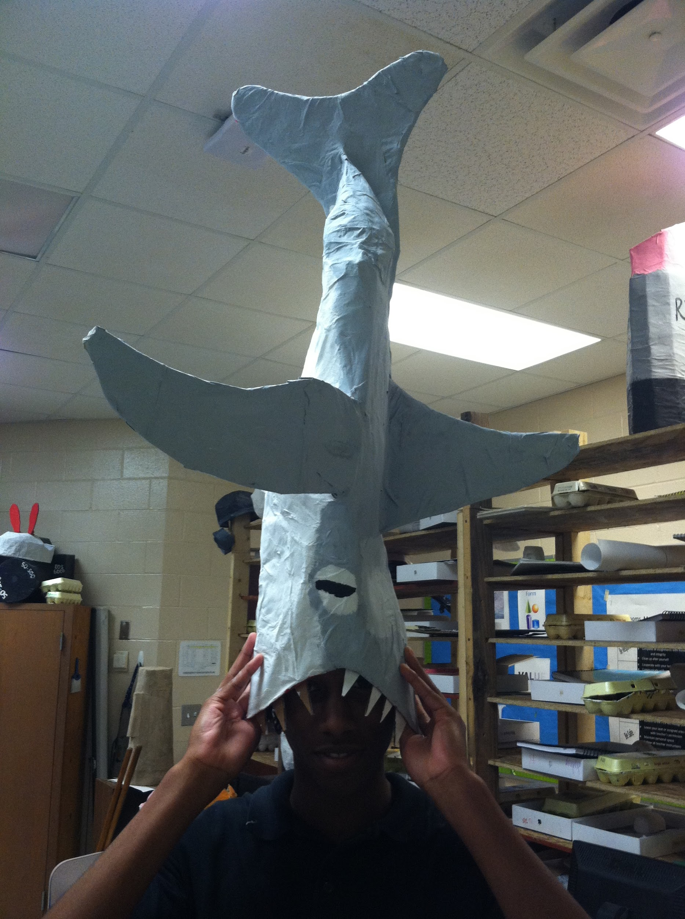

Slide 32
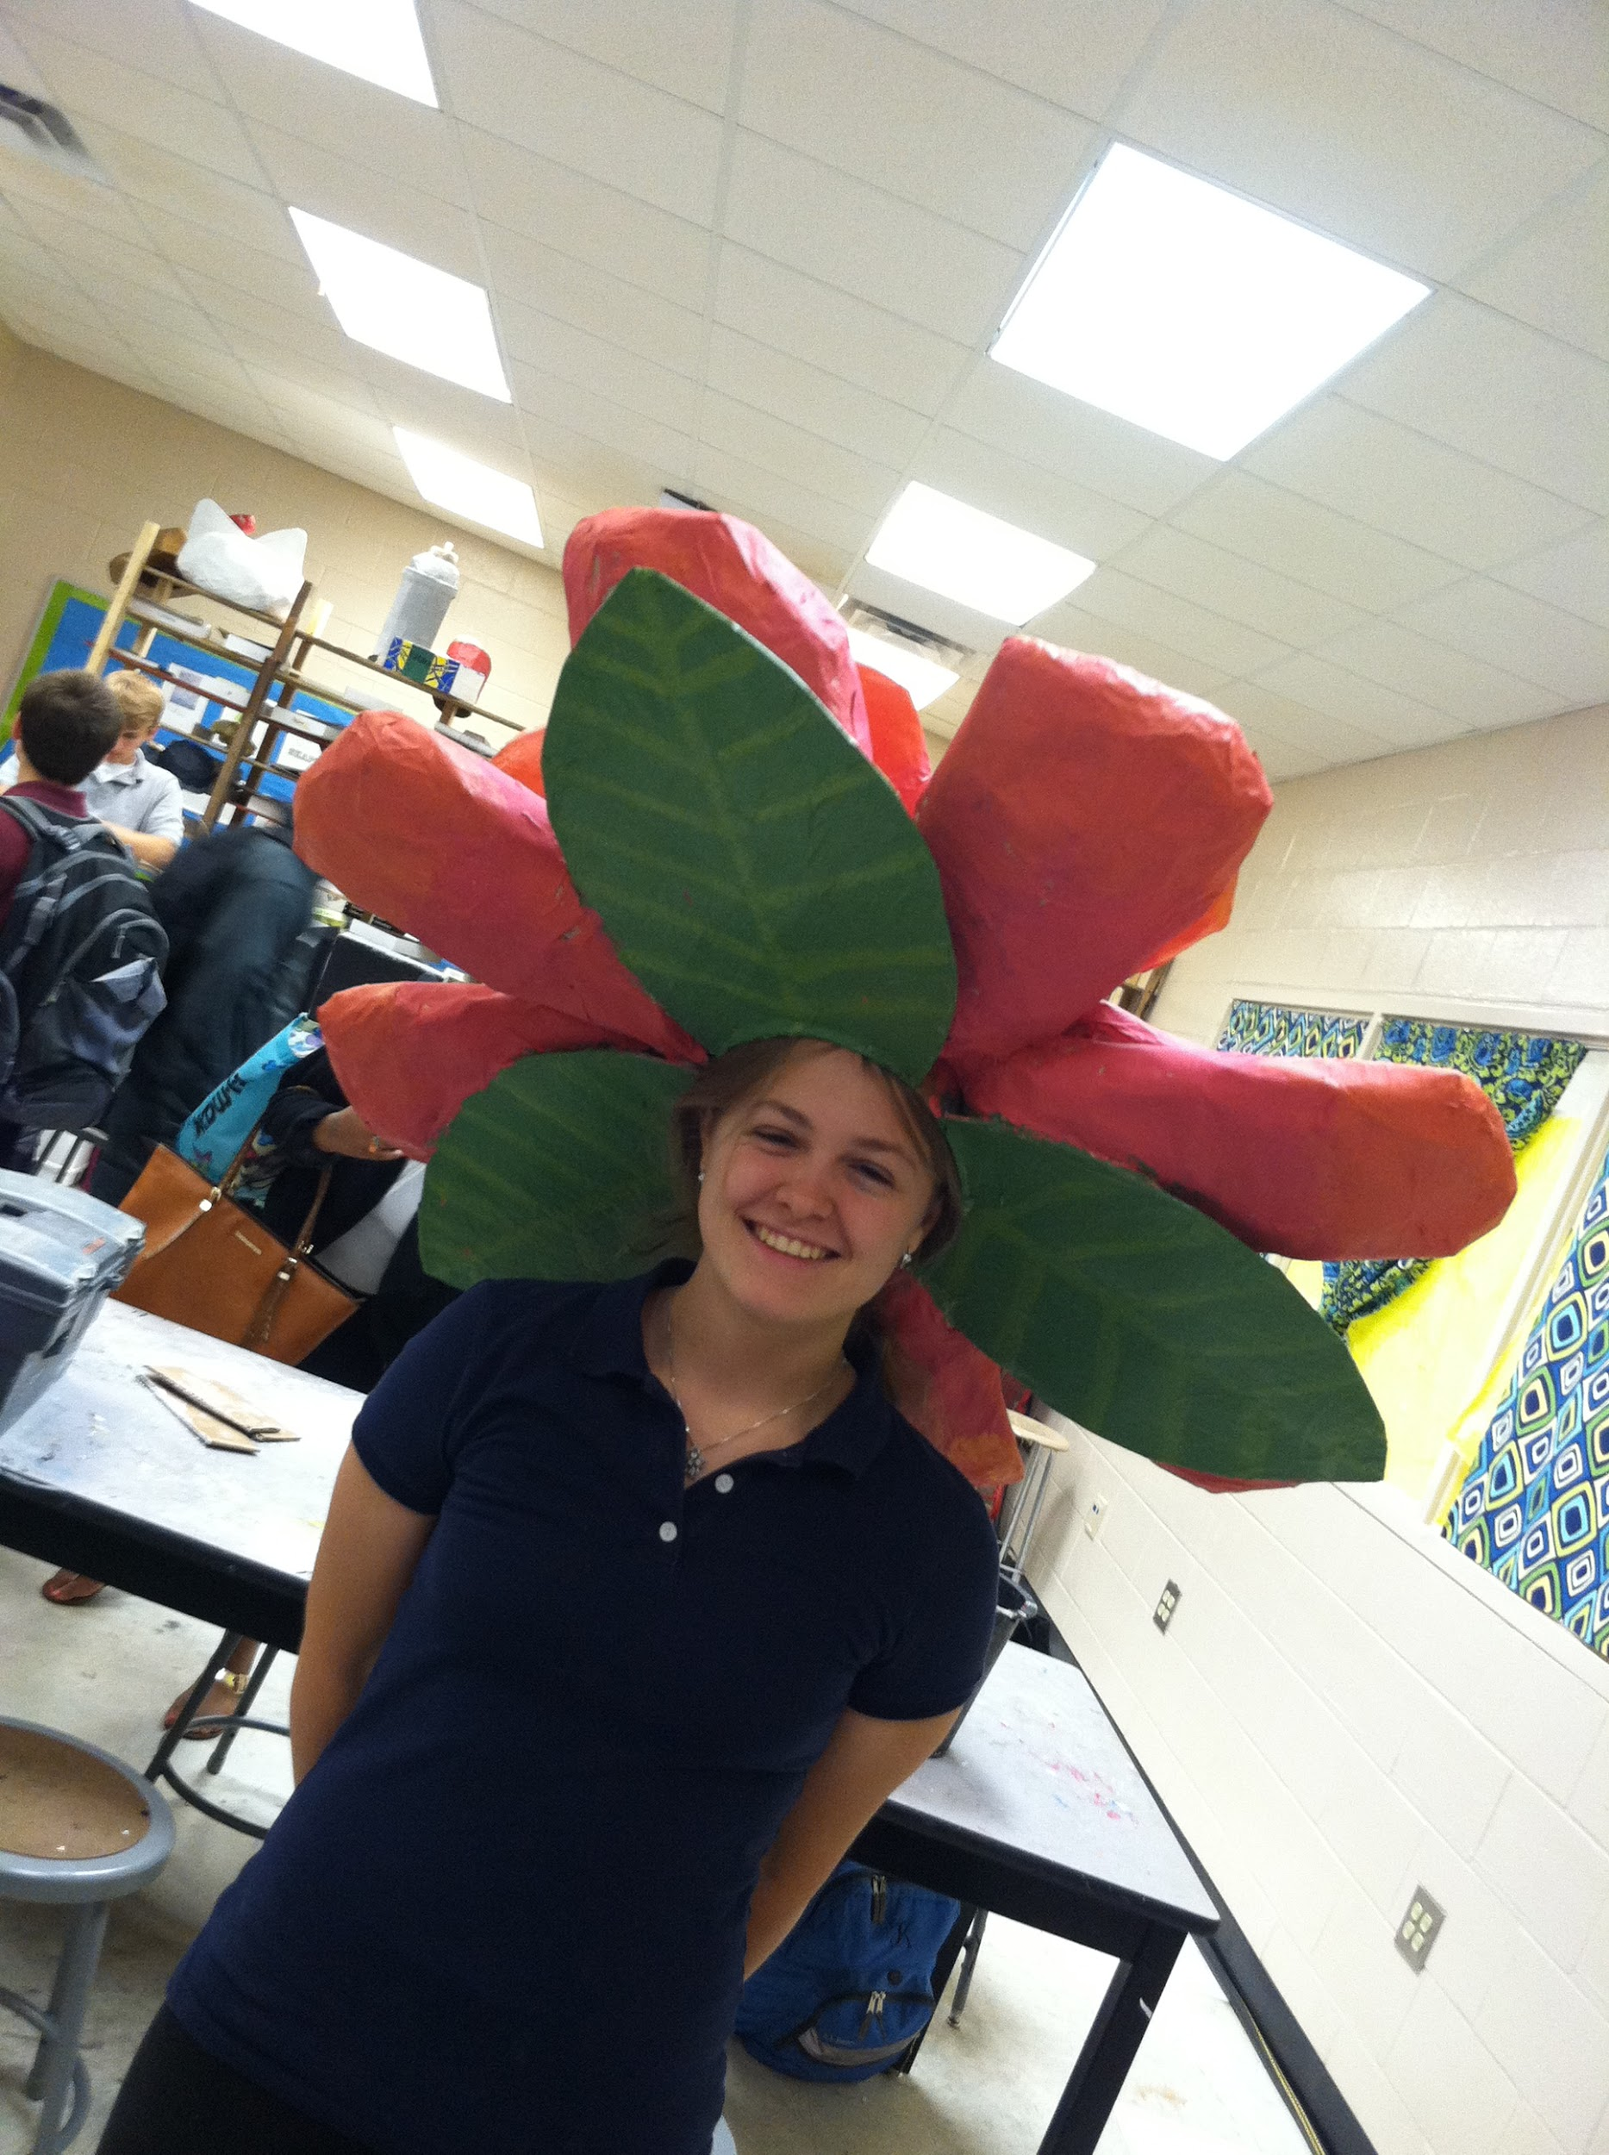

Slide 33
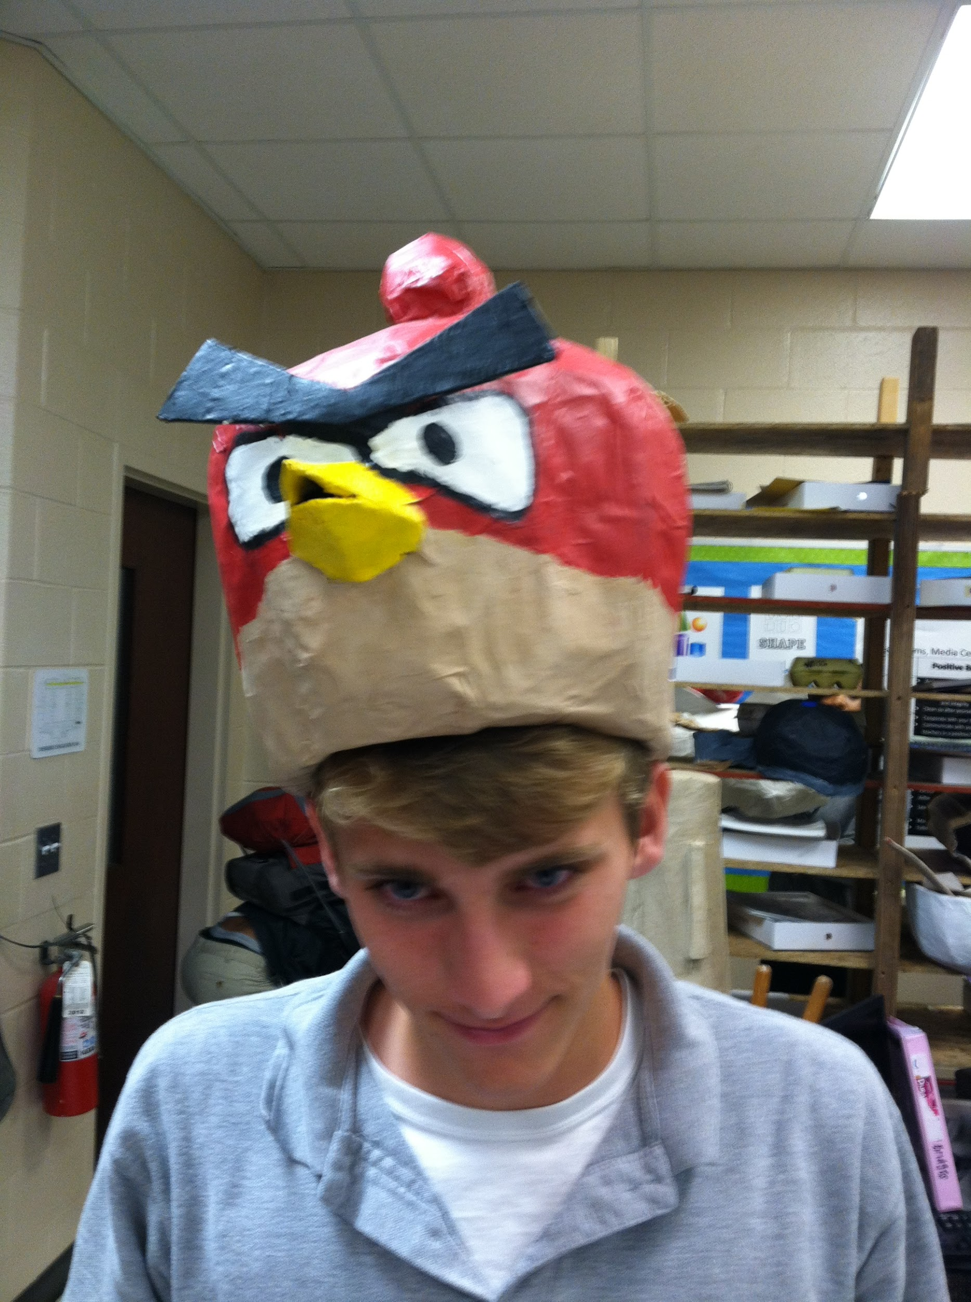

Slide 34
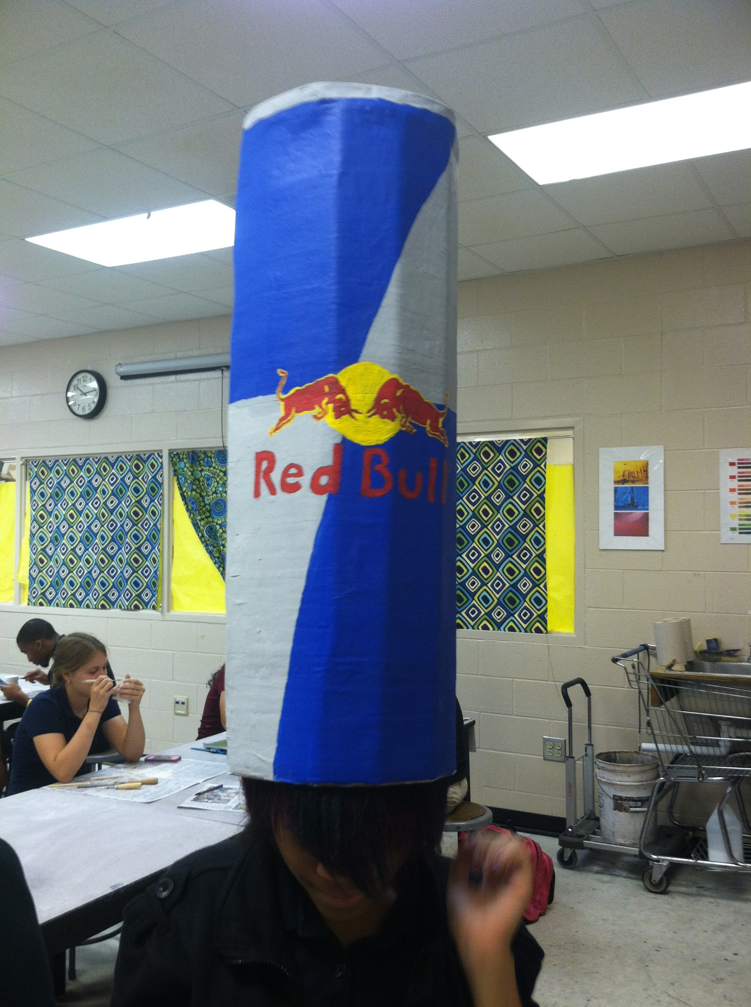

Slide 35
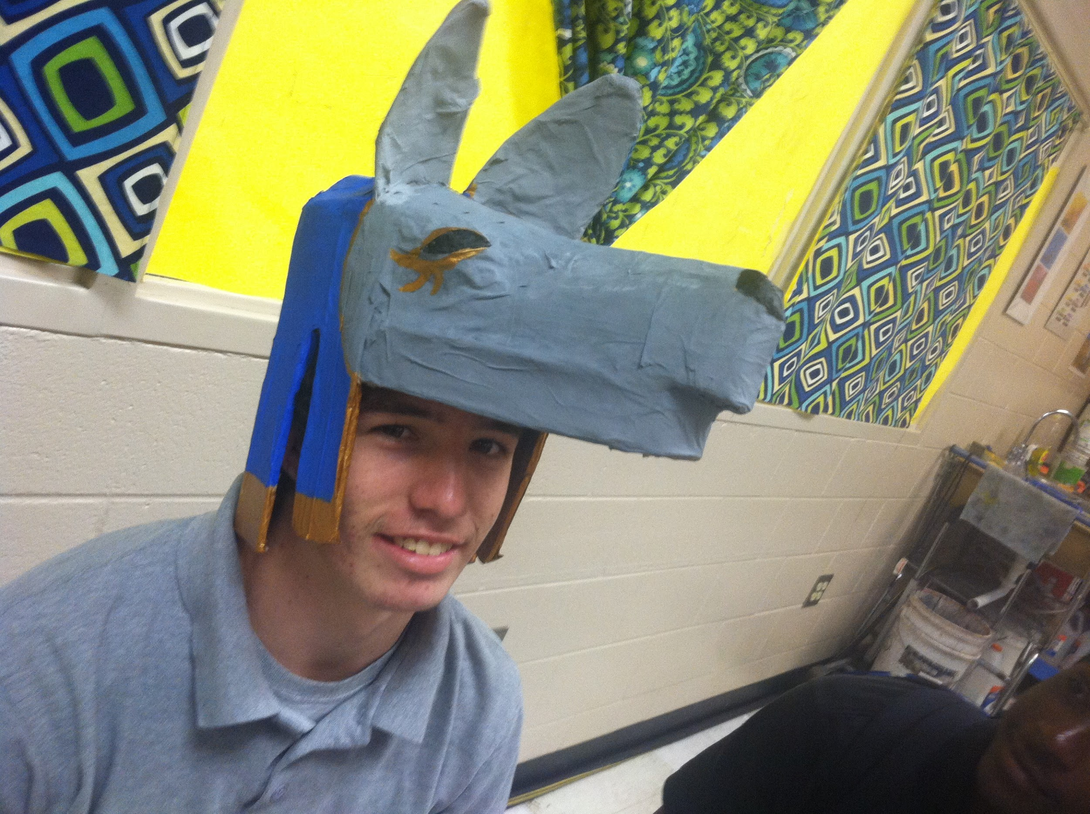

Slide 36
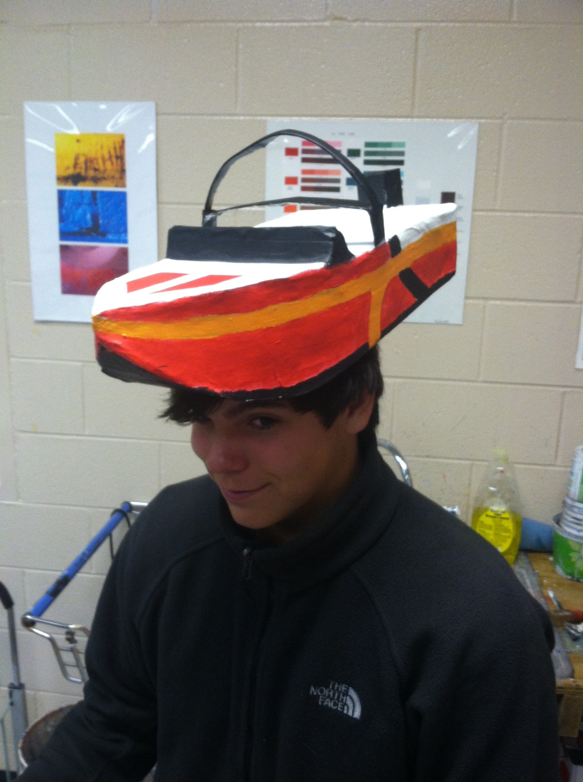

Slide 37
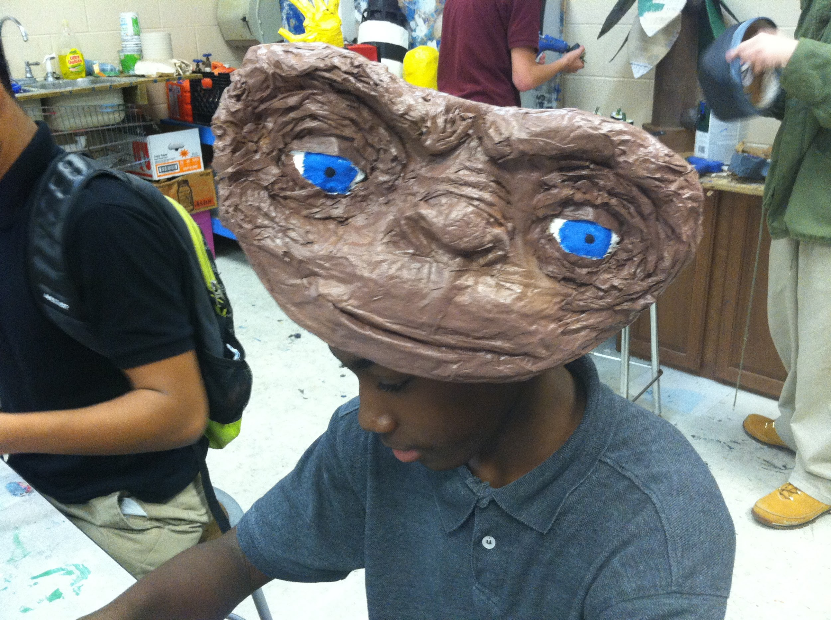

Slide 38
