Slide 1
Hands with Text
Element of Art: Line
Principle of Design: Repetition

Slide 2
Objective:
Students will create original line drawings, combine them in a unique composition, include their name, and render using colored pencils.

Slide 3
Examples

Slide 4
"A+" quality work

Slide 5
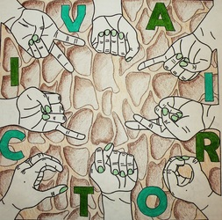
"A" quality work

Slide 6
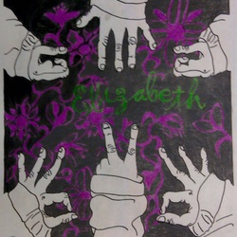
"B+" quality work

Slide 7
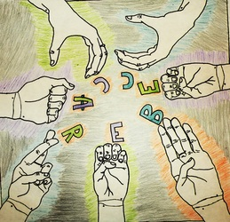
"B" quality work

Slide 8
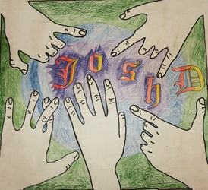
"C" quality work

Slide 9
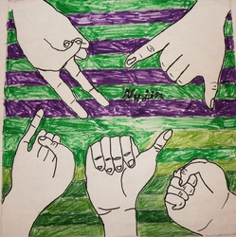
"C" quality work

Slide 10
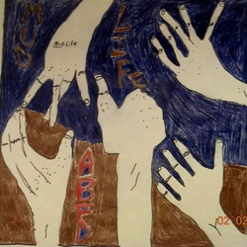
Low "D" quality work

Slide 11
Directions
1. On separate sheets of paper, draw 8 hands in 8 different positions
2. Outline hands in dark marker
3. Rough cut out hands
4. Center a 16in by 16in square on 18in by 24in paper
5. Arrange hands in an interesting composition
6. Trace hands with pencil
7. Integrate text into composition
8. Outline everything with sharpie
9. Render negative space with colored pencils

Slide 12
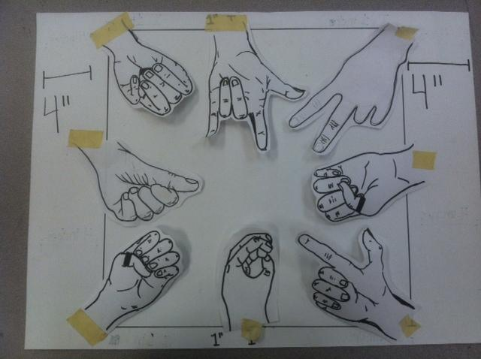
Arrange hands so they don’t overlap

Slide 13
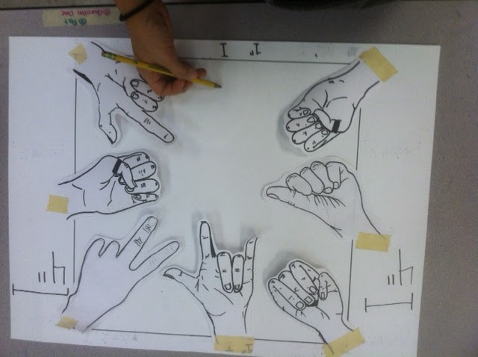
Slip one hand under at a time, and trace in pencil

Slide 14
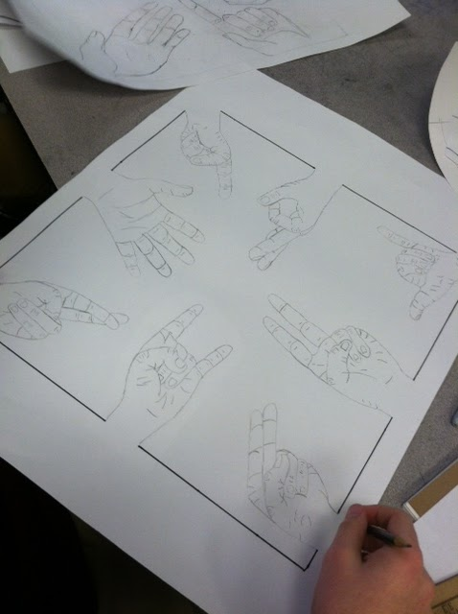
When all hands are traced in pencil, you can go over in black sharpie
Do not trace over the wrist!
&
Use a ruler to trace a straight line

Slide 15
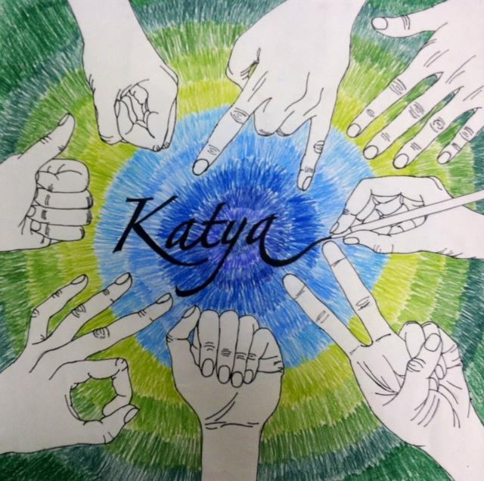
Add Text
Render in Colored Pencil
Then you are done!

