Slide 1
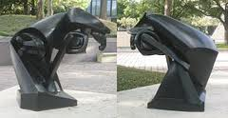
Cubist Animal Sculpture
Duchamp The great horse

Slide 2
Objectives:
You will create a free standing 3D animal sculpture using cardboard and paint.
You will become familiar with cubism and master the 3D construction additive process.
Artists associated with cubism:
Braque, Picasso, Lipchitz, Duchamp

Slide 3
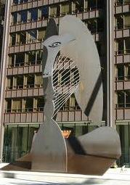
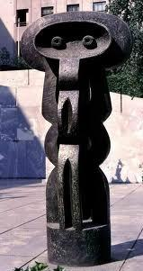
Picasso The Lady Lipchitz Figure

Slide 4
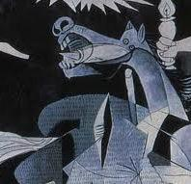
Picasso's Guernica

Slide 5
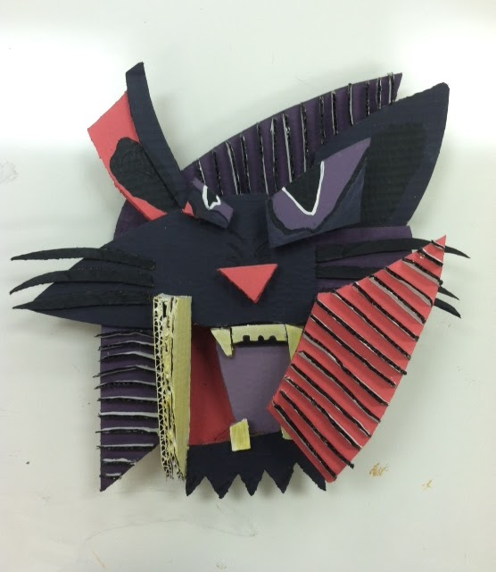
Lots of planes
Multiple views
excellent use of color

Slide 6
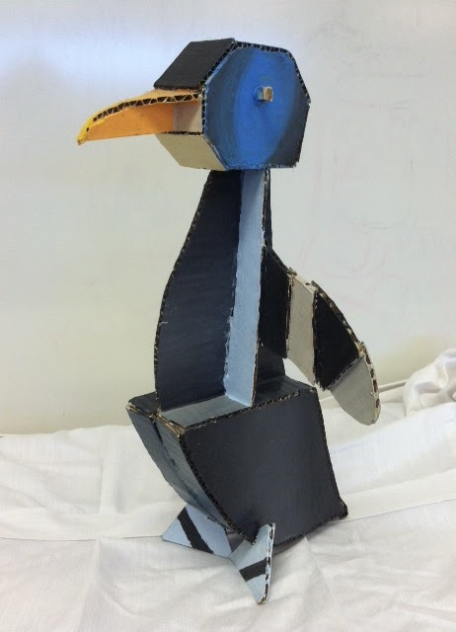
multiple planes
color used to accent planes

Slide 7
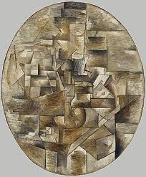
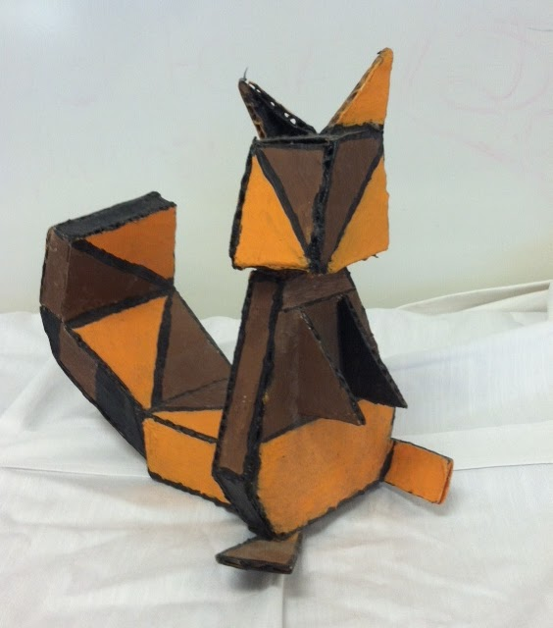
Braques candlestick

Slide 8
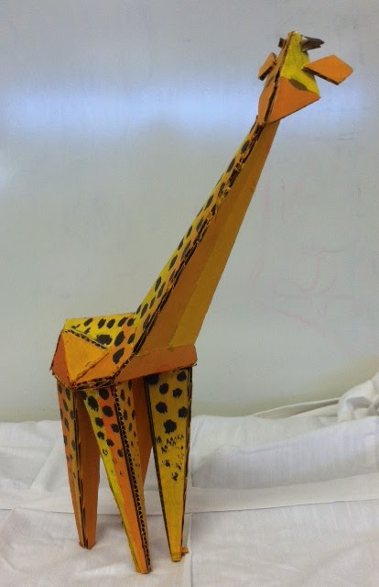
multiple views
painting and color selection
pulls eye through sculpture

Slide 9
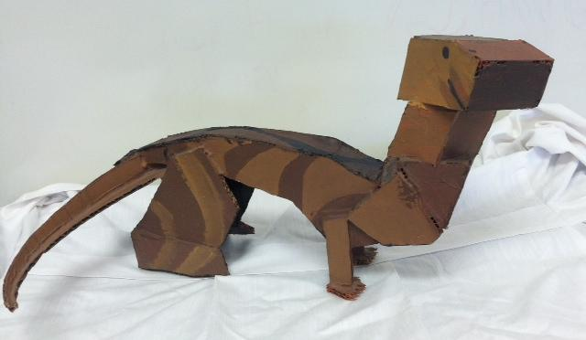
A bit boxy
Drab color choice
Not sure of the species

Slide 10
Directions:
-Make a list of 10 animals or more
-Choose the one that best represents you
-Draw the animal
-Draw the animal abstractly
-Create a small scale model of the animal
-Build your animal no larger than 16"x16" using
cardboard
-Paint to further abstract and accentuate your sculpture

Slide 11
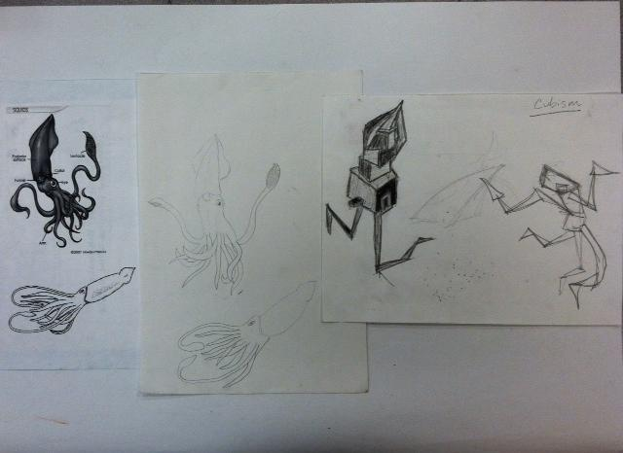
choose draw abstract

