Slide 1
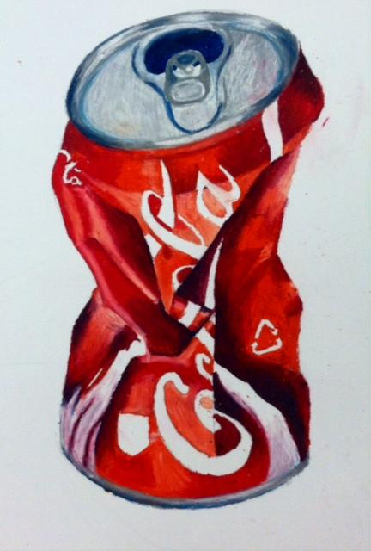
Crushed Cans
Intermediate Art 2

Slide 2
During this project you will
- increase observational drawing ability
- learn to measure proportion
- experiment with oil pastels as a medium
- expand understanding of form and value

Slide 3
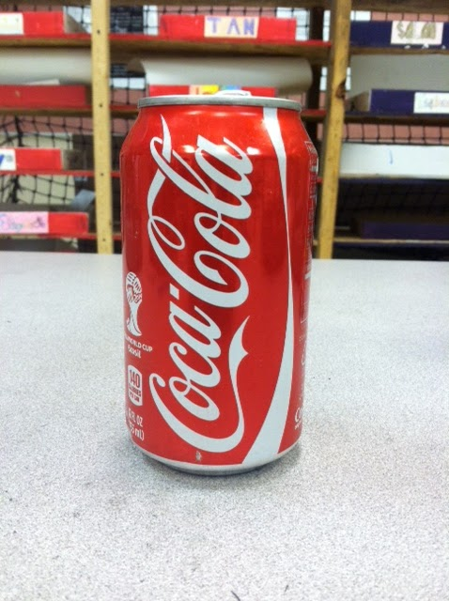
Select a can with an interesting logo.

Slide 4
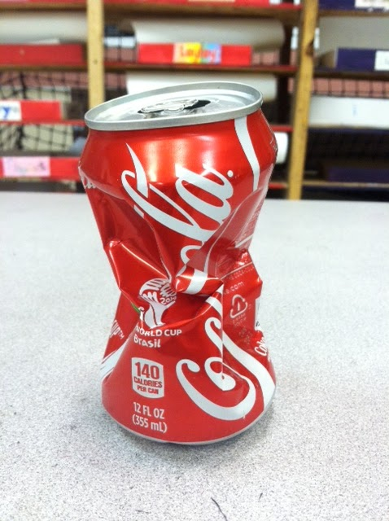
Now crush it
Crush it real good.

Slide 5
Study your can’s proportions.
Proportion refers to the relative size of parts to its whole.

Slide 7
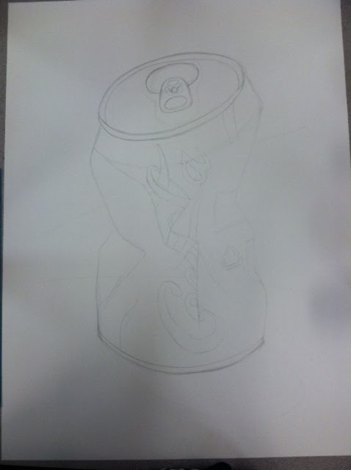
Practice sketching your can in your sketchbook before you begin on big paper.

Slide 8
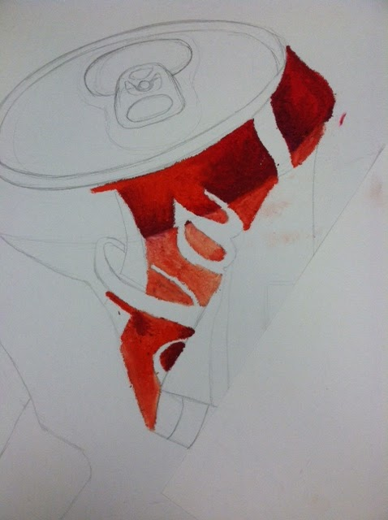
Once on big paper begin
rendering highlights and shadows in oil pastel one shape at a time.

Slide 9
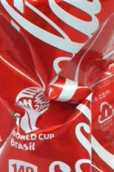
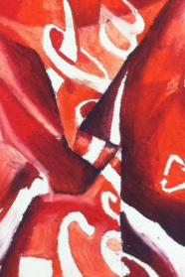

Slide 10
